Slide 1
Water Filtration Fun!
Designed by:
Taylor Ourada, Mary Scherer, and
Ramon Weldemicael

Slide 2
Over 750 million people in the world do not have access to clean water.
Notes:
http://water.org/water-crisis/water-facts/water/

Slide 3
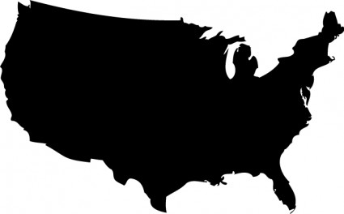
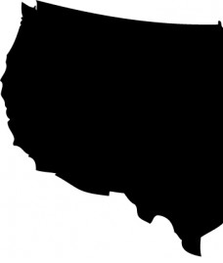
That is 2.5 times the number of people living in the United States.
Notes:
http://all-free-download.com/free-vector/vector-silhouettes/us_map_silhouette_vector_144872.html

Slide 4
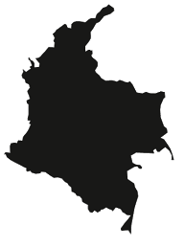
That is 15.5 times the population of the Colombia.

Slide 5
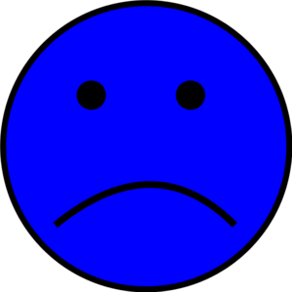
Drinking dirty water can make you very sick.

Slide 6
Water can be contaminated in several ways:
Pieces of Dirt/Trash
Bacteria
Harmful Chemicals
Viruses

Slide 7
Water can be cleaned in several ways:
Filtering it
Boiling it
Adding Chemical Disinfectants

Slide 8
Filtering
How it works:
What contaminants it removes:
Advantages:
Disadvantages:

Slide 9
Boiling
How it works:
What contaminants it removes:
Advantages:
Disadvantages:

Slide 10
Chemical Additives
How it works:
What contaminants it removes:
Advantages:
Disadvantages:

Slide 11
You will begin with an empty bottle.

Slide 12
You will fill your bottle with cotton balls, sand, and rocks.

Slide 13
You will filter your self-made dirty water.

Slide 14
You will take apart your filter and see which layer stopped each contaminant!

Slide 15
Review
Which contaminants were removed by each layer of the filter?
Rocks Sand Cotton Balls None

Slide 16
Review
Purification Techniques:
Filtering it
Boiling it
Adding Chemical Disinfectants
How it works:
What it removes:
Advantages:
Disadvantages:

Slide 17
Review
Contaminants:
Pieces of Dirt/Trash
Bacteria
Harmful Chemicals
Viruses
Purification Techniques:
Filtering
Boiling
Chemical Additives

