Slide 1
Build a speaker

Slide 2
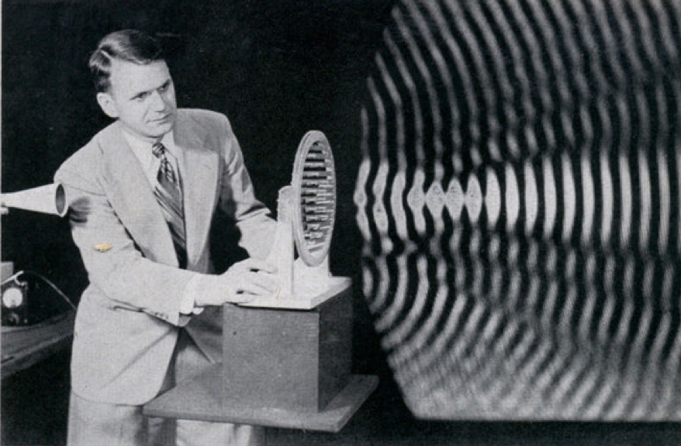
Sound wave
Compressional wave
Air is compressed and expanded rhythmically
Created by something vibrating
blog.modernmechanix.com

Slide 3
A speaker vibrates
The paper diaphragm vibrates
Pushes the air
The sound waves travel to your ear
Tiny hairs in your ear wave in the breeze
Your nerves pick this up, detect as sound
www.physclips.unsw.edu.au/ jw/electricmotors.html

Slide 4
How do we make the sound?
We must convince the paper to vibrate in synch with our music
Our music is generated by our (stereo, mp3player, etc.) as an electrical signal
High frequency electrical signal=high frequency sound
Low=Low
Music is a combination of lots of frequencies
www.cs.dartmouth.edu/ ~dwagn/aiproj/speech.html

Slide 5
We will use electromagnetism
We will create a force field:
We will make an electric field
That creates a magnetic field
That creates a force
The force will push the paper

Slide 6
First, think about magnets
Like poles repel
South repels south
Opposite poles attract
The magnets produce a force
http://www.swe.org/iac/lp/magnets_03.html

Slide 7
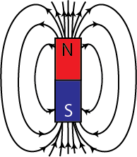
We say the magnet has a field
The field is invisible
But it is real
It can act on objects
Repel or attract them

Slide 8
Example: compass needle
Opposite poles attract
North end of compass needle attracted to south pole of magnet
Why can’t we feel the magnetic field?
We’re not magnetic!
hyperphysics.phy-astr.gsu.edu/.../ elemag.html

Slide 9
Let’s Practice
Which side is the N pole?
Which side is the S pole?
Web.mit.edu/
Physics 8.02
Module Guide 09

Slide 10
Let’s Practice
Solution:
Arrows point out of the North pole and into the south pole.
Web.mit.edu/
Physics 8.02
Module Guide 09

Slide 11
Let’s Practice
Will these magnets attract or repel each other?
Web.mit.edu/
Physics 8.02
Module Guide 09

Slide 12
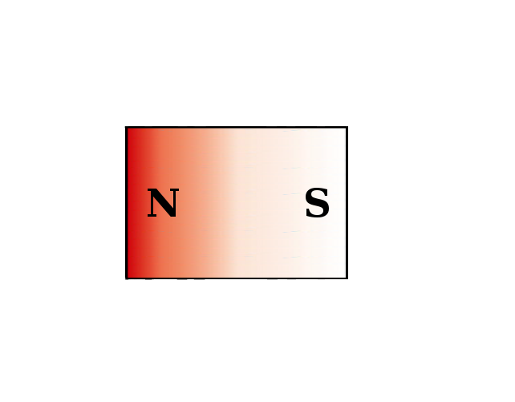
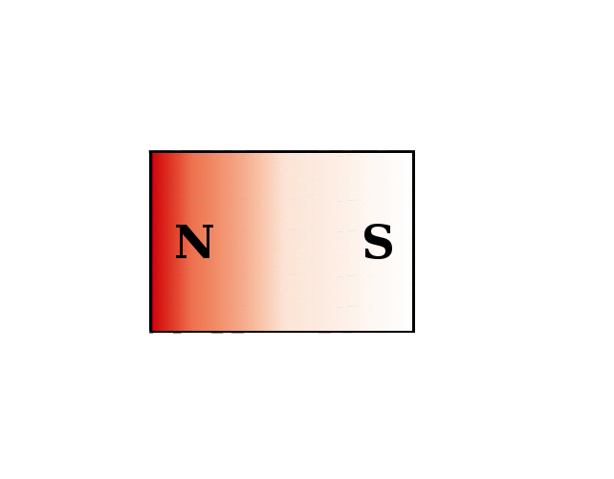
Let’s Practice
Opposite poles attract:
Web.mit.edu/
Physics 8.02
Module Guide 09

Slide 13
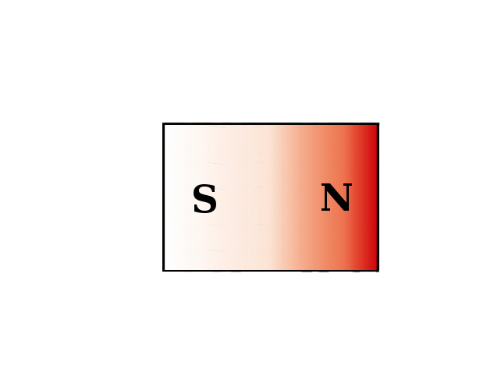
Let’s Practice
We can even make the magnets oscillate! (vibrate)
Web.mit.edu/
Physics 8.02
Module Guide 09

Slide 14
So we can push magnets around
Big whoop. We want to push the paper around.
Paper is not magnetic.
What should we do?

Slide 15
So we can push magnets around
Big whoop. We want to push the paper around.
Paper is not magnetic.
What should we do?
Glue a magnet to the paper

Slide 16
Then what?
We want to push the magnet around, but in synch with our music
Our music is in the form of an electrical signal right now
We will put electromagnetism to work

Slide 17
First piece of information
When current (I) flows though a wire, it creates a magnetic field (B)
Use right hand rule to find direction
http://en.wikipedia.org/wiki/Electromagnet

Slide 18
Is this drawn correctly?
Web.mit.edu/
Physics 8.02
Module Guide 09

Slide 19
If the current changes
Suppose the current reverses direction
What will happen to the field?

Slide 20
If the current changes
Suppose the current reverses direction
What will happen to the field?
It will reverse
Can we use this to push a magnet around?
Yes, but it’s pretty weak

Slide 21
Suppose we make a loop
All the field lines inside the loop go the same direction
Is the figure drawn correctly?
The field gets concentrated
physicsed.buffalostate.edu/.../ rhr/rhr.htm

Slide 22
Remember Two Magnets?
Will these magnets attract or repel each other?
Web.mit.edu/
Physics 8.02
Module Guide 09

Slide 23
Remember Two Magnets?
Will these magnets attract or repel each other?
Web.mit.edu/
Physics 8.02
Module Guide 09

Slide 24
Replace one magnet
Web.mit.edu/
Physics 8.02
Module Guide 09

Slide 25
Reverse Current
Web.mit.edu/
Physics 8.02
Module Guide 09

Slide 26
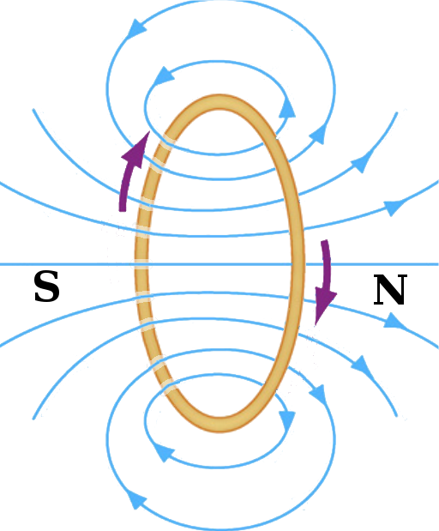
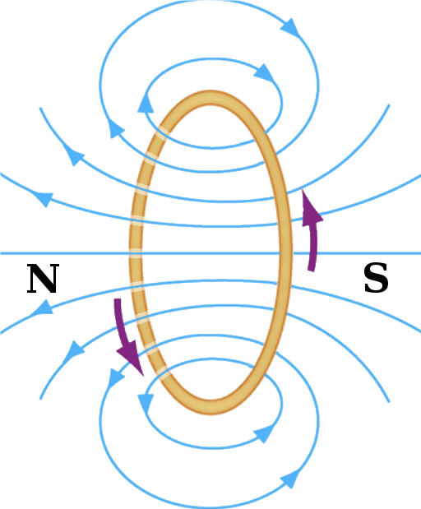
Electricity creates oscillation!
By alternating the current direction…
We can make the coil oscillate!
Web.mit.edu/
Physics 8.02
Module Guide 09

Slide 27
Ok! We can push the magnet!
But the field is still weak.
Need a way to amplify the field.

Slide 28
A bunch of loops=electromagnet
www.utm.edu/~cerkal/ magnetic.htm

Slide 29
OK, we have all the pieces!
Need a paper diaphragm
Need a “voice coil”
About 50 turns should do it
Need a magnet
And a music source!
(and probably an amplifier)

Slide 30
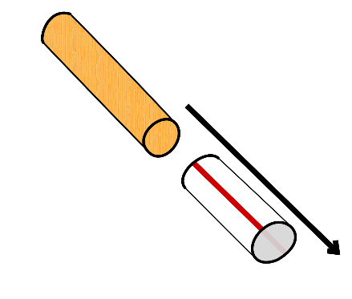
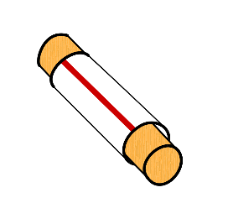
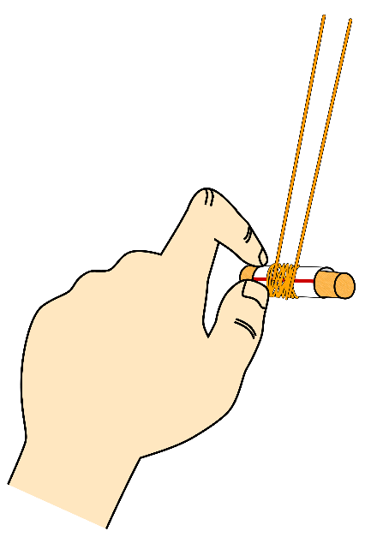
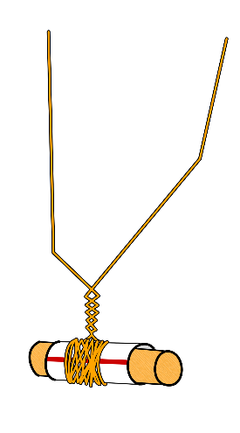
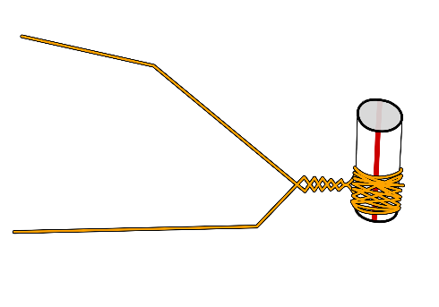
Voice coil
Slide straw over dowel
Wrap wire around straw
Leave about 6” free before you start winding
Leave 6” at the end
Overlap wire as much as possible
Make sure all wire is on the straw
Twist wire so it doesn’t unwind
When finished, slide coil to one end of straw
Remove dowel

Slide 31
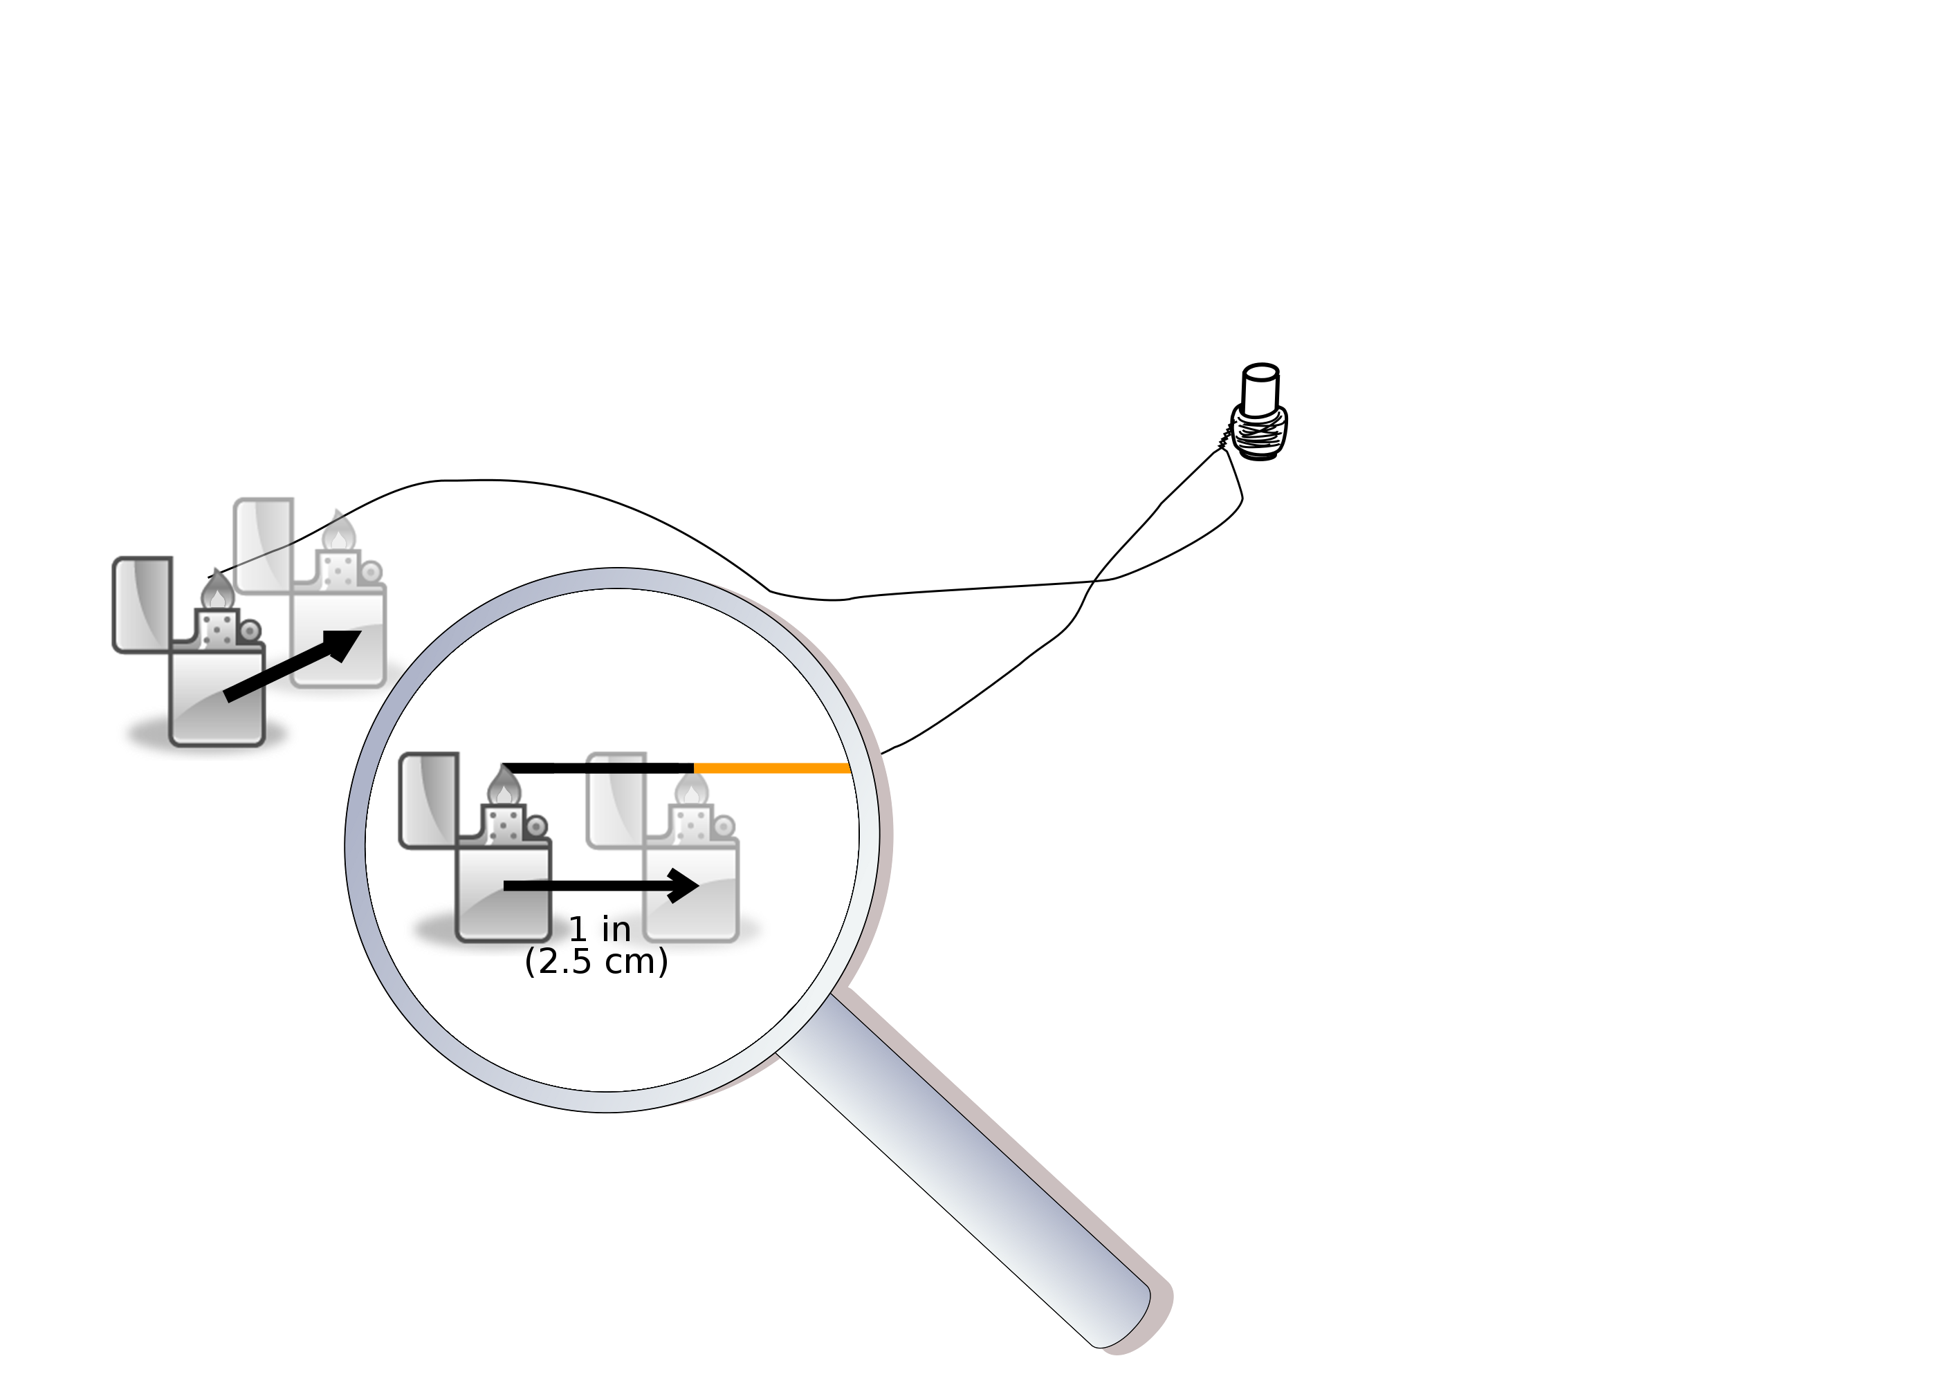
Burn speaker leads
Burn 1 inch of the end of each of the two wires coming off the coil.

Slide 32
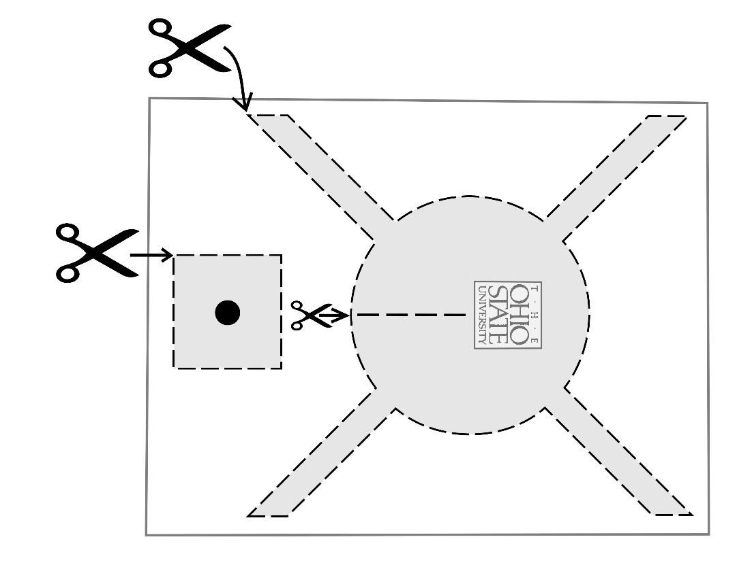
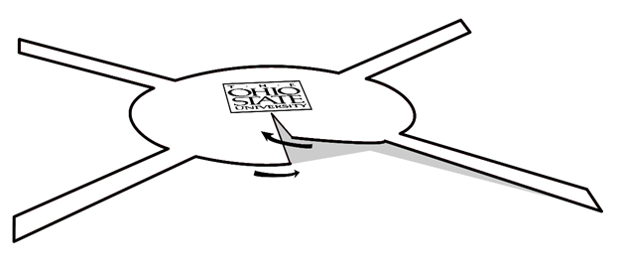
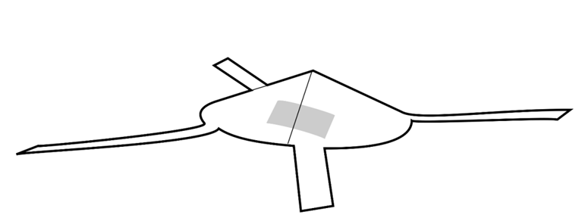
Diaphragm
Cut out template
Cut slot at white line
Make cone and tape it

Slide 33
Glue magnets to the square

Slide 34
Attach coil to diaphragm
Glue long end of straw to bottom of cone
Coil should be at end away from cone
Don’t get glue on the end of the straw away from the cone – need room for magnet to move!

Slide 35
Tape legs to the cardboard
Coil should hover above or gently rest on cardboard after all four legs have been taped.

Slide 36
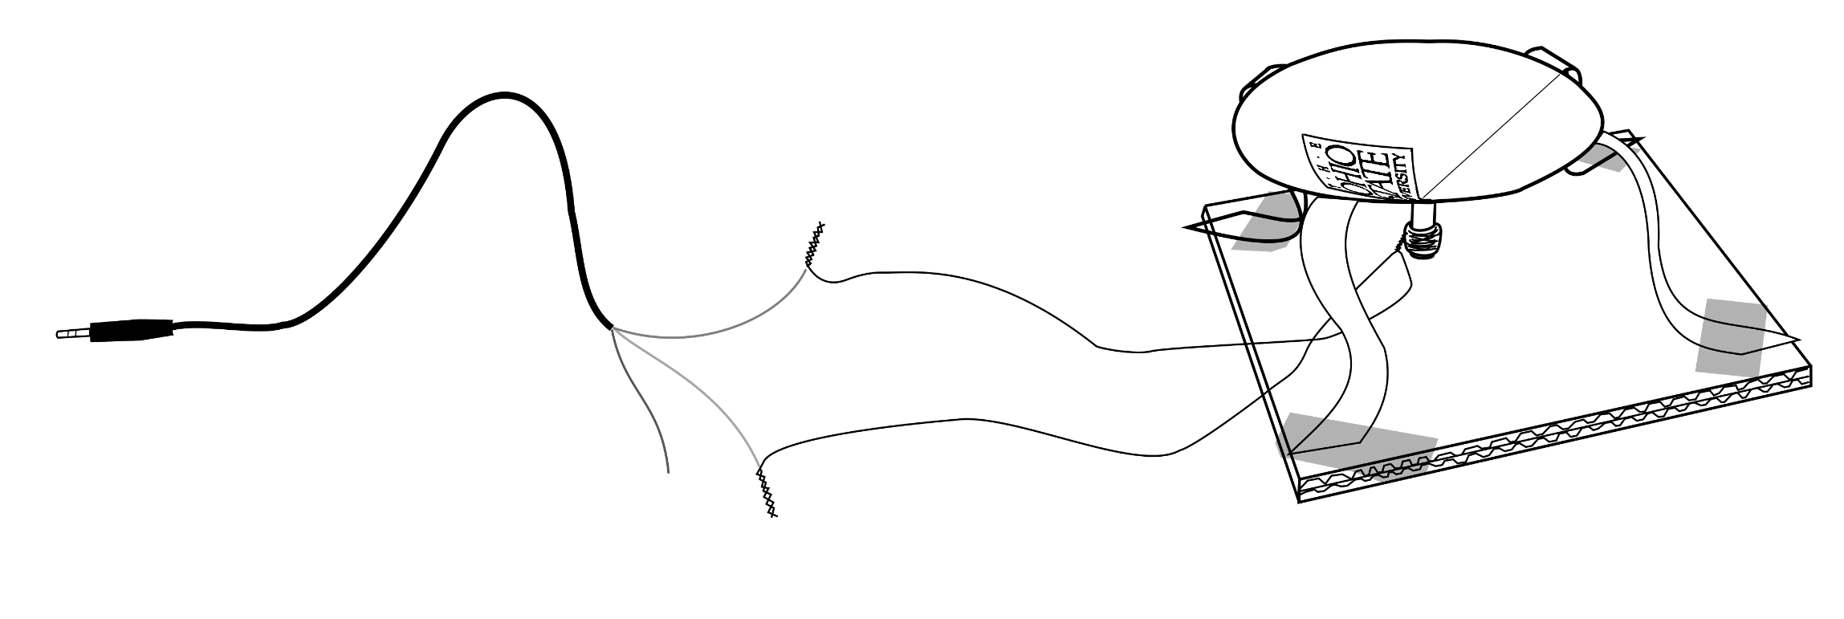
Connect to audio cable
Twist yellow wire and one lead from your speaker together
Twist red or white wire with other speaker lead.

Slide 37
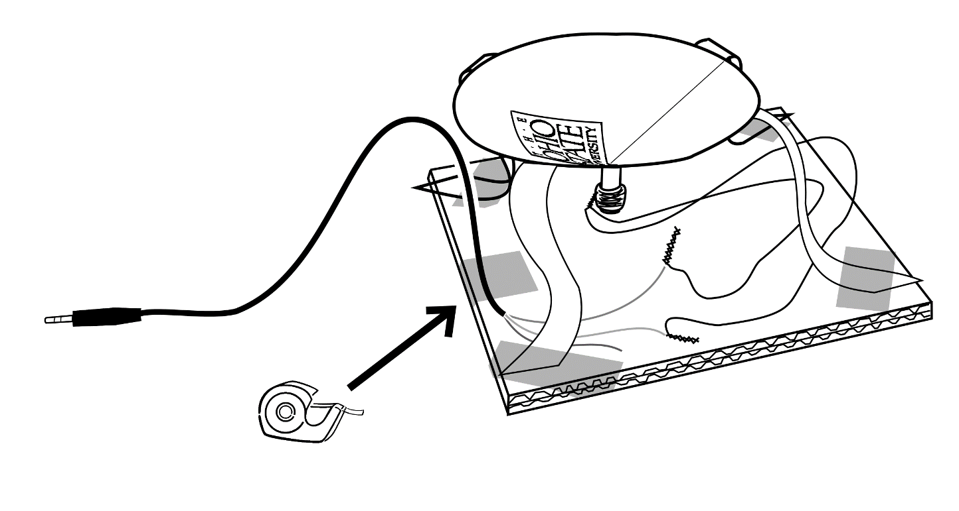
Tape audio cable to cardboard
Tape the black audio cable to the edge of your cardboard.

Slide 38
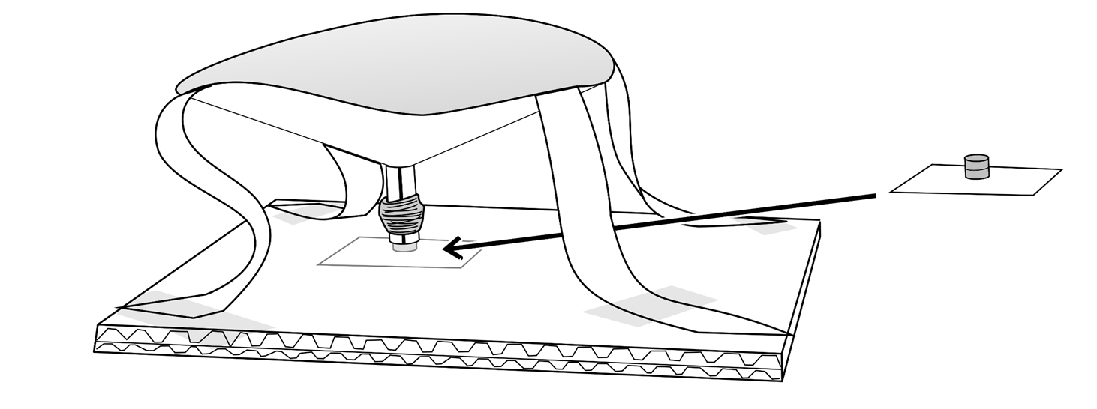
Position Magnets Inside Coil
Do not tape paper down! (Yet)

Slide 39
Once it works, tape the square

Slide 40
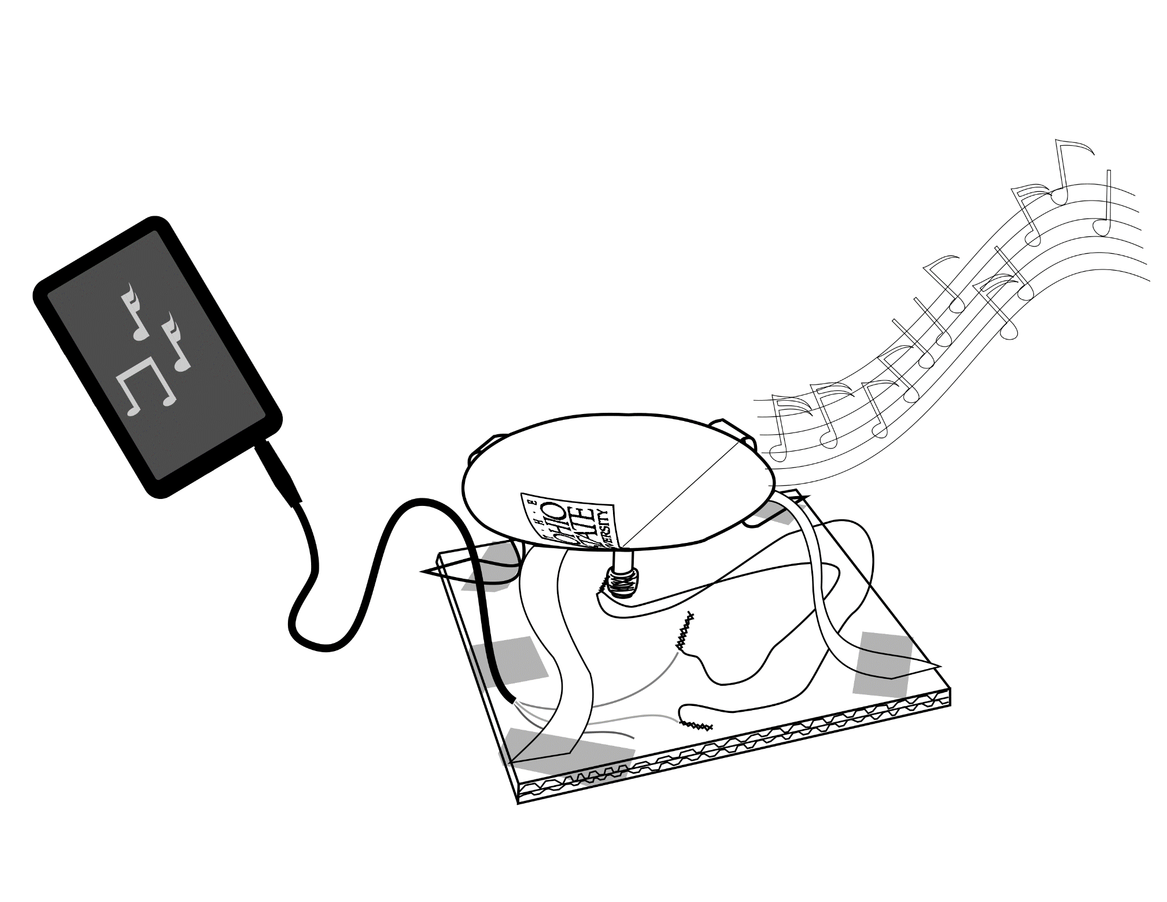
Connect to mp3 and play!
You have applied electromagnetism to create sound from an electrical signal.
How do you suppose a microphone works?

Slide 41
Troubleshooting
Volume set to max?
Speaker is plugged into phone all the way?
Magnets are inside the coil?
Coil can easily slide up and down on the magnets?
Coil is at the bottom of the straw? (Closest to the cardboard)
1 inch of each speaker lead was burned?
The two twisted connections are not touching each other?
If your audio cable doesn’t have a red, white and yellow wire, you can use any two wires
Try re-twisting the audio cable to the speaker leads!

