Slide 1
Introduction to Circuits: Build a Magic Wand!
Mark Morscher
Electrical and Computer Engineer
Brought to you by OSU STEM Outreach

Slide 2
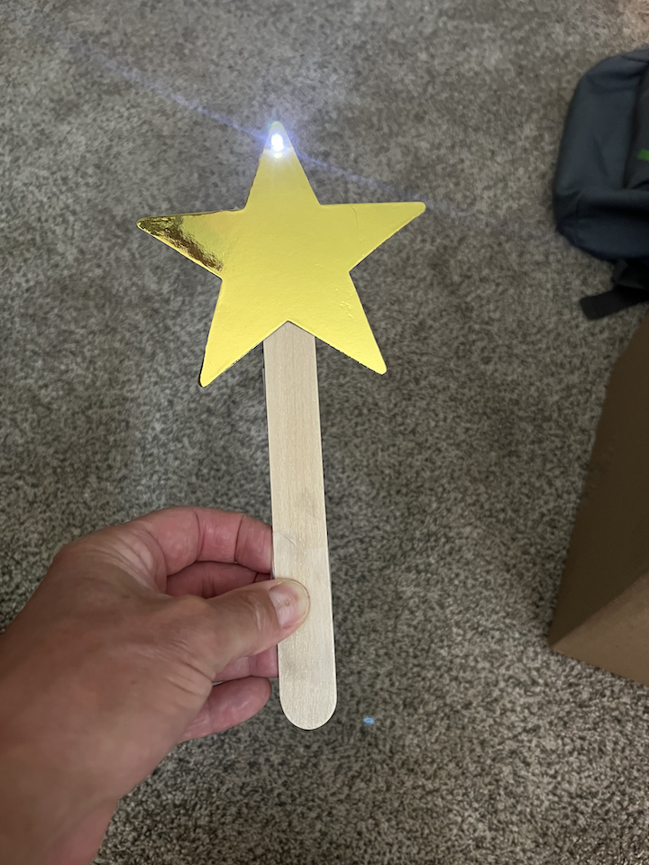
Introduction to Circuits
Magic Wand

Slide 3
How does it work?
When electricity flows through an LED (light-emitting diode), the LED lights up
We need a battery, an LED, some wire, a switch and some know-how!

Slide 4
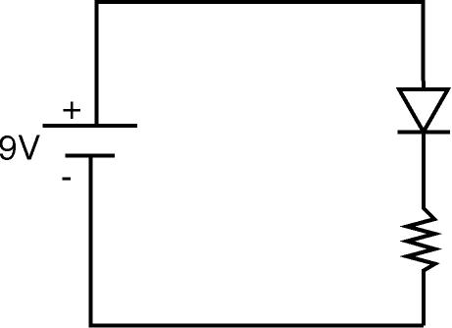
This is our circuit!
Battery
LED
Switch

Slide 5
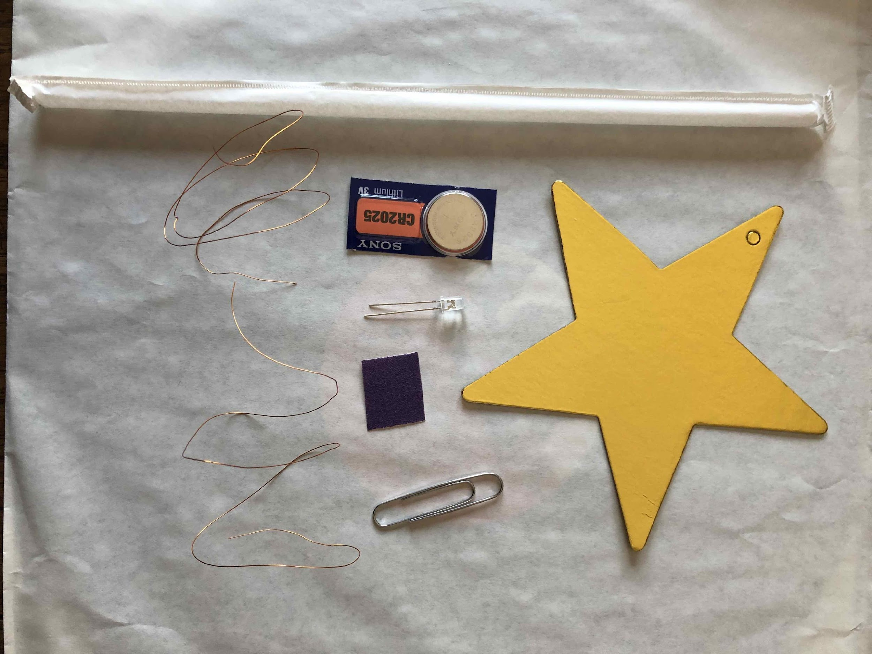
Are you ready to build?
Star
Coin battery
LED
2 pieces wire
Paper clip
Popsicle Stick
Sandpaper

Slide 6
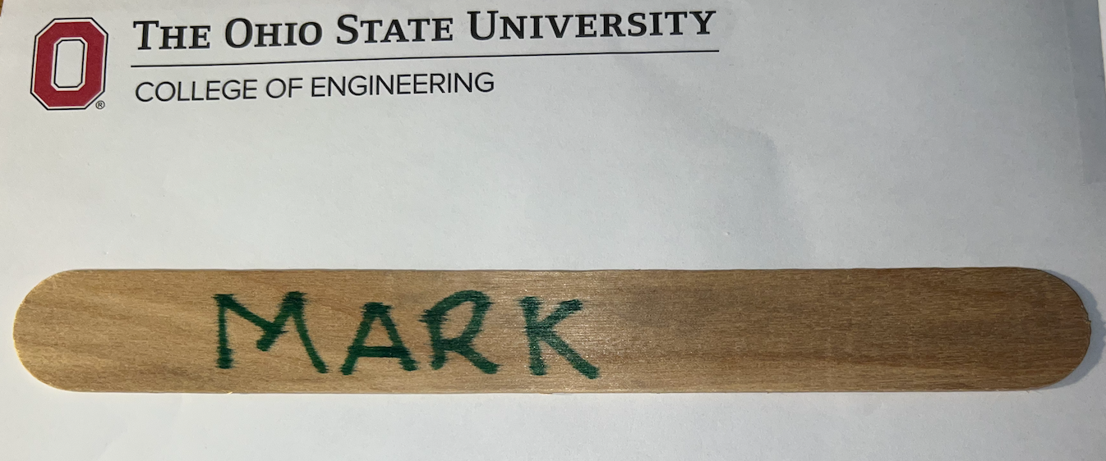
Put your name on the wand!

Slide 7
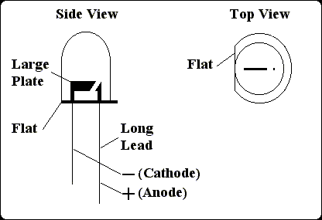
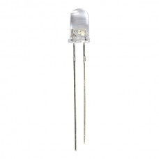
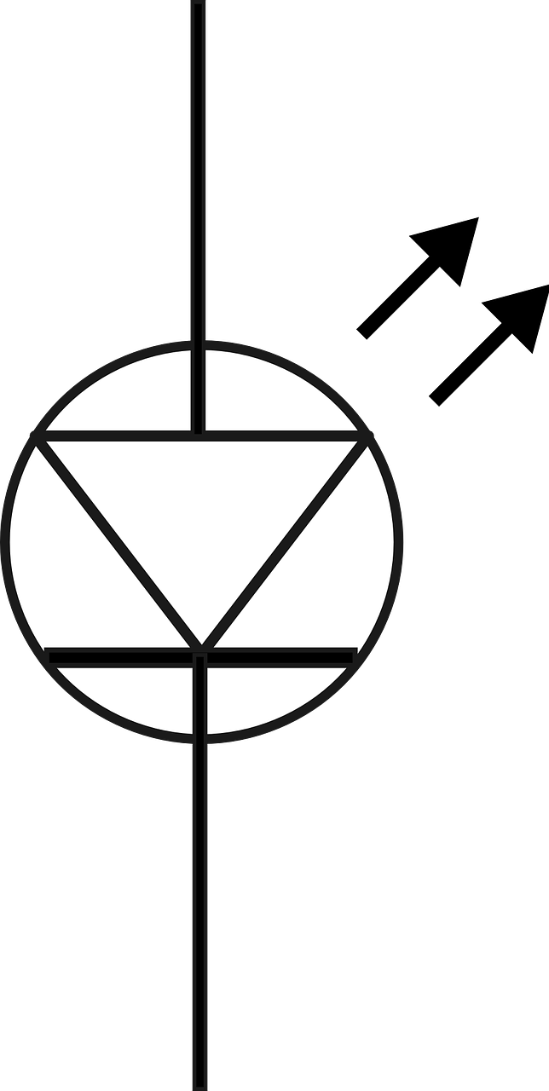
LED: one lead is shorter!
If you forget which is shorter, look for the flat edge

Slide 8
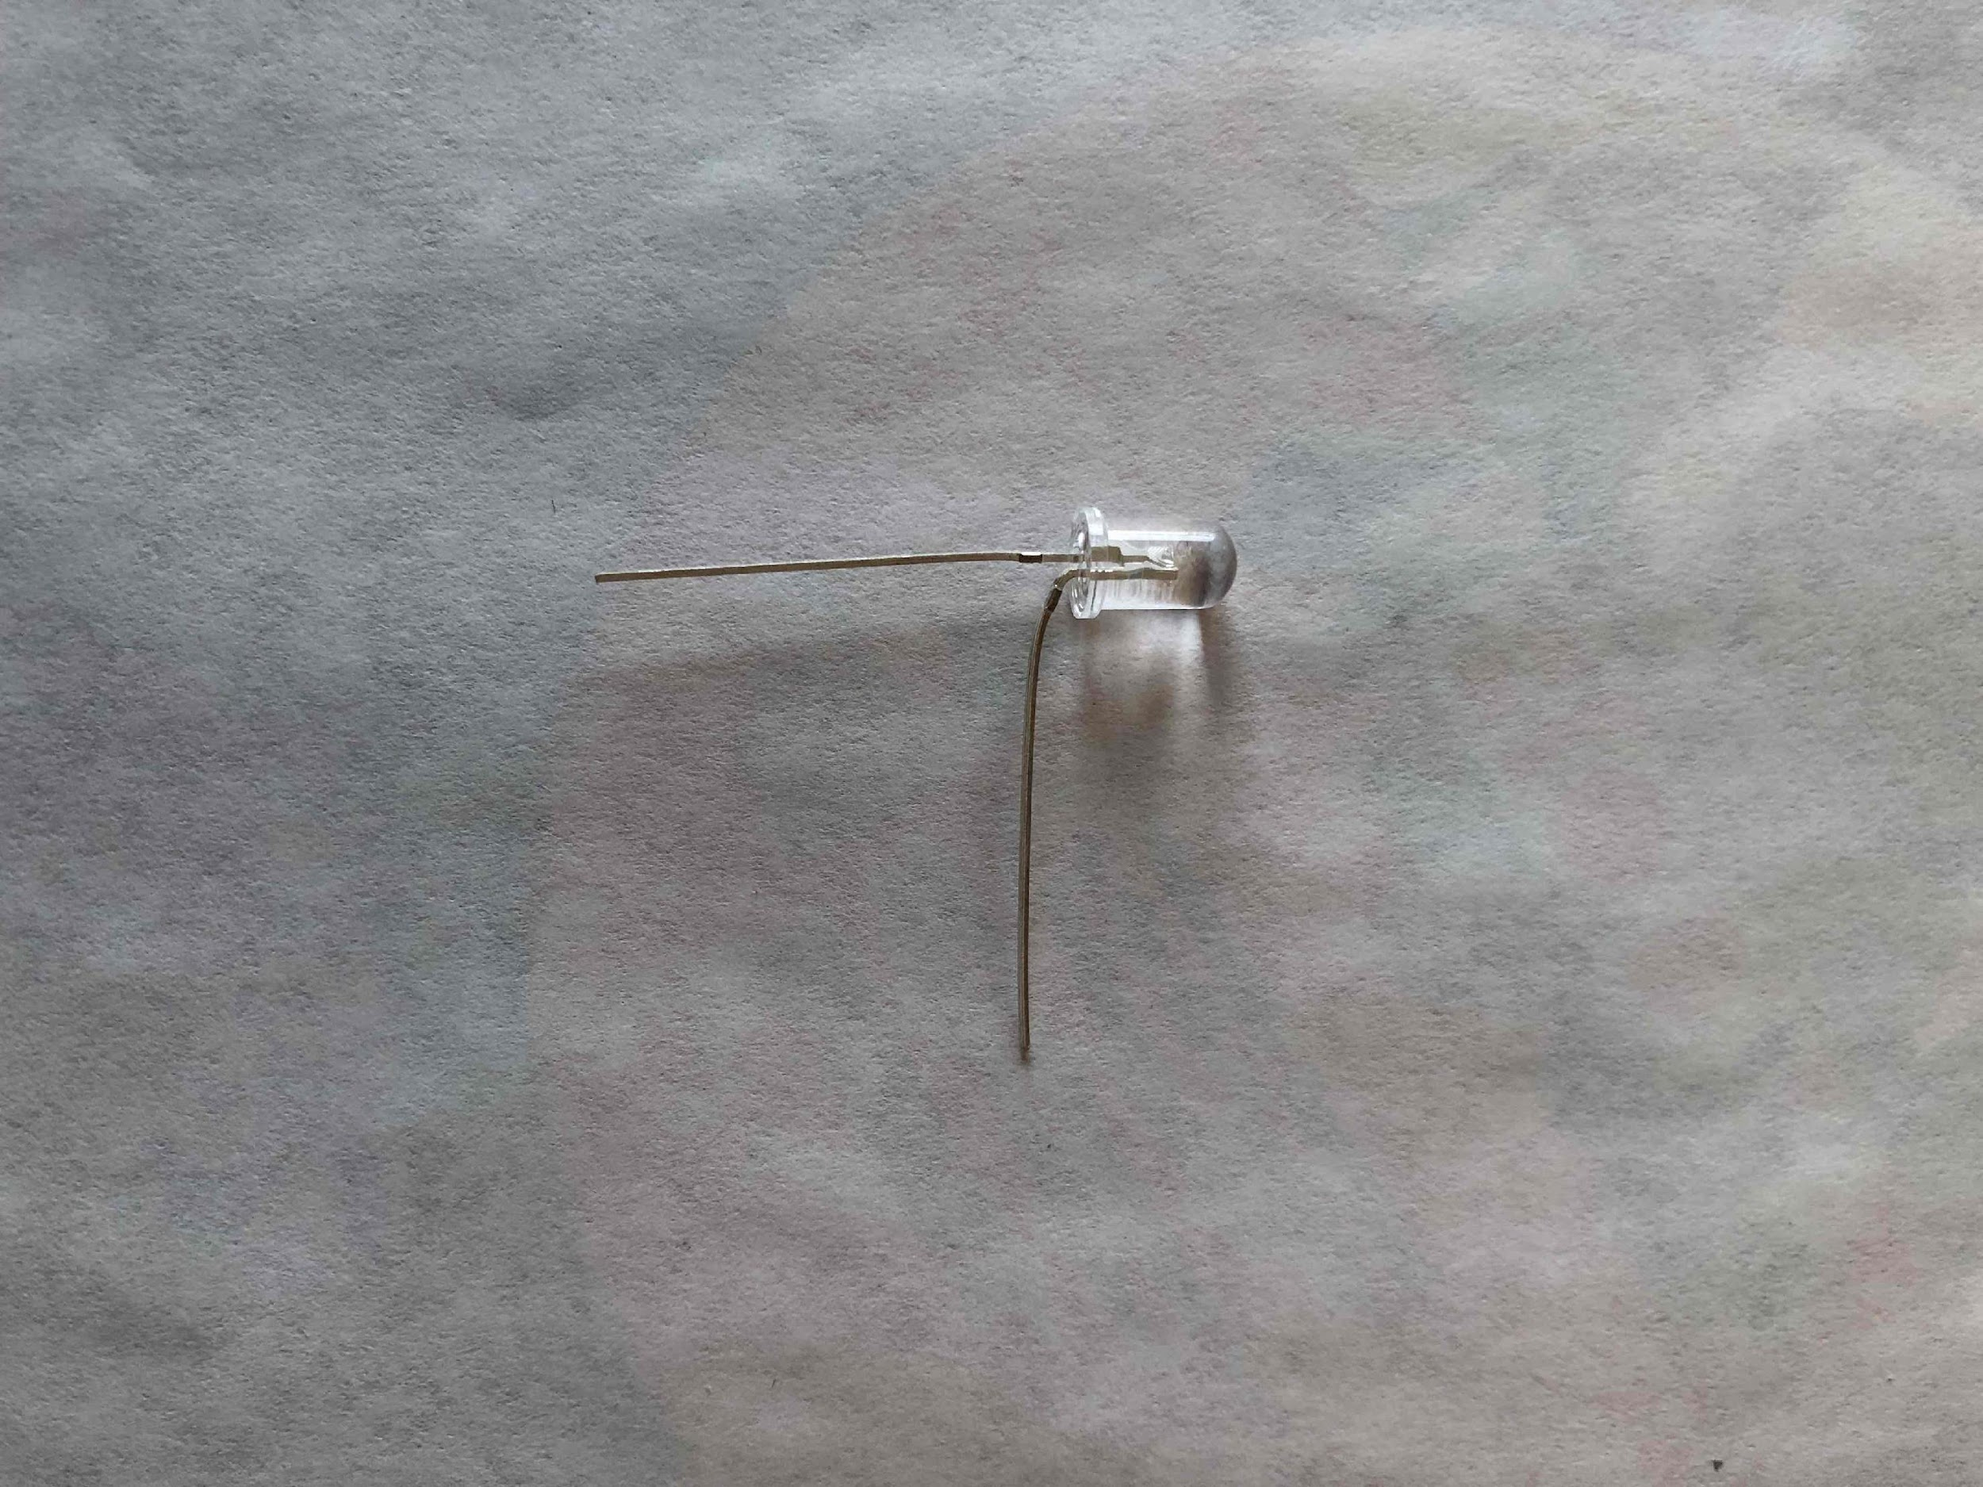
Bend the LONG lead

Slide 9
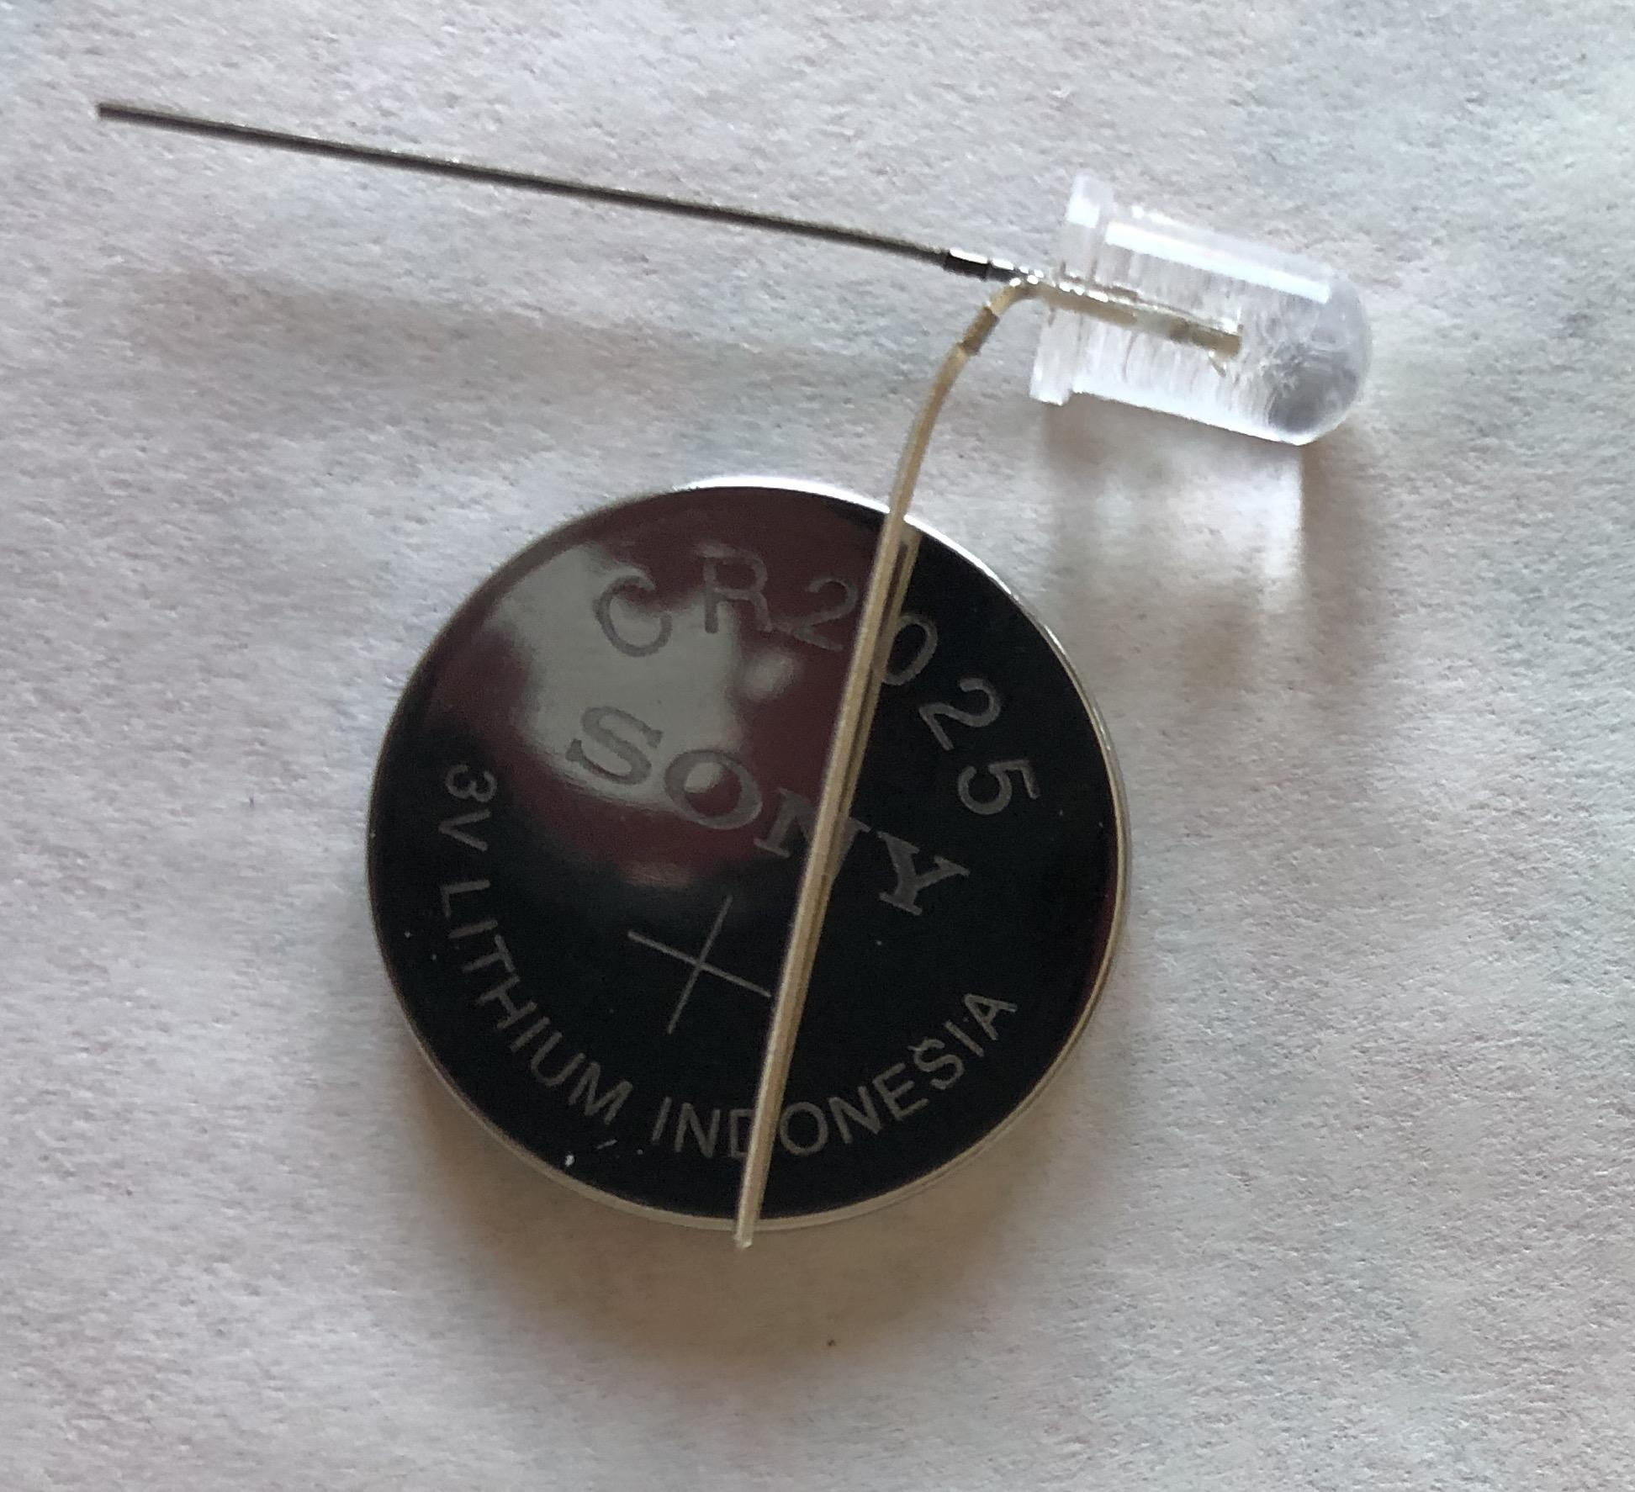
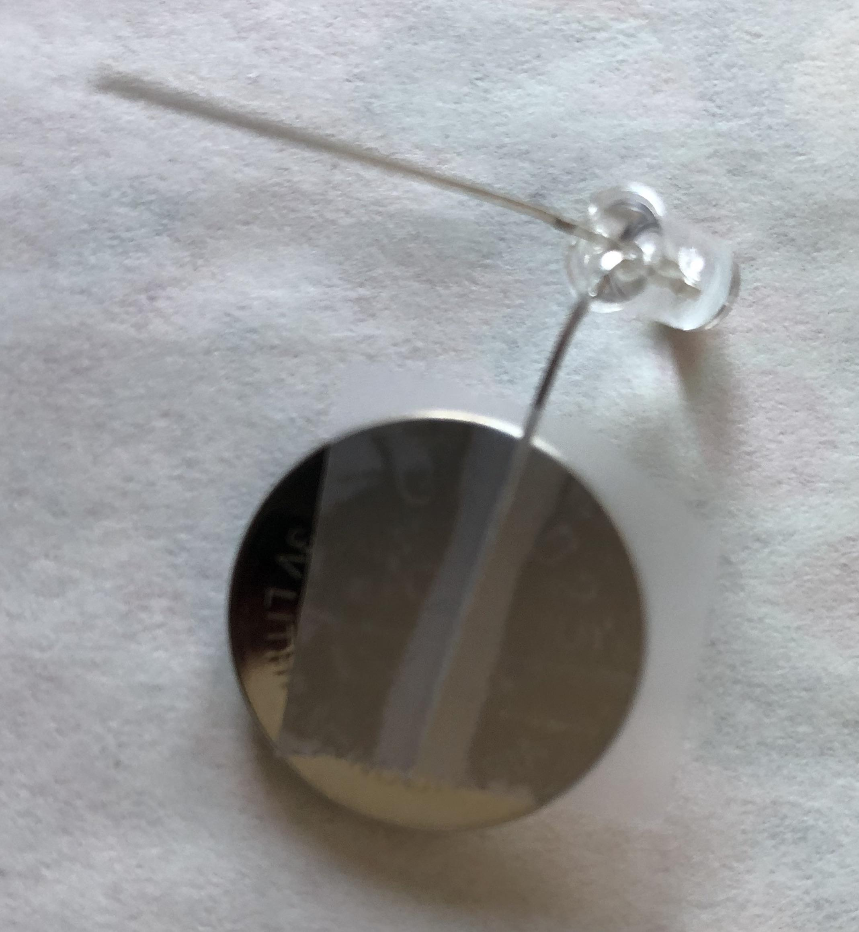
Lay the long lead on the battery
Short!
Must be the side with the writing!
Short!
Short!
TAPE IT!

Slide 10
We just started building our circuit!
Battery
LED
Switch

Slide 11
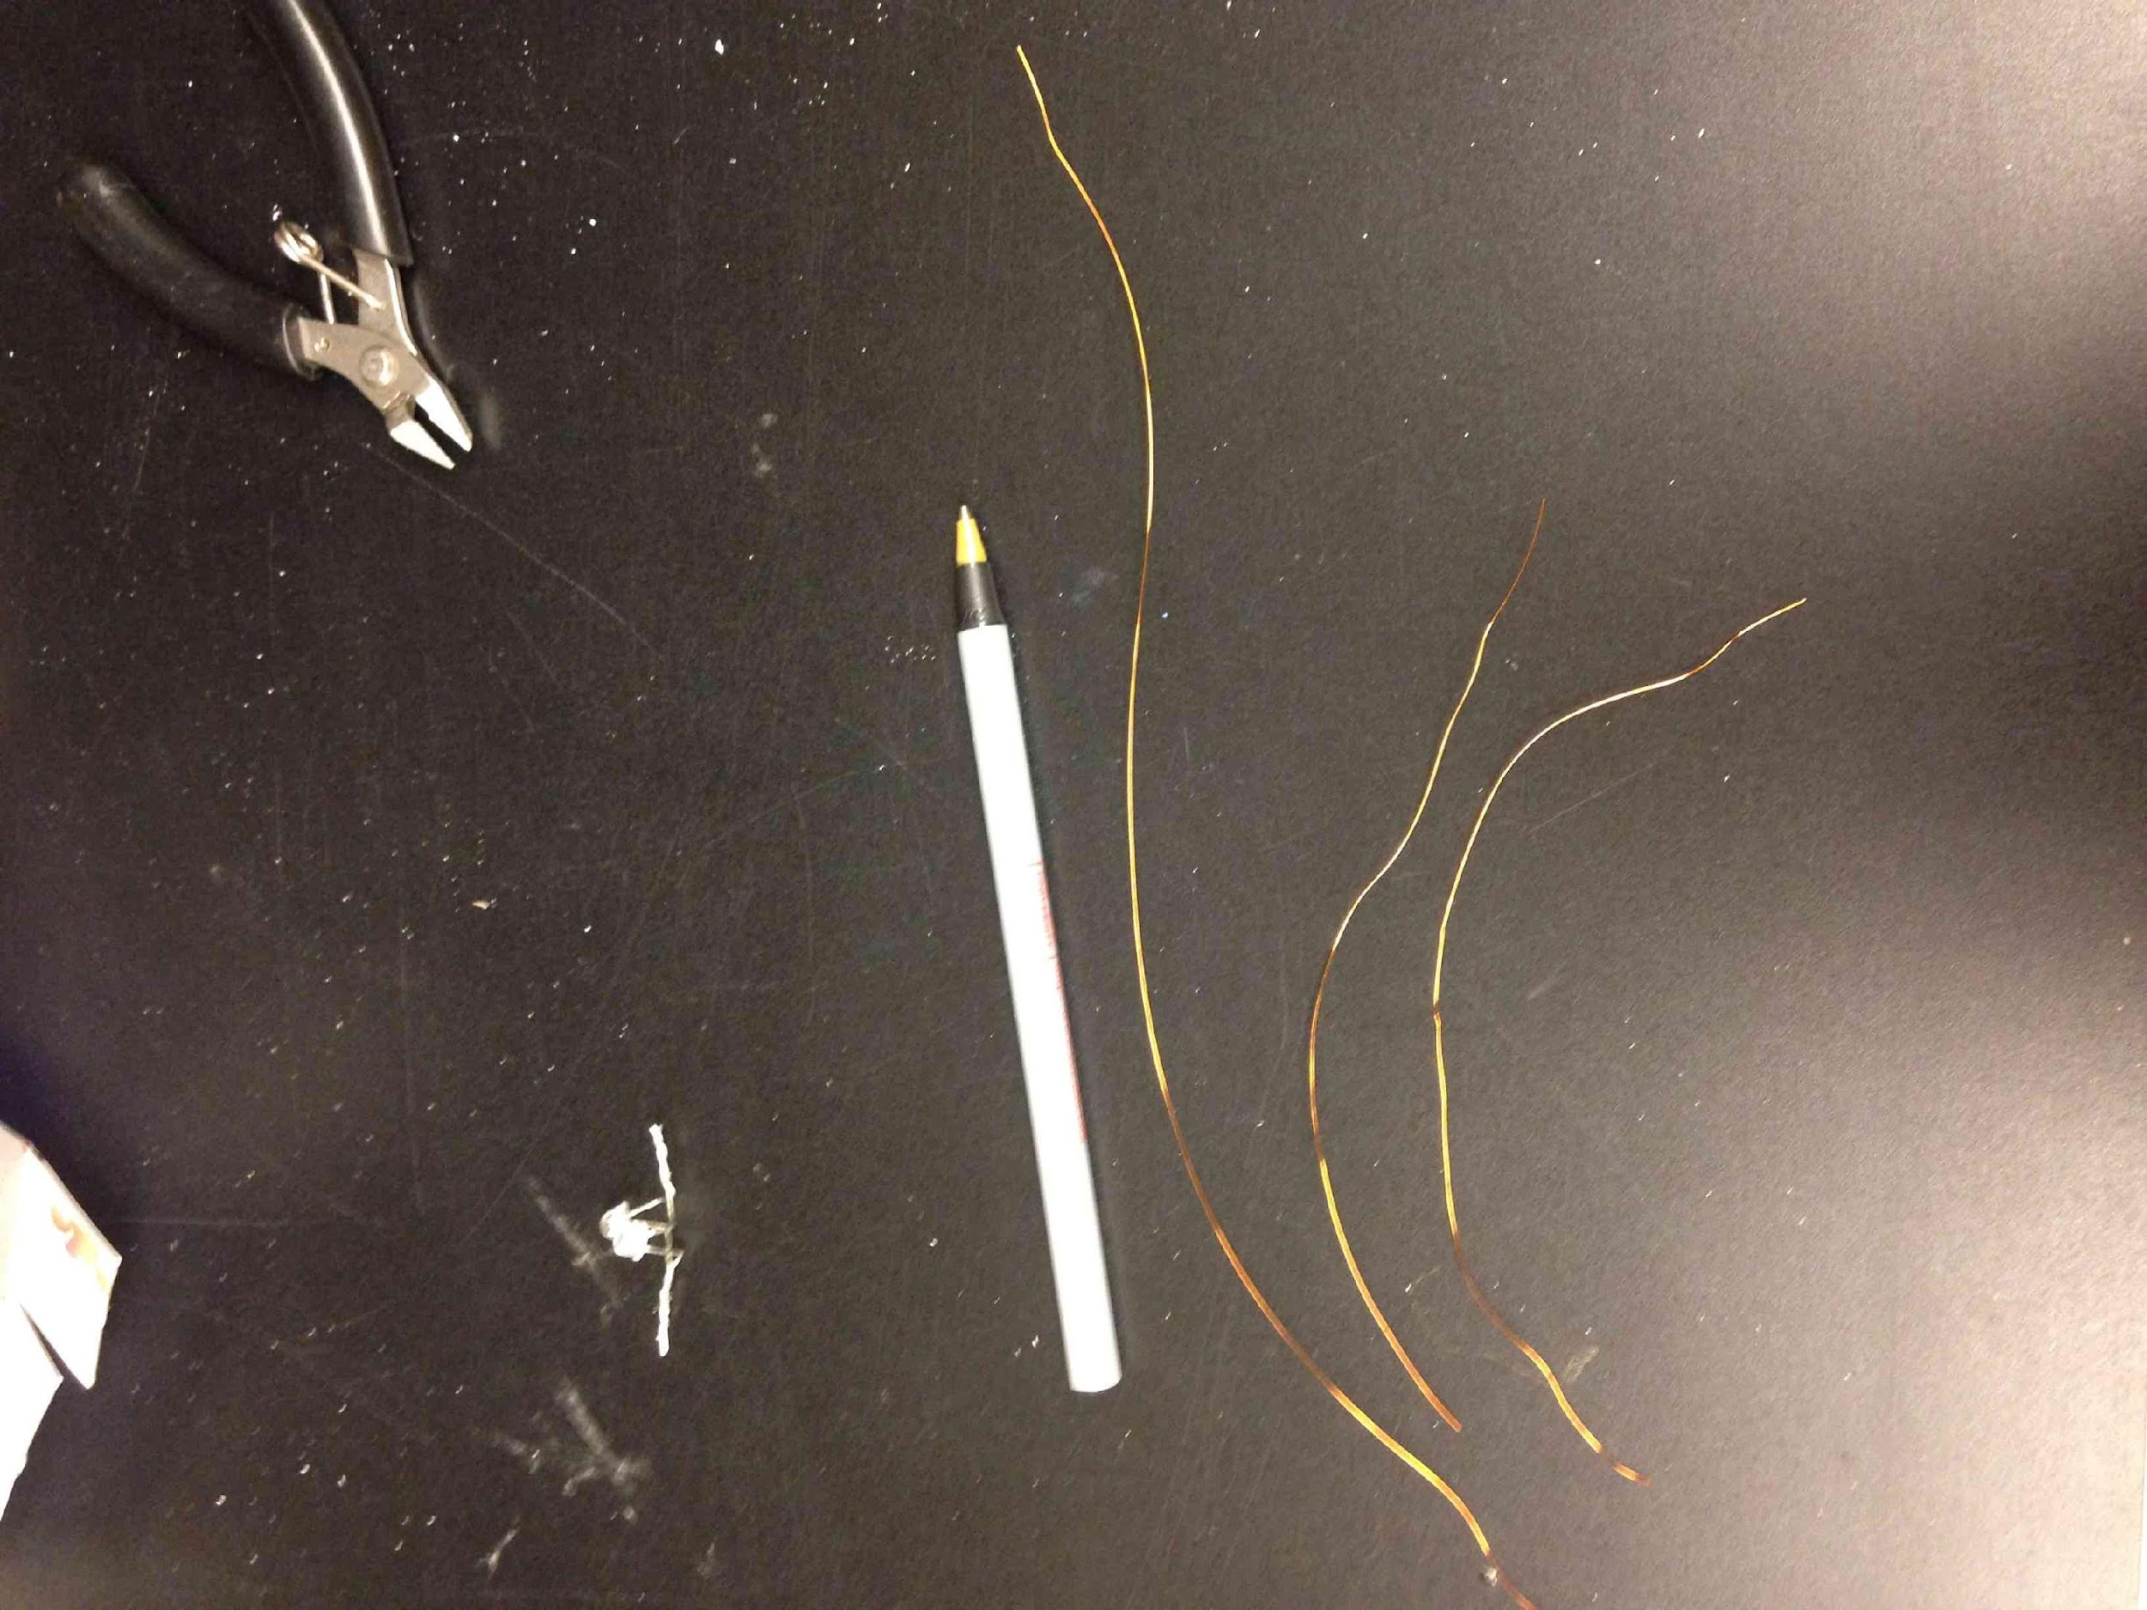
Got two pieces of magnet wire?

Slide 12
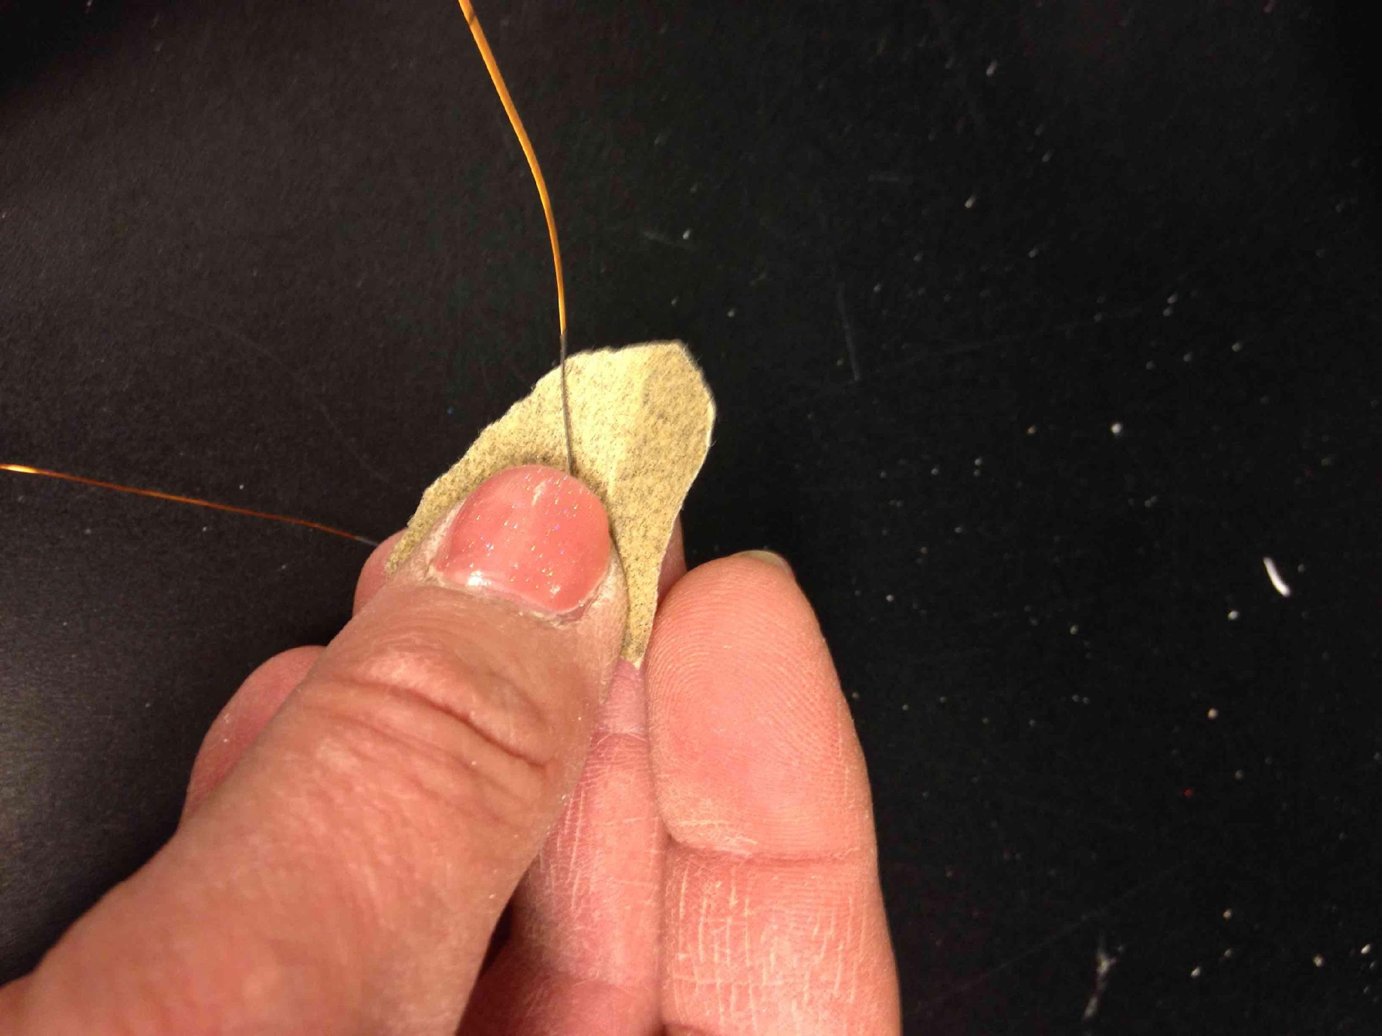
The insulation has been burnt
Sand off the black stuff
Not burned yet (golden)

Slide 13
Let’s attach this wire.
Battery
LED
Switch

Slide 14
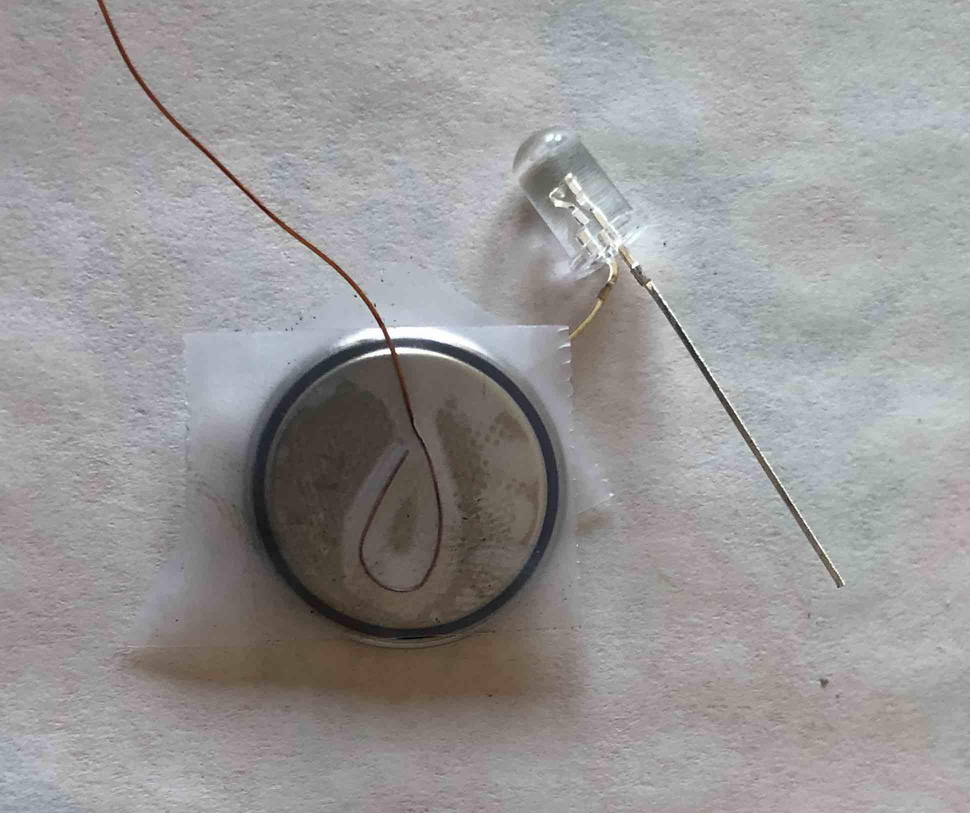
Make a loop on one wire, tape it to the back of the battery
TEST it by touching the other side of the wire to the other lead of the LED!

Slide 15
Let’s put this wire in place.
Battery
LED
Switch

Slide 16
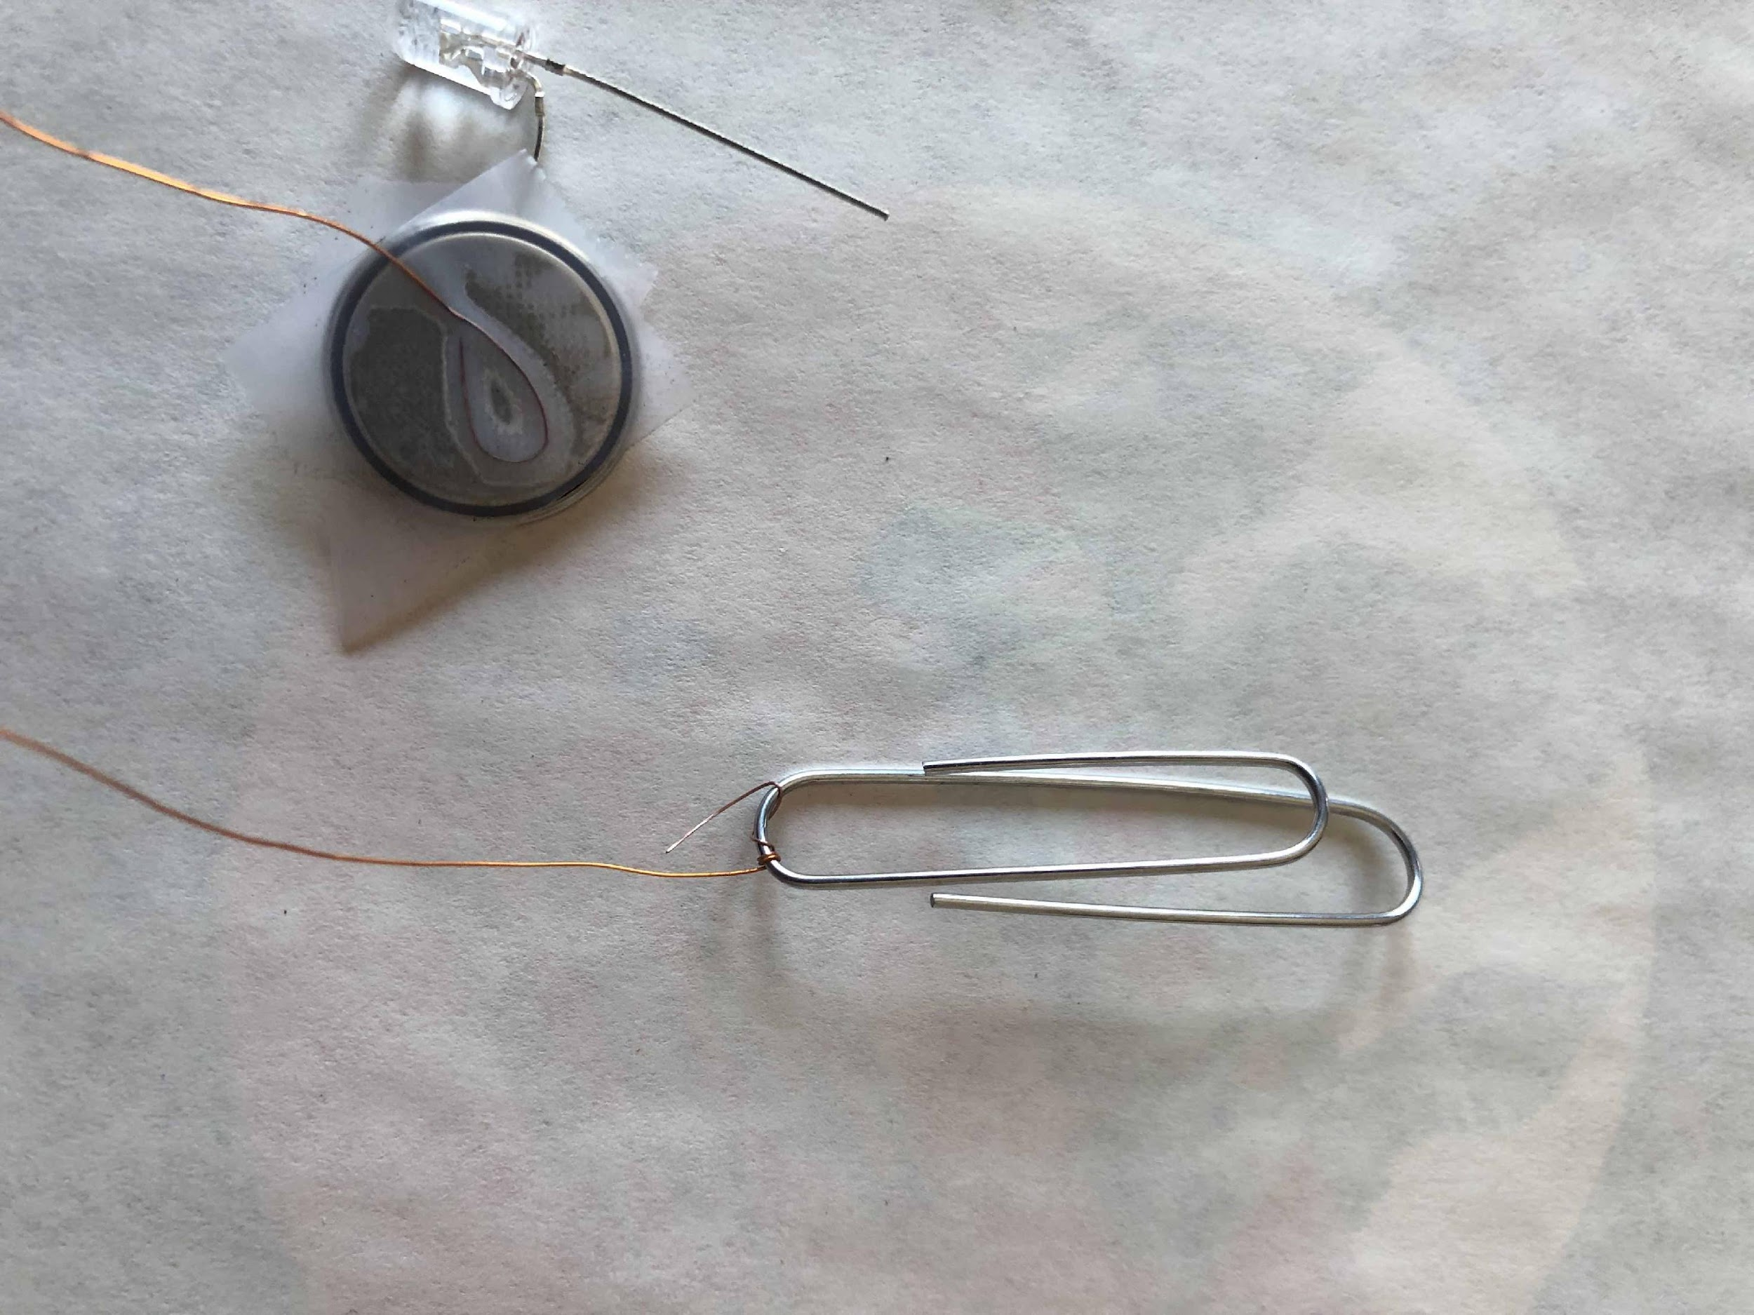
Open up the paper clip
Twist other end of wire from the battery around front of alligator’s mouth
Need a good connection!

Slide 17
Technique
1. Loop sanded end of wire over the bottom of long end of paper clip.

Slide 18
Technique
2. Pinch the wire with your fingers of hand not holding paper clip

Slide 19
Technique
3. Twist the paper clip several times to make a good connection
4. Now test it!

Slide 20
Let’s attach this wire.
Battery
LED
Switch

Slide 21
Attach second wire to other LED lead
Need a good connection!

Slide 22
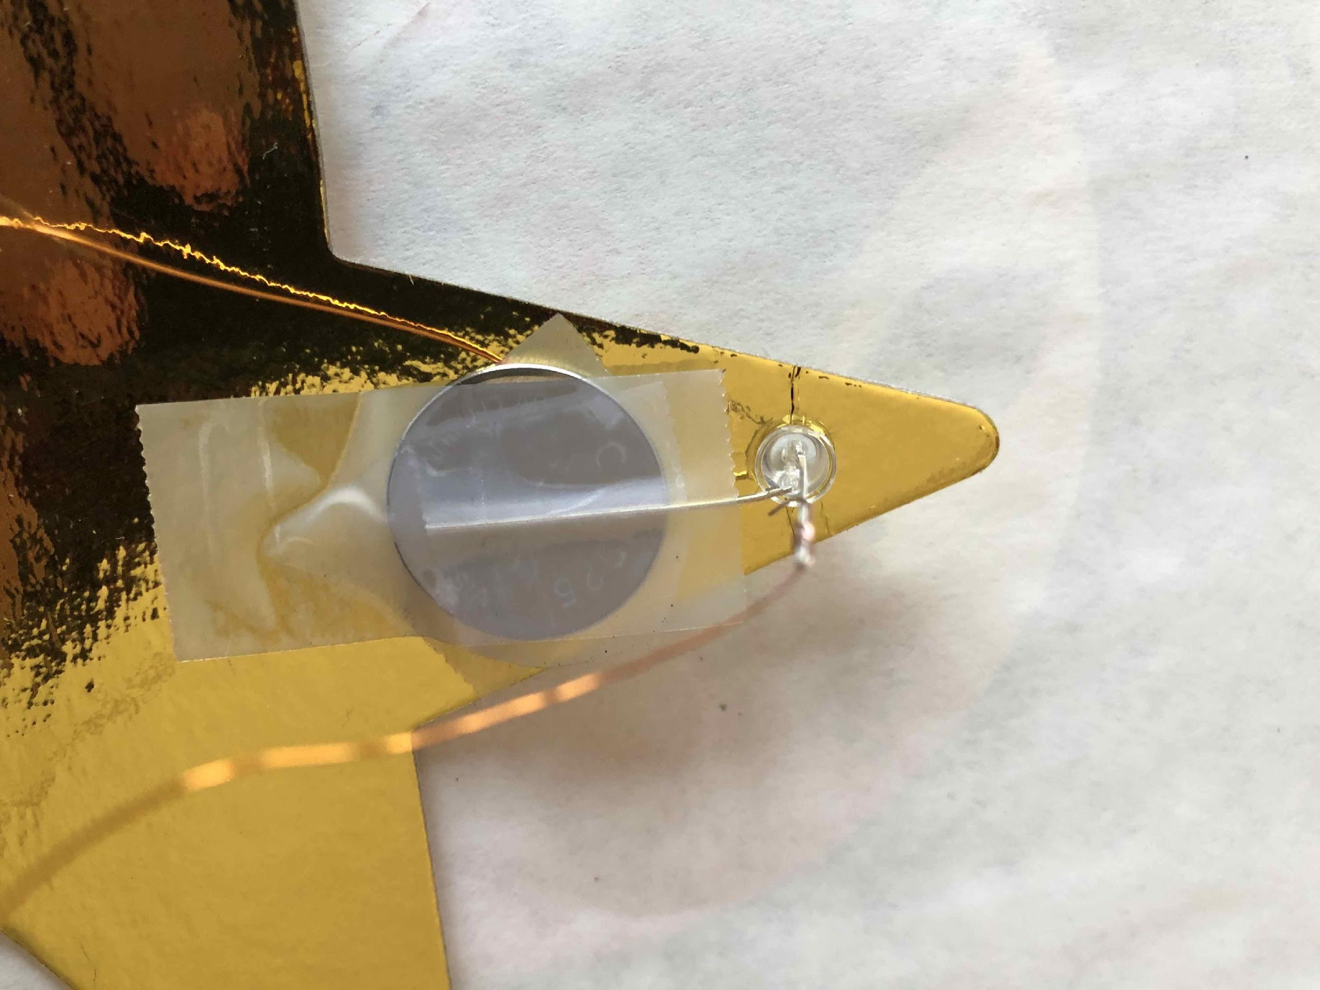
Put LED through hole in star and tape down battery.
Then bend down the other LED lead!

Slide 23
Tape star to popsicle stick.

Slide 24
Put tape inside alligator’s mouth

Slide 25
Making the Switch
1. Tape over the bottom of the paper clip between “jaws”

Slide 26
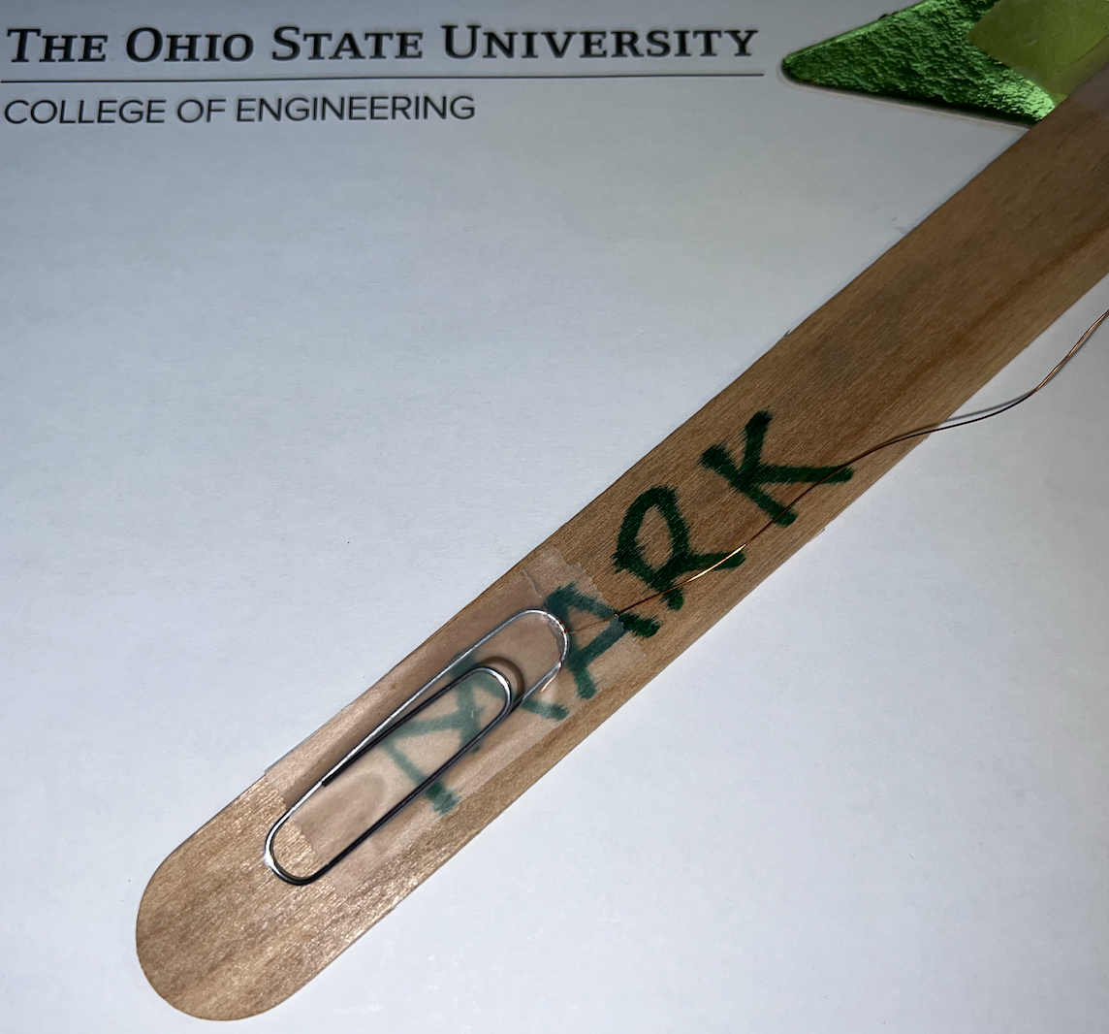
Tape paper clip to handle

Slide 27
Let’s attach this wire.
Battery
LED
Switch

Slide 28
Making the Switch
2. Sanded part of wire placed across bottom of paper clip, below the top of the alligator mouth
Wire
3. Secure wire by taping it down outside of paper clip
Wire

Slide 29
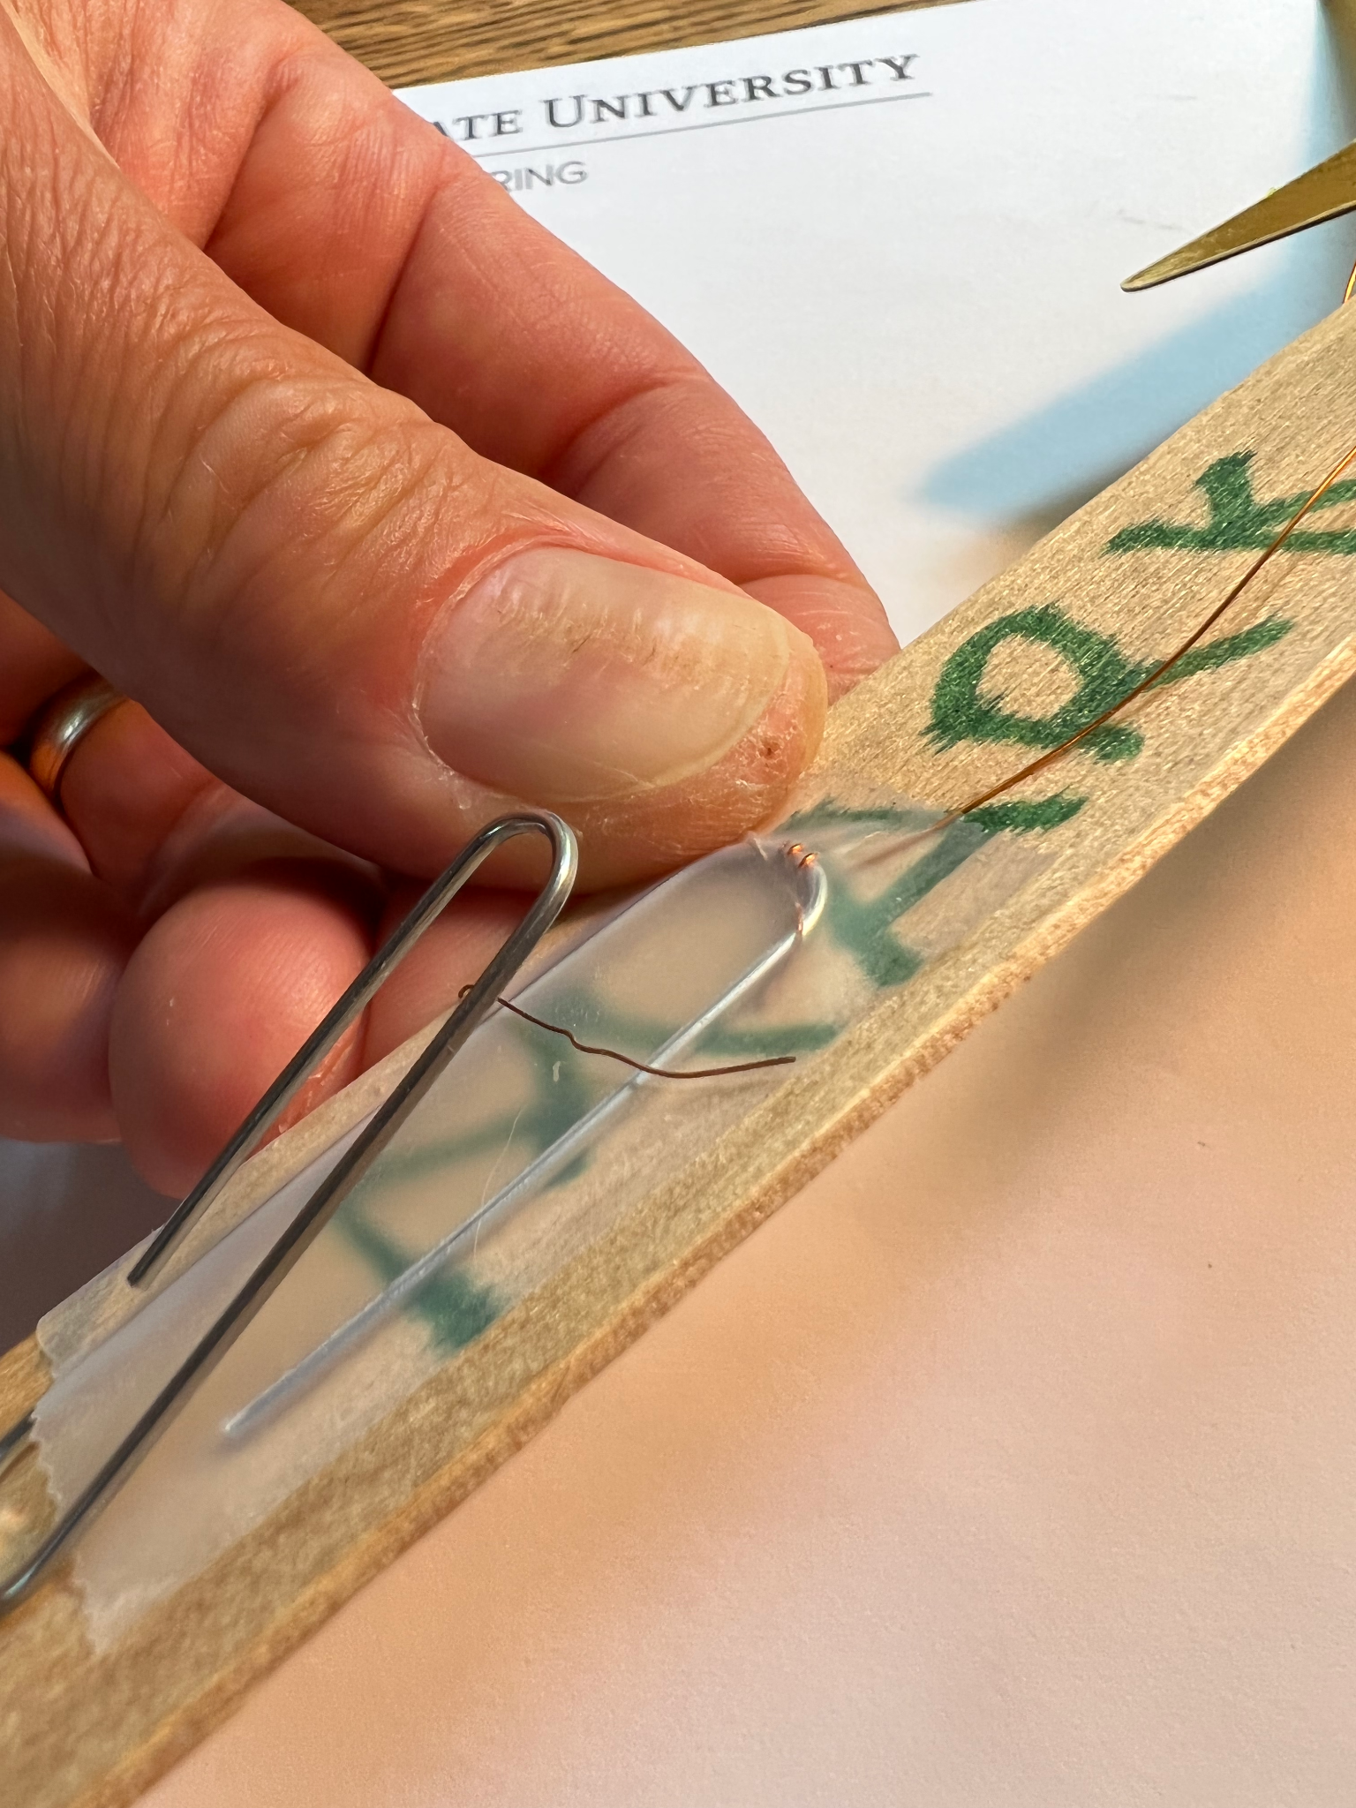
Put burned part of wire inside alligator’s mouth

Slide 30
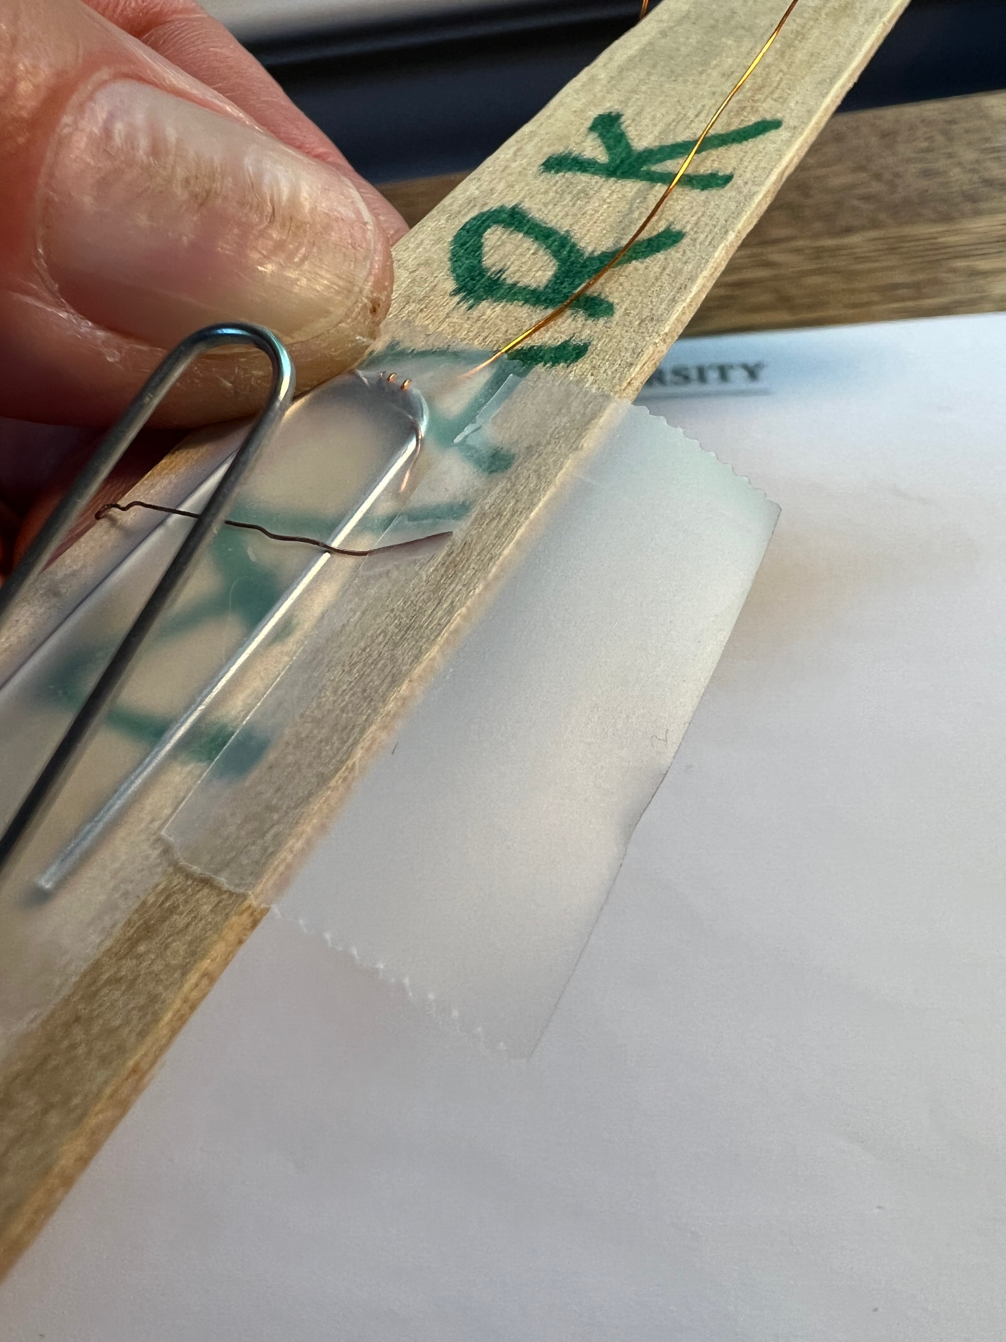
Tape the end of the wire
Test it!
Don’t get tape INSIDE mouth

Slide 31
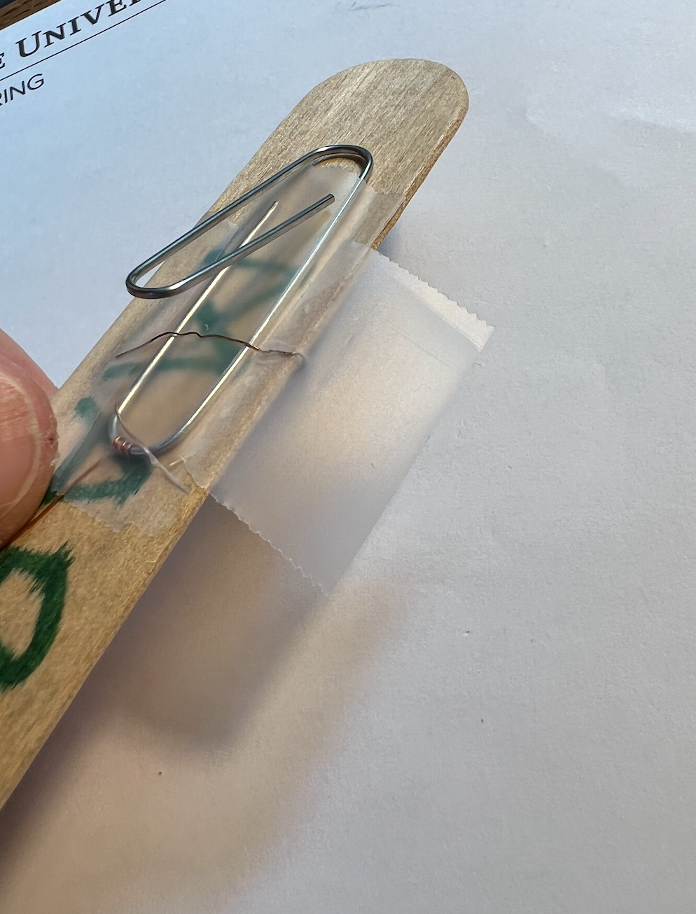
Tape other end of wire
Test it!
Tape the loose wires on to the back of the popsicle stick!
Don’t get tape INSIDE mouth

Slide 32
You are done!
Squeeze the paper clip to close the circuit and light up the wand!

Slide 33
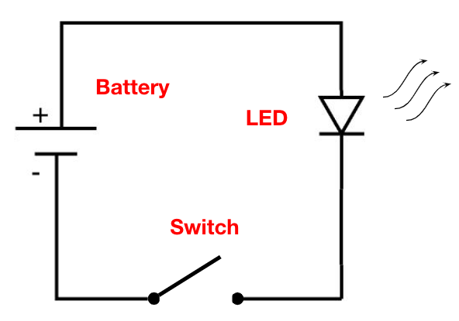
You built a Circuit!
Troubleshooting:
Is tape covering wire in alligator mouth?
Is paper clip touching wire when closing?
Do you have good wire connections?

Slide 34
Questions?

