Slide 1
COLLEGE OF ENGINEERING
Build An Electric Train

Slide 2
COLLEGE OF ENGINEERING
Pre-Lab
Introduction to the Physics

Slide 3
COLLEGE OF ENGINEERING
ELECTRICITY
Flows like water in a stream
Goes from higher to lower potential like a stream flows from the top to the bottom of a hill
Electricity travels through conductive material

Slide 4
COLLEGE OF ENGINEERING
CAN ELECTRICITY TRAVEL THROUGH PLASTIC?

Slide 5
COLLEGE OF ENGINEERING
CAN PLASTIC CONDUCT ELECTRICITY?
NO! Plastic cannot conduct electricity.
Can you think of anything that can?

Slide 6
COLLEGE OF ENGINEERING
CAN ELECTRICITY TRAVEL THROUGH COPPER?
YES!
Copper is a conductor!

Slide 7
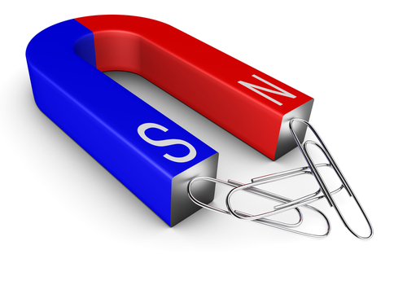
COLLEGE OF ENGINEERING
CONDUCTORS
Magnets can also be conductors!

Slide 8
COLLEGE OF ENGINEERING
ELECTROMAGNETISM
We will make an electromagnet by passing an electric current through a copper wire
That creates a magnetic field
That creates a force
The force will push the train
http://www2.ece.ohio-state.edu/~anderson/Outreach_speaker.html

Slide 9
COLLEGE OF ENGINEERING
MAGNETS
Every magnet has two poles
North pole
South pole
Even if a magnet breaks it still has two poles
Like poles repel
South repels South
North repels North
Opposite poles attract
http://www.swe.org/iac/lp/magnets_03.html
http://www2.ece.ohio-state.edu/~anderson/Outreach_speaker.html

Slide 10
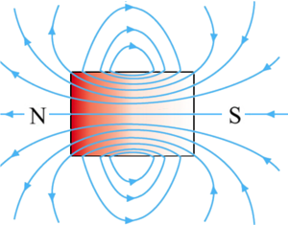
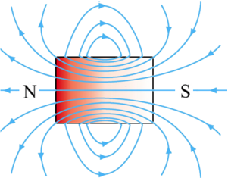
COLLEGE OF ENGINEERING
MAGNETS
Magnets produce a magnetic field, which can interact with other magnets and cause a force

Slide 11
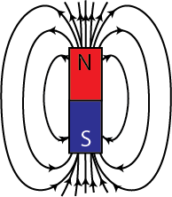
COLLEGE OF ENGINEERING
WE SAY THE MAGNET HAS A FIELD
The field is invisible
But it is real
It can act on magnetic objects
Repel or attract them
http://www2.ece.ohio-state.edu/~anderson/Outreach_speaker.html

Slide 12
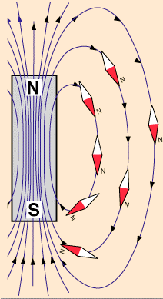
COLLEGE OF ENGINEERING
Example: compass needle
Opposite poles attract
North end of compass needle attracted to south pole of magnet
Why can’t we feel the magnetic field?
We’re not magnetic!
hyperphysics.phy-astr.gsu.edu/.../ elemag.html
http://www2.ece.ohio-state.edu/~anderson/Outreach_speaker.html

Slide 13
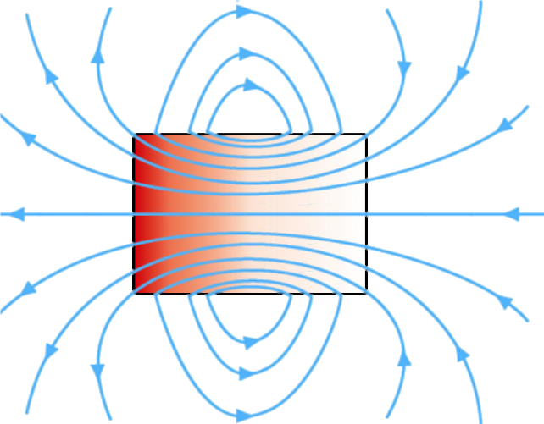
COLLEGE OF ENGINEERING
Let’s Practice
Which side is the N pole?
Which side is the S pole?
Web.mit.eduPhysics 8.02
Module Guide 09
http://www2.ece.ohio-state.edu/~anderson/Outreach_speaker.html

Slide 14
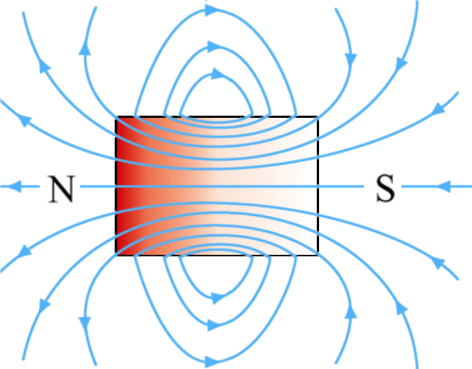
COLLEGE OF ENGINEERING
Let’s Practice
Solution:
Arrows point out of the North pole and into the south pole.
Web.mit.edu/
Physics 8.02
Module Guide 09
http://www2.ece.ohio-state.edu/~anderson/Outreach_speaker.html

Slide 15
COLLEGE OF ENGINEERING
Let’s Practice
Will these magnets attract or repel each other?
Web.mit.edu/
Physics 8.02
Module Guide 09
http://www2.ece.ohio-state.edu/~anderson/Outreach_speaker.html

Slide 16
COLLEGE OF ENGINEERING
Opposite poles attract:
Web.mit.edu/
Physics 8.02
Module Guide 09
http://www2.ece.ohio-state.edu/~anderson/Outreach_speaker.html

Slide 17
COLLEGE OF ENGINEERING
CURRENT THROUGH WIRE
Lenz Law:
When a current (I) passes through a wire, it creates a magnetic field (B)
Use right hand rule
http://www.siemon.com/uk/white_papers/images/06-05-01-magnets2.gif
http://www2.ece.ohio-state.edu/~anderson/Outreach_speaker.html

Slide 18
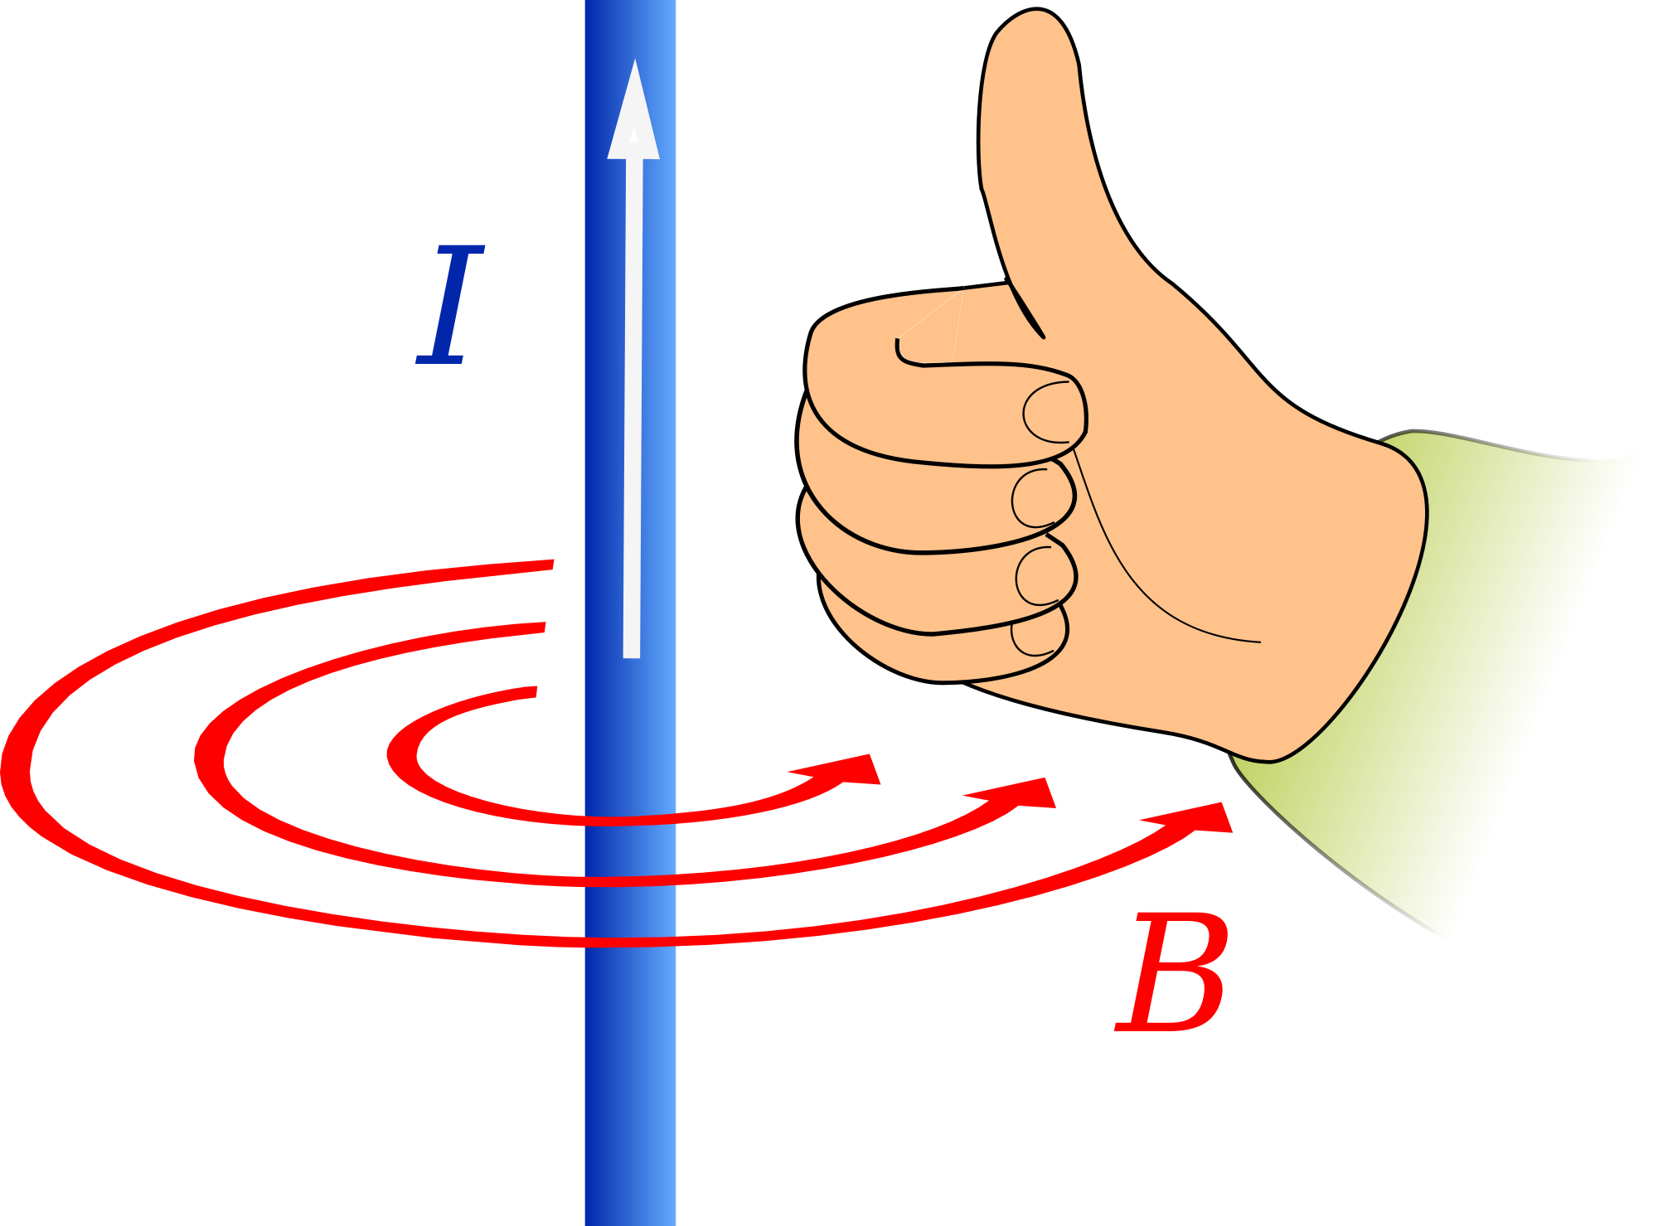
COLLEGE OF ENGINEERING
RIGHT HAND RULE
Point your thumb in the direction of the current (I) and wrap your fingers around the wire.
Your fingers point in the direction of the magnetic field (B)

Slide 19
COLLEGE OF ENGINEERING
Experimental Procedure

Slide 20
COLLEGE OF ENGINEERING
Grab All Of Your Parts
# | Unit | Description
4 or 6 | Each | Rare Earth Neodymium Magnets, 1/2 x 1/8 inch Disc N48
1 | Spool | 6 yard spool of 20 gauge, uninsulated copper wire (5.5m, d=.032" = .812mm)*
1 | Each | AAA battery (preferably Procell Alkaline Batteries from duracell)
1 | Each | Dowel Rod - ¾ inch diameter

Slide 21
COLLEGE OF ENGINEERING
SOLENOID
Grab your dowel rod
Uncoil 3-4 inches of copper wire from the spool
Curl that amount of the wire over the top of the rod and under and towards you, then pull it tight
Hold that part of the wire with your finger

Slide 22
COLLEGE OF ENGINEERING
Curling Wire
Now turn the rod and coil the wire in the same direction
Note: Keep the coil very tight and DO NOT curl the wire on top of another part of your wire
If possible have a partner hold the spool with the wire taut
Does not have to be perfect but DO YOUR BEST for the best results

Slide 23
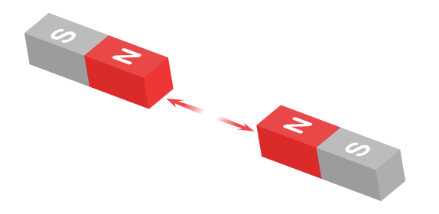
COLLEGE OF ENGINEERING
MAKING YOUR TRAIN
Once you are done coiling the wire, carefully pull the wire from the dowel rod and set it aside
Now it is time to create the train
Divide your magnets into two equal stacks
Test the poles by finding which ends of the two stacks repel each other

Slide 24
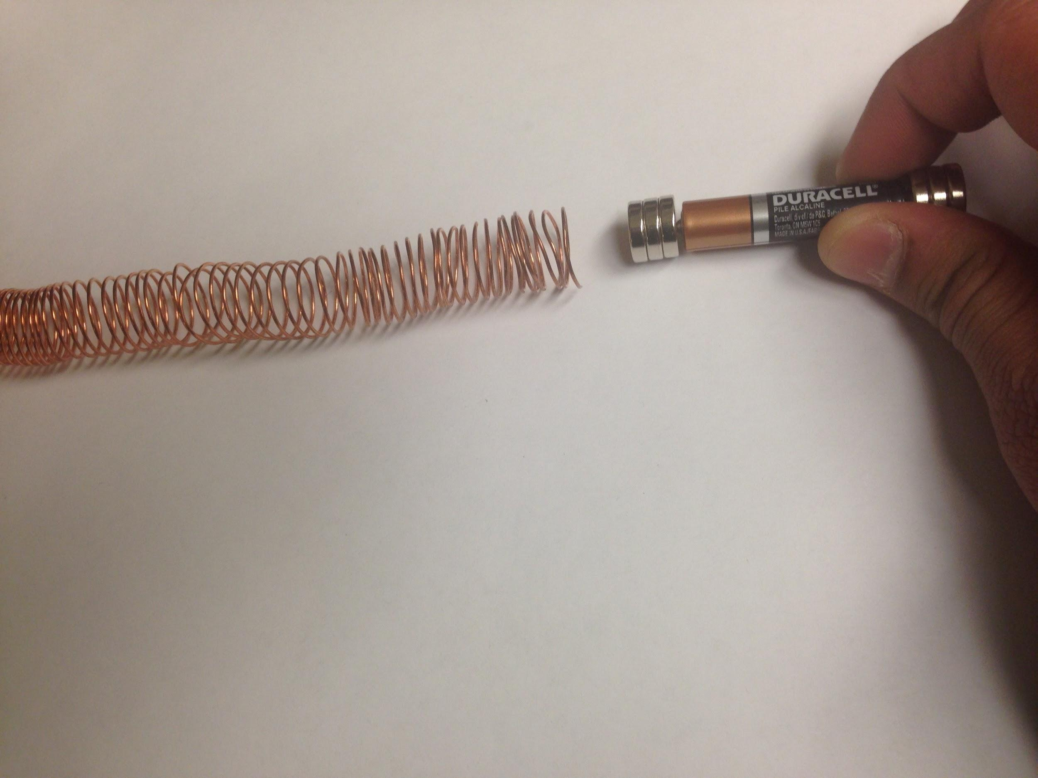
COLLEGE OF ENGINEERING
MAKING YOUR TRAIN
Stick the repelling ends onto each end of the battery like shown
Gently push the “train” into your solenoid
Then watch it shoot out the other end

Slide 25
COLLEGE OF ENGINEERING
TROUBLESHOOTING
If your train refuses to enter the solenoid, then turn your train around and try again
If your train does not move and your wire is shaking, this means the magnets are attracted to each other and you must turn one stack of magnets around and try again

Slide 26
COLLEGE OF ENGINEERING
ADVANCED
You can add multiple solenoid “tracks” together to form one longer “track”:
Ensure that the two solenoids are wound in the same direction (if they are wound in opposite directions, they cannot be combined)
Insert a dowel rod through each solenoid and push them together
Gently use scotch tape to connect the two ends together, being careful not to deform the smooth, circular shape of the solenoids (or else the train will snag)
Remove the dowel rod

