Slide 1
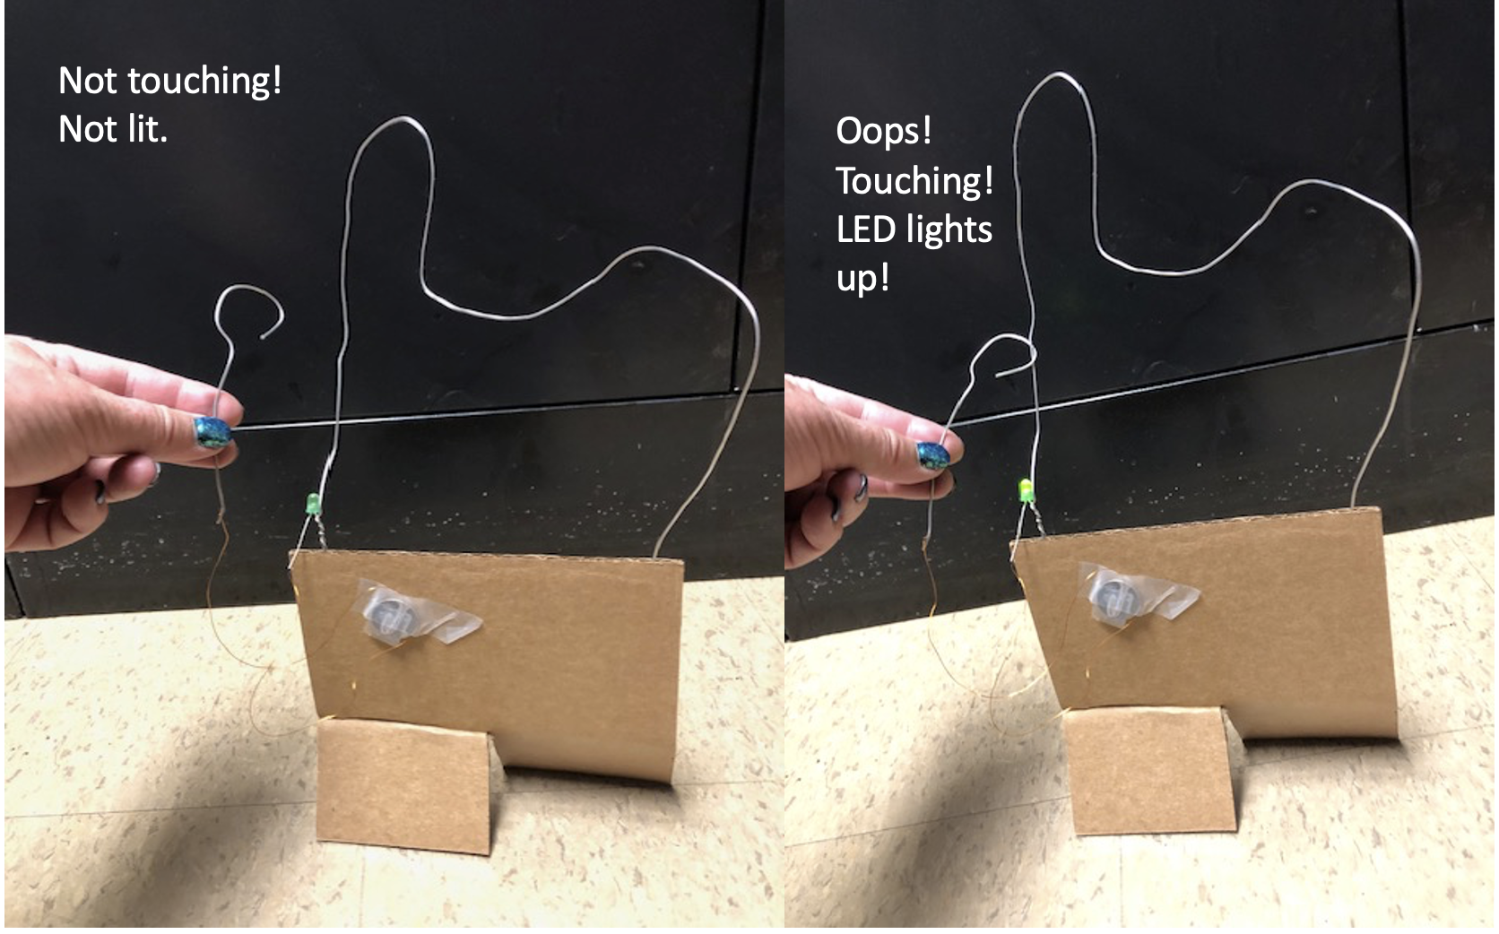
Circuit Game

Slide 2
How does it work?
When electricity flows through an LED (light-emitting diode), the LED lights up
We need a battery, an LEDs, some wire, and some know-how!

Slide 3
Need to learn some things
How to read an electrical schematic
What parts we’re using
How to build the game

Slide 4
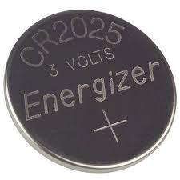
Reading Schematics:
What’s this?
Battery

Slide 5
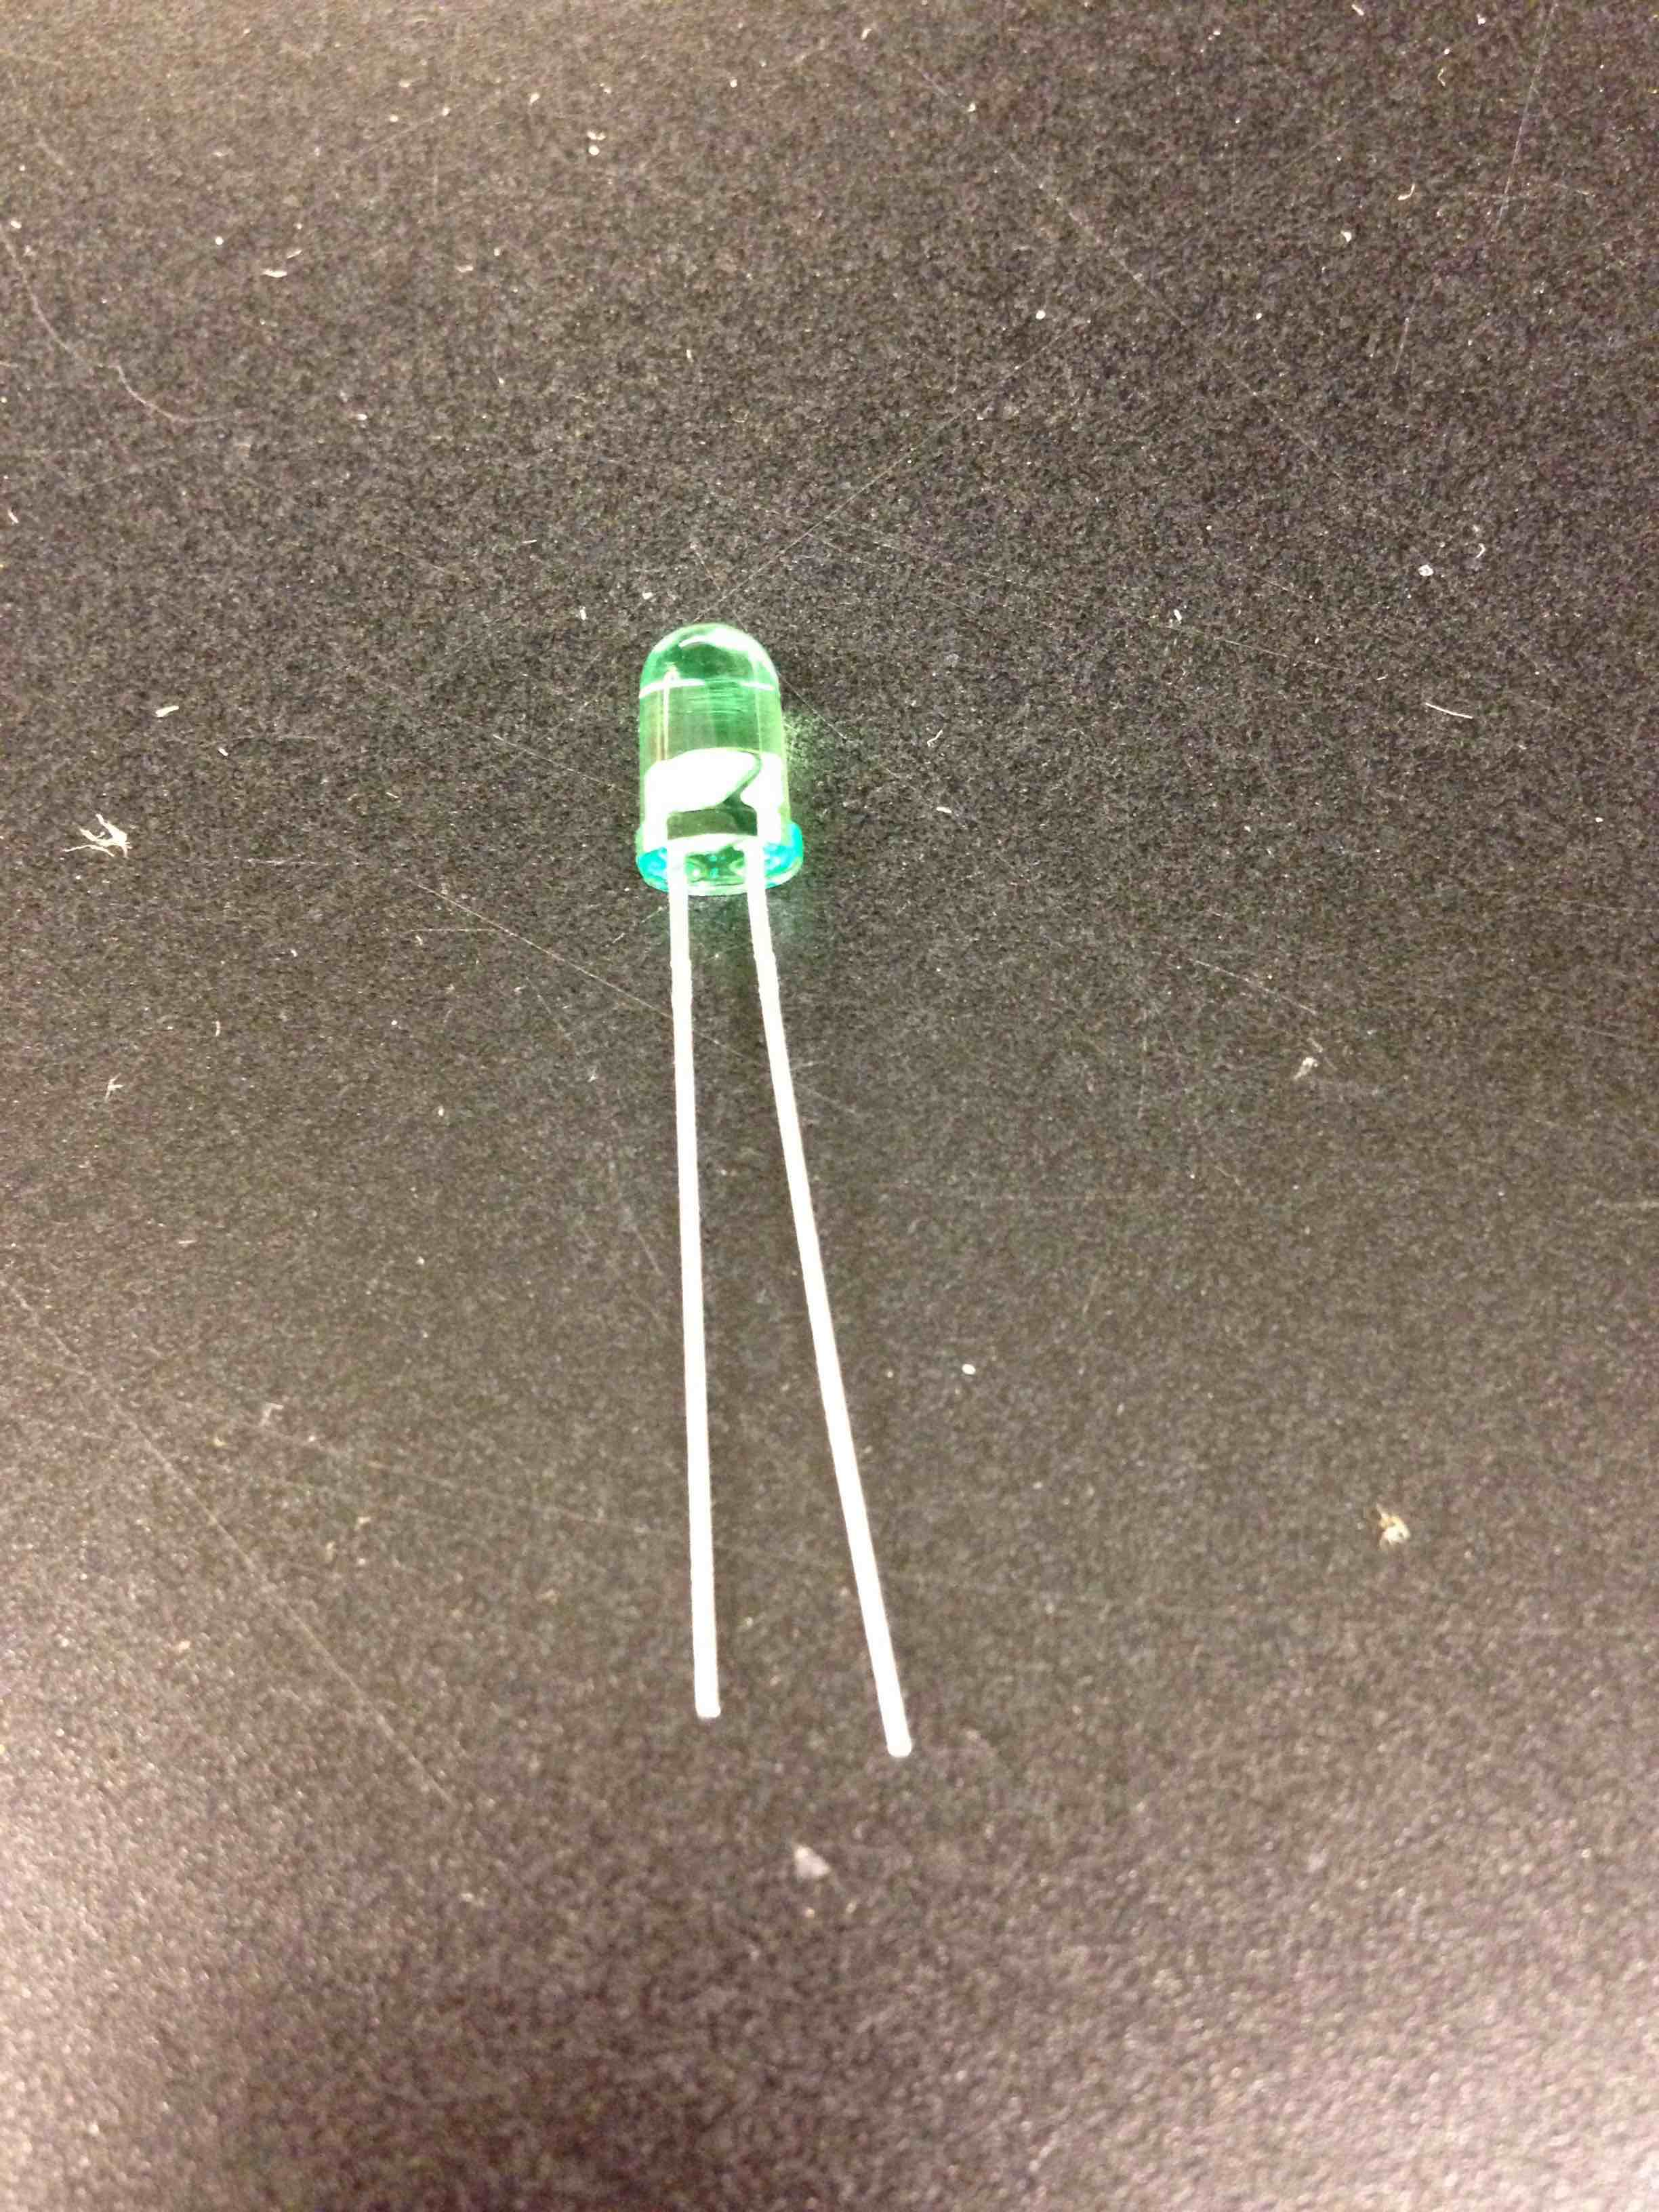
What’s this?
Diode
Lets current flow one direction but not the other
YES
X
NO

Slide 6
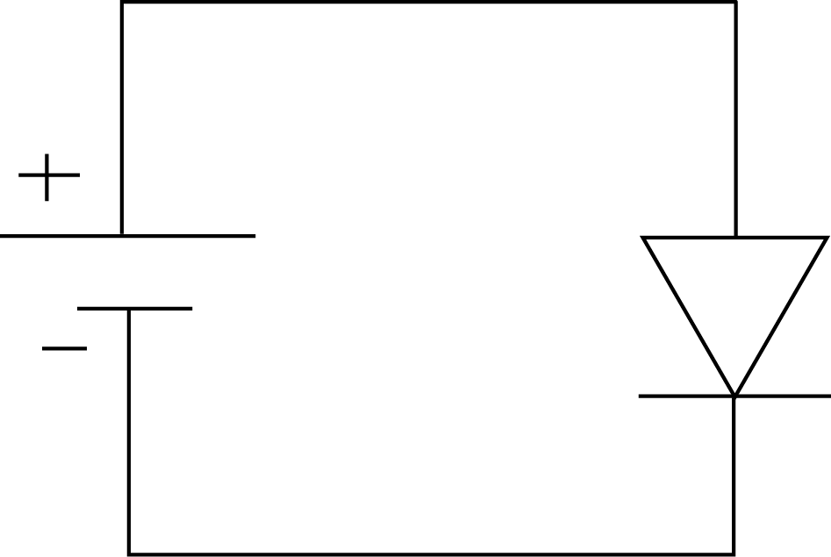
Will current flow?

Slide 7
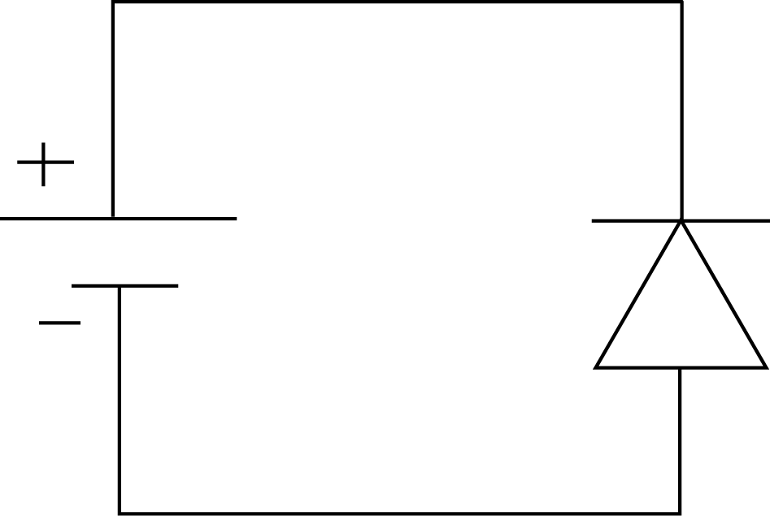
How about here?

Slide 8
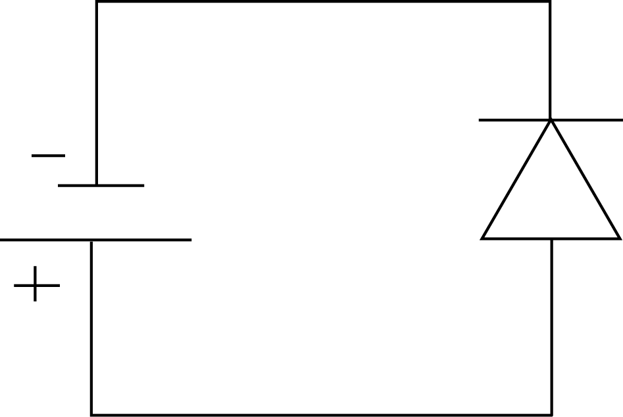
How about this one?

Slide 9
Electrical circuit
Must have a closed path all the way from one terminal of the battery to the other

Slide 10
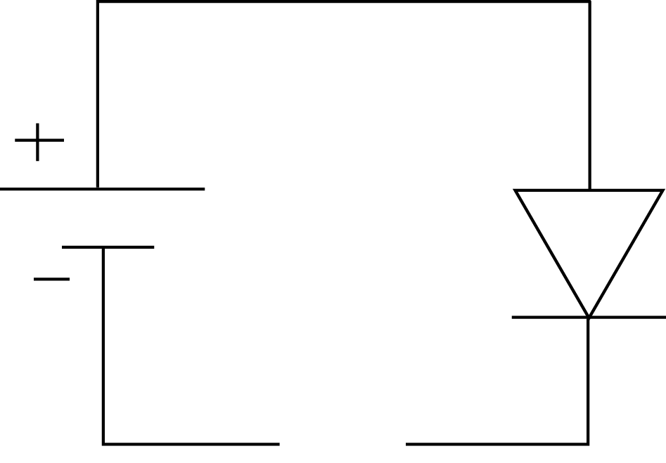
Will current flow?

Slide 11
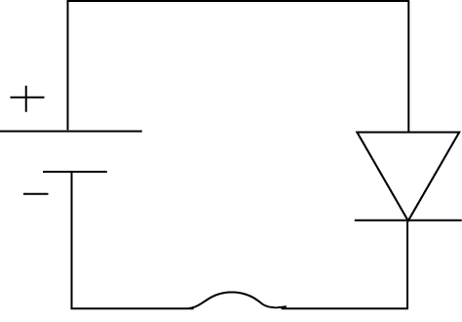
How about now?

Slide 12
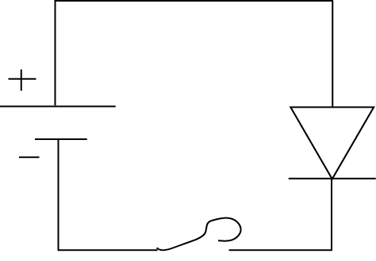
Now?

Slide 13
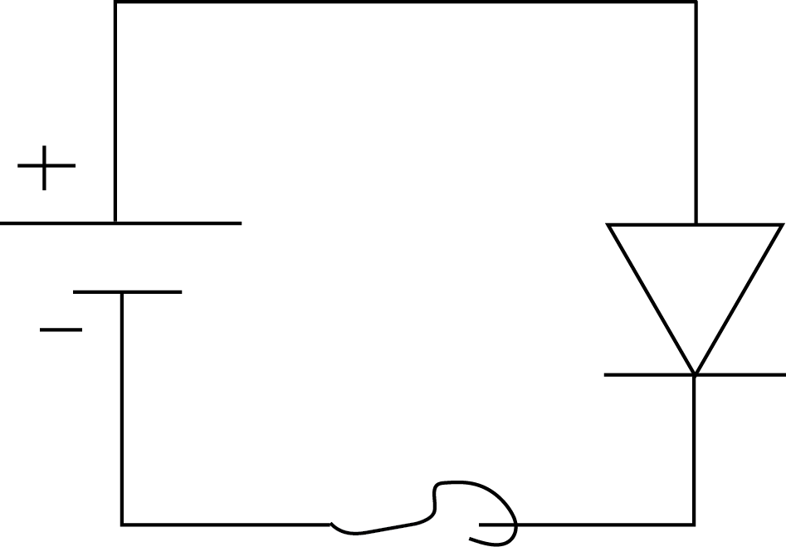
Will it light up?

Slide 14
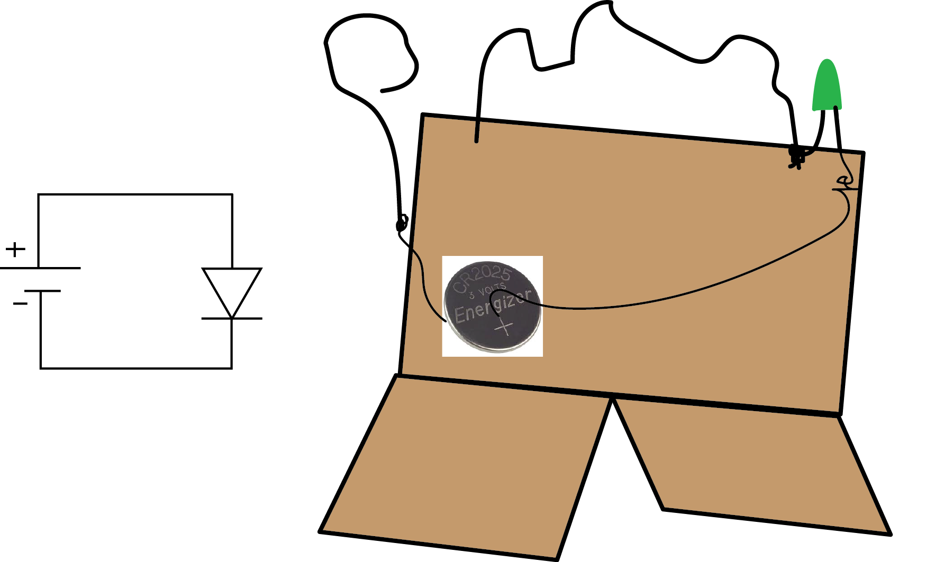
Schematic versus real life
long lead
is anode
anode
cathode
cathode

Slide 15
Here’s our battery
Called a coin or button battery
This one is only 3 V
Hey, we don’t need a resistor then!
Notice the top is positive- that should connect to the anode (long lead)

Slide 16
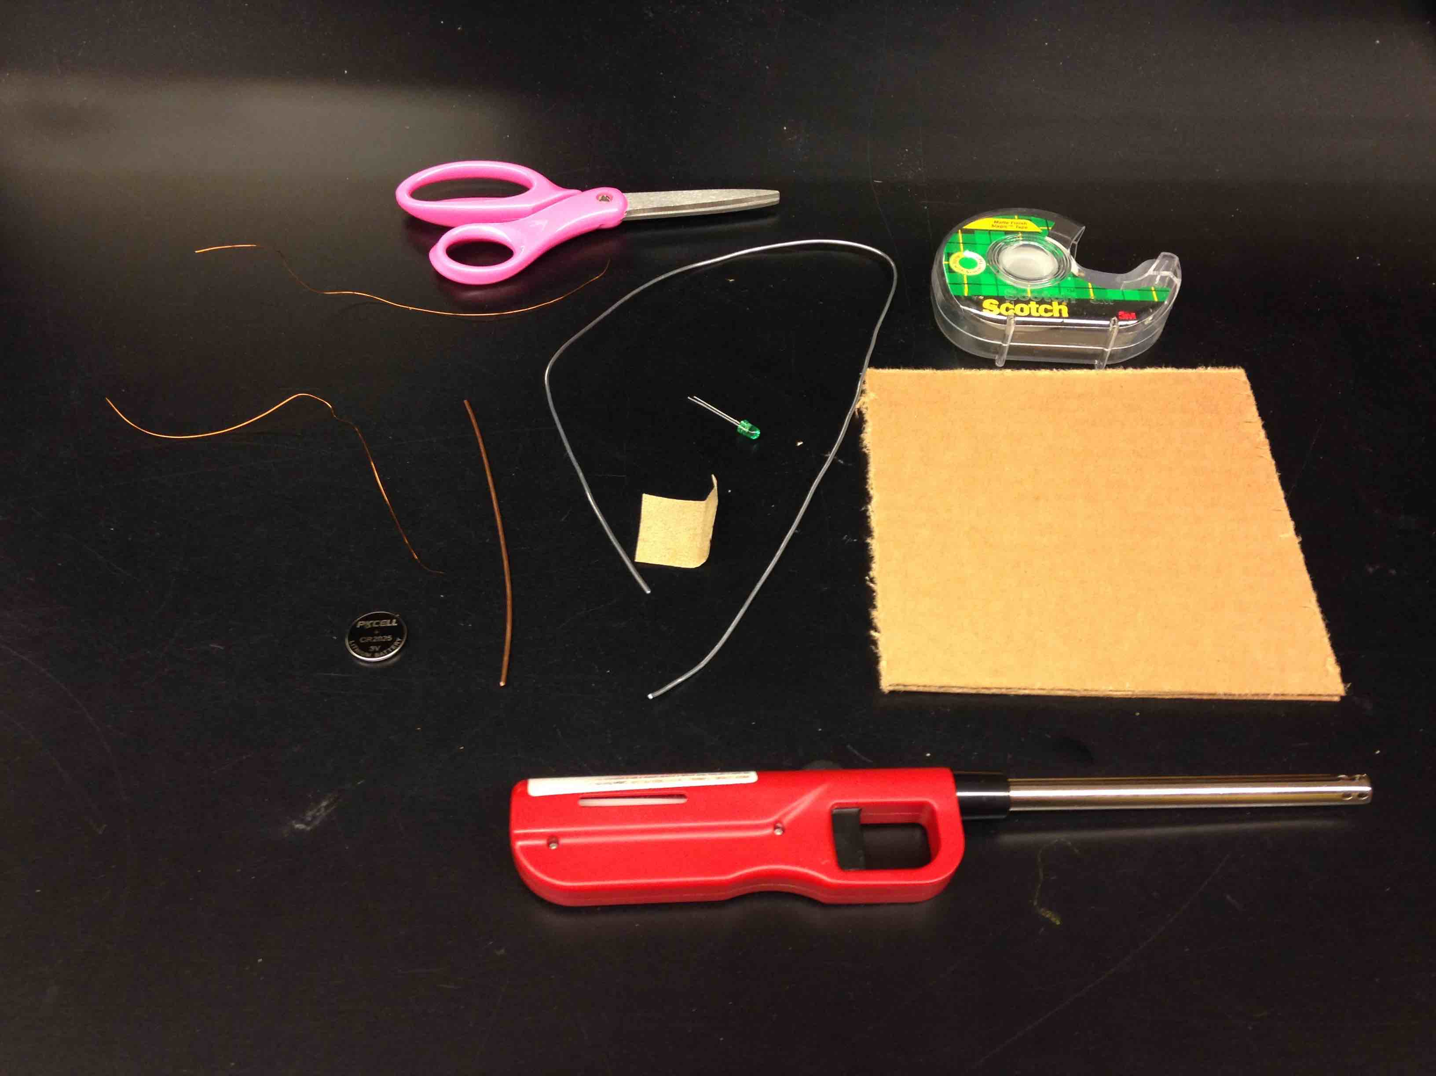
Are you ready to build?
Cardboard
2’ piece of stiff wire
6” piece of stiff wire
2 8” pieces of magnet wire
LED
Tape, scissors, sandpaper, flames

Slide 17
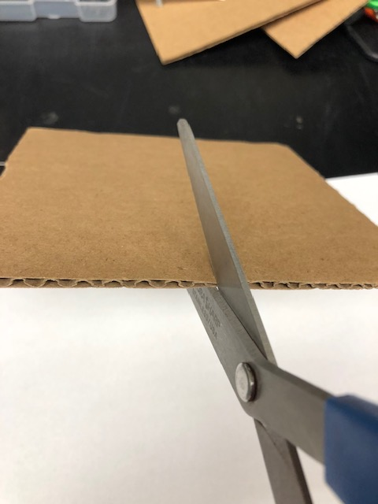
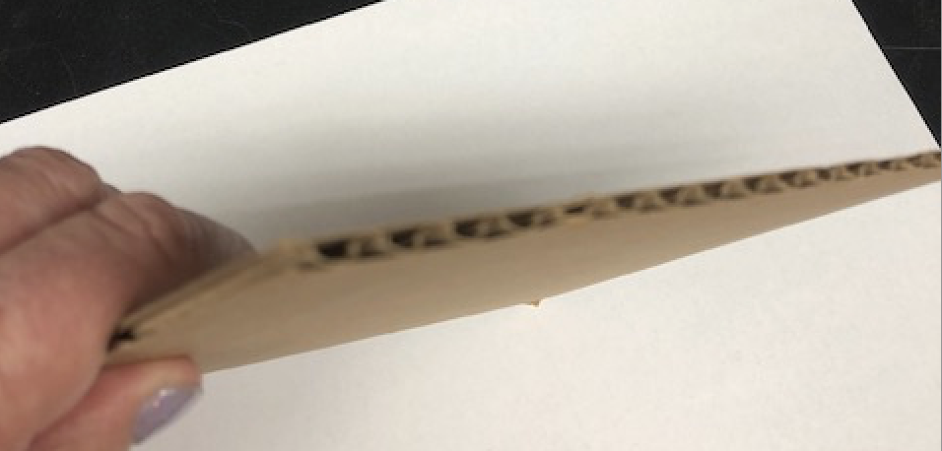
Cut cardboard
See the holes? Cut that edge

Slide 18
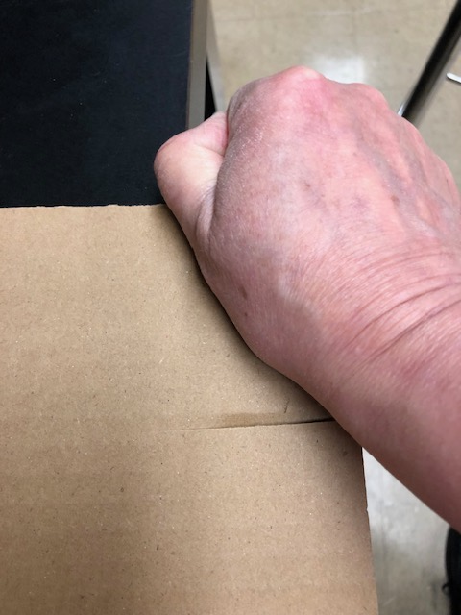
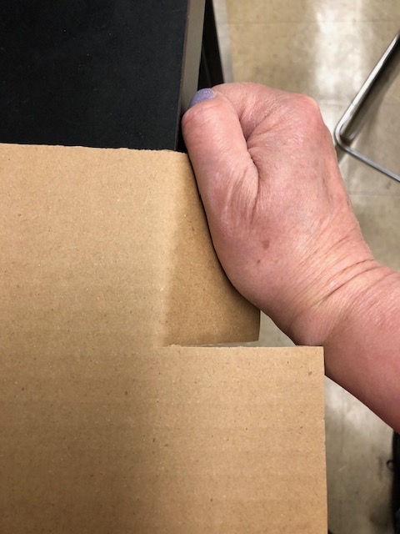
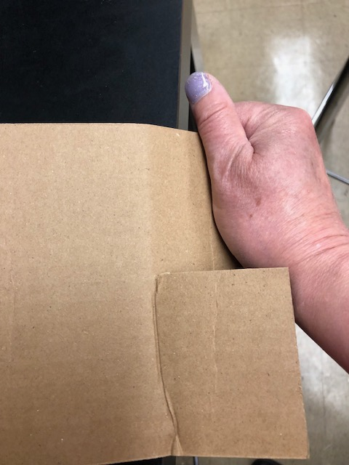
Only part way!
Use the edge of the table to help you bend the feet

Slide 19
Got two pieces of magnet wire?
Burn about 1” of the insulation off each end
Do this both ends, both wires

Slide 20
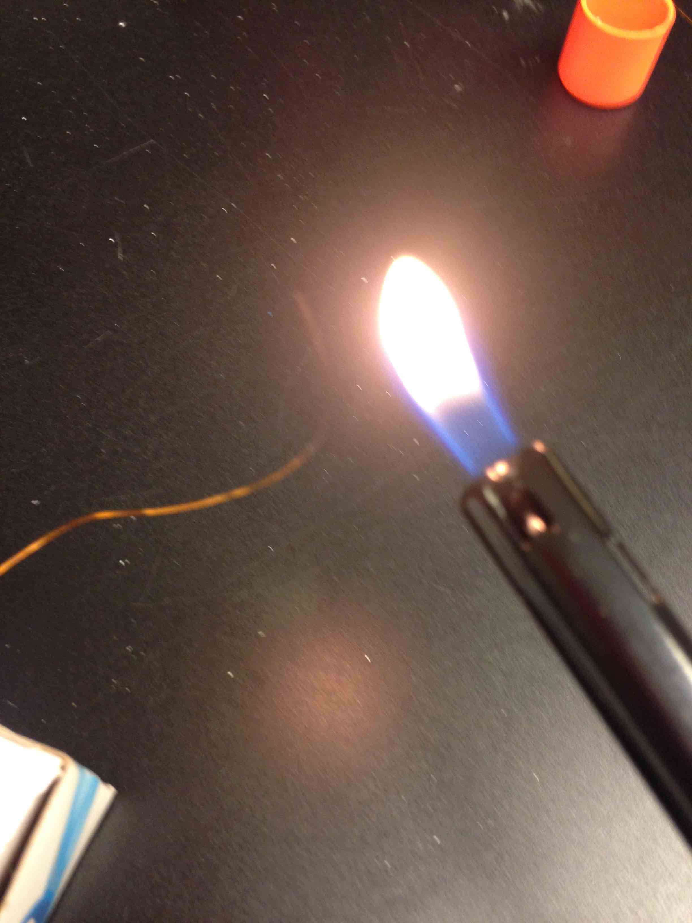
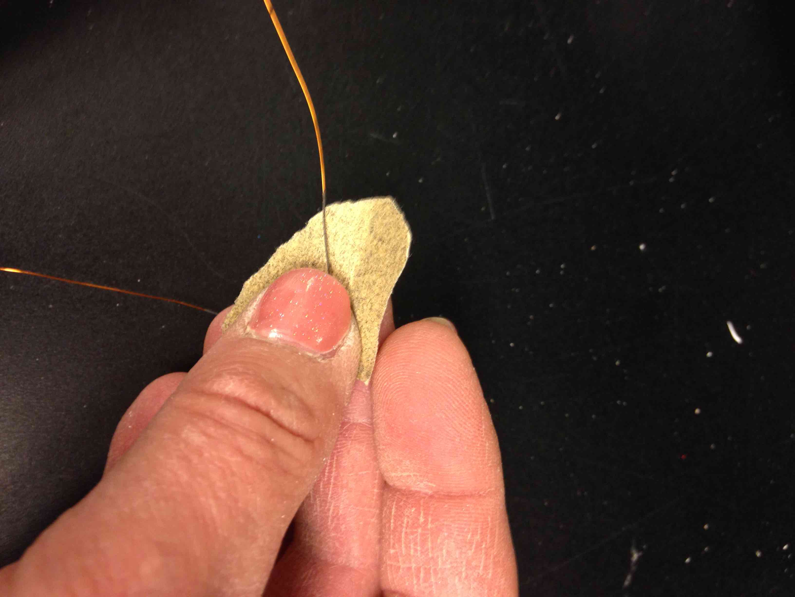
Burn insulation off the ends
Then sand off the black stuff

Slide 21
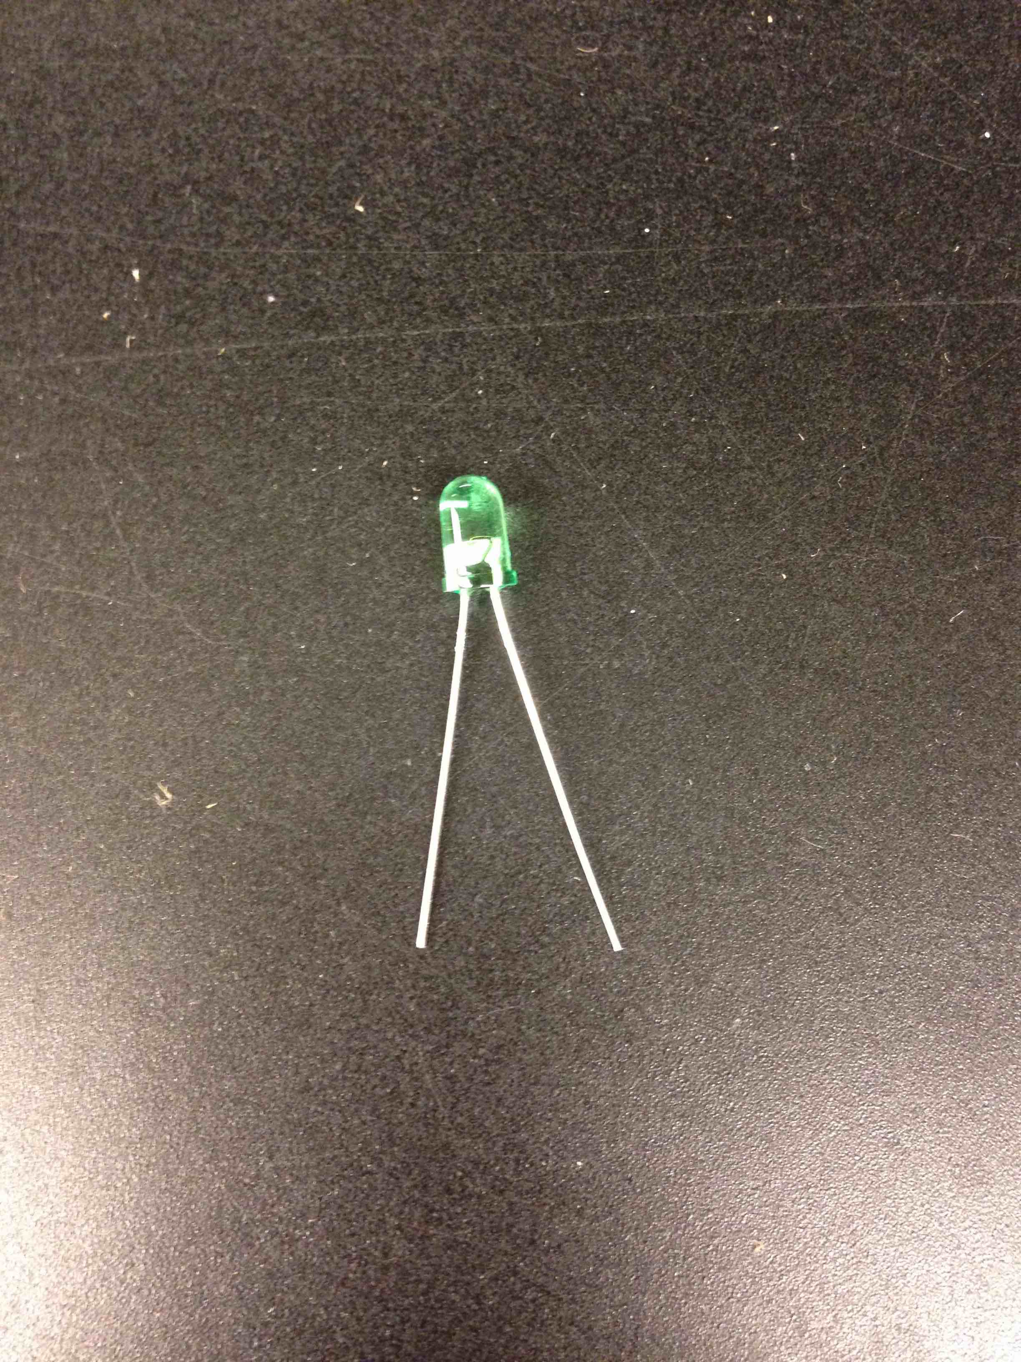
Here is the LED
One leg is shorter
Keep track!
Bend legs a little

Slide 22
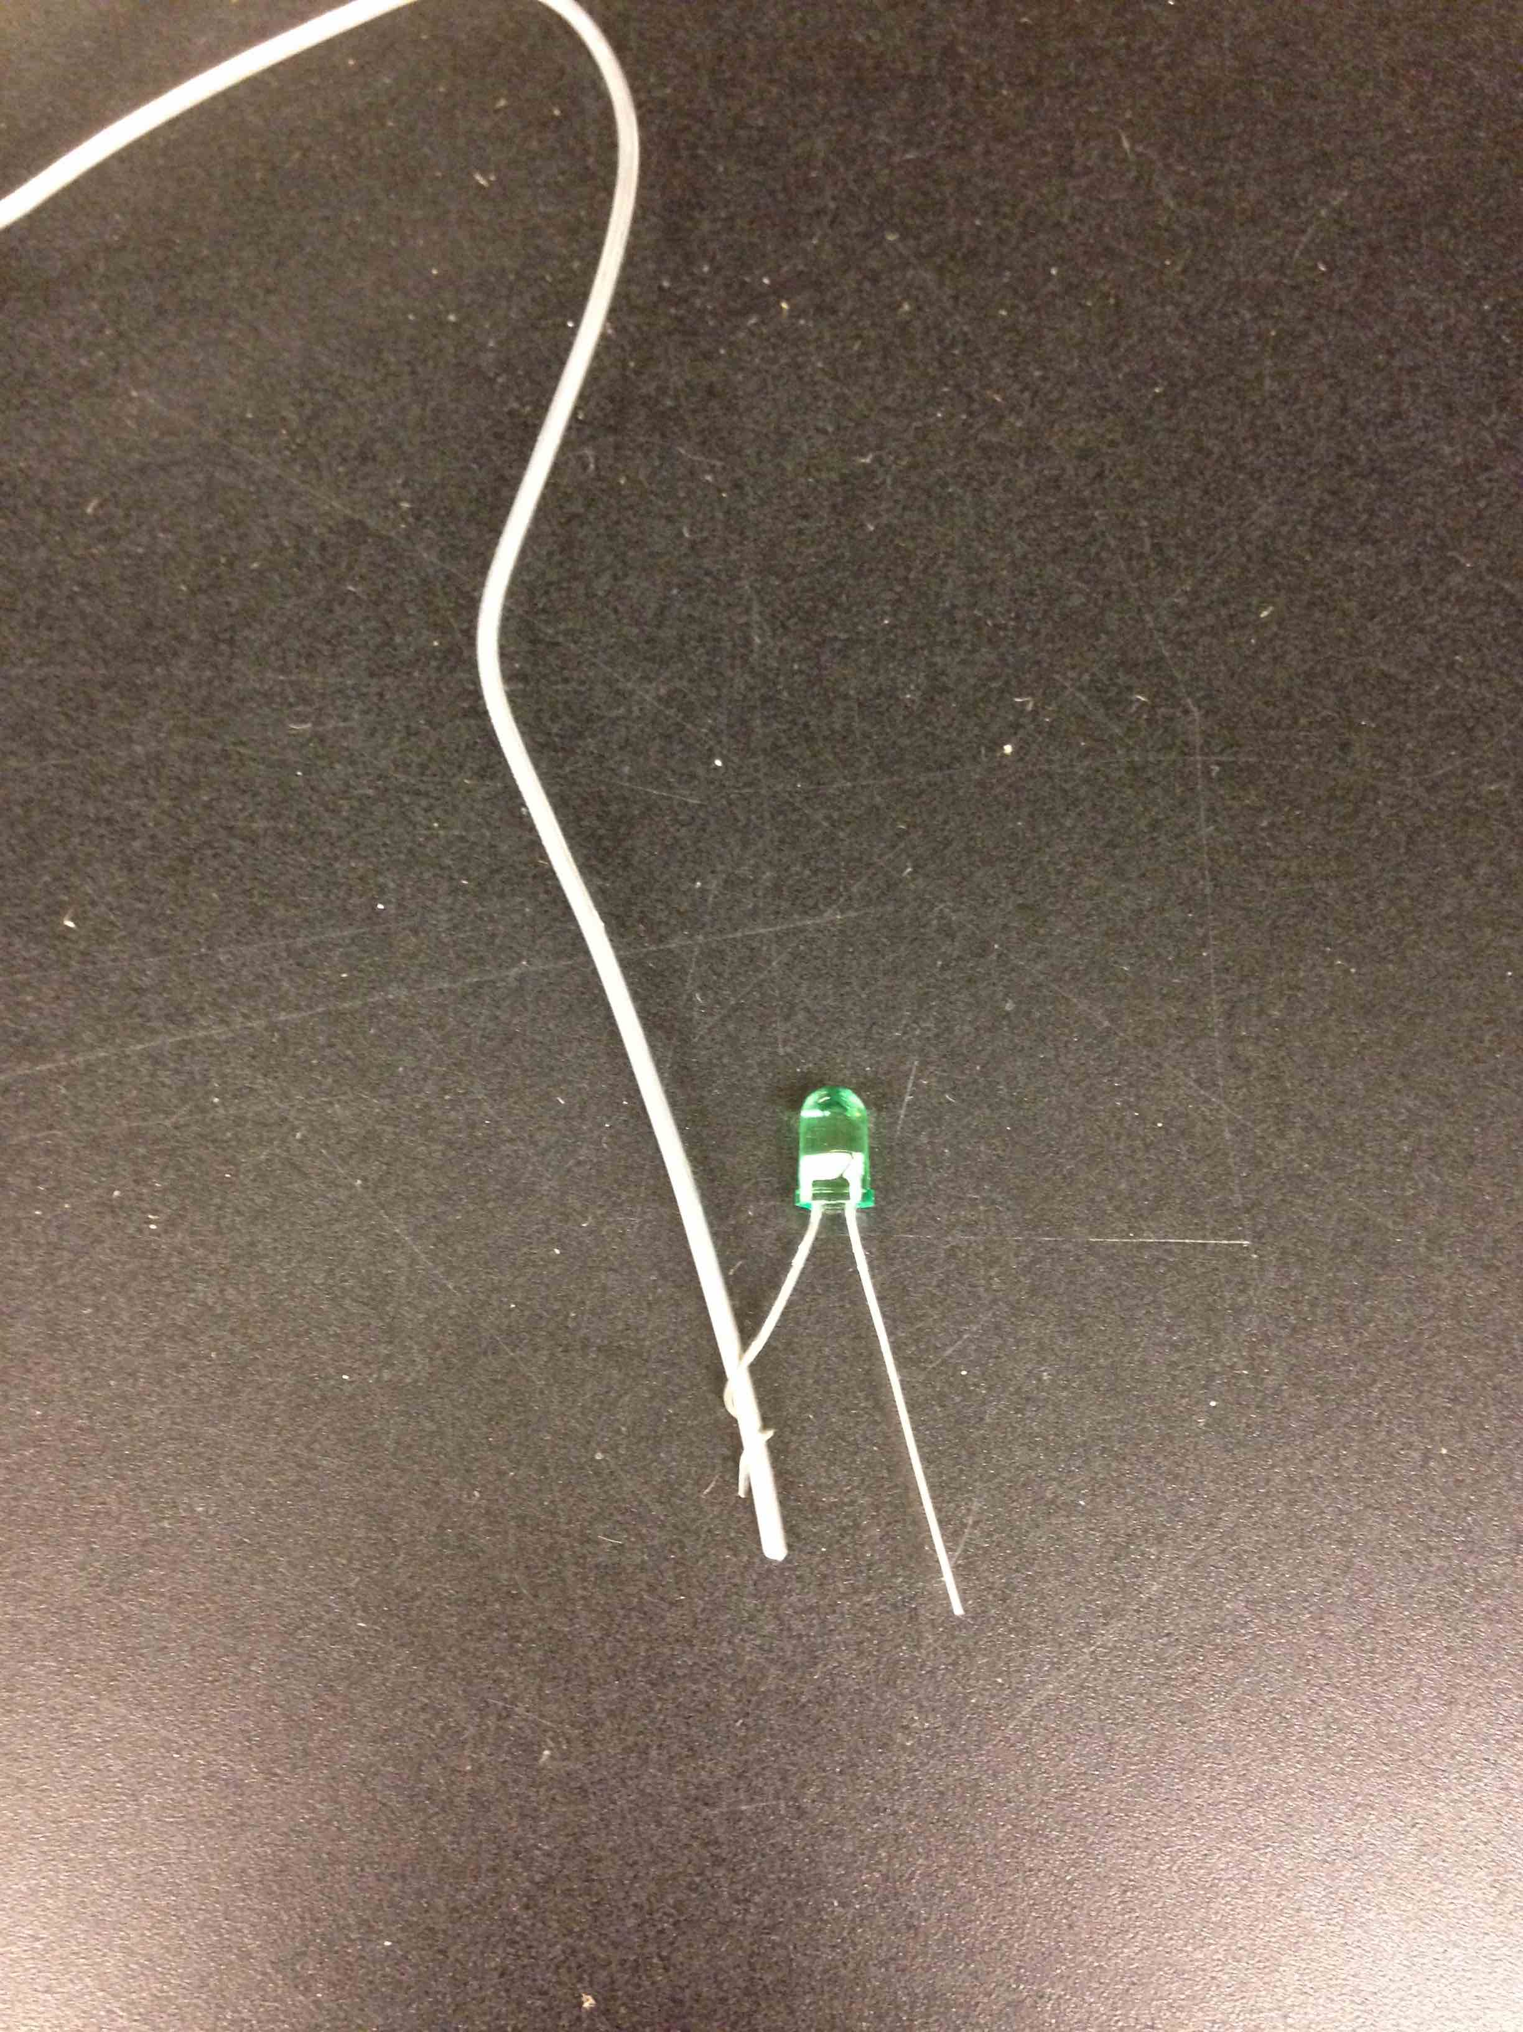
Wrap the SHORT LED wire around the puzzle wire
Wrap it tight!

Slide 23
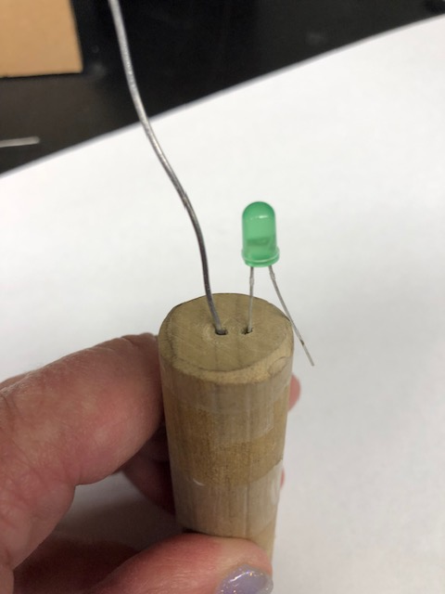
If you have a twisty tool…
Put SHORT LED lead in one hole
Put one end of long wire in the other hole

Slide 24
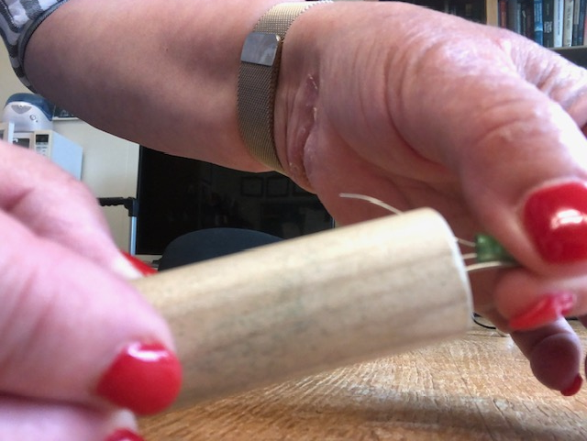
Pinch, push and twist!
PINCH THESE TOGETHER and hold them tight
TWIST while pushing until the tool comes off

Slide 25
Or you can use pliers
Make sure their twisted tightly!

Slide 26
Find one of the thin wires Make a small loop in one end
tape it to the side of the battery with the writing on it
Has to be the burned part
Don’t let it cross itself

Slide 27
Twist other end around other LED leg (the long one!)

Slide 28
Engineers test at every step!
Close the loop!
Touch the big wire to the other side of the battery
The LED should light up

Slide 29
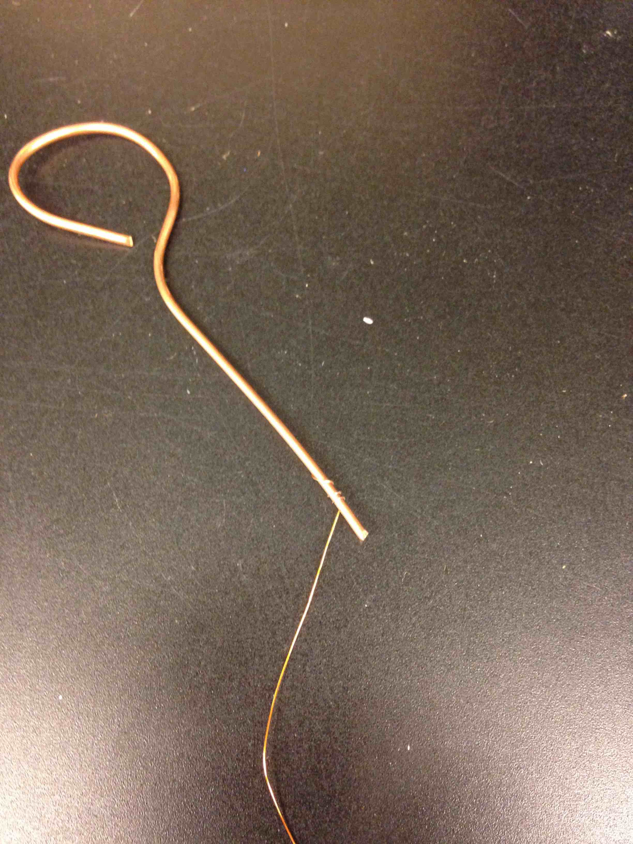
Bend the short wire into a wand
Wrap one end of the other skinny wire to handle
Make a big loop
Leave an opening!

Slide 30
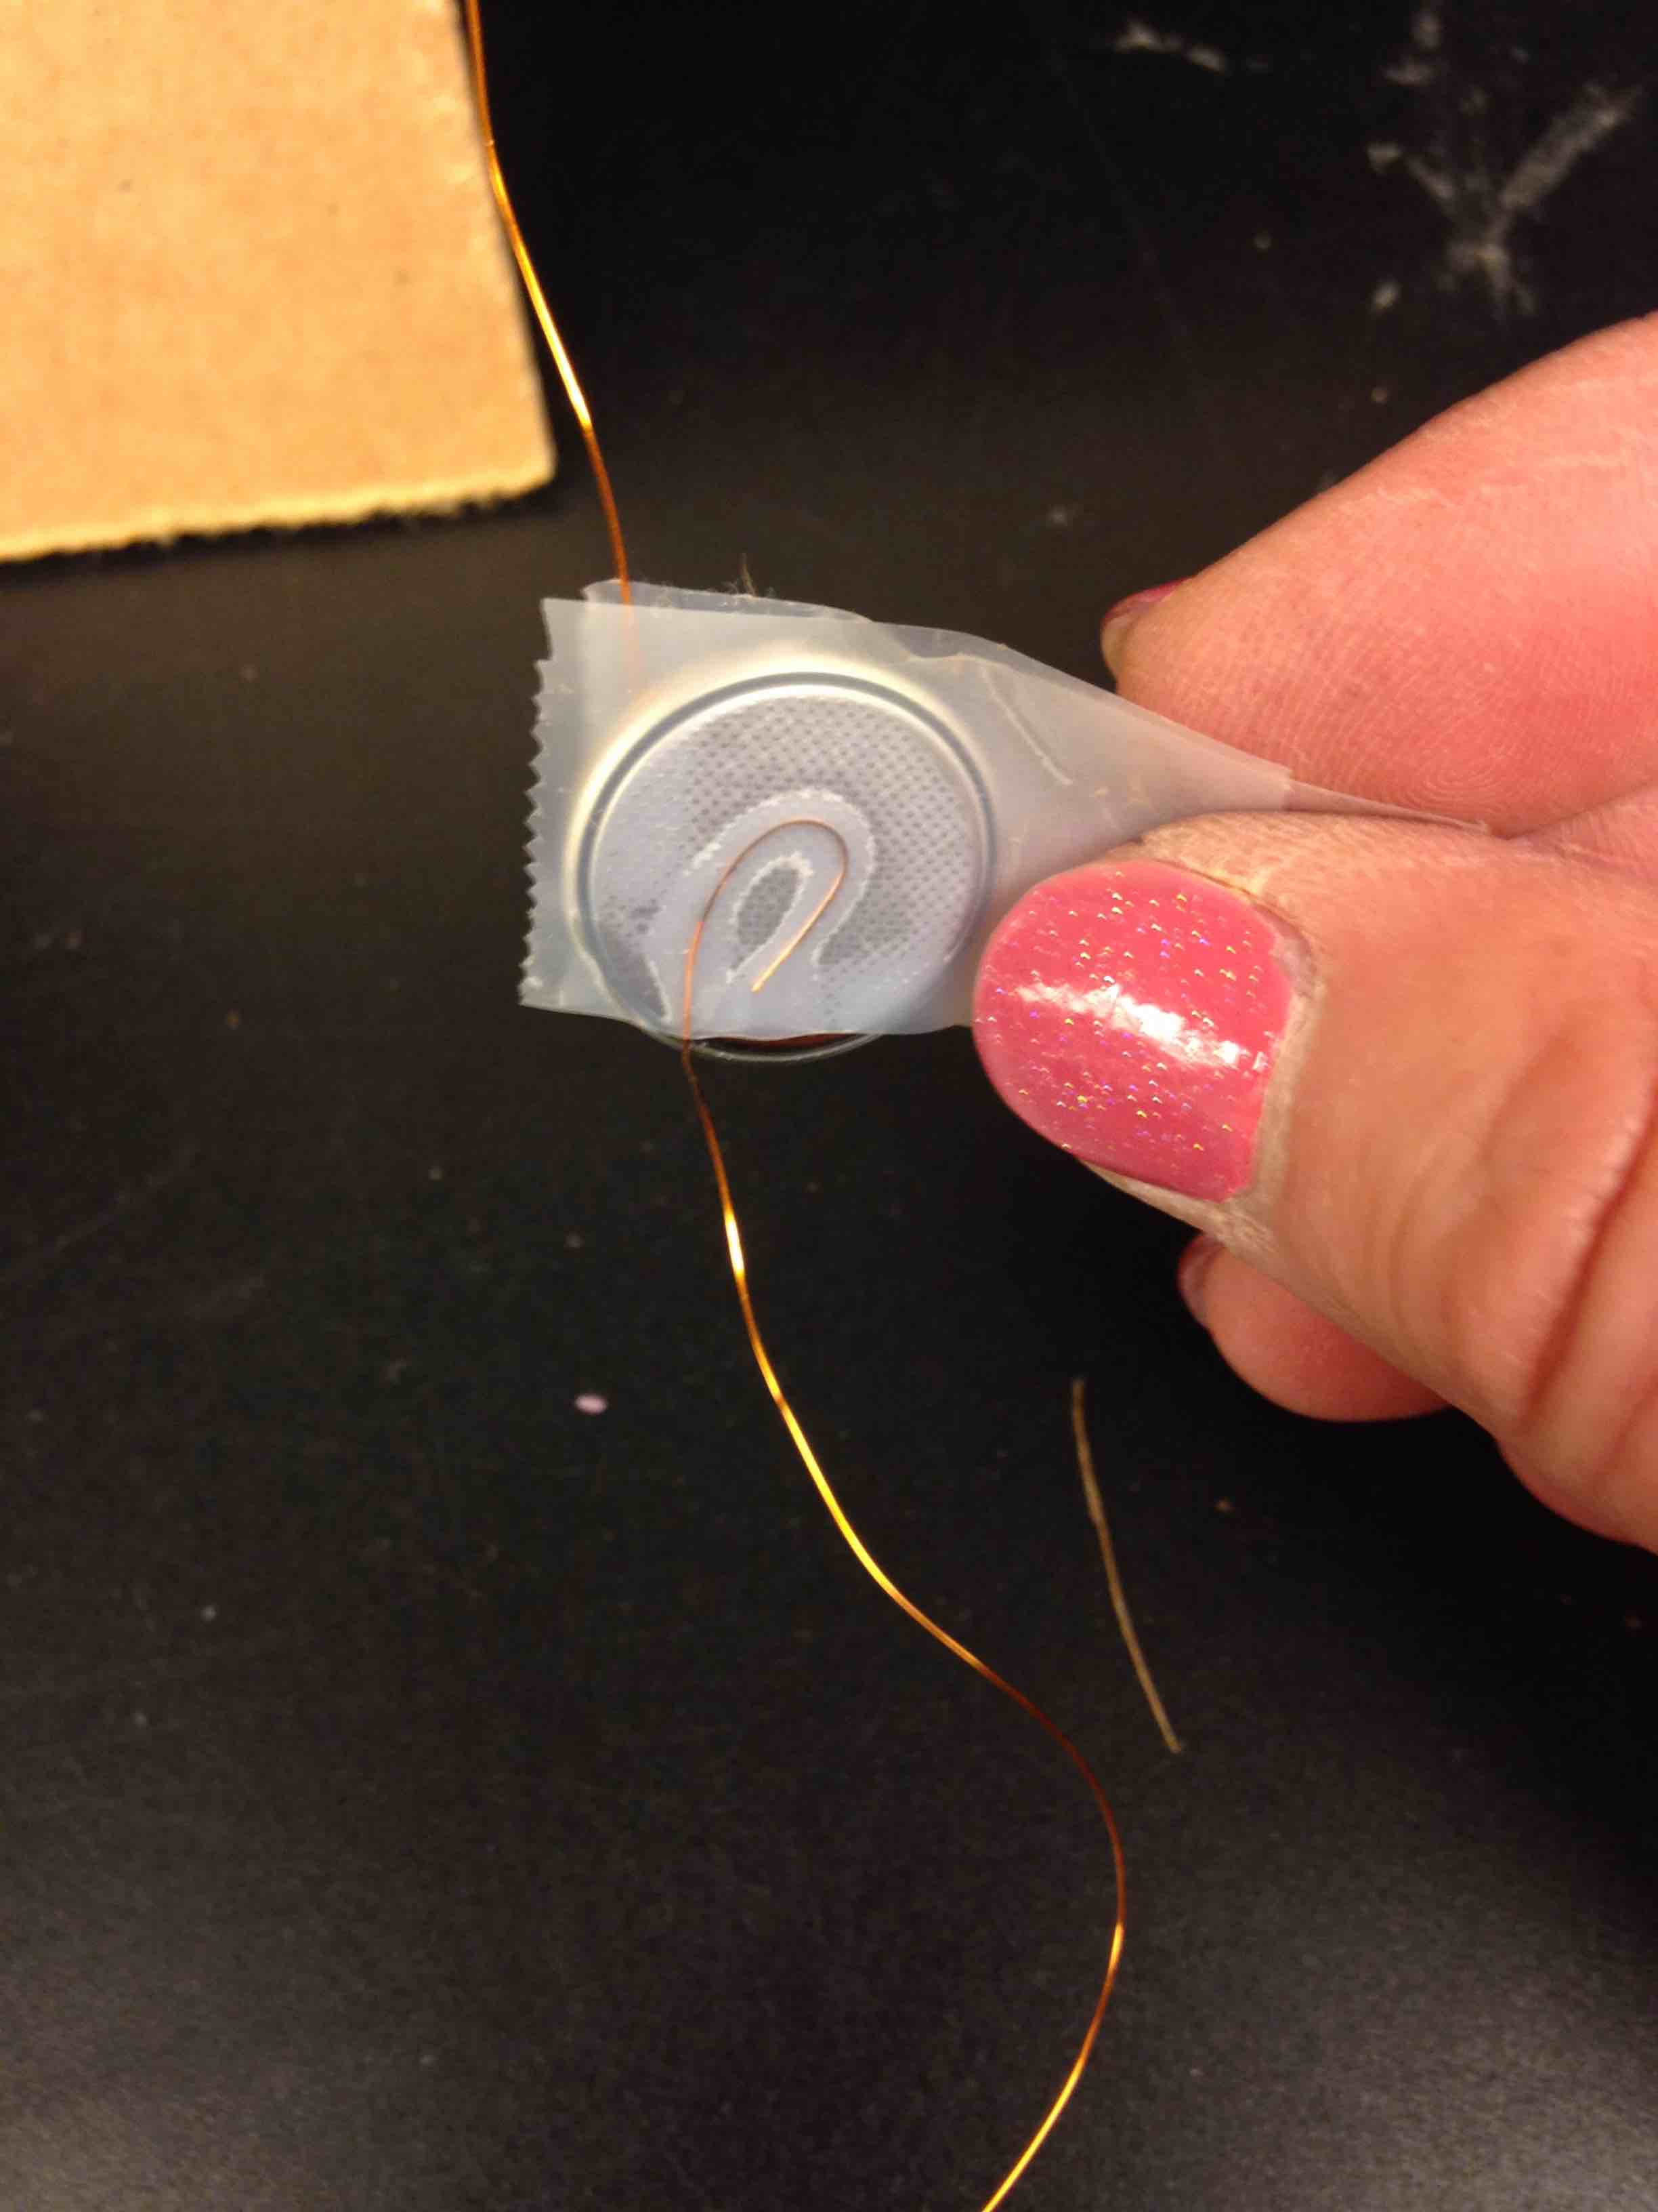
Make a loop in the other end
Tape loop to other side of battery (no writing)

Slide 31
Test again!
Close the loop!

Slide 32
Stick the puzzle wire and LED in the edge of the carboard

Slide 33
Tape battery to cardboard
You’re ready to play!

Slide 34
How does it work?
long lead
is anode
anode
cathode
cathode

