Slide 1
Build a CD Spectrometer
Prof. Betty Lise Anderson
Department of Electrical and Computer Engineering

Slide 2
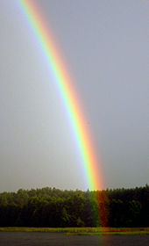
What’s a spectrometer?
An instrument that measures a spectrum
Spectrum: all the colors that make up light
Can include ultraviolet and infrared

Slide 3
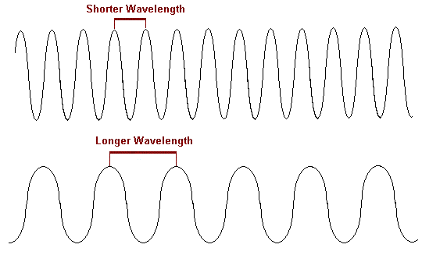
Light is a wave
Something (electric field) is changing in a periodic manner
The distance between two crests is a wavelength

Slide 4
Sound is a wave
Something (air pressure) is changing in a periodic manner
The distance between two crests is a wavelength

Slide 5
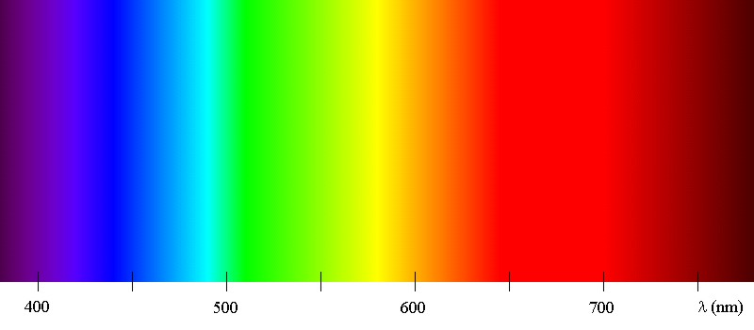
The wavelength relates to the color
400
500
600
700
Wavelengths measured in nanometers
http://www.chm.davidson.edu/vce/coordchem/color.html

Slide 6
Which color has the longest wavelength?
400
500
600
700
http://www.chm.davidson.edu/vce/coordchem/color.html
http://www.chm.davidson.edu/vce/coordchem/color.html

Slide 7
What is the wavelength of infrared?
400
500
600
700
Take an educated guess
http://www.chm.davidson.edu/vce/coordchem/color.html

Slide 8
The wavelength relates to the color
400
500
600
700
Wavelengths measured in nanometers
http://www.chm.davidson.edu/vce/coordchem/color.html

Slide 9
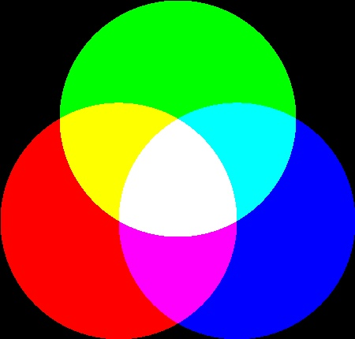
How do colors mix?
White light contains lots of wavelengths
http://www.chm.davidson.edu/vce/coordchem/color.html

Slide 10
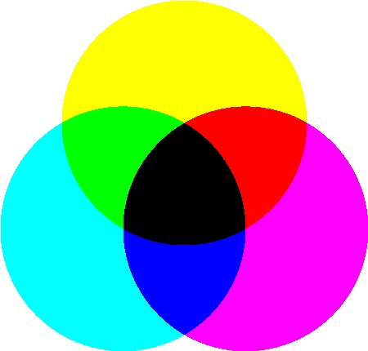
Light works differently than paint or ink
White light contains lots of wavelengths
Light: start with black, add colors to make white
Light: start with white, add colors to make black
http://www.chm.davidson.edu/vce/coordchem/color.html

Slide 11
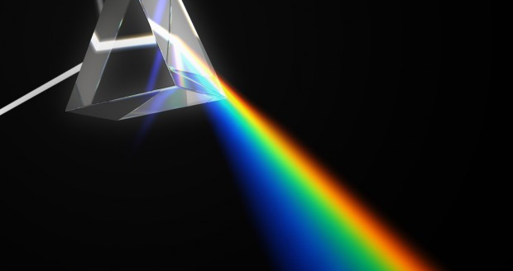
A prism separates the light into colors
http://www.salon.com/2013/06/15/prism_software_is_technically_the_same_as_tailored_facebook_ads_partner/

Slide 12
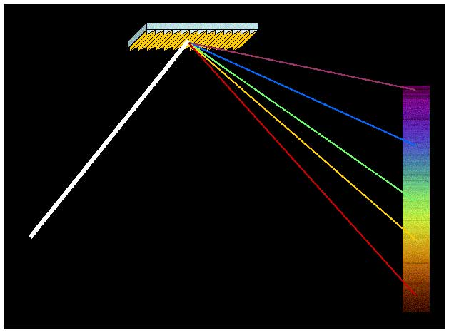
A grating also separates light
Grating: a periodic structure
http://www.thunderbolts.info/wp/2012/03/30/essential-guide-to-the-eu-chapter-11/diffraction-grating-spectrograph-nasa-jpl/

Slide 13
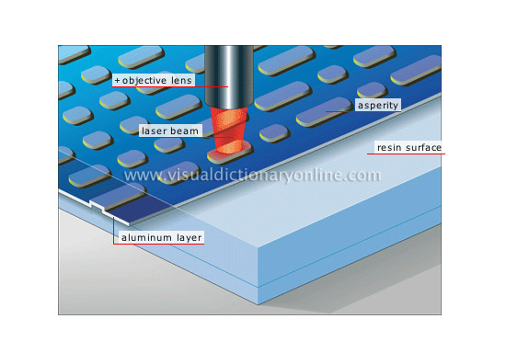
A CD can act like a grating
Periodic structure!
http://visual.merriam-webster.com/communications/communications/sound-reproducing-system/compact-disc-reading.php
http://www.123rf.com/photo_13124567_vector-compact-disc--blend-and-gradient-only.html

Slide 14
We will make a spectrometer
We will use the CD as a grating
We will split light into its different wavelengths
We will compare the spectra of different light sources

Slide 15
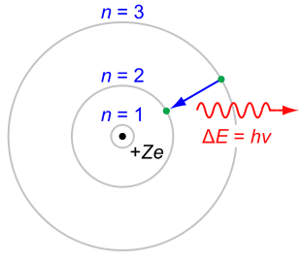
What creates light?
Electrons!
Electrons in atoms
When they get extra energy, they move from one orbit to another
When they relax to lower energy, they release the extra energy as light
http://en.wikipedia.org/wiki/Bohr_model

Slide 16
The wavelengths depend on the atom
By looking at the spectrum of wavelengths, we can tell what kind of atoms are in the source
Molecules can also emit (or absorb!) light
http://en.wikipedia.org/wiki/Bohr_model

Slide 17
The sun contains just about every kind of atom
So, we expect sunlight to contain lots of colors
A fluorescent light bulb contains phosphors (chemicals that glow when they are excited)
The phosphors determine the color

Slide 18
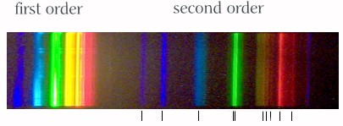
Compare fluorescent light to sunlight
Spectrum of fluorescent light
Spectrum of sunlight
What’s different?
http://www.euhou.net/index.php/exercises-mainmenu-13/classroom-experiments-and-activities-mainmenu-186/179-observations-of-various-spectra-with-a-home-made-spectroscope
http://www.bealecorner.org/best/measure/cf-spectrum/

Slide 19
Compare fluorescent light to sunlight
Spectrum of fluorescent light
http://www.euhou.net/index.php/exercises-mainmenu-13/classroom-experiments-and-activities-mainmenu-186/179-observations-of-various-spectra-with-a-home-made-spectroscope
http://www.bealecorner.org/best/measure/cf-spectrum/

Slide 20
What is going on?
There are several phosphors, of different colors
When the colors are combined, the light looks white
http://www.chm.davidson.edu/vce/coordchem/color.html

Slide 21
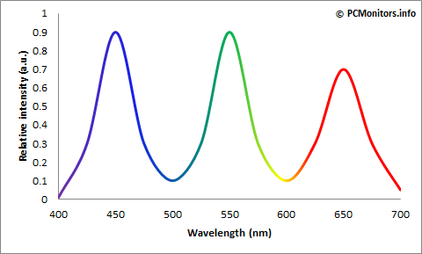
What about a computer monitor?
Has three colors in each pixel
Can make any color from these
https://pcmonitors.info/articles/the-evolution-of-led-backlights/

Slide 22
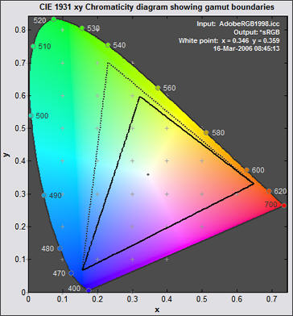
Any color? Really?
No
Depends on what R,G, B’s you have available

Slide 23
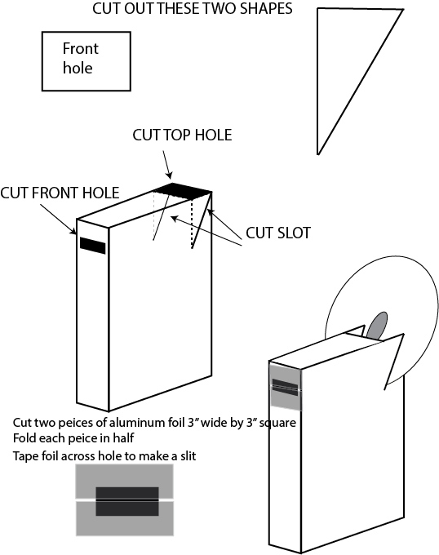
OK, let’s build!
Cereal box
CD
Aluminum foil
Scissors
Tape
Template
Brain

Slide 24
First, cut out these two shapes
These will be templates

Slide 25
Use triangle to mark slot
Put short end of triangle in corner of box
Pointy end should be away from edge of box
Trace this line with a pencil

Slide 26
Use triangle to mark slot
Repeat on other side

Slide 27
Cut the slots with scissors
Put short end of triangle in corner of box
Pointy end should be away from edge of box
Trace this line with a pencil

Slide 28
Cut a viewing hole
It doesn’t have to be super precise

Slide 29
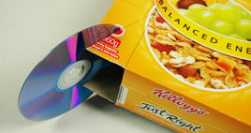
This is what you’re going for
http://www.questacon.edu.au/outreach/programs/science-circus/activities/cd-spectrometer

Slide 30
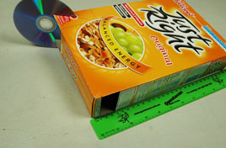
Using rectangular template
Cut the front slot near the top of the box
http://www.questacon.edu.au/outreach/programs/science-circus/activities/cd-spectrometer

Slide 31
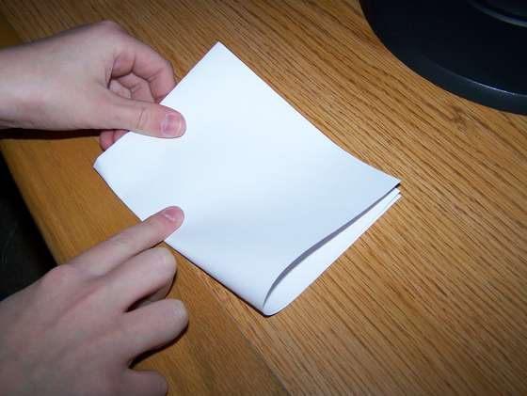
Now cut two squares of aluminum foil
Make them about 3” square
Fold them in half in as straight a fold as you can manage

Slide 32
Tape them across front hole
Make sure there’s a slot between them
The narrower the slot the better- but not touching

Slide 33
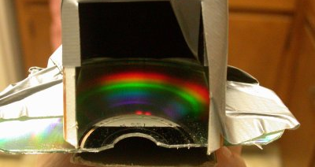
Look down into box at bottom of CD
https://www.cs.cmu.edu/~zhuxj/astro/html/spectrometer.html

Slide 34
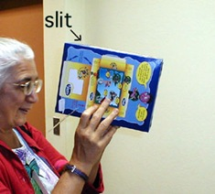
How to use
http://www.instantfundas.com/2008/11/create-your-own-spectrometer-with-cd.html

Slide 35
Some colors on a monitor to look at:
What do you expect to see in the spectrometer for each of these?

Slide 42
A fun place to play
http://www.rapidtables.com/web/color/RGB_Color.htm

