Slide 1
Build a DC motor
Prof. Anderson
Electrical and Computer Engineering

Slide 2
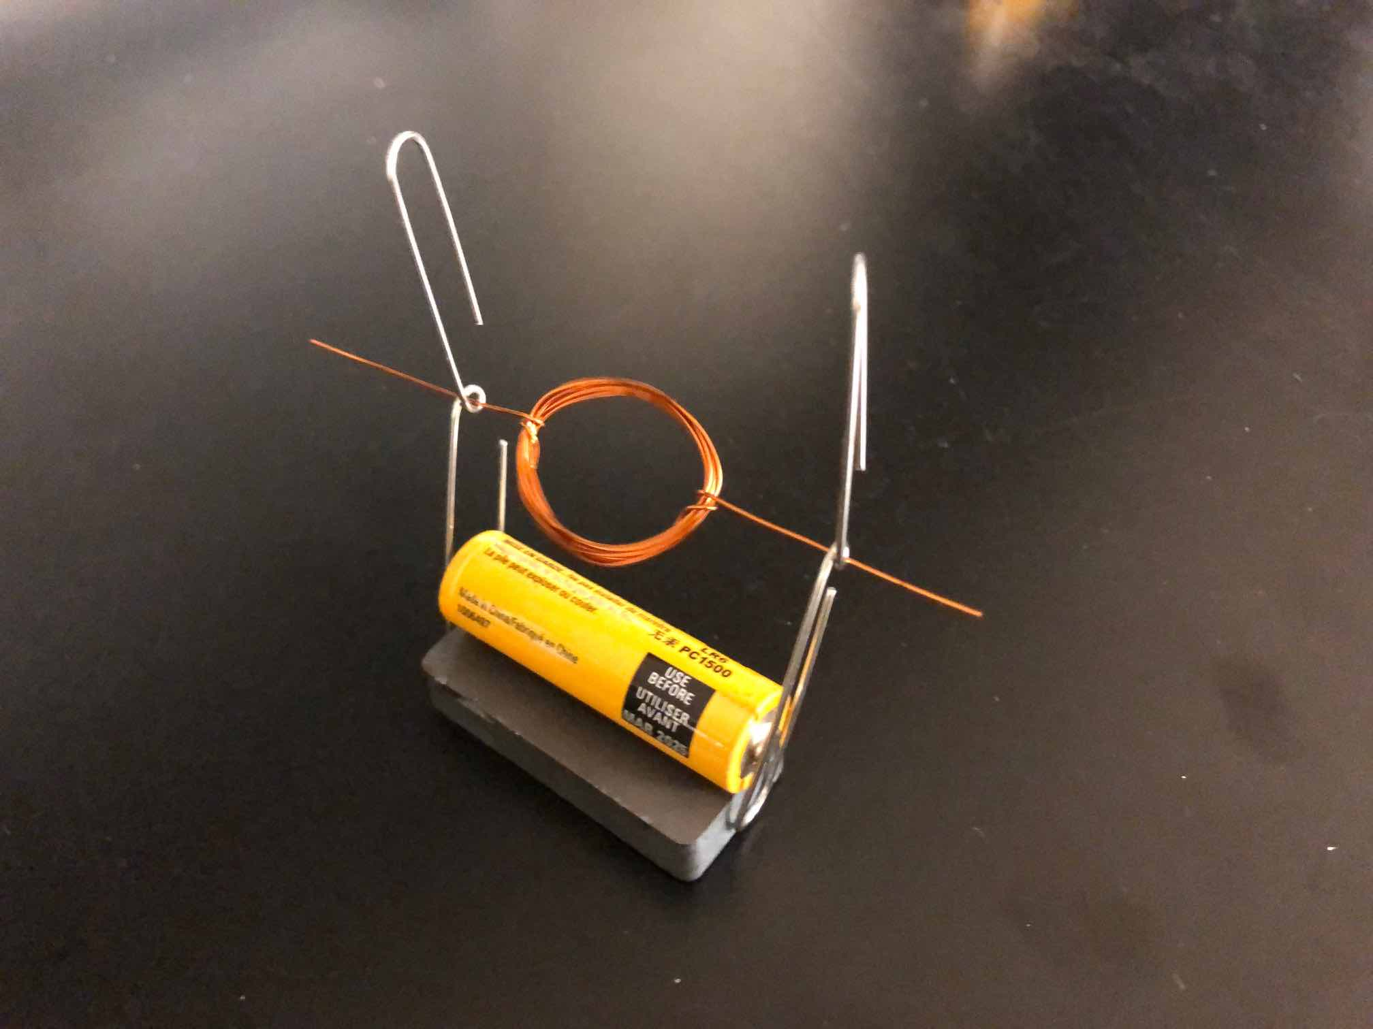
Here is what you will build

Slide 3
We will use electromagnetism
We will create a force field:
We will use electric current to produce a magnet (electromagnet)
We will use the interaction of that magnet with a permanent magnet to rotate the coil
How is that supposed to work?

Slide 4
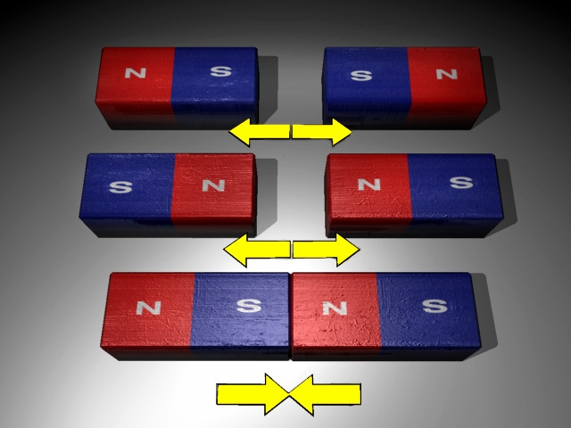
First, think about magnets
Like poles repel
  South repels south
Opposite poles attract
The magnets produce a force
http://www.swe.org/iac/lp/magnets_03.html

Slide 5
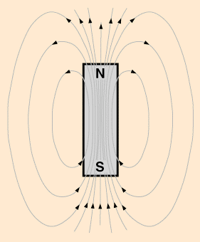
We say the magnet has a field
The field is invisible
But it is real
It can act on objects
Repel or attract them
hyperphysics.phy-astr.gsu.edu/.../ elemag.html

Slide 6
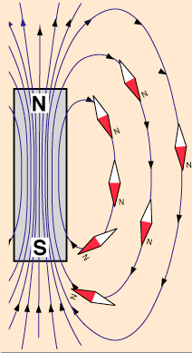
Example: compass needle
Opposite poles attract
North end of compass needle attracted to south pole of magnet
Why can’t we feel the magnetic field?
  We’re not magnetic!
hyperphysics.phy-astr.gsu.edu/.../ elemag.html

Slide 7
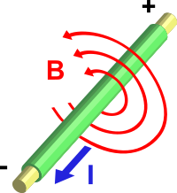
First piece of information
When current (I) flows though a wire, it creates a magnetic field (B)
Use right hand rule to find direction
http://en.wikipedia.org/wiki/Electromagnet

Slide 8
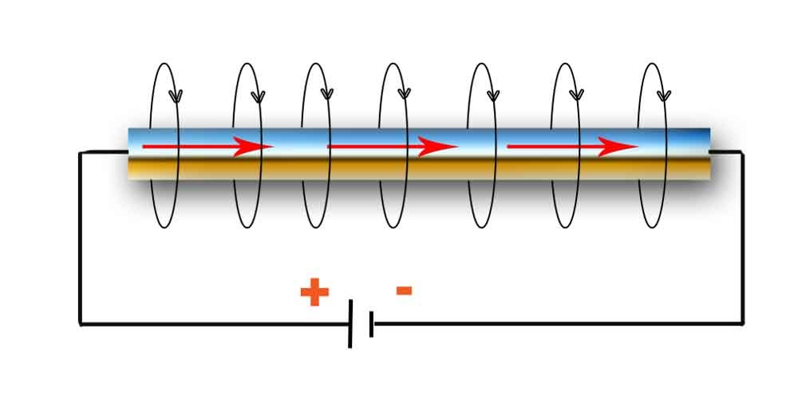
Is this drawn correctly?
feelingwaves.blogspot.com/

Slide 9

If the current changes
Suppose the current reverses direction
What will happen to the field?
  It will reverse
Can we use this to push a magnet around?
  Yes, but it’s pretty weak

Slide 10
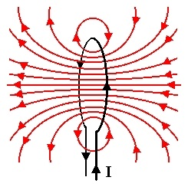
Suppose we make a loop
All the field lines inside the loop go the same direction
  Is the figure drawn correctly?
The field gets concentrated
N
S
physicsed.buffalostate.edu/.../ rhr/rhr.htm

Slide 11
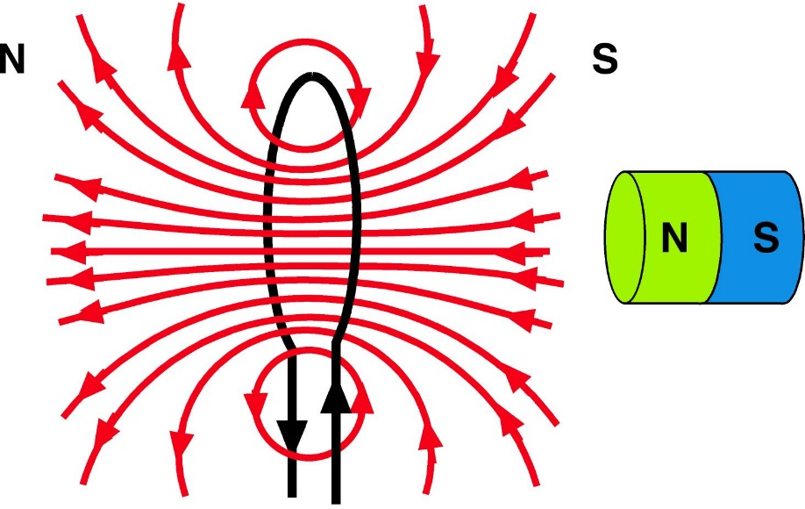
Add a permanent magnet outside
Is there a force?
Which direction?

Slide 12
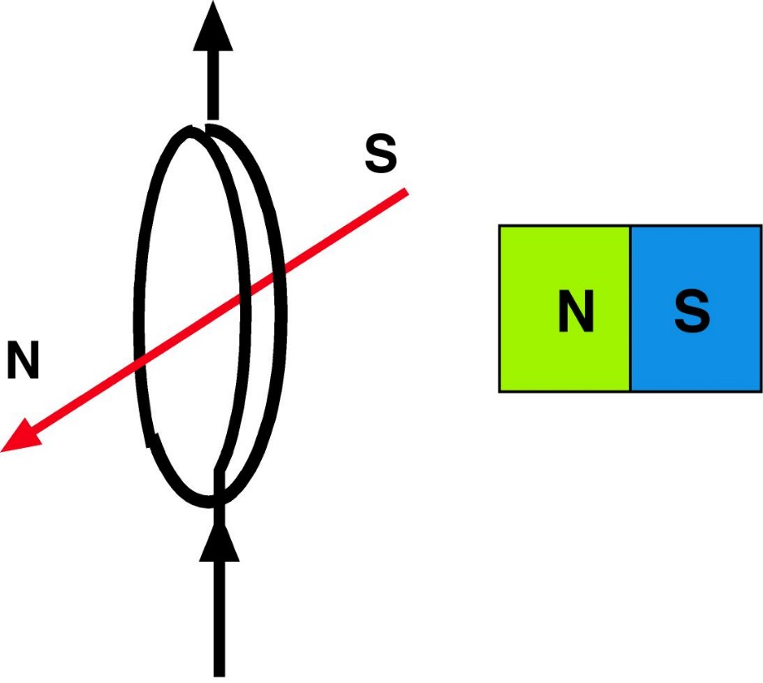
Now suppose loop is tilted
What will happen to the loop?
N attracts S
N repels N
Loop will rotate

Slide 13
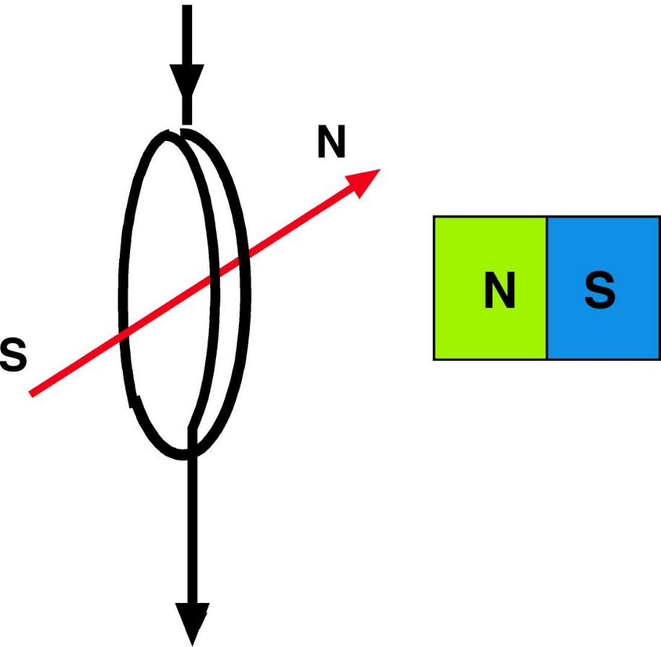
What if you reverse the current?
Poles of electromagnet reversed
N attracts S
N repels N
Rotates the other way

Slide 14
But wait…
Once loop rotates halfway around, poles will be pointing the other way, and it will want to come back
Will flap back and forth or stick in one position

Slide 15
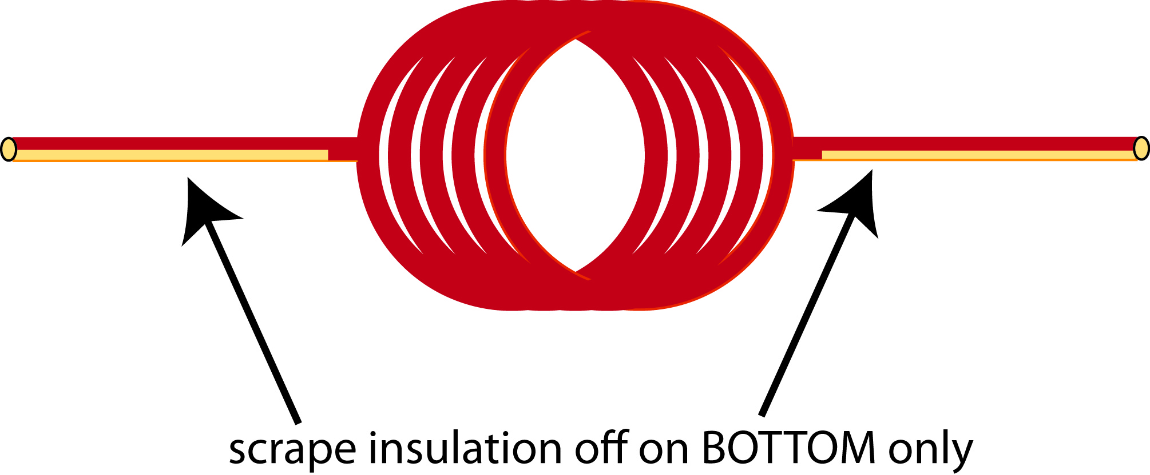
Trick: Insulate one side of the wire
When loop is turned one way, current flows, magnet points in one direction
When loop is turned the other way, no current flows, no electromagnet
Will it just stop?

Slide 16
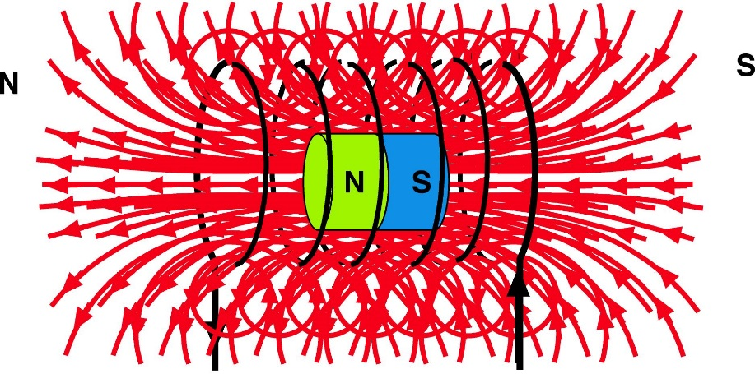
Ok! We can rotate the loop!
But the field is still weak.
Need a way to amplify the field.

Slide 17
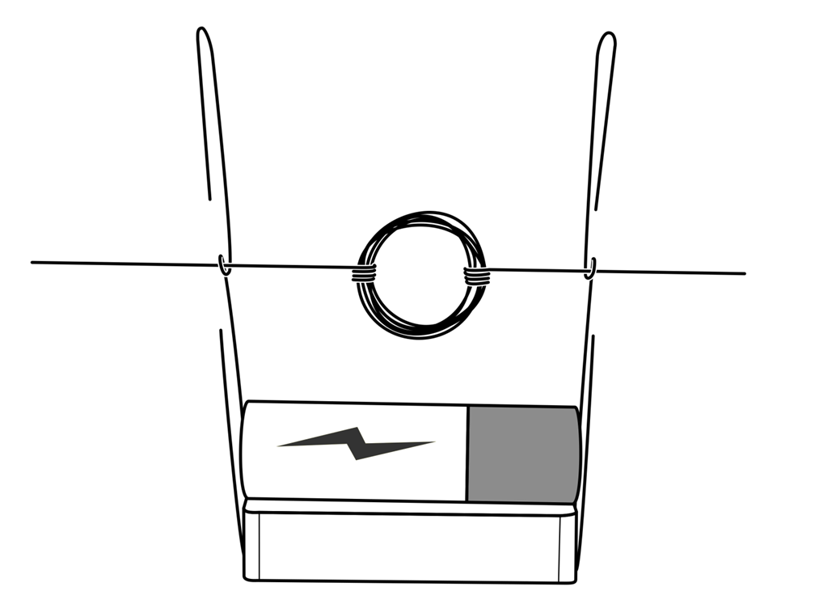
OK, we have all the pieces!
Battery produces current
You make a coil
Suspend between paper clips
Put a magnet underneath

Slide 18
Contents of Your Bag
1 bar style magnet
2 jumbo paper clips
1 AA-size battery
A two foot length of magnet wire
1 sheet of sand paper
1 rubber band
PLEASE LET US KNOW IF YOU ARE MISSING ANY SUPPLIES

Slide 19
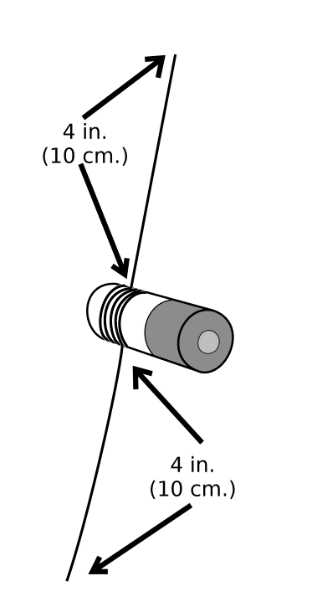
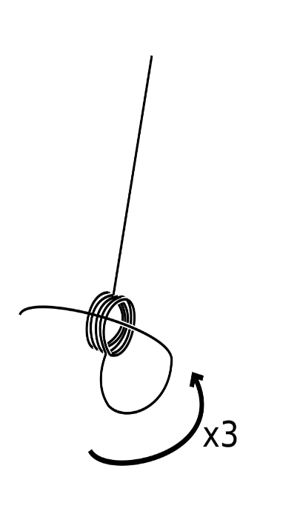
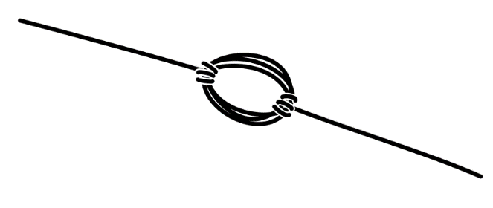
Building the Coil
Leave about 4 inches of wire unwrapped at the beginning and end of your coil, these are your leads
Wrap the wire around the battery
Carefully remove the coil from the battery
Wrap each lead through the coil at least twice
Keep wrapping the leads until they stick out at opposite sides of the coil

Slide 20
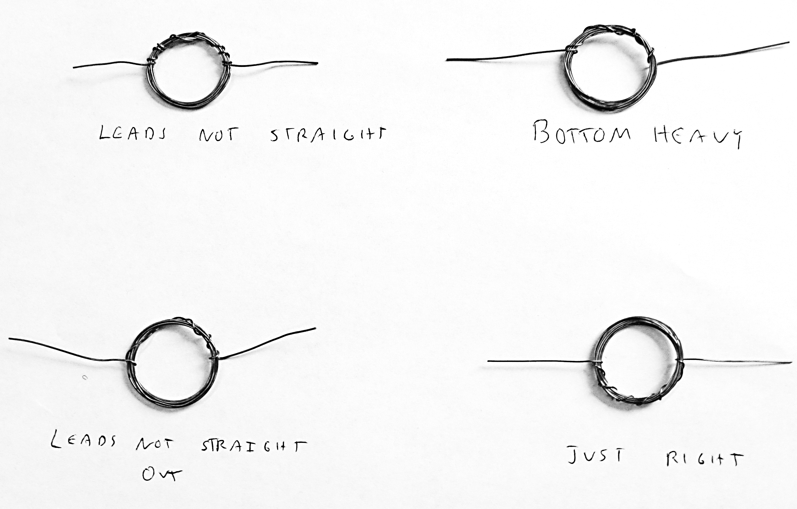
Wrong vs Right!
Leads not straight
Bottom Heavy
Leads not
straight out
Just right!

Slide 21
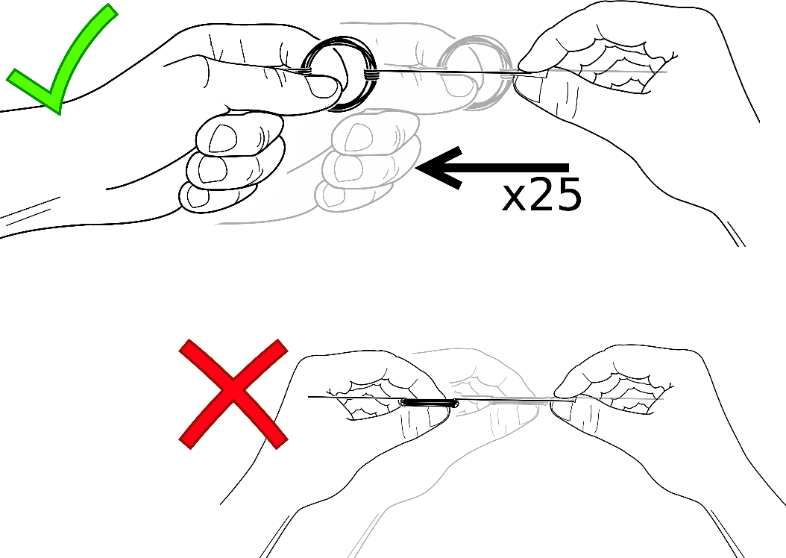
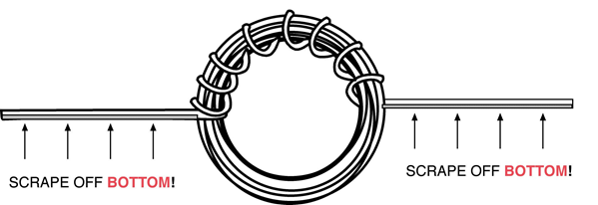
Make the commutator
Sand the bottom half of each lead
Hint: Place the sand paper on the table and drag the wire across it, making sure to get as much insulation off as possible

Slide 22
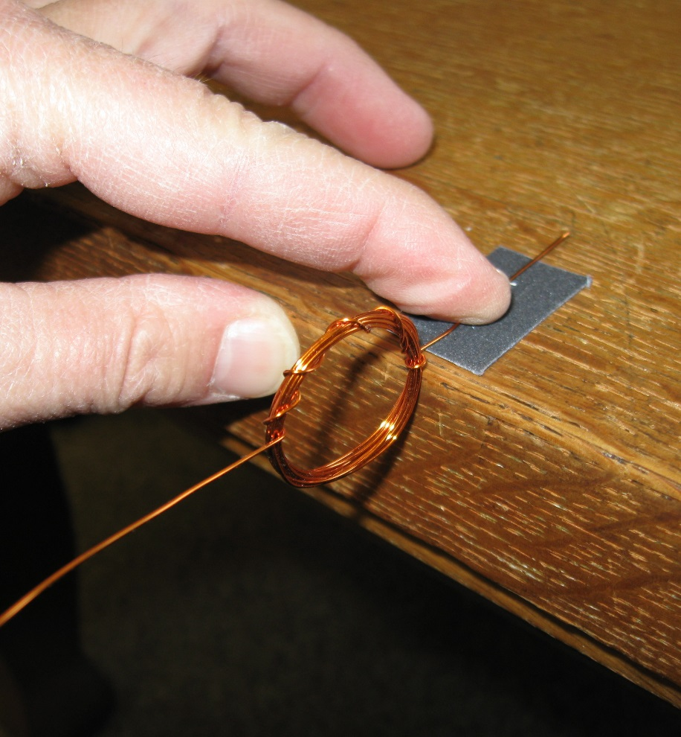
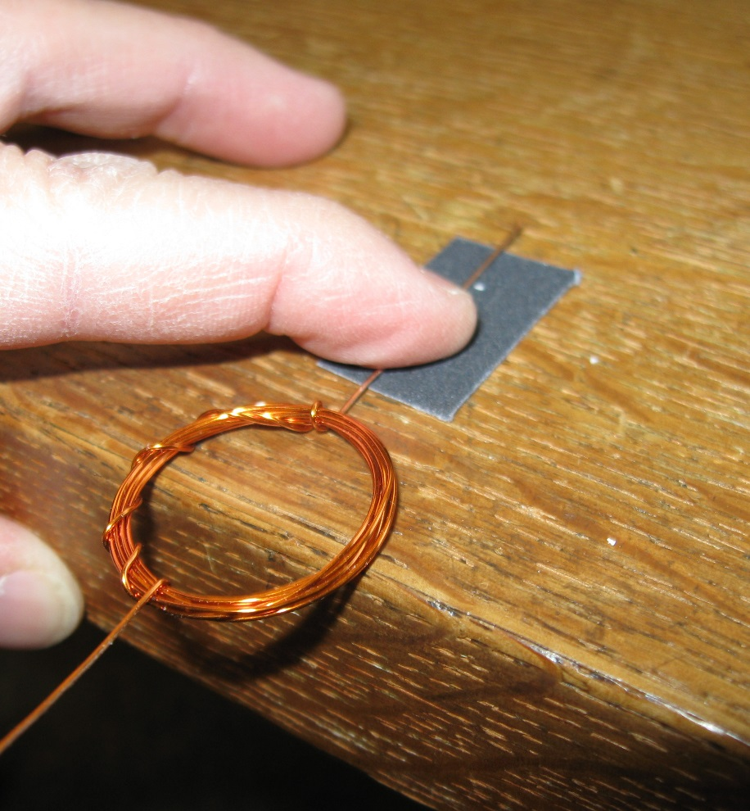
This is important
YES
NO! NO! NO!

Slide 23
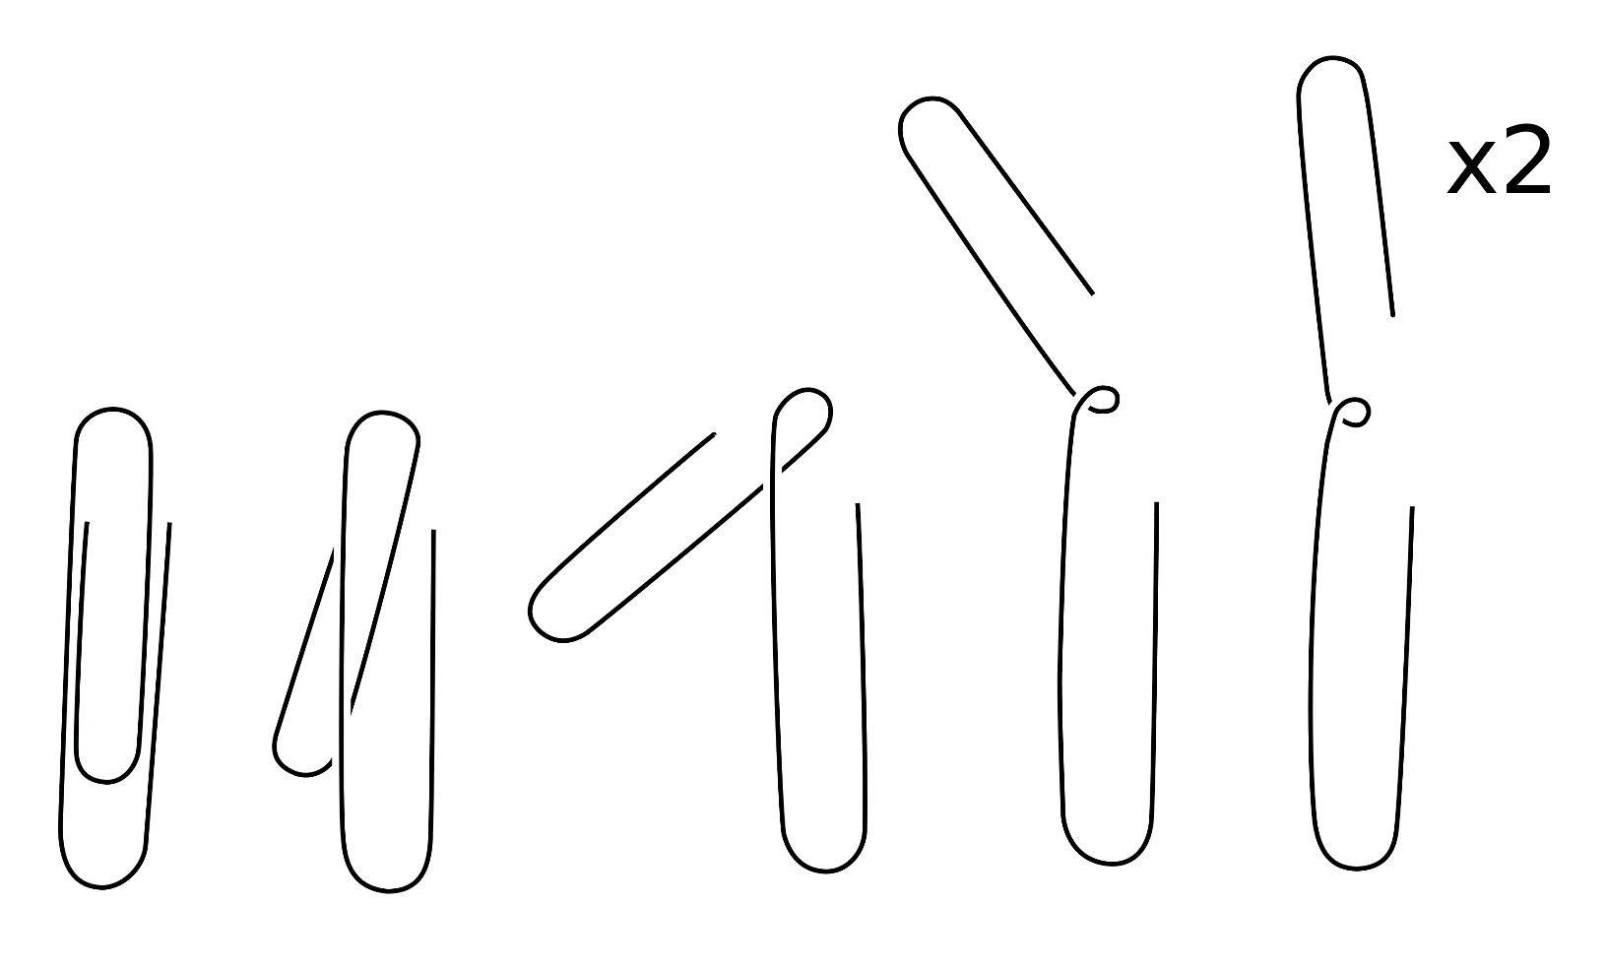
Bend the paper clips
Before
After

Slide 24
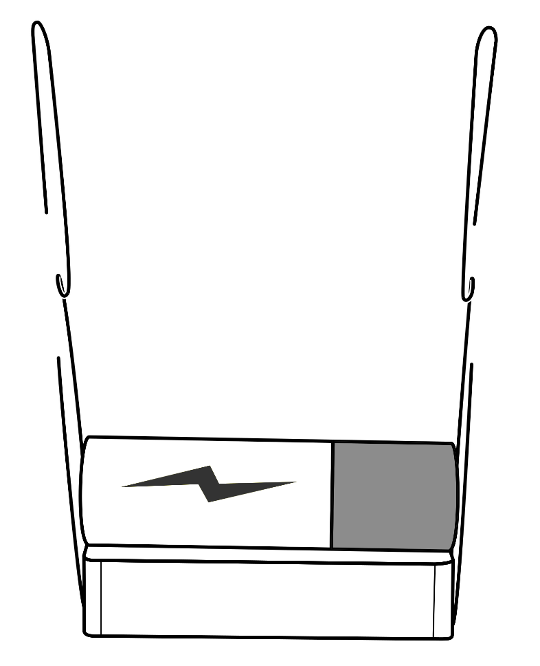
Assemble base
Stick magnet to side of battery
Rubber-band the paperclips to the battery terminals

Slide 25
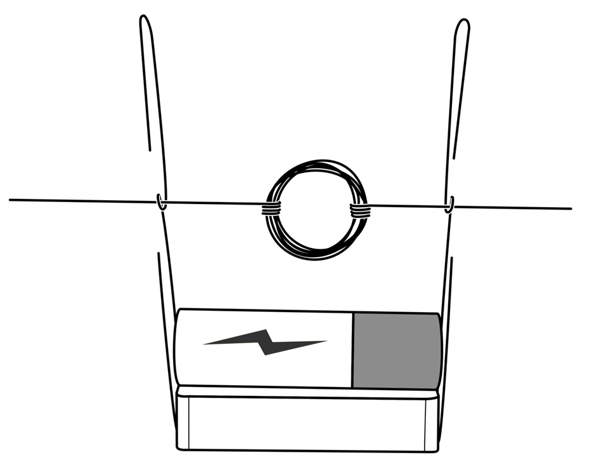
Add the coil
Hang the coil in the loops made by the paper clips
It will complete the circuit when the sanded side of the commutator is down
Hint:
  Make sure all components are level and that the wires coming out of the coil are as straight as possible.

Slide 26
Making Your Motor Run
If all steps were done correctly and carefully, your motor should run just by manually turning the coil and then letting go.
If your motor does not run correctly, there are several things that could be wrong:
  Coil is bottom-heavy (check that it spins easily when you spin it with your fingers)
  Not enough insulation was sanded from the bottom half of the coil lead wires, try to get as close to the coil as possible when sanding
  A lead is either bent or out of alignment. Check these components.

Slide 27
How does a generator work?
A motor converts electrical current into mechanical motion
  The current produces a magnetic field that pushes off the permanent magnet to turn
A generator converts mechanical motion into current
  The turning magnet induces a current in the wire

