Slide 1
Decisions in assembler code

Slide 2
3 < A < 8
Flowchart and assembler
LDAA VALA
CMPA #3
BLE OUT
CMPA #8
BGE OUT
Do action
OUT continuation

Slide 3
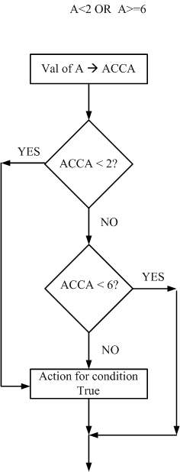
A<2 or A>=6
Flowchart and assembler
LDAA vala
CMPA #2
BLT act
CMPA #6
BGE out
act action for True
out continuation

Slide 4
2<=A<=5
Flowchart and assembler
LDAA vala
CMPA #2
BLT out
CMPA #5
BGT out
action when true
out continuation

Slide 5
Simulation Assignment 1
Enter the following code into THRSIM
ORG $50
INNR RMB 1
OTTR RMB 1
ORG $E000
LDAB #$FF
STAB $1007 configure port C for output
OL LDAA delayval try 1, try 10, etc
STAA ottr
TOP DECR INNR
BNE TOP
DEC OTTR
BNE TOP
EORB #$FF
STAB $1003
BRA OL
LDA $FF
END BRA END

Slide 6
Sim Asg 1 (cont)
Before running your code configure an LED on pin PC 0. To do this go to the connect window, choose LED. When the popup comes up scroll in the left side and select PC0. Then hit connect. Then say OK.
After entering the code run your code, using different values for DELAYVAL
Note the difference in the time it takes from when you click on RUN until accumulator A becomes FF.
Try the program with delay val of 1 and delay val of $F0.
Change the value until you achieve approximately 1 second.

Slide 7
Being able to reset simulator
If you want to be able to reset the simulator to rerun you code enter the following.
ORG $FFFE
FCB $E0
FCB $00
What does this do? It resets the PC when a reset occurs to value $E000

