Slide 1
Pulse Detector
Ramiro Duarte, Clayton Greenbaum
Frank Paynter
Prof. Betty Lise Anderson

Slide 2
Here’s what you’re going to build

Slide 3
Principle of operation
An infrared beam passes through your finger
You are mostly transparent, but blood absorbs this wavelength
Amount of absorption depends on amount of blood
Varies with your pulse
Oximeters use two wavelengths, one for blood pulse and one for oxygen- we’ll use one to keep it simple
http://www.pulmolink.co.uk/products/pulse_oximeters/pulse-oximeter-work.html

Slide 4
First part is the sensor
Infrared light-emitting diode
Photodetector
Potato chip clip
Screw allows you to adjust the pressure
Don’t want to squeeze the blood out of your finger!
LED
Photodiode

Slide 5
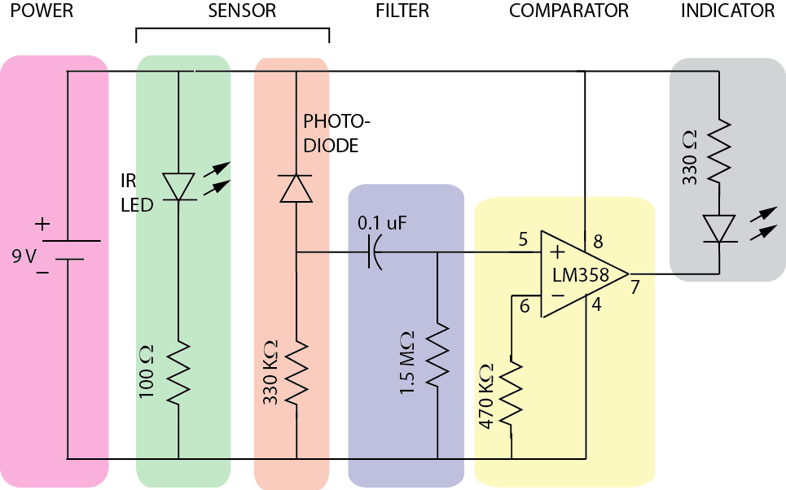
Second is the part you’ll build

Slide 6
Need to learn some things
How to read an electrical schematic
What parts we’re using
How to design the display
How to build the display

Slide 7
Reading Schematics:
What’s this?
Battery

Slide 8
How about this?
Resistor

Slide 9
What’s this?
Diode
Lets current flow one direction but not the other
LED: current flow produces light
Photodetector: should be hooked up backward (reverse bias)
YES
X
NO

Slide 10
Will current flow?

Slide 11
How about here?

Slide 12
And here?

Slide 13
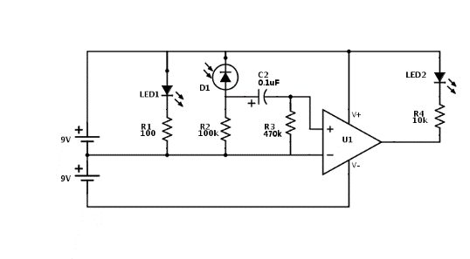
Operational amplifier
Has two inputs
Function depends on circuit around it
Highly versatile
We’ll use one
It will function as a comparator

Slide 14
Two come in one package
Tells you pin numbering
NOTE DIMPLE

Slide 15
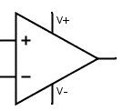
Comparator
Output depends on which input has a higher voltage
If inverting input is higher, output is V-
If non-inverting input is higher, output is V+

Slide 16
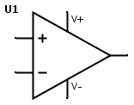
Comparator
What will the output be?
+9V
2 V
?
4 V
-9V

Slide 17
Comparator
What will the output be?
+9V
2 V
-9V
4 V
-9V

Slide 18
Comparator
What will the output be?
+9V
6V
?
4 V
-9V

Slide 19
Comparator
What will the output be?
+9V
6 V
+9V
4 V
-9V

Slide 20
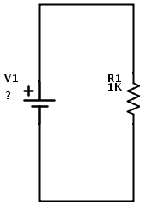
Ohm’s Law
V=IR
Voltage equals current times resistance
V = 1 ma X 1 KΩ
V = ?
I = 1 ma

Slide 21
Ohm’s Law
V=IR
Voltage equals current times resistance
V = 1 ma X 1 KΩ
V = 0.001A X 1000Ω
V = ?
I = 1 ma

Slide 22
Ohm’s Law
V=IR
Voltage equals current times resistance
V = 1 ma X 1 KΩ
V = 0.001A X 1000Ω
V = 1 Volt
I = 1 ma

Slide 23
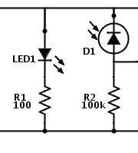
Example: Sensor block
Current flows through LED
Causes light
Light lands on photodetector
Causes current
Produces a voltage across R2
Voltage will be input to next stage (filter)

Slide 24
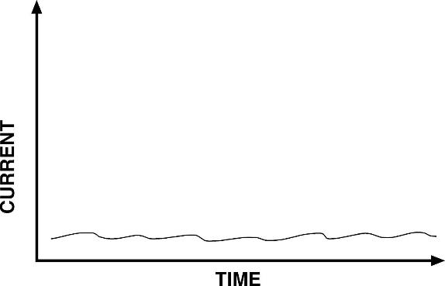
Output will look like
I
Ohm’s Law
V=IR
Transforms the current signal into a voltage signal that the comparator can use
V
I
VOLTAGE

Slide 25
DC Offset
A fancy way of saying what voltage a signal is centered at
~AC Signal
DC Offset
VOLTAGE

Slide 26
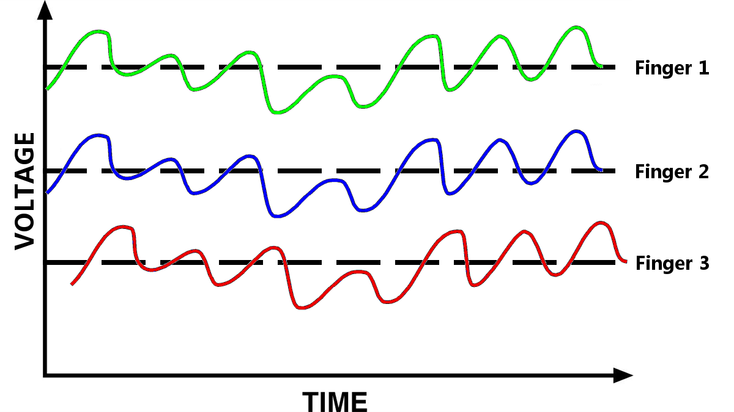
DC Offset
Will be different for every finger

Slide 27
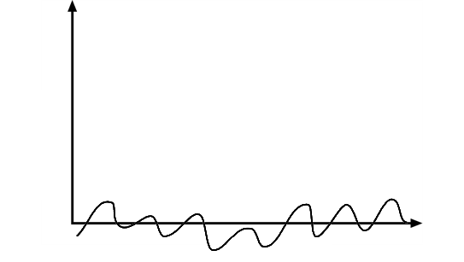
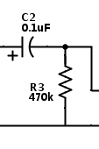
Blocking Capacitor
Only AC signals can pass through a capacitor
We can get rid of the DC offset so any finger will work in our circuit!

Slide 28
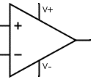
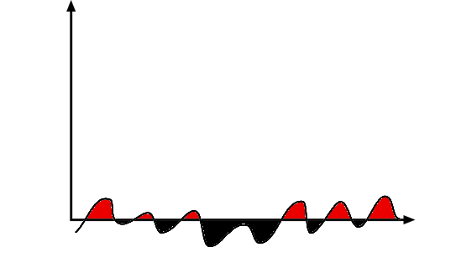
Indicator Circuit
Compare the AC signal to 0V
Comparator drives indicator circuit
When the signal dips below 0V, the indicator shuts off
When the signal is above 0V, the indicator turns on
Signal
0V

Slide 29
The breadboard

Slide 30
The buses
Every hole along this green line is electrically connected

Slide 31
There are four buses you can use

Slide 32
All rows connected too

Slide 33
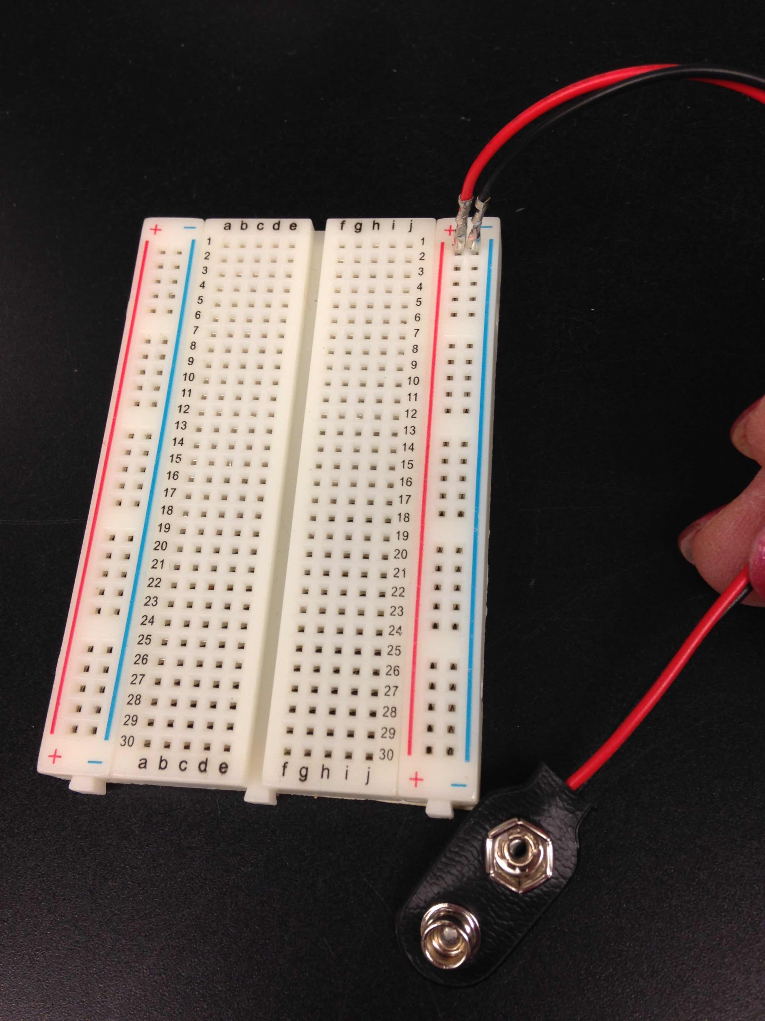
Start by connecting supply
Connect negative (black wire) to one blue bus
Just stick the black wire in any hole on that bus
Connect red wire to the red bus
Disconnect battery from clip before proceeding

Slide 34
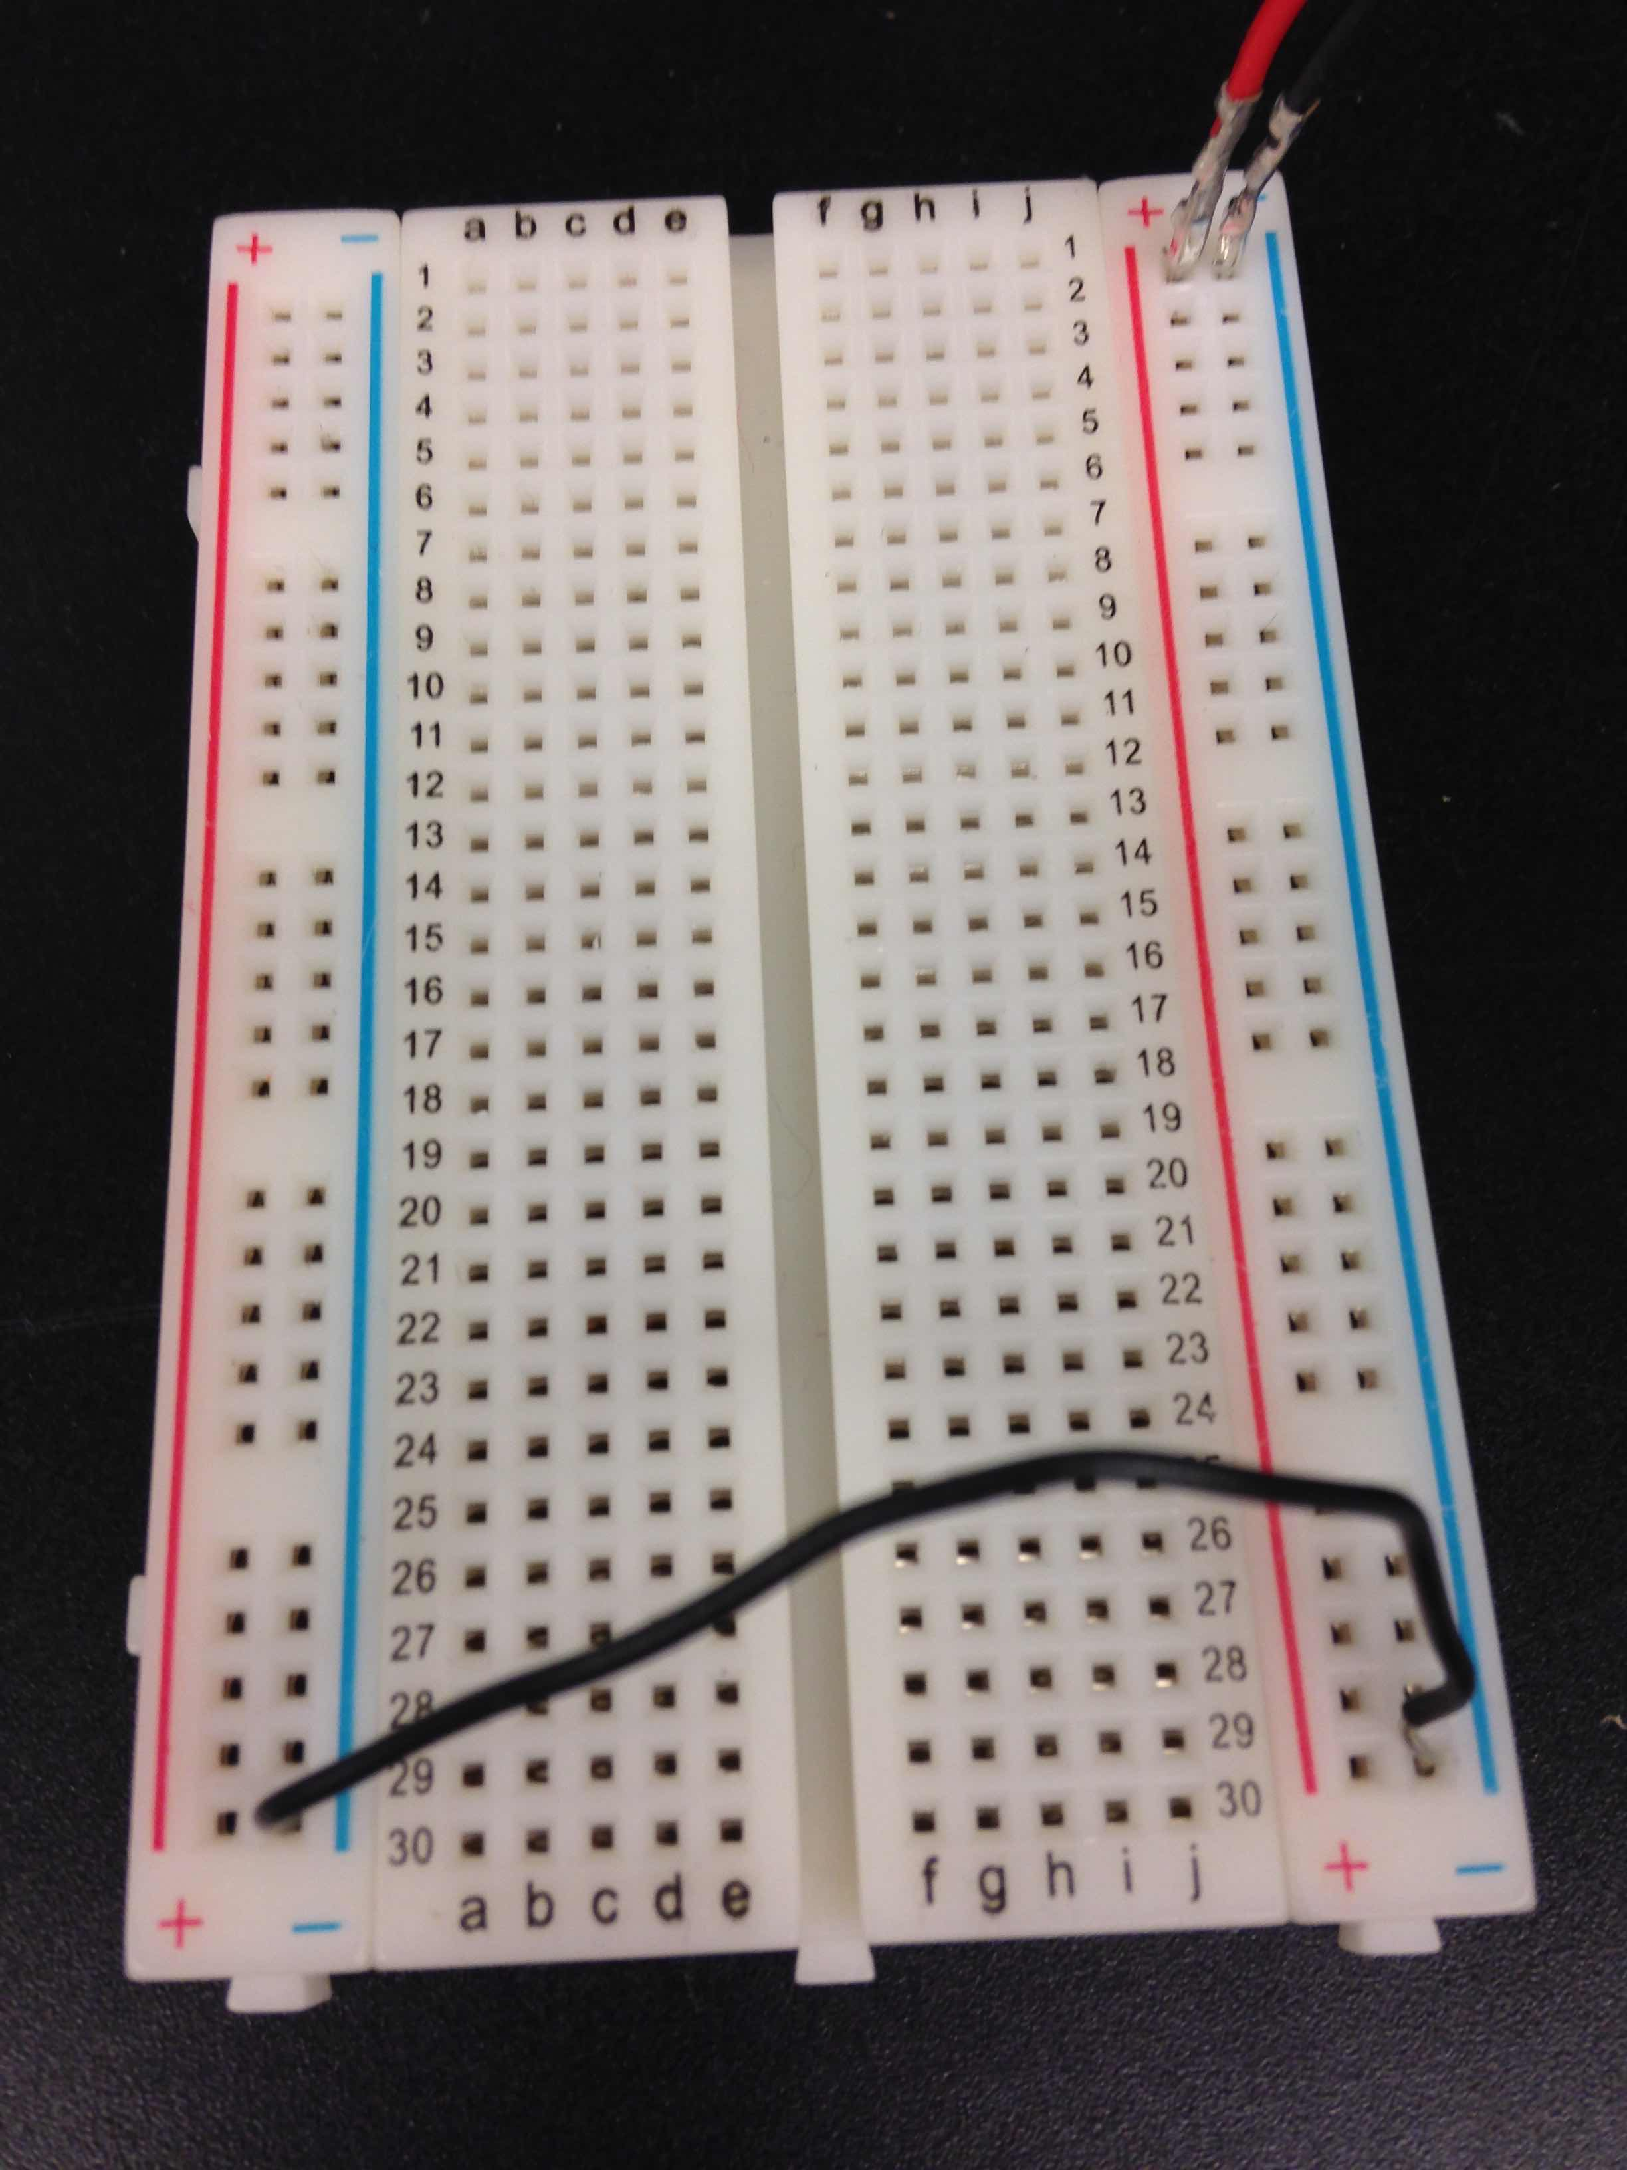
Connect other negative bus
Connect a black wire from one blue bus to the other
Disconnect battery from clip before proceeding
Common Bus
Negative Bus
Positive Bus

Slide 35
Place op amp on board
Check the divot!
Should be up!

Slide 36
Which pins are the power pins?
Pin 8 goes to positive
Pin 4 goes to negative
Use the buses
Positive
Negative

Slide 37
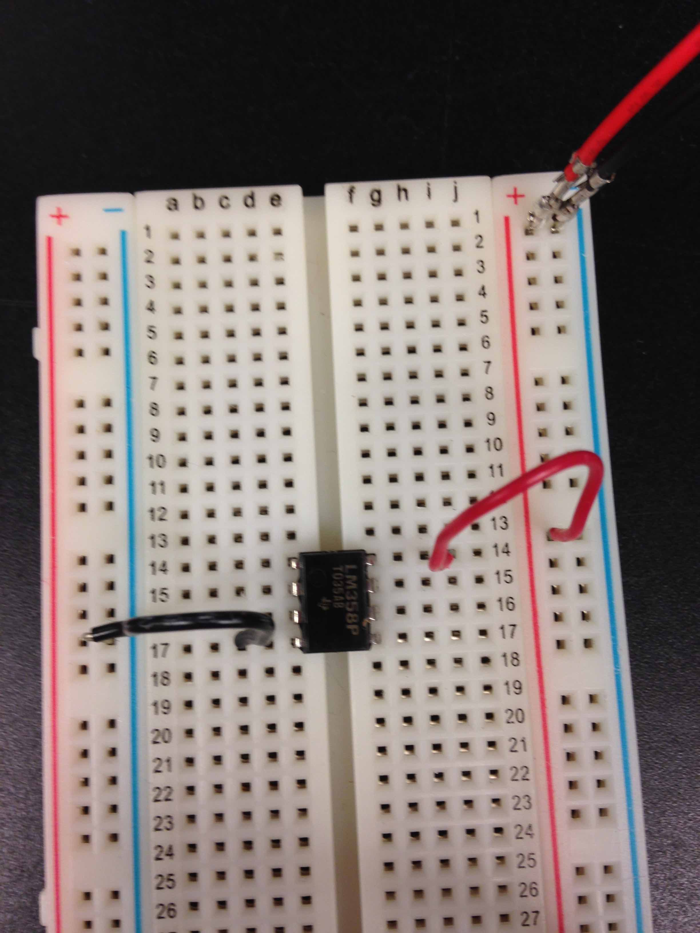
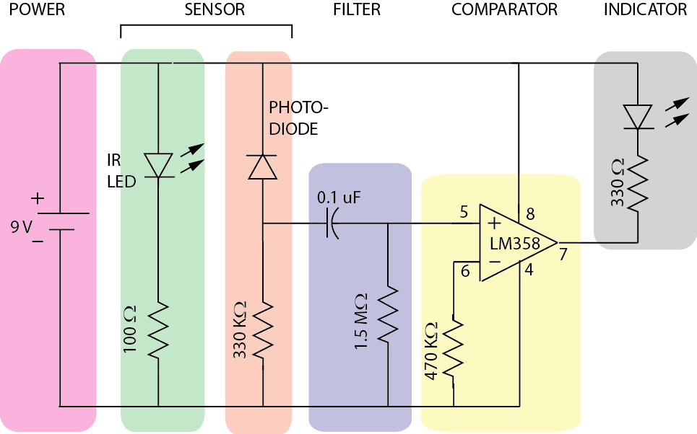
Connect op amp to power

Slide 38
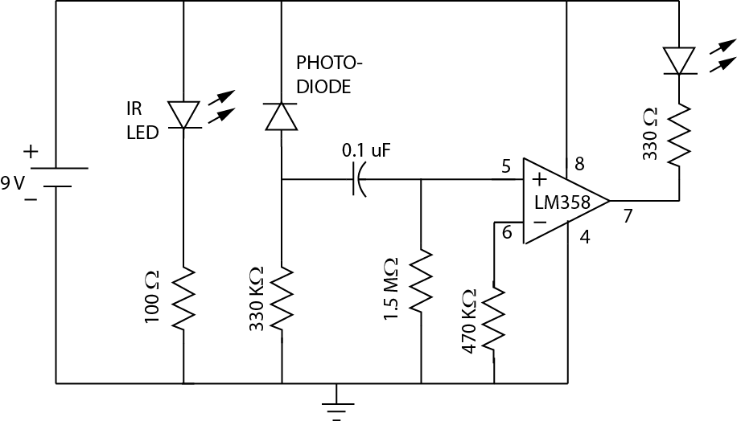
OK, we did POWER

Slide 39
Now on to the sensor

Slide 40
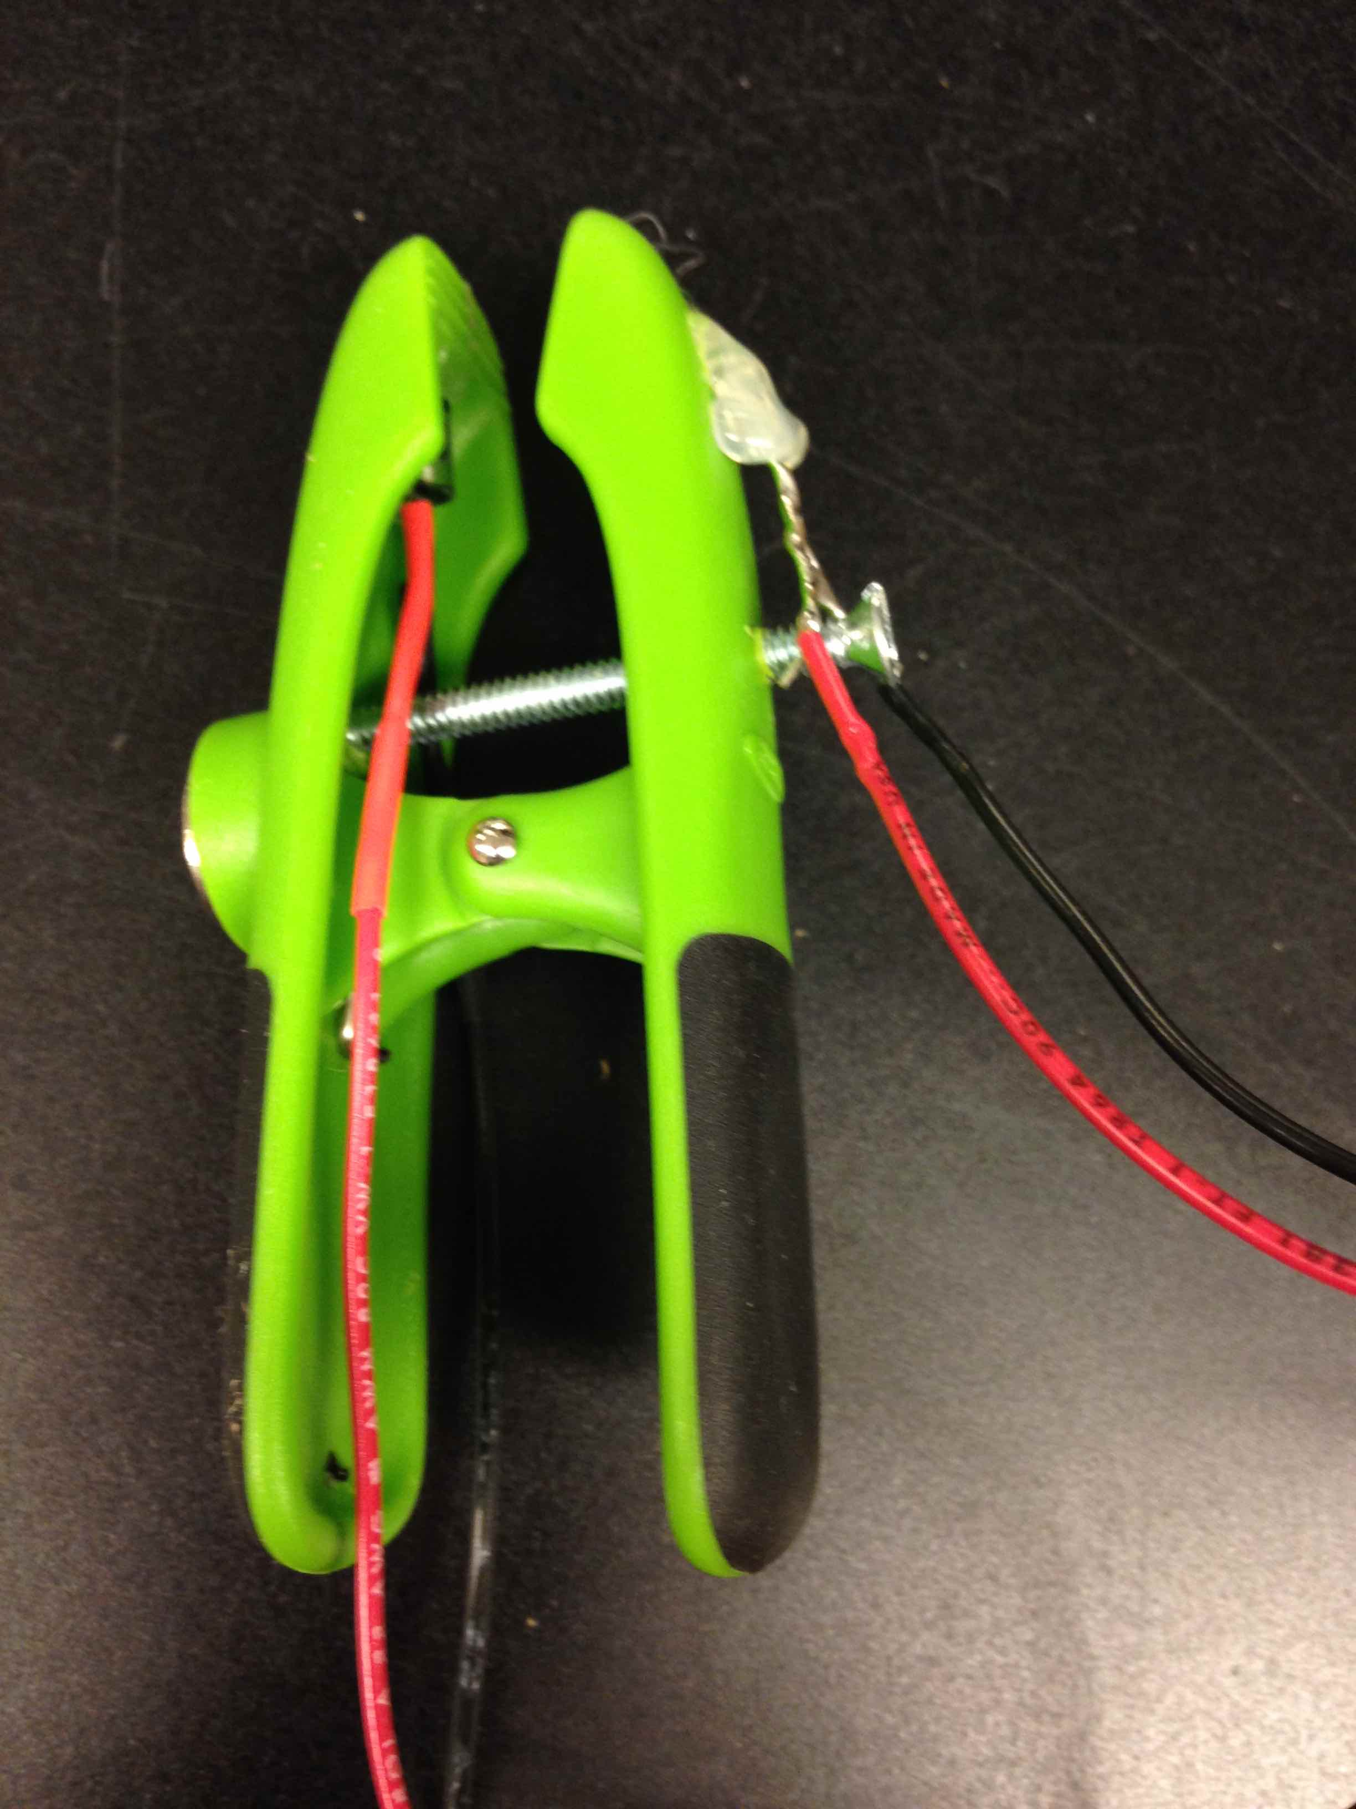
Here’s the sensor head
The one inside the clip is the PHOTODIODE
The one outside the clip is the INFRARED LED
We’ll connect the LED first

Slide 41
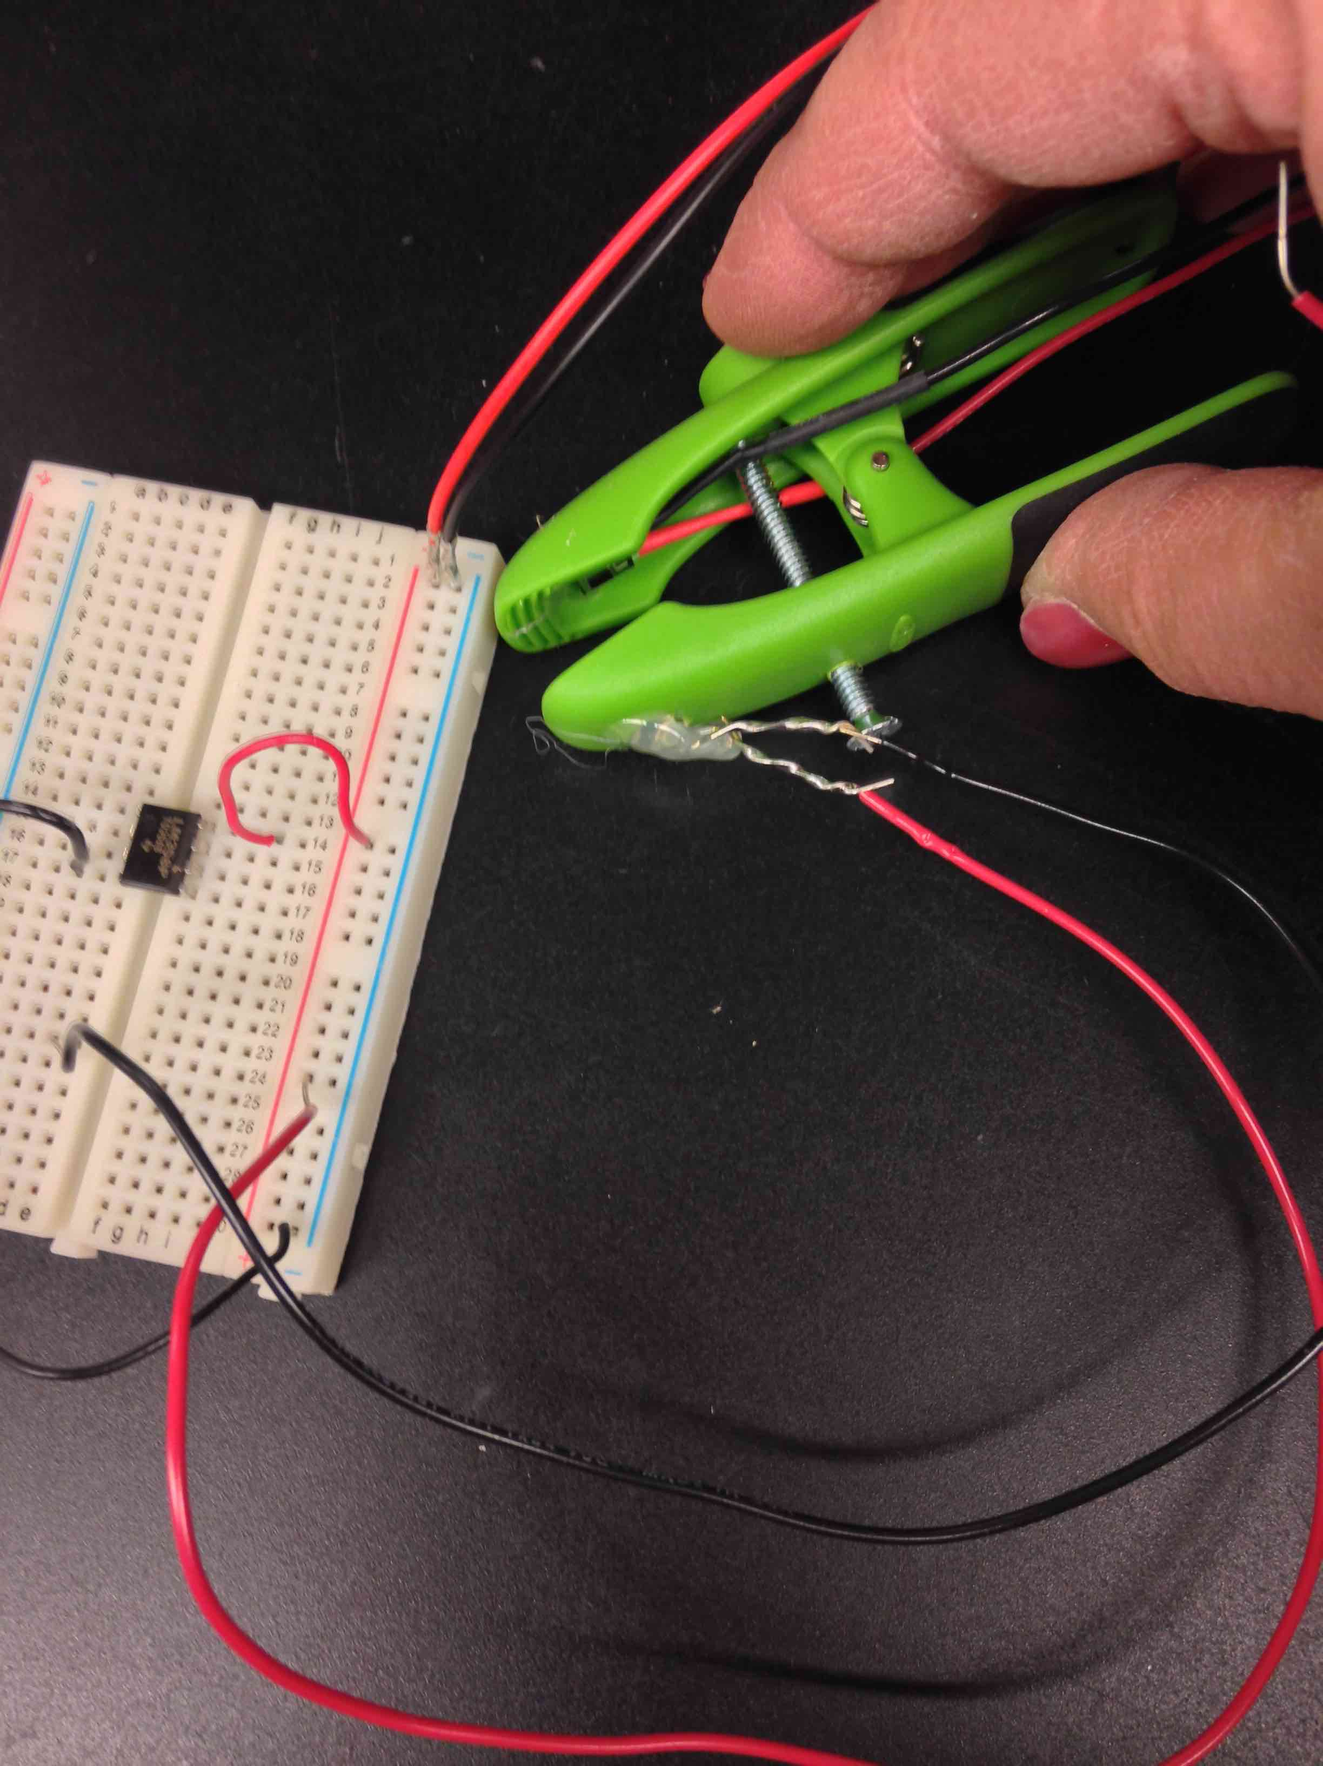
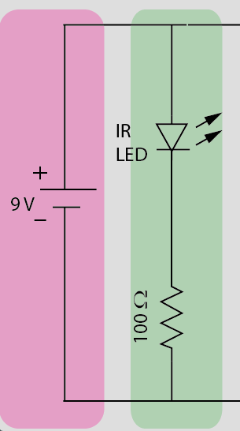
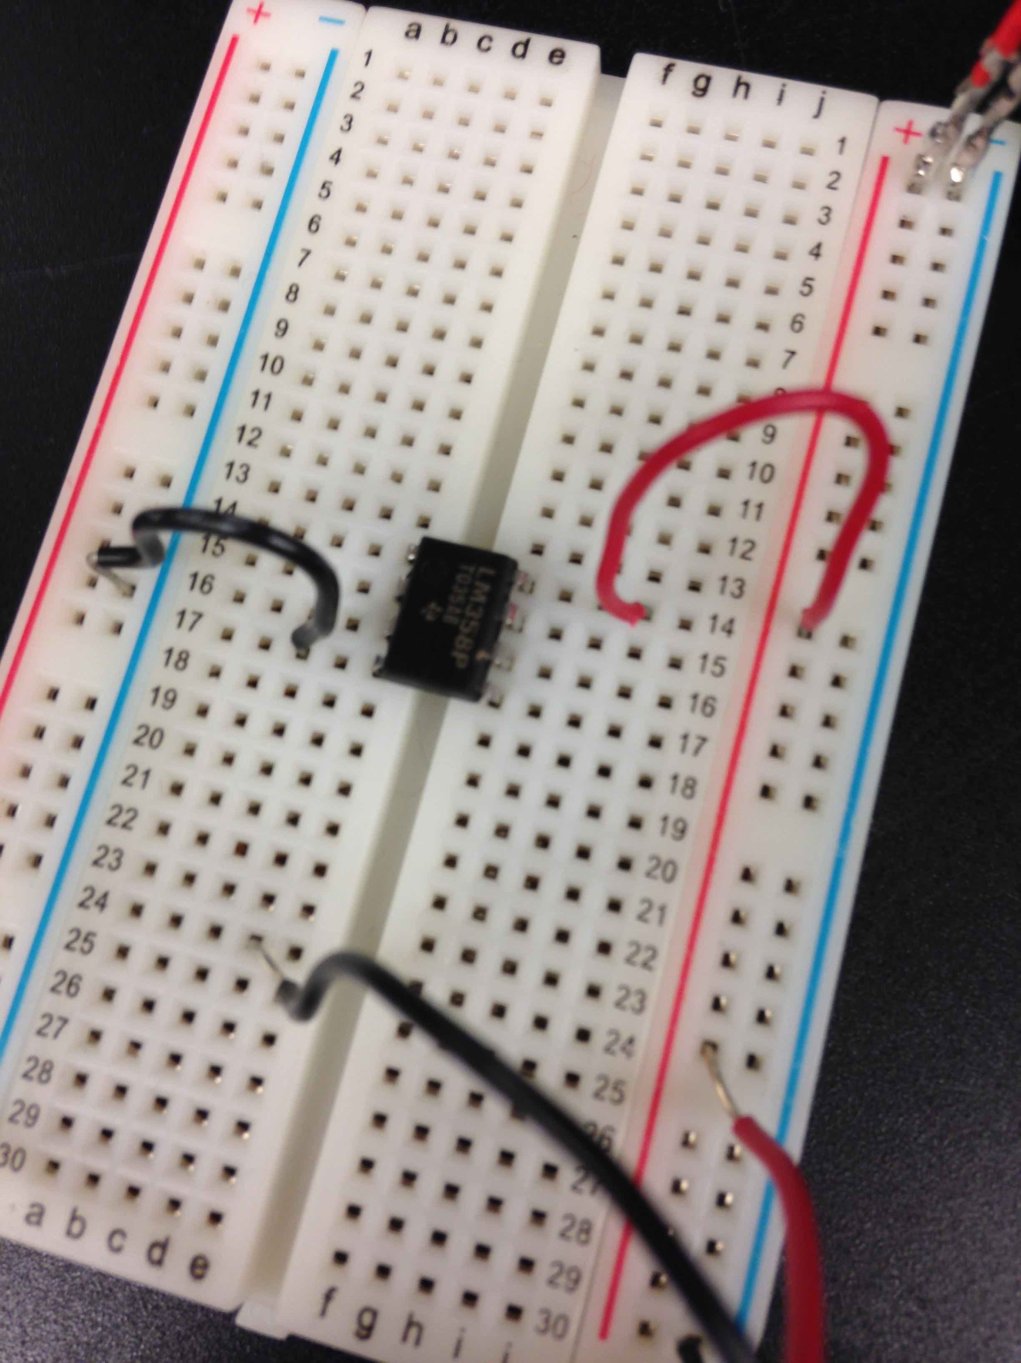
Red is the ANODE
positive bus
anode
cathode
anode
cathode
negative bus

Slide 42
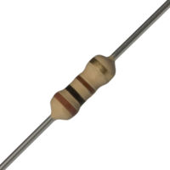
Next, look at schematic
Need a resistor (R1) connected from the cathode of the LED to the common bus
Cathode = pointy end of diode icon
Resistor =100 Ω
Stripes are brown, black, brown

Slide 43
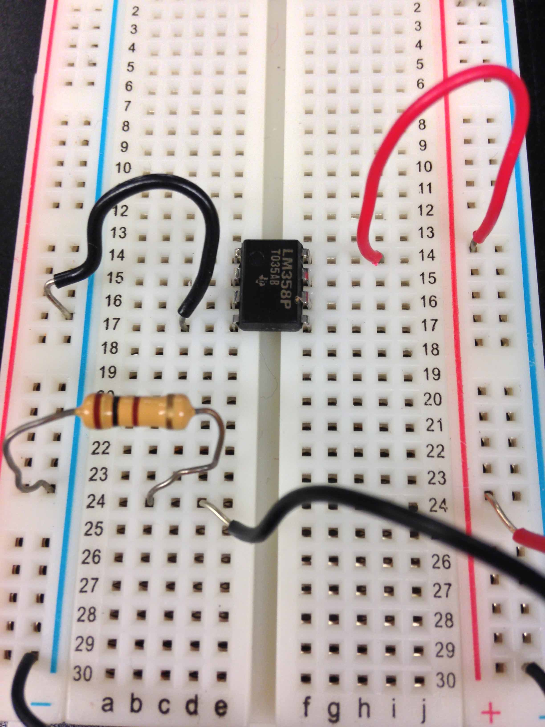
100 = brown black brown
positive bus
positive bus
anode
cathode
Ohm resistor connects LED cathode to negative bus
cathode
negative bus

Slide 44
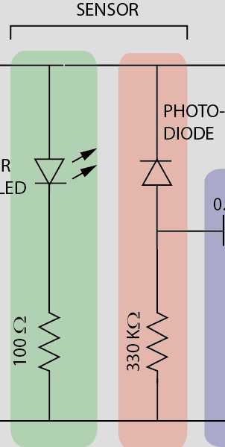
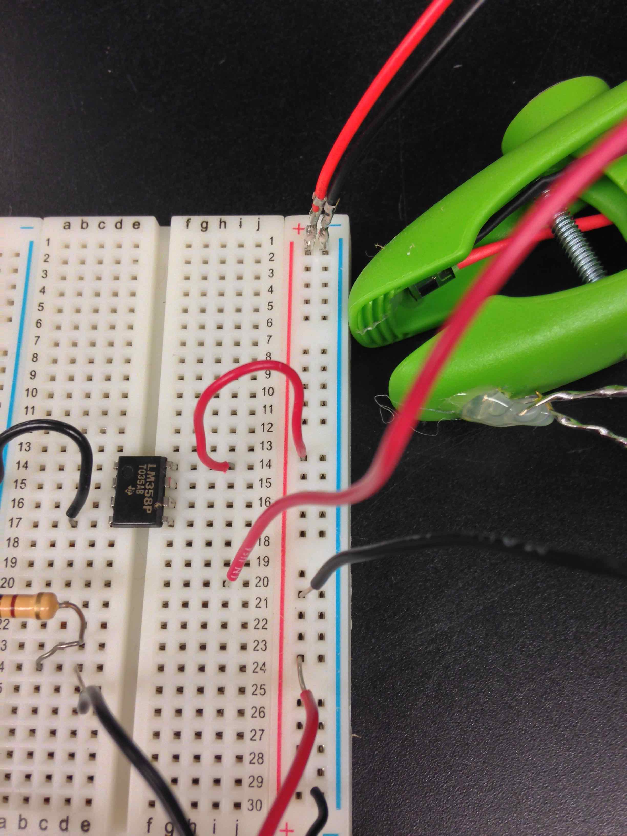
Photodiode is upside down
Connect cathode to positive bus
Connect anode to a node
cathode
anode
anode
cathode

Slide 45
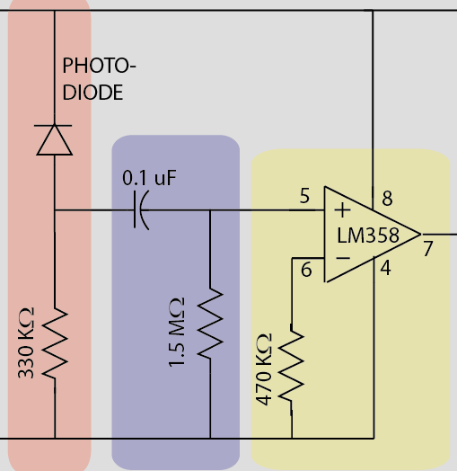
Capacitor goes to pin 5
Positive
Negative

Slide 46
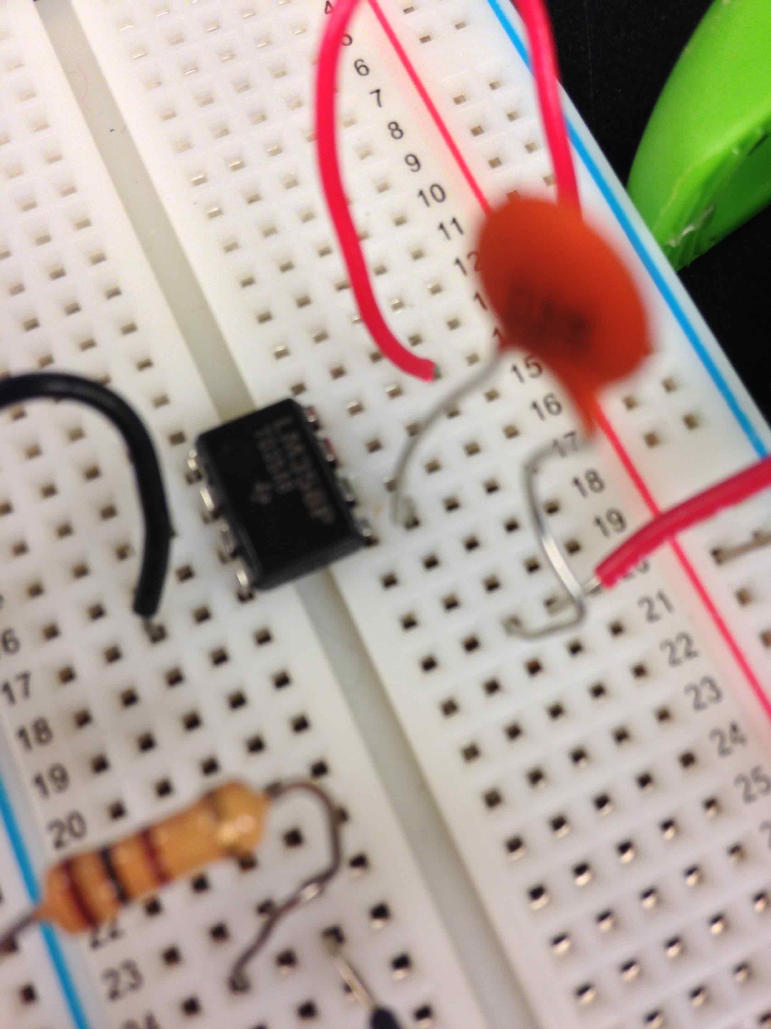
Capacitor goes to pin 5

Slide 47
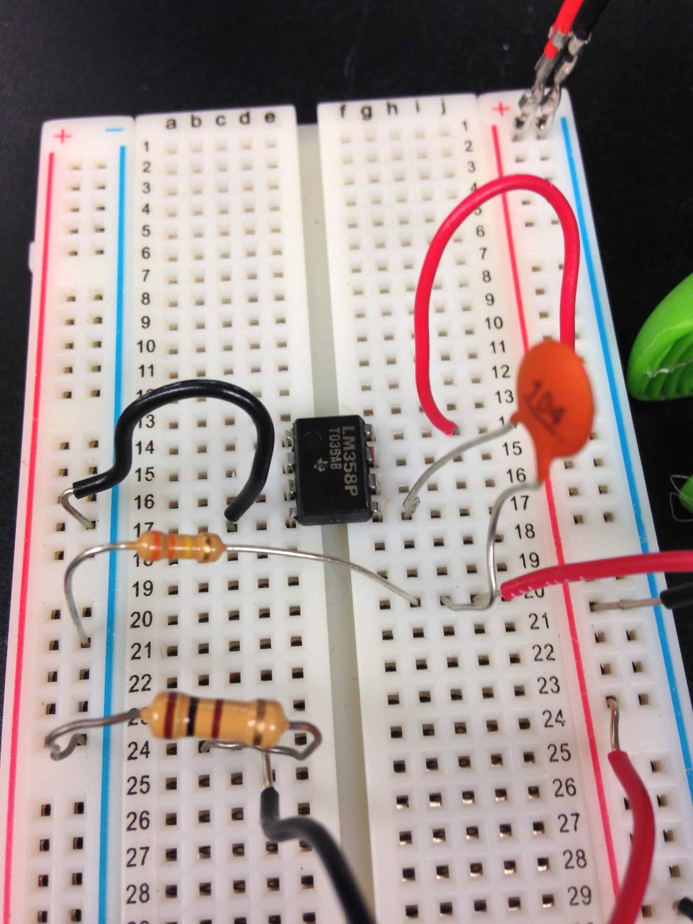
330K=orange orange yellow

Slide 48
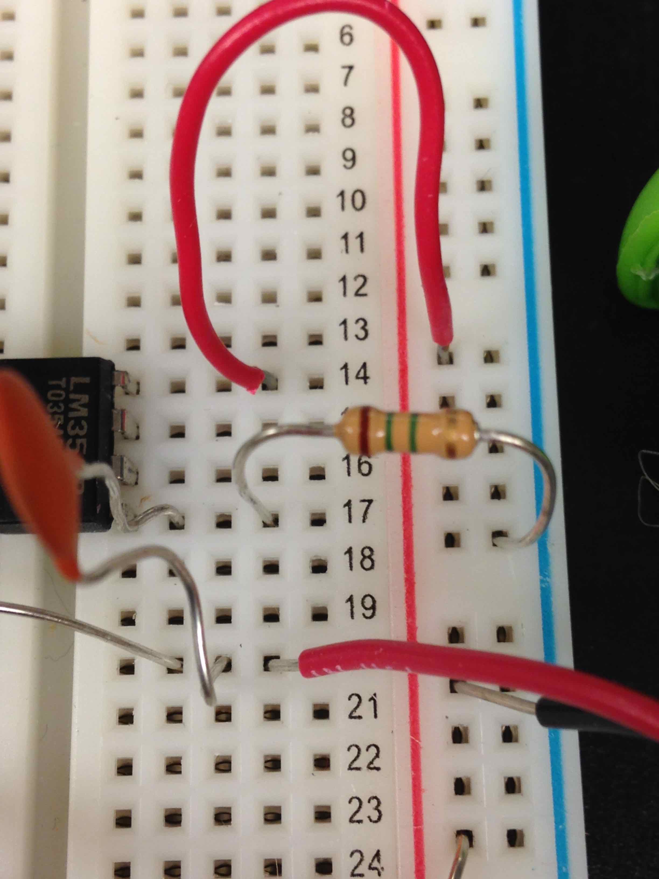
1.5 M=brown green green

Slide 49
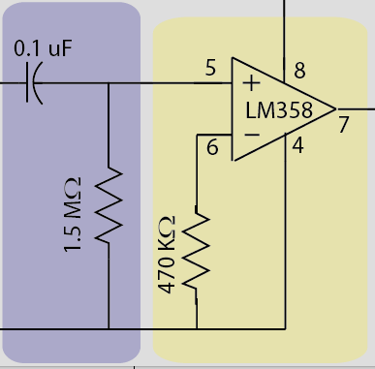
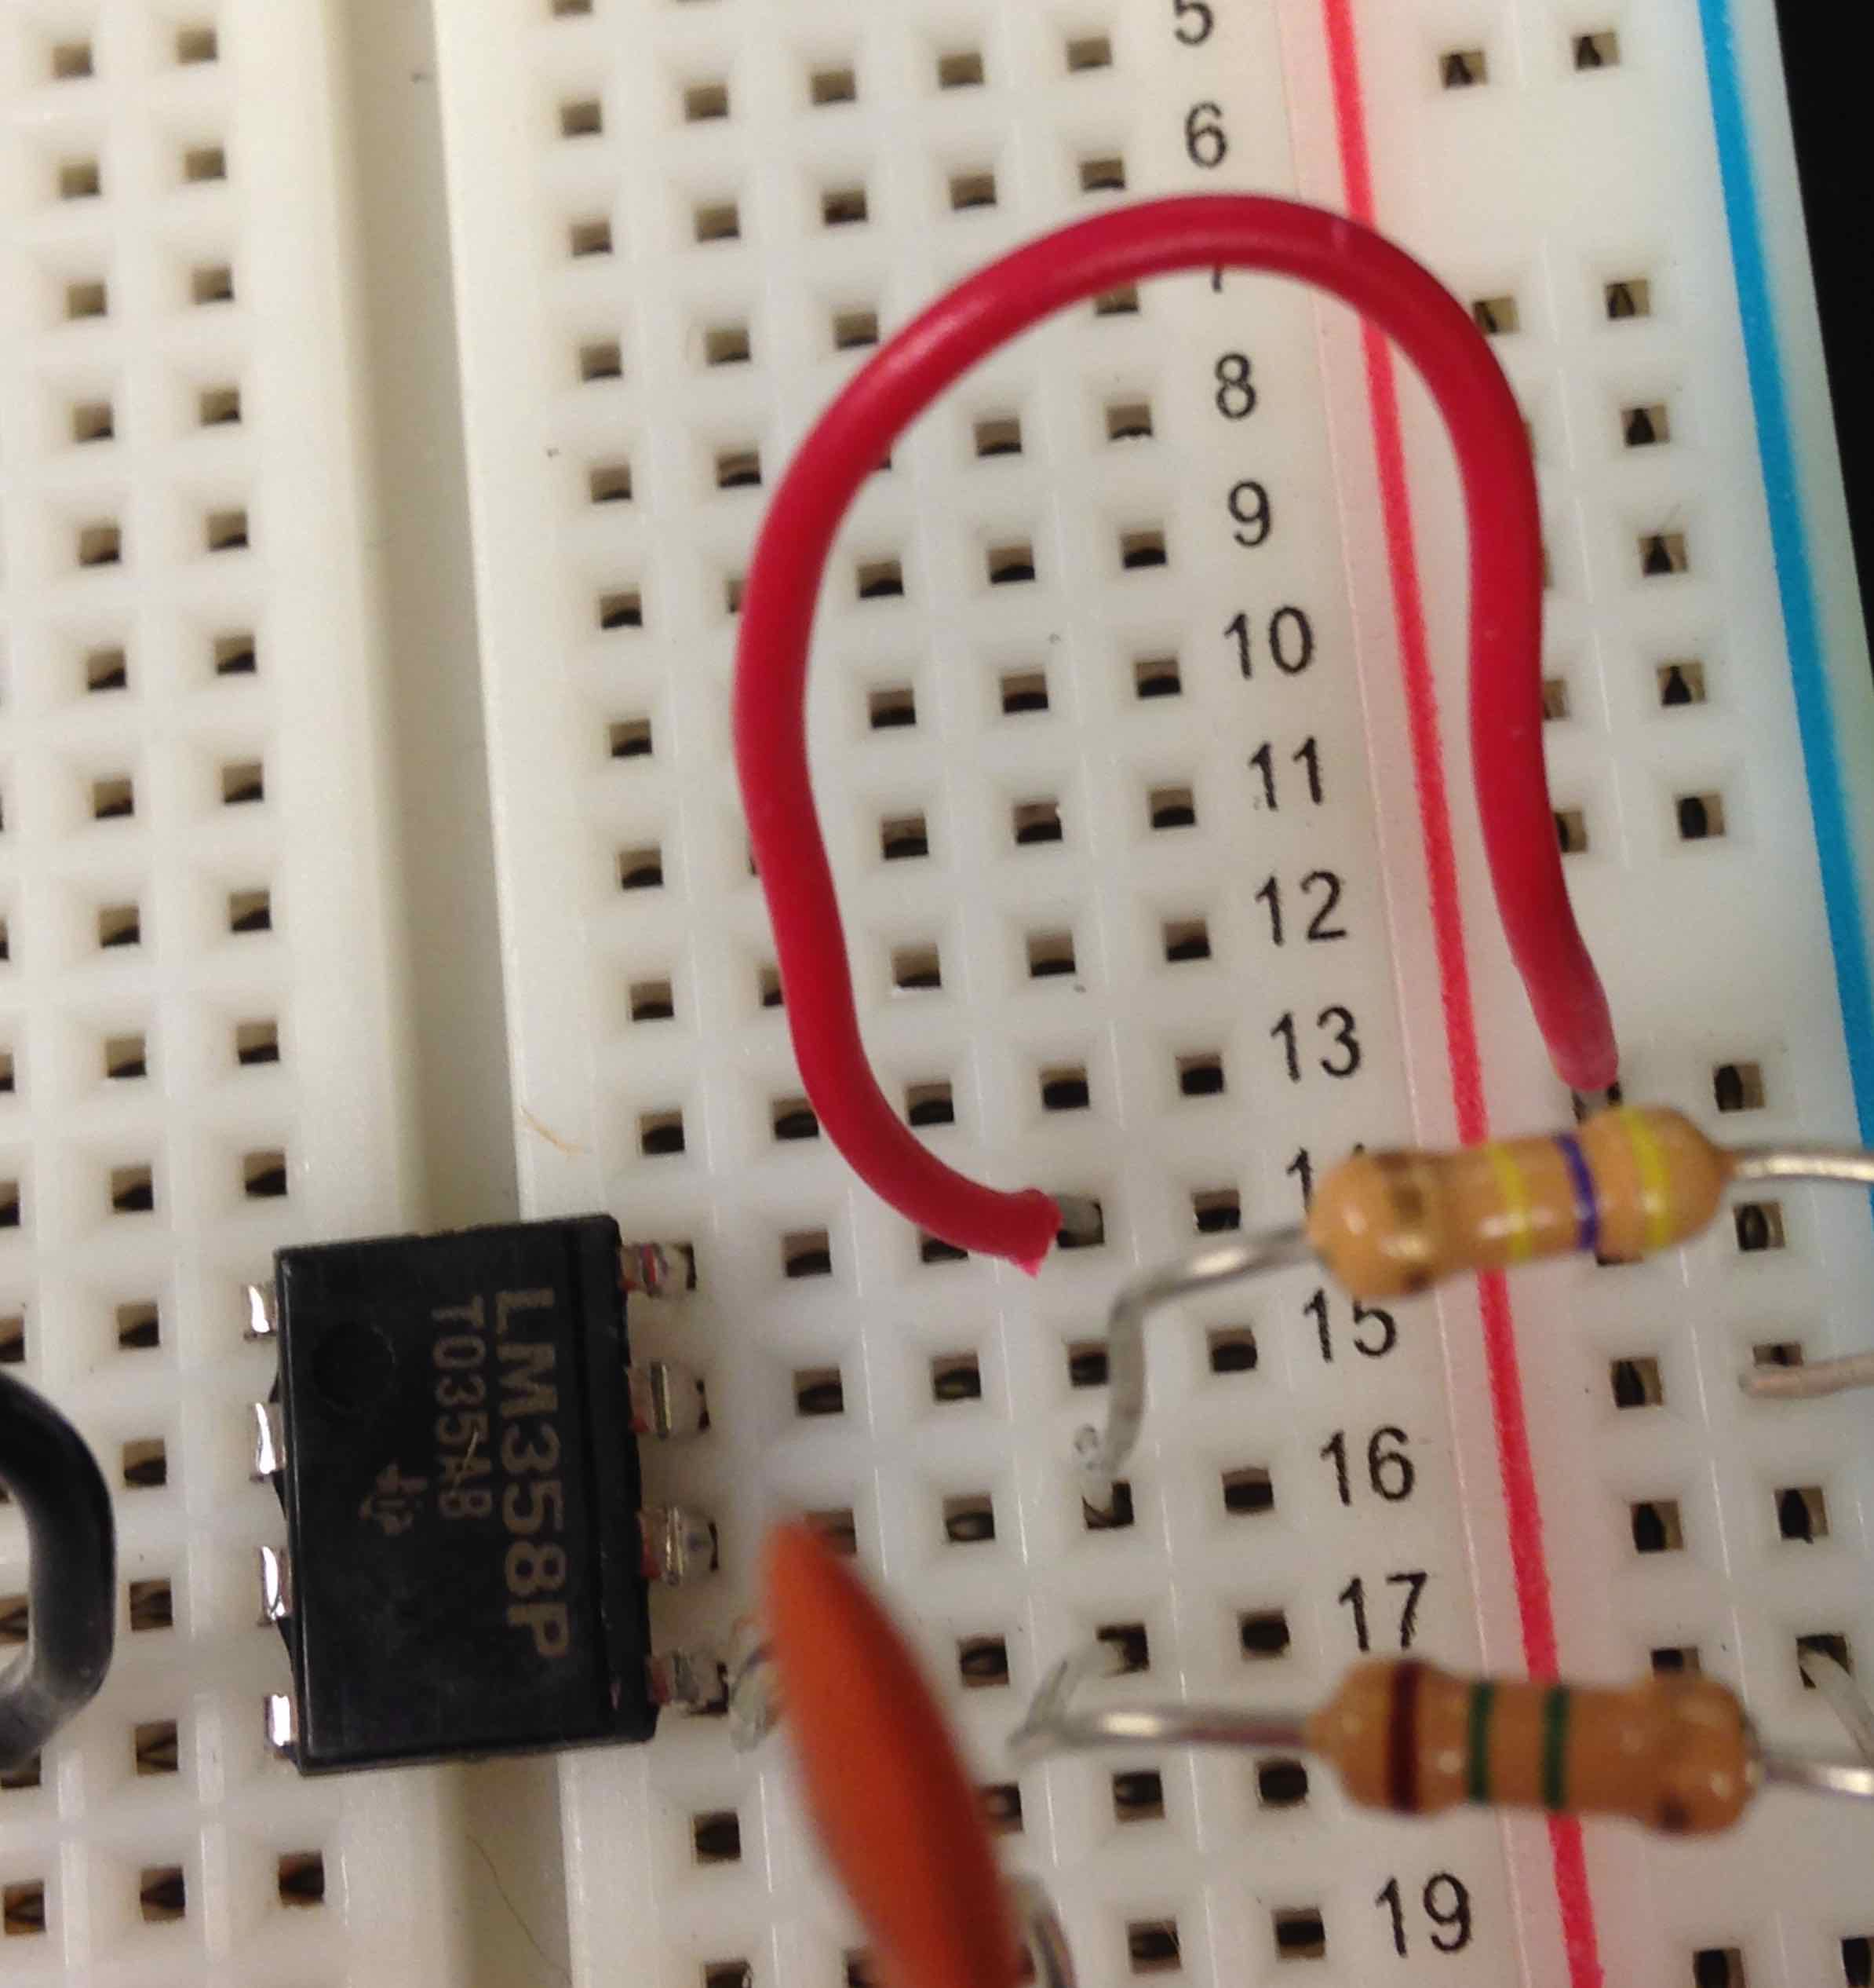
470K= yellow purple yellow

Slide 50
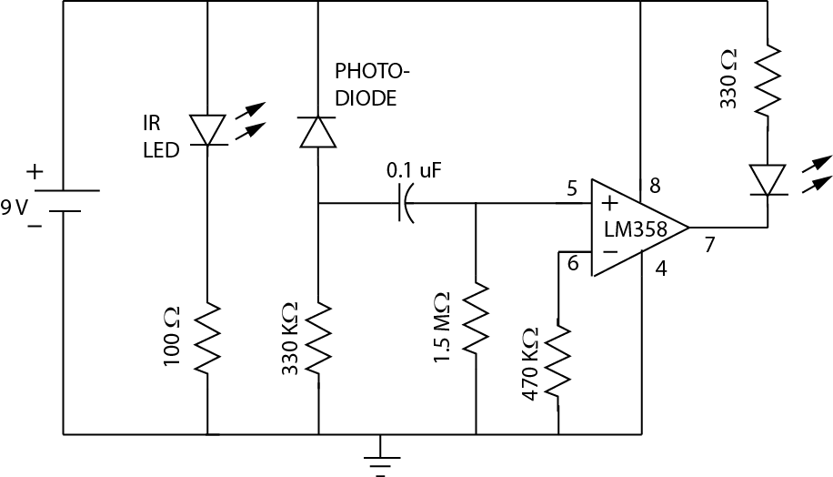
We’ve done all this

Slide 51
All that’s left is this!

Slide 52
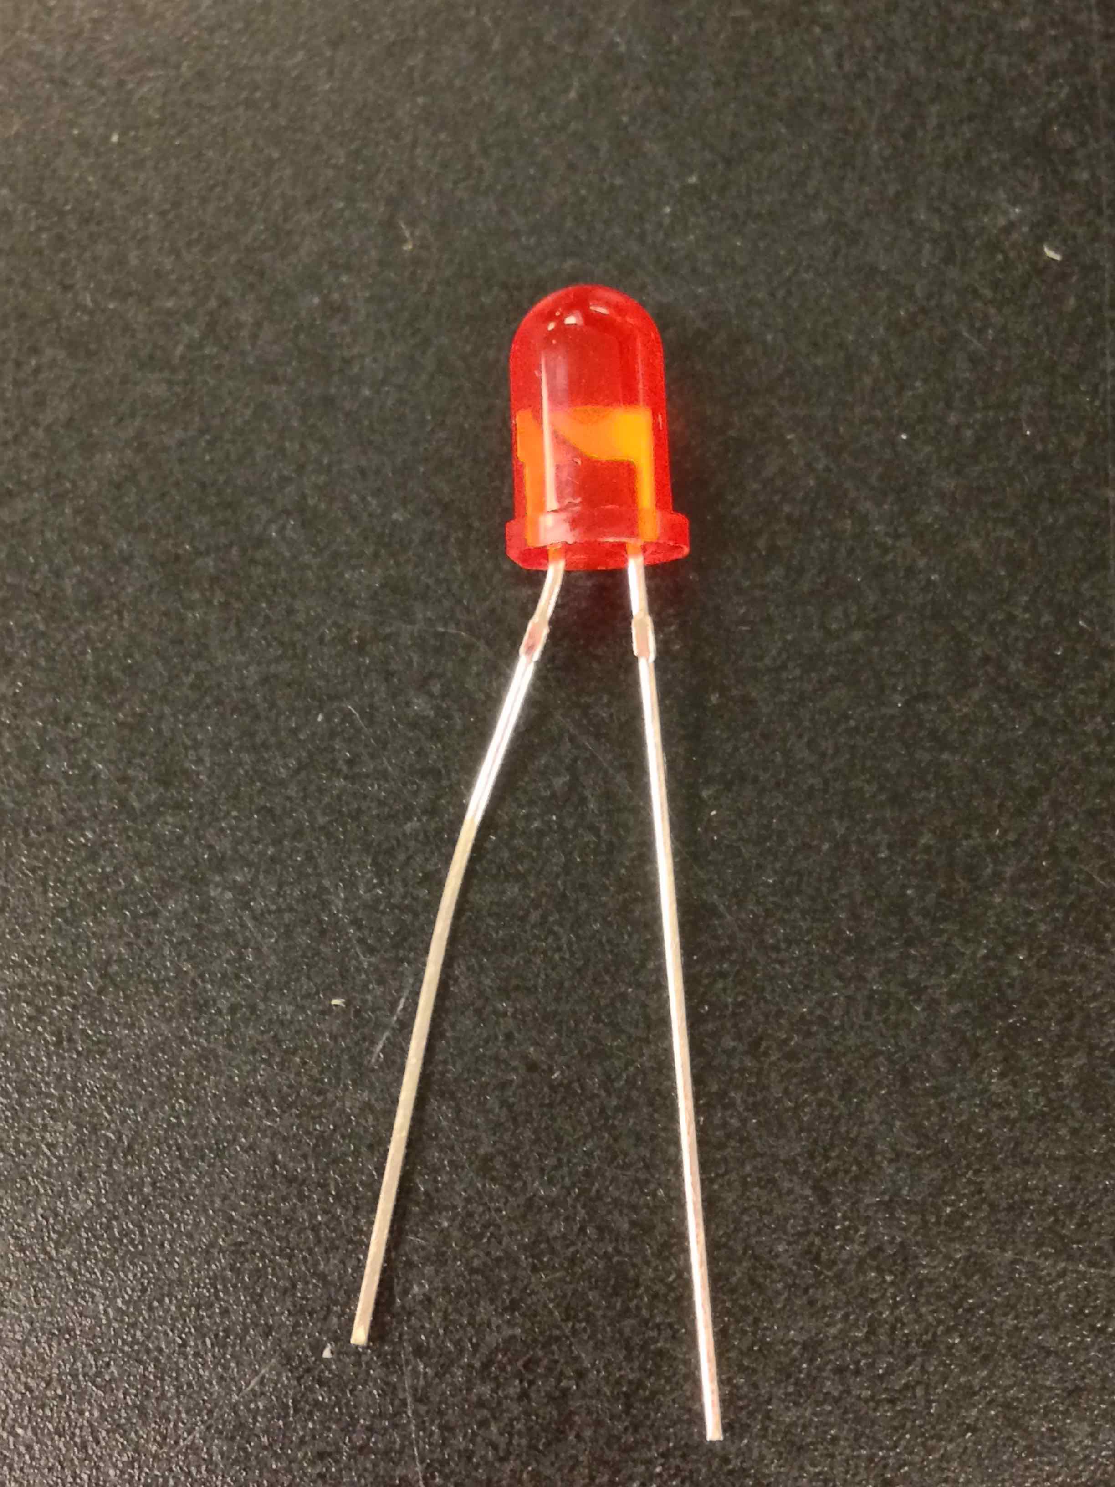
The LED has a long and short lead
Short lead is the Cathode!
Long lead is the Anode!

Slide 53
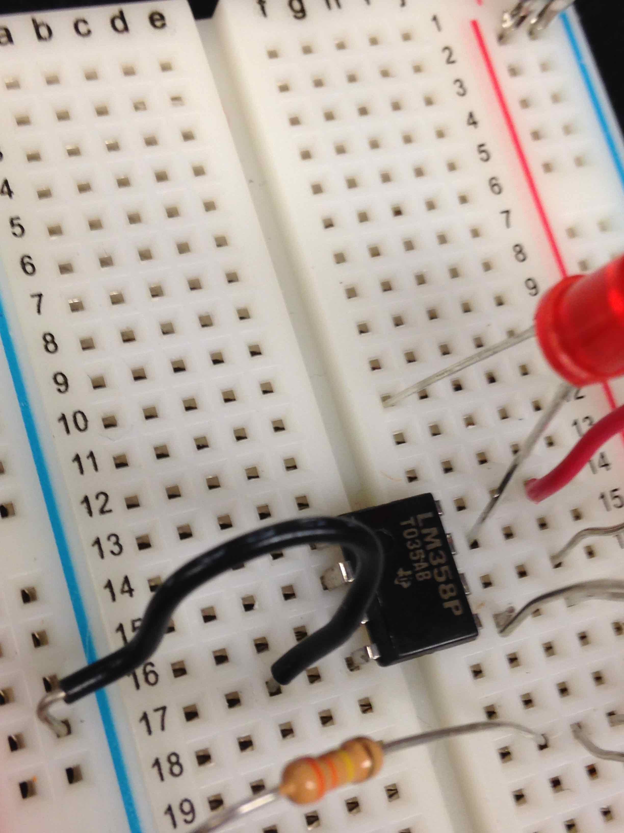
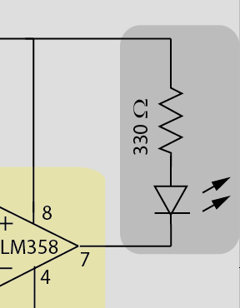
Connect cathode to pin 7
cathode

Slide 54
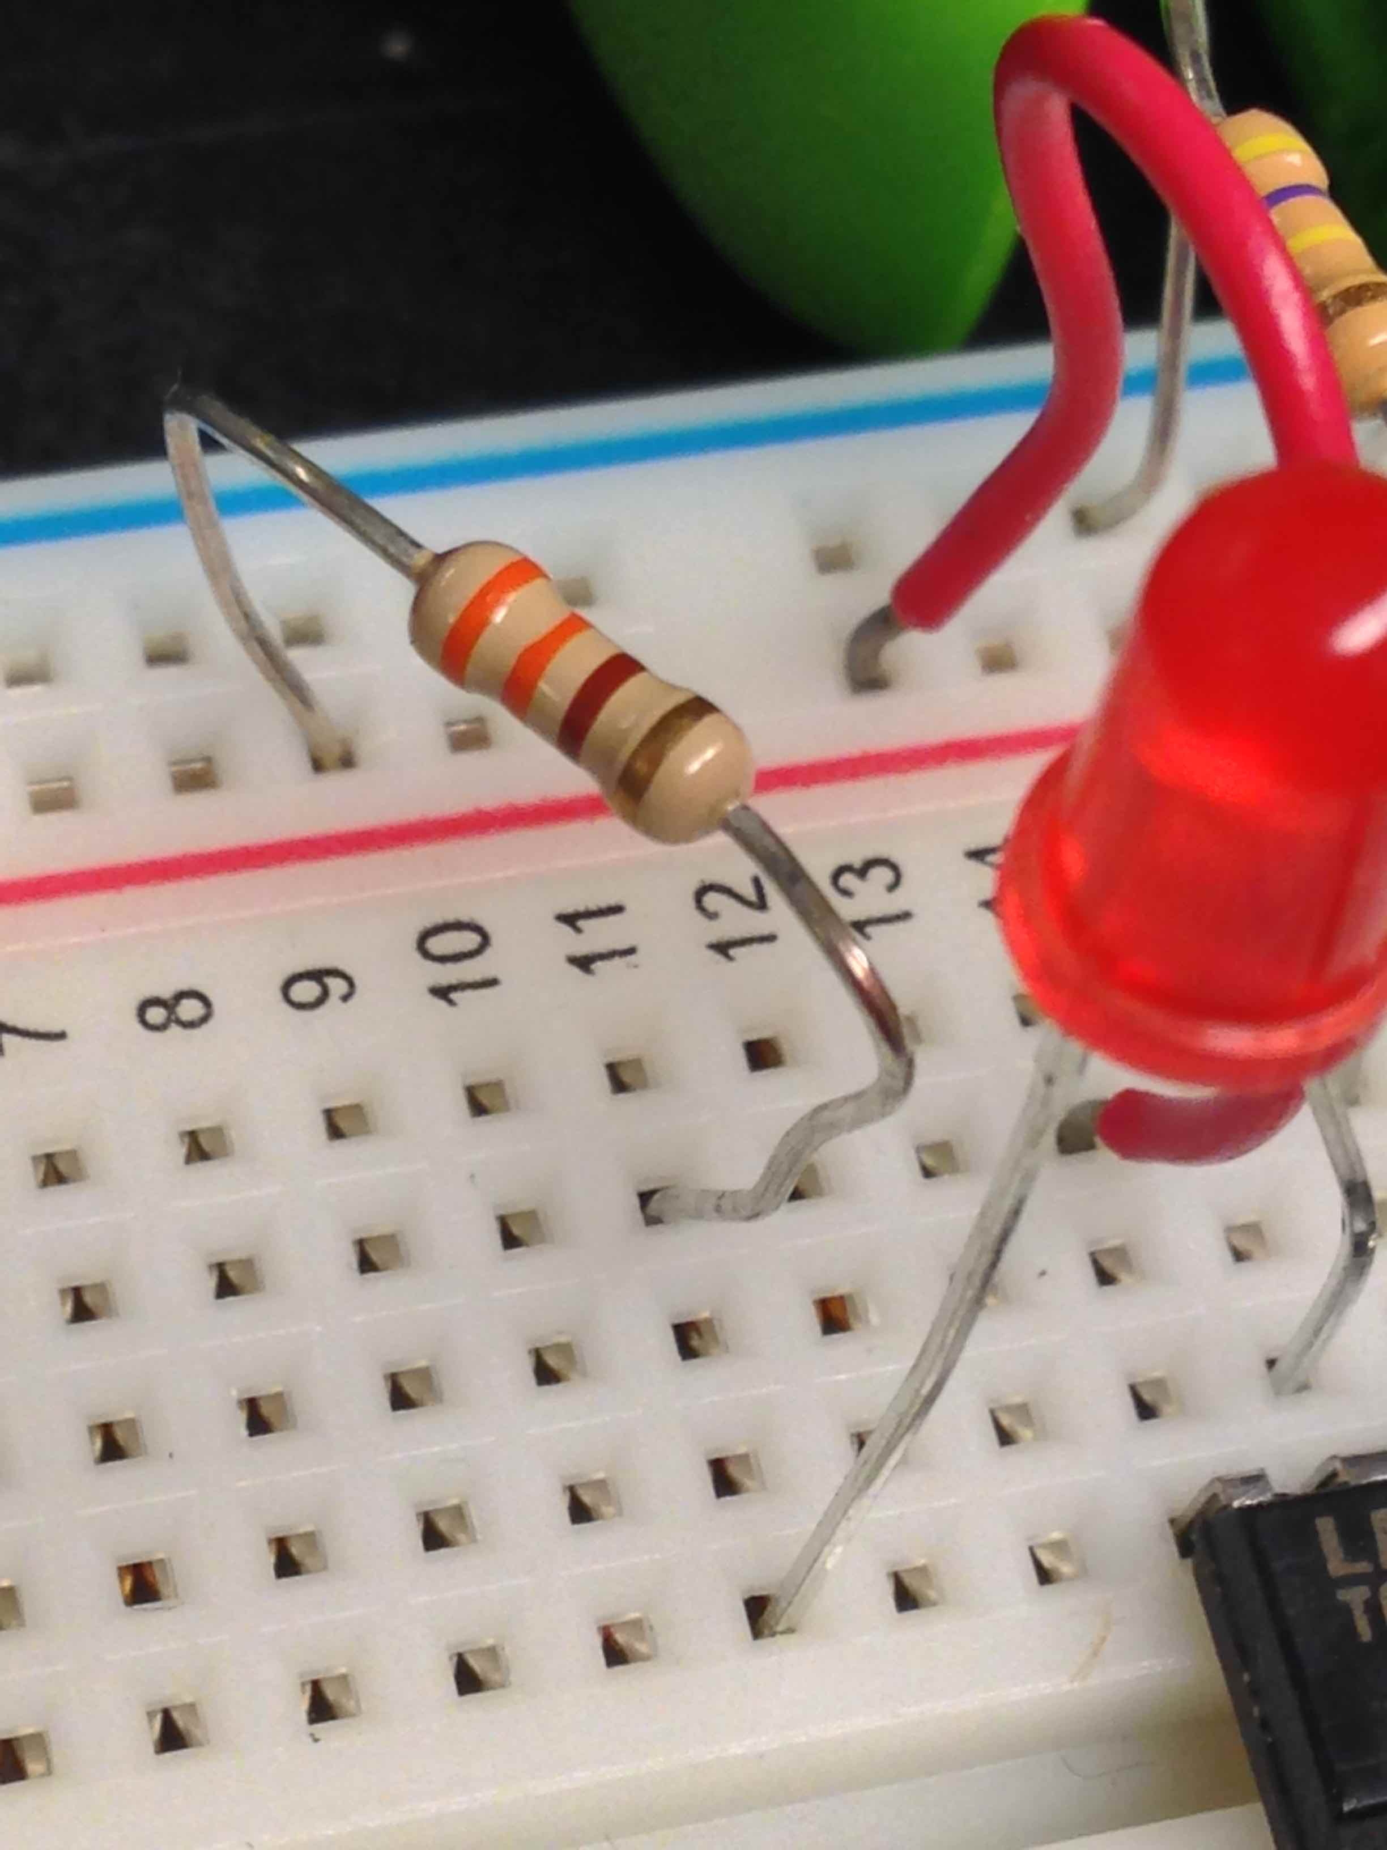
330= orange orange brown

Slide 55
To operate
Put clip on tip of finger
If everything is working correctly, moving your finger in the clip should cause the LED to blink. If the LED never, ever blinks there is a problem with your circuit or one of the parts. (E.g. dead battery)
Adjust screw to make pressure gentle
Hold very still
Light should begin to blink with your pulse
If you see a double blink with each pulse, you can move the clip to a thicker part of your finger (try a joint)

Slide 56
Here’s what you’ve built
330

