Slide 1


Op-Amp Oscillator

Slide 2
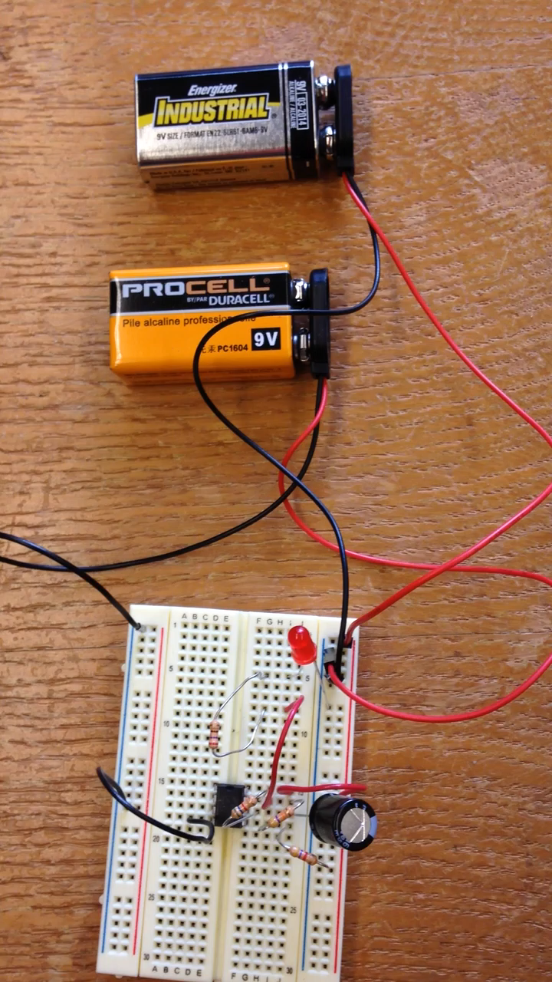
Here’s what you will build

Slide 3
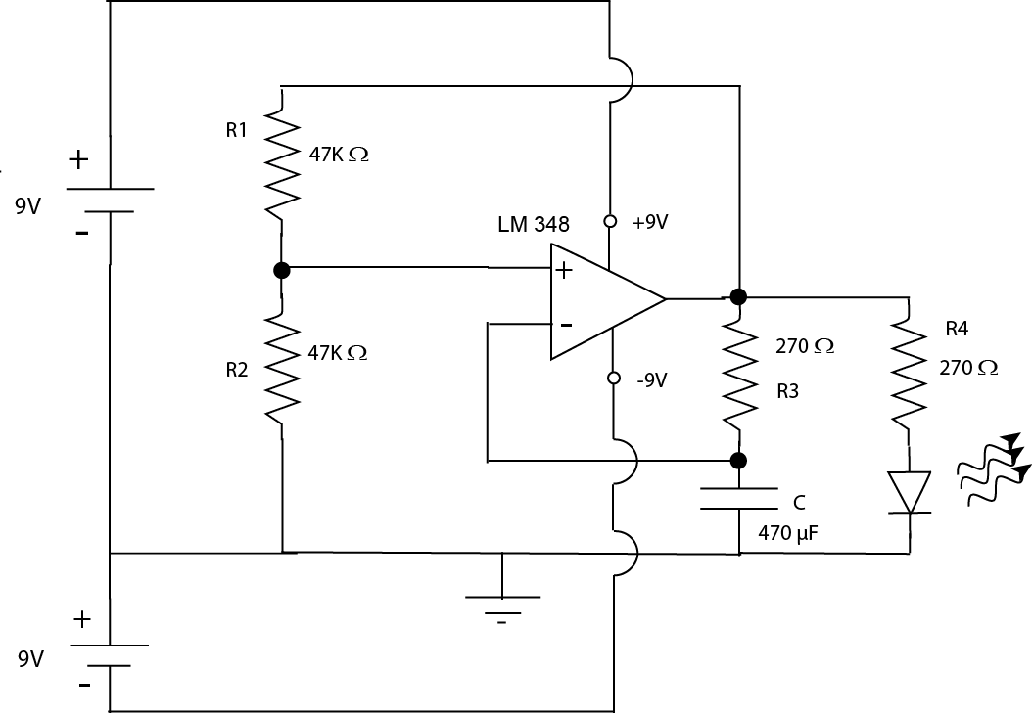
And here’s the schematic diagram
Each icon on the schematic represents an actual component

Slide 4
We’ll see what each component is first
Then we’ll see how they work together to make the oscillator

Slide 5
Each icon on the schematic represents an actual component

Slide 6
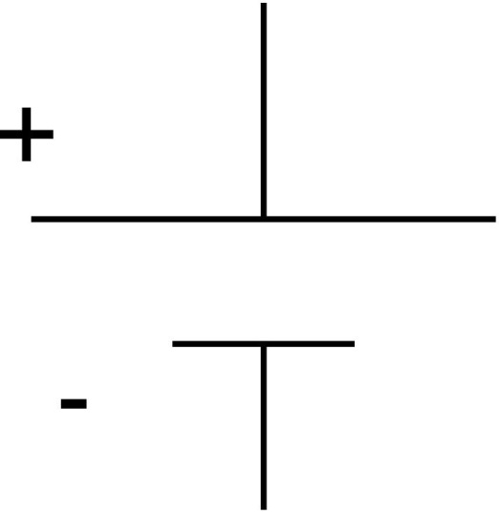

Reading Schematics:
What’s this?
Battery

Slide 7
Each icon on the schematic represents an actual component

Slide 8

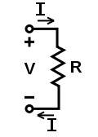

How about this?
Resistor
Current flowing through it creates a voltage

Slide 9
Each icon on the schematic represents an actual component

Slide 10
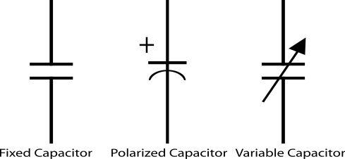
Capacitor
Store electrical energy in an electric field (static electricity).
Uses include:
  Timing circuits
  Coupling circuits
  Energy storage
  Bypass circuits
  Filter circuits
Eric Schrader
CC BY-SA 2.0

Slide 11
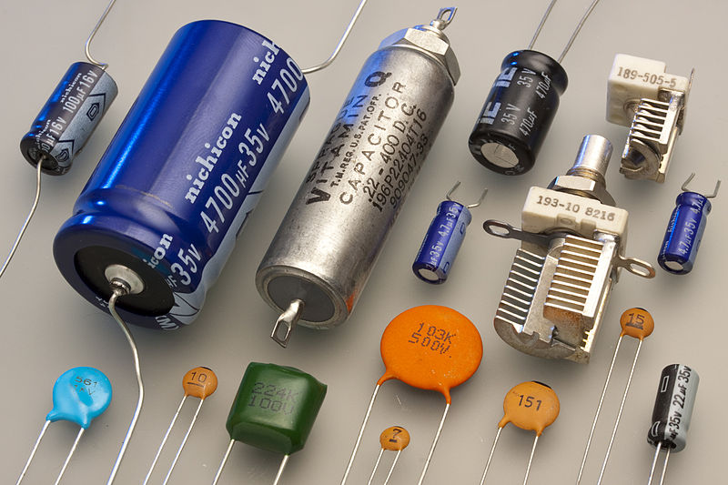
Capacitors
Eric Schrader
CC BY-SA 2.0

Slide 12
Each icon on the schematic represents an actual component

Slide 13

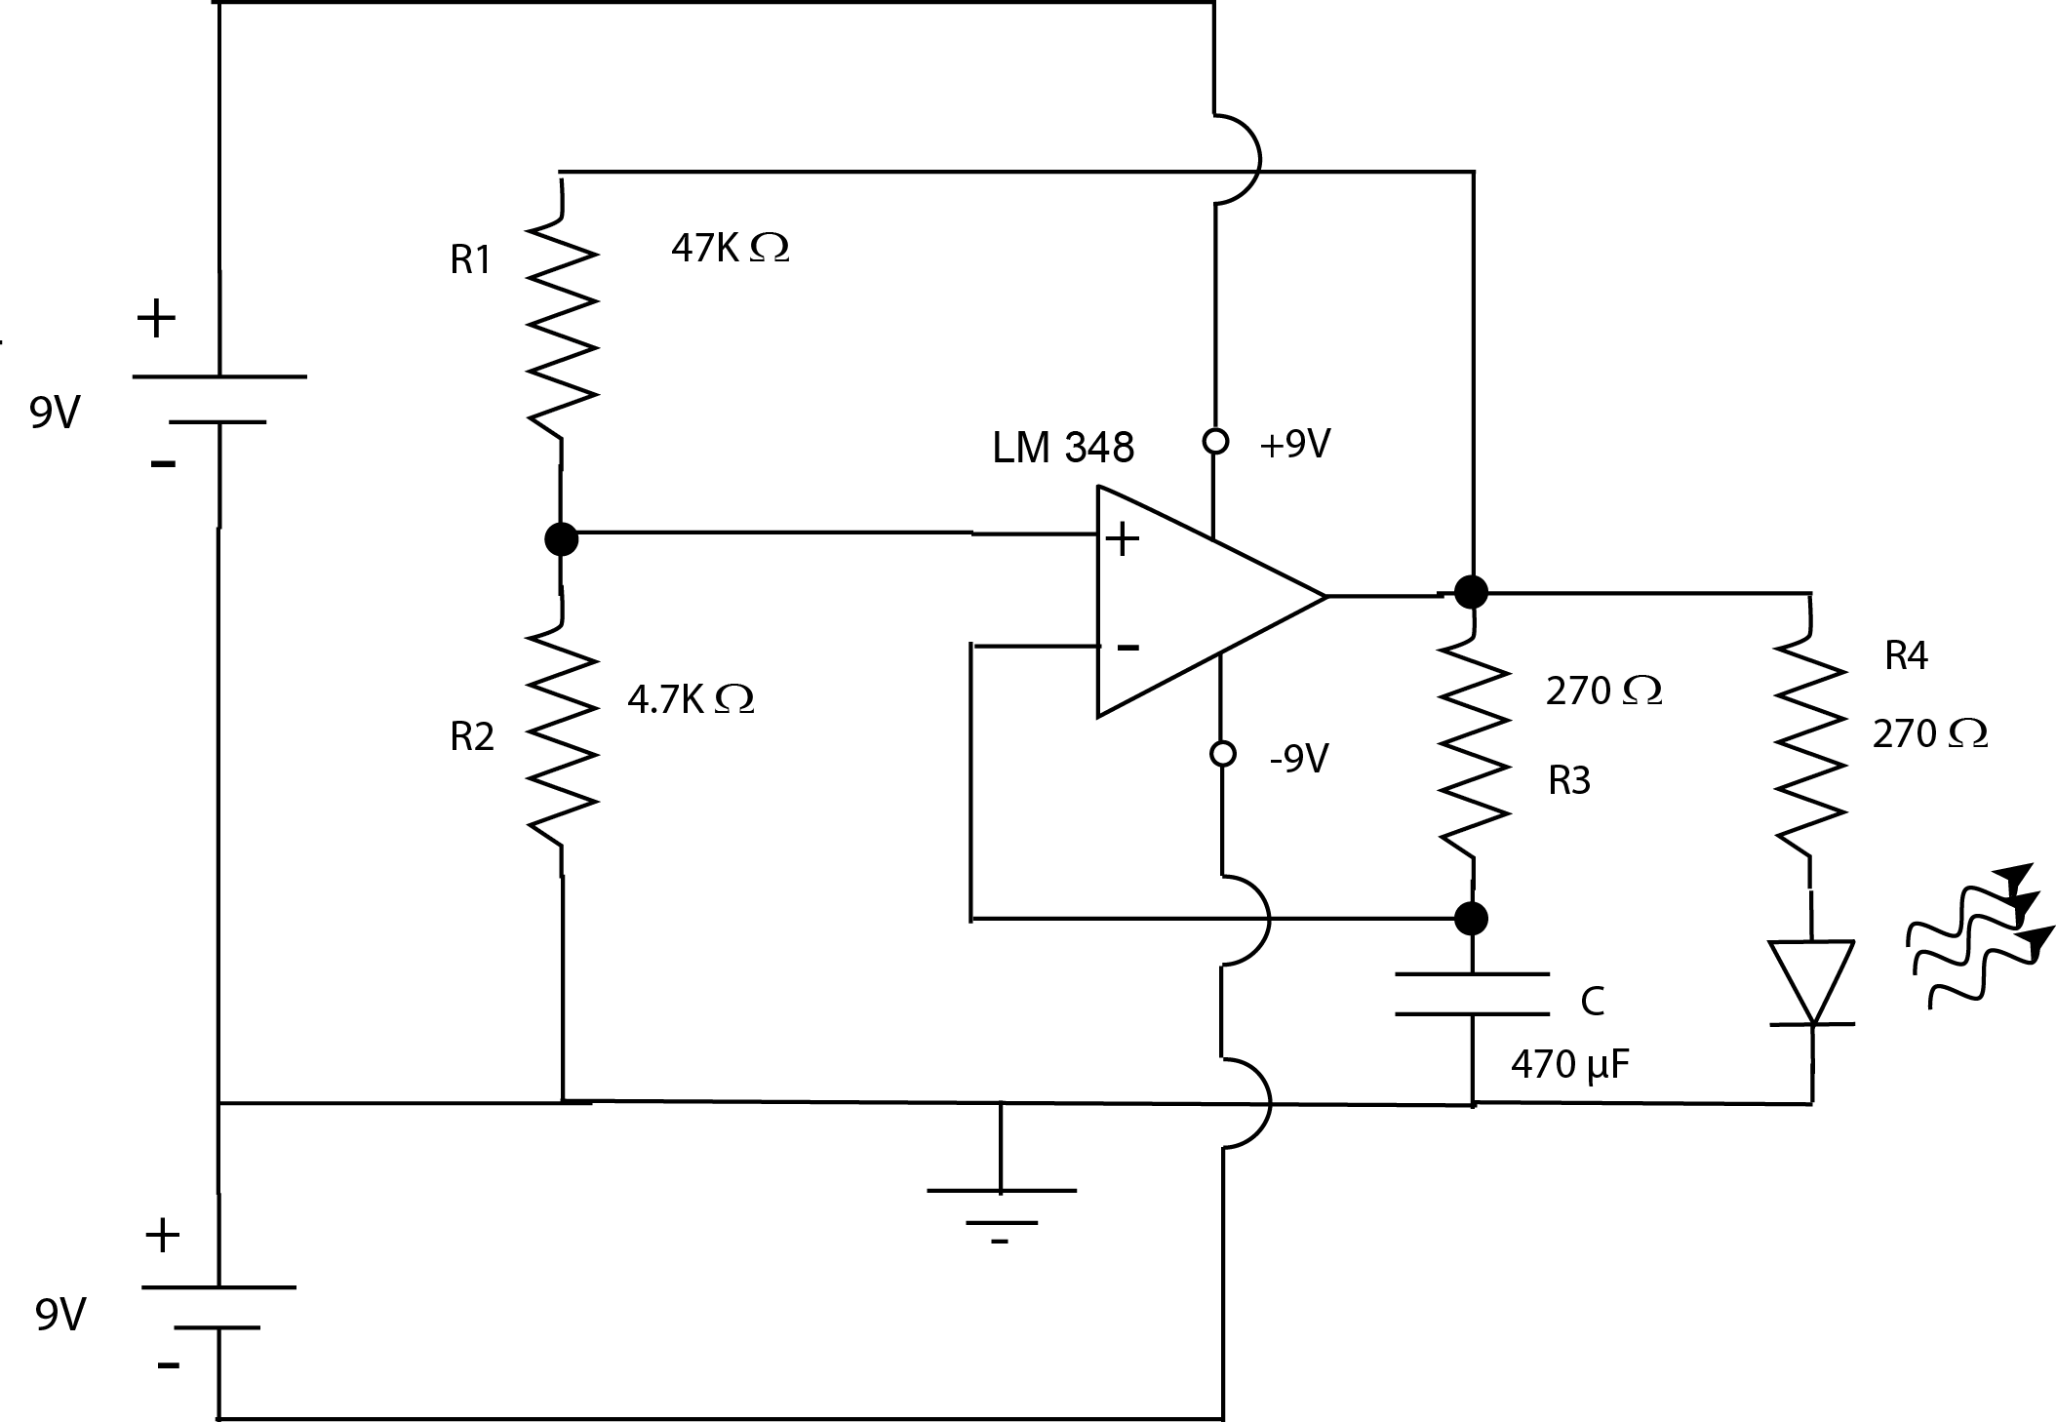
Operational amplifier
Has two inputs
Function depends on circuit around it
  Highly versatile
We’ll use one
  It will function as a comparator

Slide 14
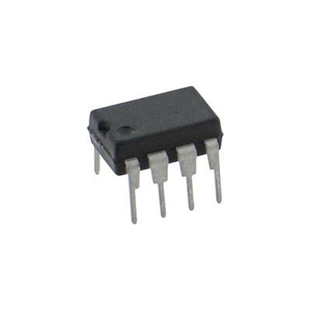
Two come in one package
Indicates pin numbering
NOTE DIMPLE

Slide 15
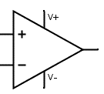
Comparator
Output depends on which input has a higher voltage
  If inverting input is higher, output is V-
  If non-inverting input is higher, output is V+

Slide 16
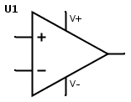
Comparator
What will the output be?
+9V
2 V
?
4 V
-9V

Slide 17
Comparator
What will the output be?
+9V
2 V
-9V
4 V
-9V

Slide 18
Comparator
What will the output be?
+9V
6V
?
4 V
-9V

Slide 19
Comparator
What will the output be?
+9V
6 V
+9V
4 V
-9V

Slide 20
Each icon on the schematic represents an actual component

Slide 21

What’s this?
Diode
  Lets current flow one direction but not the other
LED: current flow produces light
YES
X
NO

Slide 22
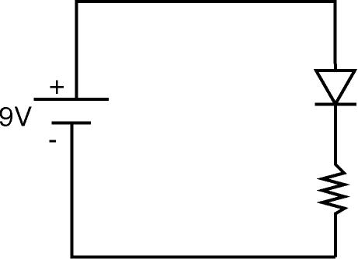
Will current flow?

Slide 23

How about here?

Slide 24
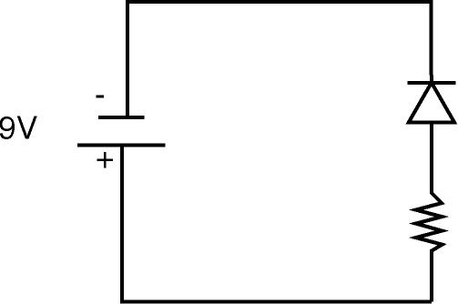
And here?

Slide 25
Each icon on the schematic represents an actual component

Slide 26
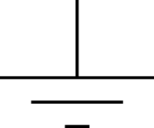
“Ground”
We’ll use it as a reference point
Anything connected to ground is by definition at zero volts

Slide 27
Quiz
What is the voltage here?
It is 9V higher than ground
Ground is at 0 V
Thus this point is at +9 V
0V

Slide 28
Quiz
Ground is 9 V above this point
Ground is at 0 volts
Thus this point is at -9 V
0V
What is the voltage here?

Slide 29
Let’s start with the voltage divider

Slide 30
Remember the resistor
What is the voltage here?
It’s at ground
It’s at zero volts

Slide 31
Remember the resistor
What is the voltage here?
It’s 9V above ground
It’s at +9V

Slide 32
What do you think the voltage is here?
The arrow is halfway between +9V and 0 V
The voltage there is +4.5 V
How much resistance is above the arrow?

Slide 33
How about now?
The arrow is 1/10th of the way up the resistor
How much resistance is below the arrow?
10 Ohms
What is the voltage at this point?
1/10th of 9V=0.9 V

Slide 34
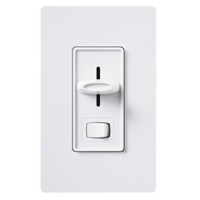
Kind of like a light dimmer switch
We can control the voltage by moving the lever, which Is just like moving the arrow

Slide 35
If we don’t need to change it, we can just use two resistors

Slide 36
If the output voltage is +9V
What is the voltage at the non-inverting input?
So about 1/2 of 9V

Slide 37
Let’s review
What is the voltage on the non-inverting input?
  It’s +4.5 V
If the inverting input is at 5 V, what is the output?
  The output goes to -9V
If the inverting input is at -4 volts, what is the output?
  The output goes to +9V
47KΩ
47KΩ

Slide 38
Notice our voltage divider is connected to the output!

Slide 39
What is the non-inverting input voltage if the output is high?

Slide 40
If the output is high, we have this
The non-inverting input is at +4.5 V
47KΩ
47KΩ

Slide 41
What is the non-inverting input voltage if the output is low?

Slide 42
Now the input is 1/2 of -9V
So the non-inverting input (the reference) changes with the output voltage
47KΩ
47KΩ

Slide 43
Let’s look at the other input

Slide 44
Suppose output is high
Remember a capacitor can store charge
Suppose there is no charge on it to start with
The instant you connect the battery, the capacitor starts to charge
  Current (electrons) flow to the capacitor and charge it up
  That takes time

Slide 45
Here’s the voltage on the capacitor
It keeps charging until it reaches +9V
That’s as far as it can go
http://www.s-cool.co.uk/a-level/physics/capacitors/revise-it/charging-and-discharging

Slide 46
But the output (of the op amp) could be at -9V!

Slide 47
Now the capacitor wants to discharge
But it will discharge to –9V
http://www.s-cool.co.uk/a-level/physics/capacitors/revise-it/charging-and-discharging

Slide 48
Whew! That’s a lot of stuff!
Let’s put it all together

Slide 49
Suppose the starting conditions are:
Output is high
What is the voltage on the +input?
The capacitor has no charge (0 V)

Slide 50
What is the output?
The output is at +9 V
The capacitor starts to charge
What happens when the capacitor voltage becomes greater than the non-inverting input?

Slide 51
What will happen?
Right! The output will switch to low when the inverting input gets bigger than the non-inverting!
4.5V

Slide 52
What will happen to the non-inverting input?
It will go to -4.5 V
4.5V
-4.5V

Slide 53
Now which is higher, the inverting or non-inverting input?
-4.5 V
+4.5 V
The inverting!
So the output stays low

Slide 54
Until the inverting input gets smaller than the non-inverting one
Then the output will go high again
But that means the non-inverting input also goes positive
Now the capacitor starts to charge up again
4.5V

Slide 55
The process continues
4.5V

Slide 56
How will we know if it’s working?
Add an LED at the output

Slide 57
What’s this?
Diode
  Lets current flow one direction but not the other
LED: current flow produces light
YES
X
NO

Slide 58
Will current flow?

Slide 59
How about here?

Slide 60
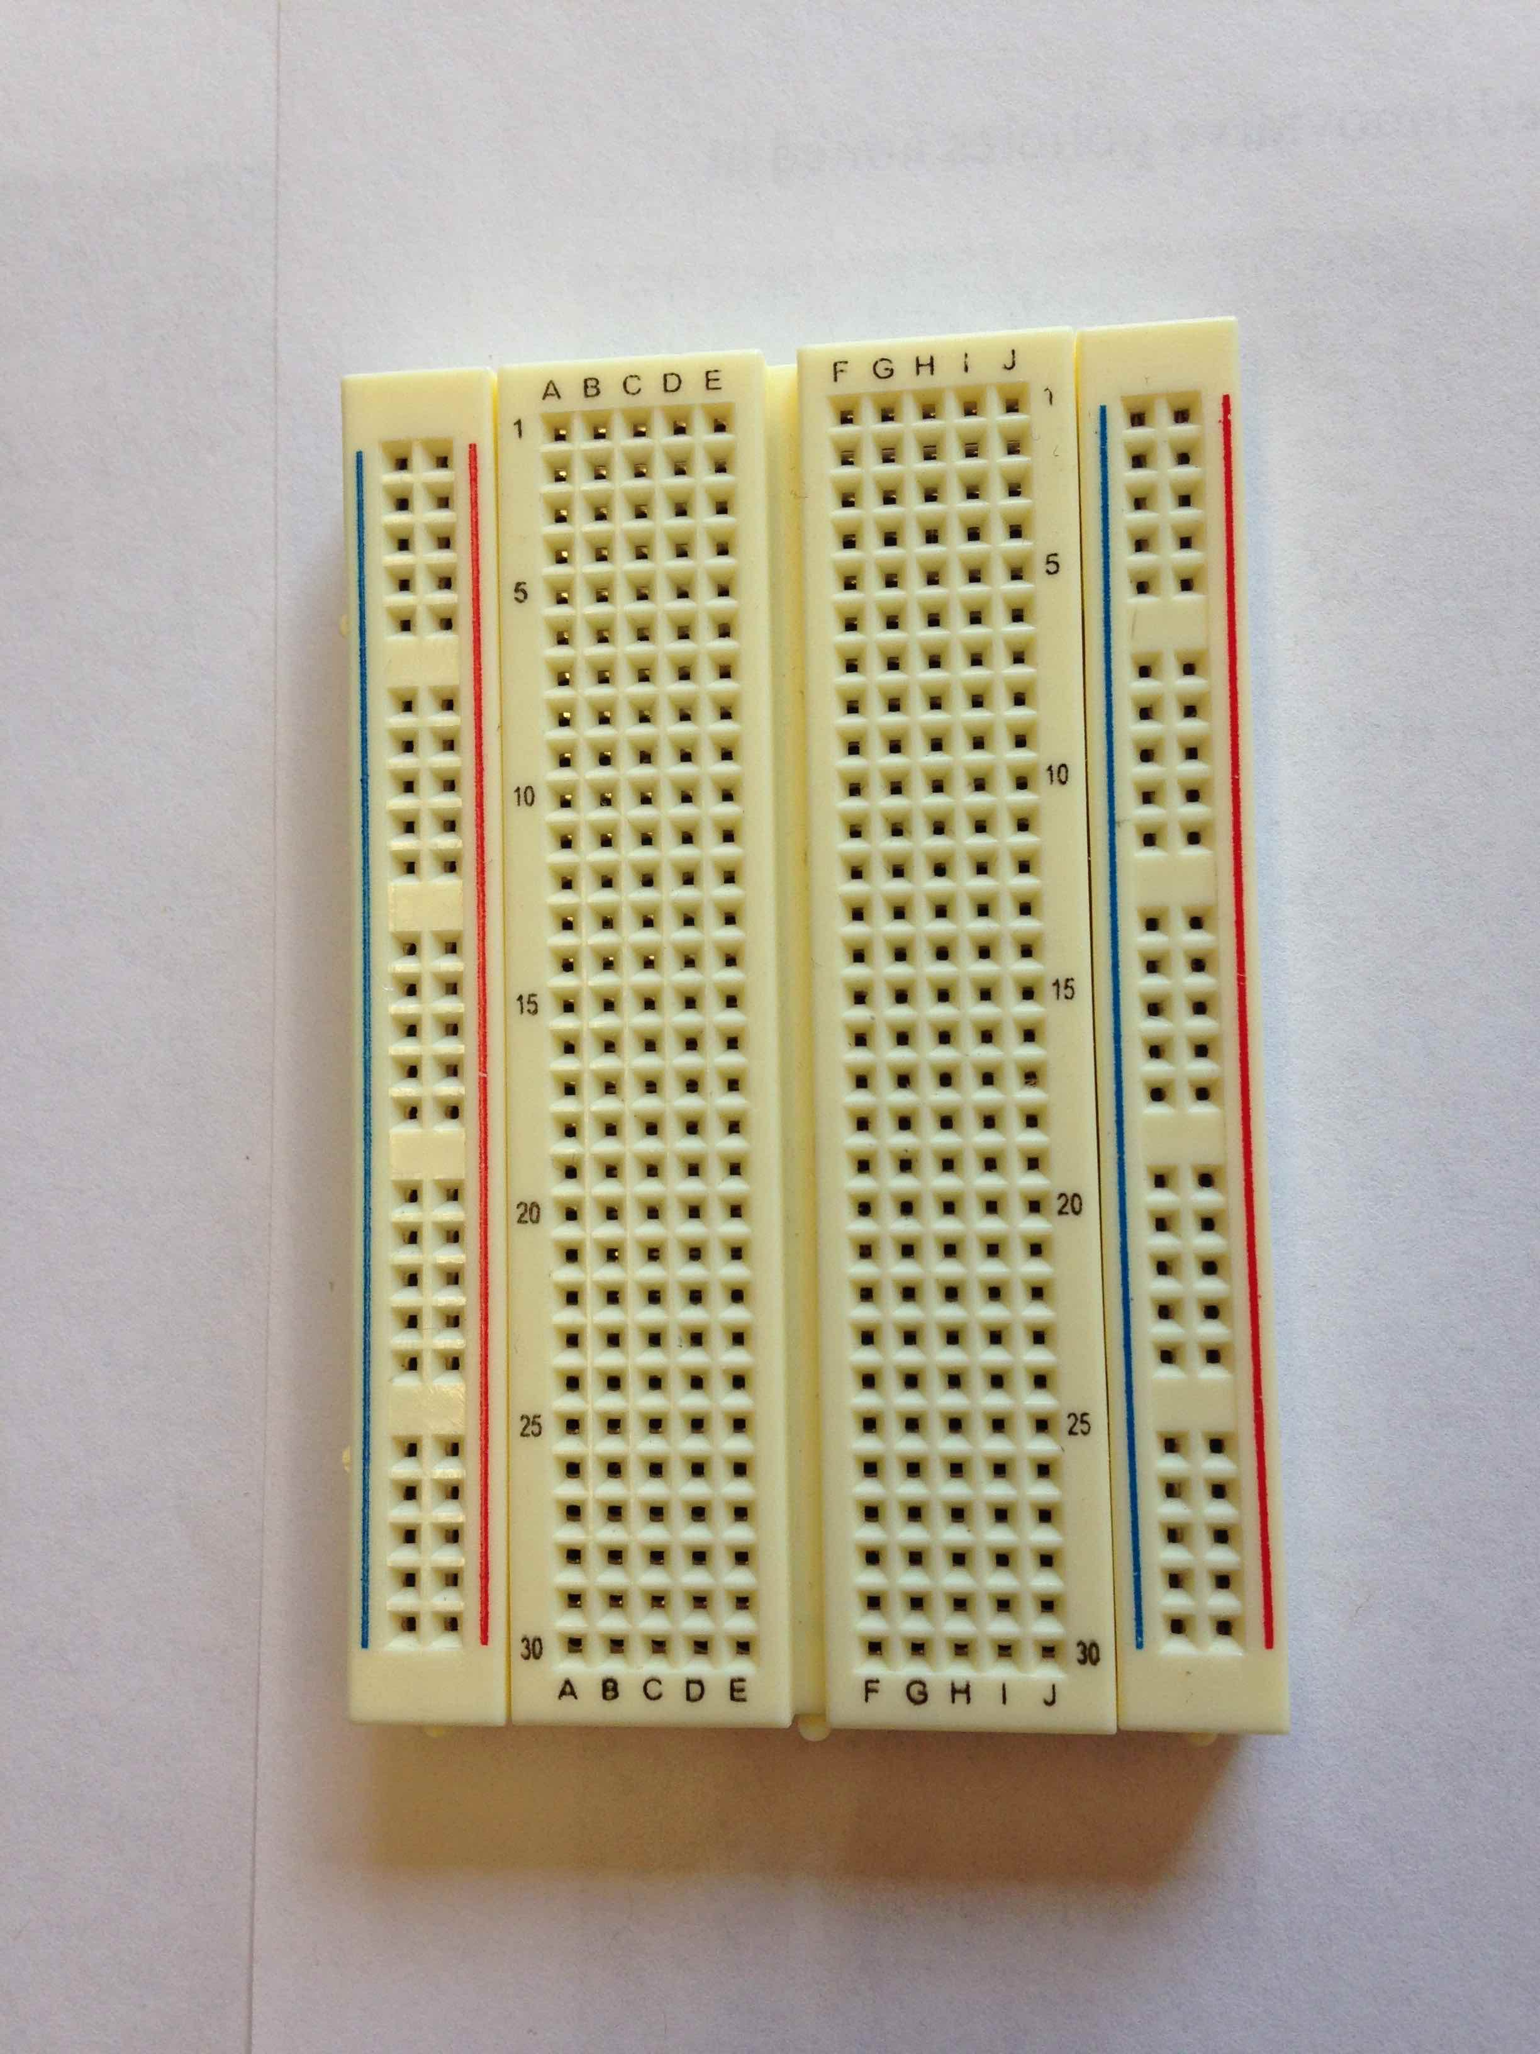
The breadboard

Slide 61
The buses
Every hole along this green line is electrically connected

Slide 62
There are four buses you can use

Slide 63
All rows connected too

Slide 64
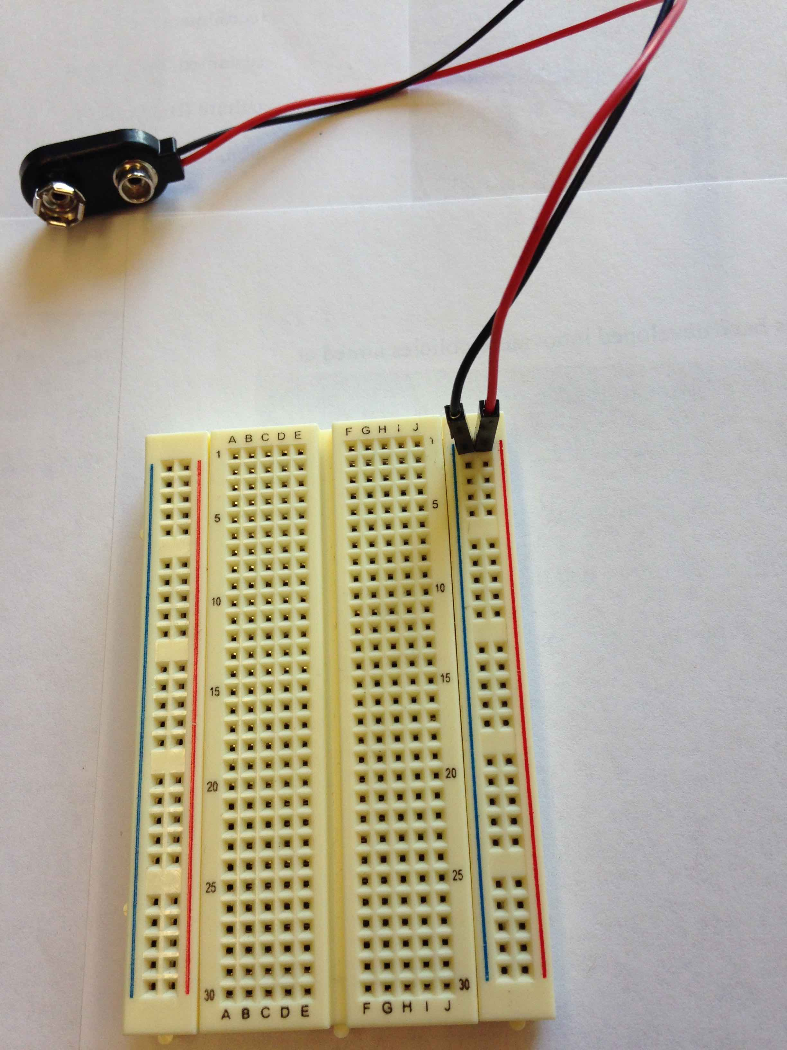
Battery snaps first!

Slide 65
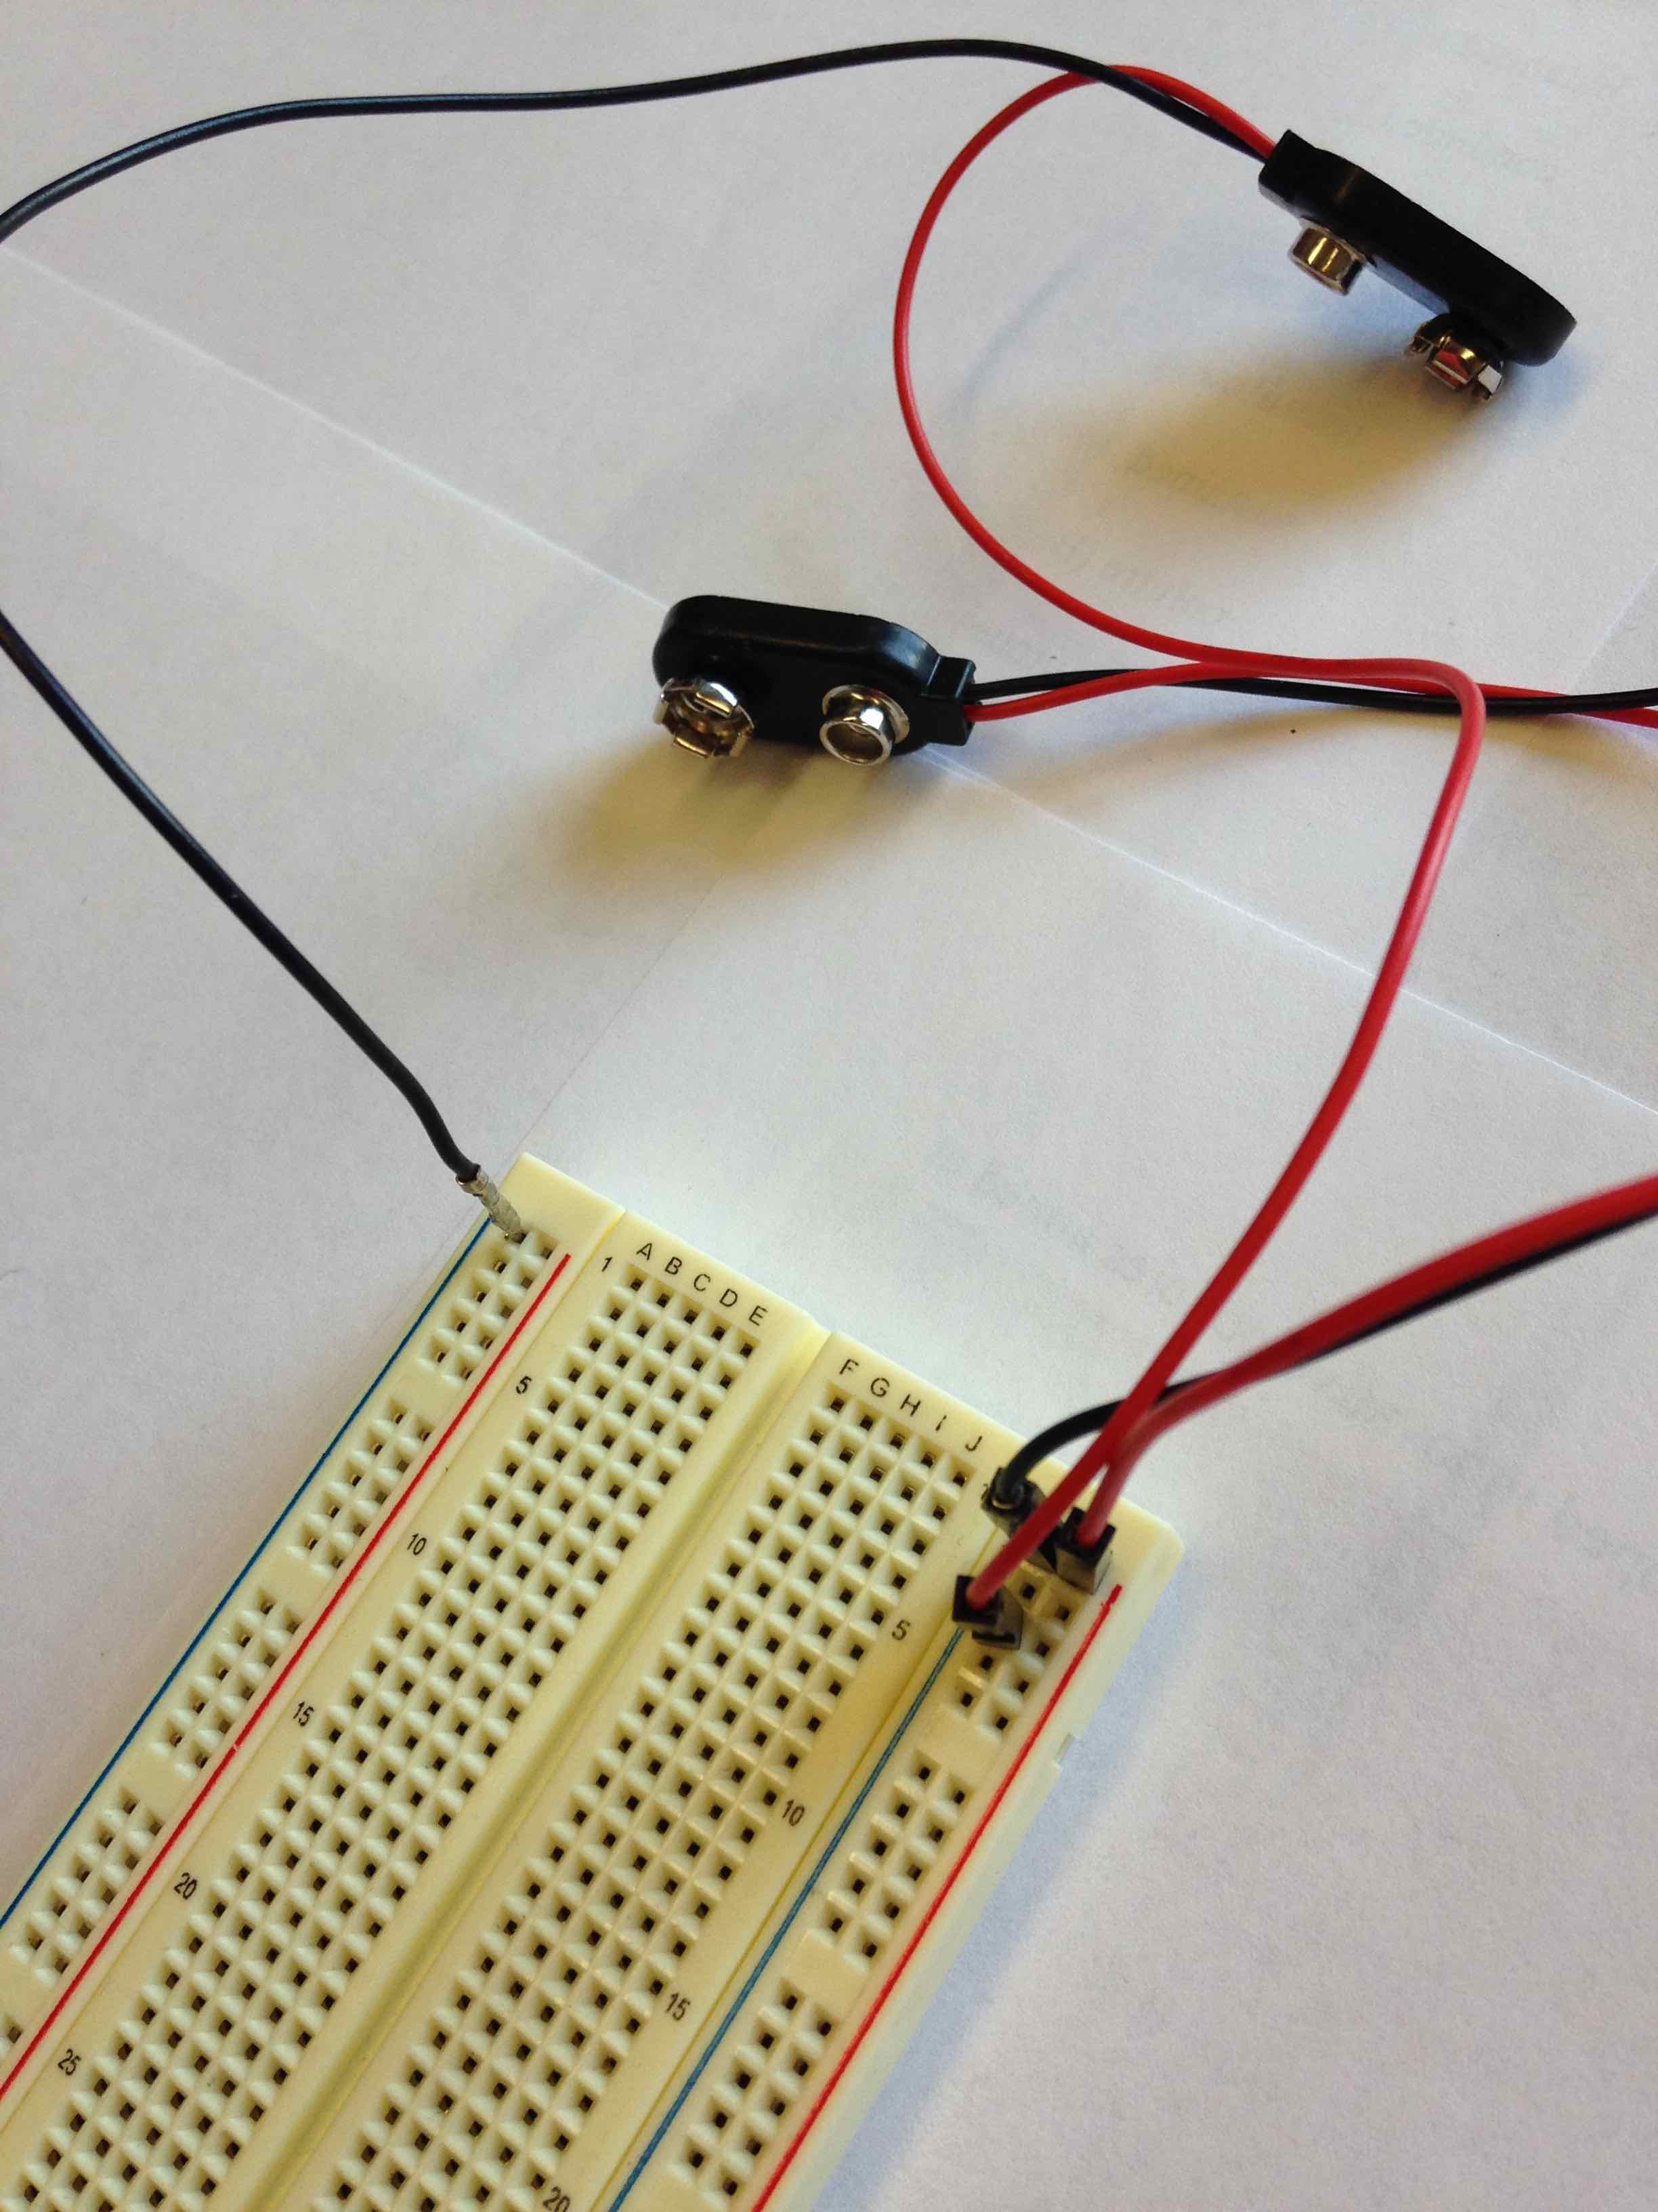
Battery snaps first!

Slide 66
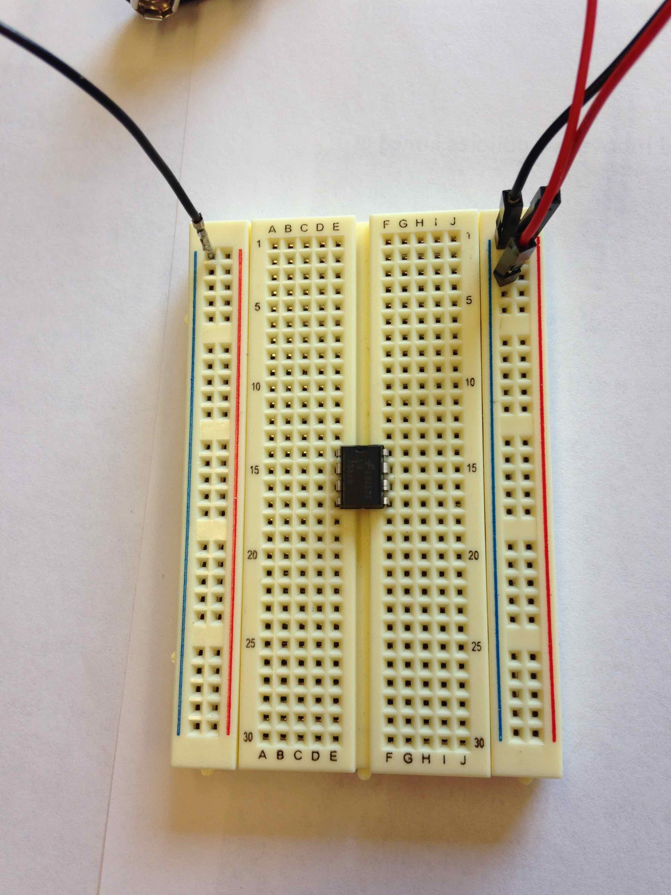
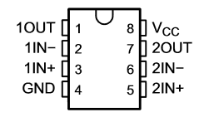
Place chip in board
Dot or divot means up!
Note pin numbering scheme

Slide 67
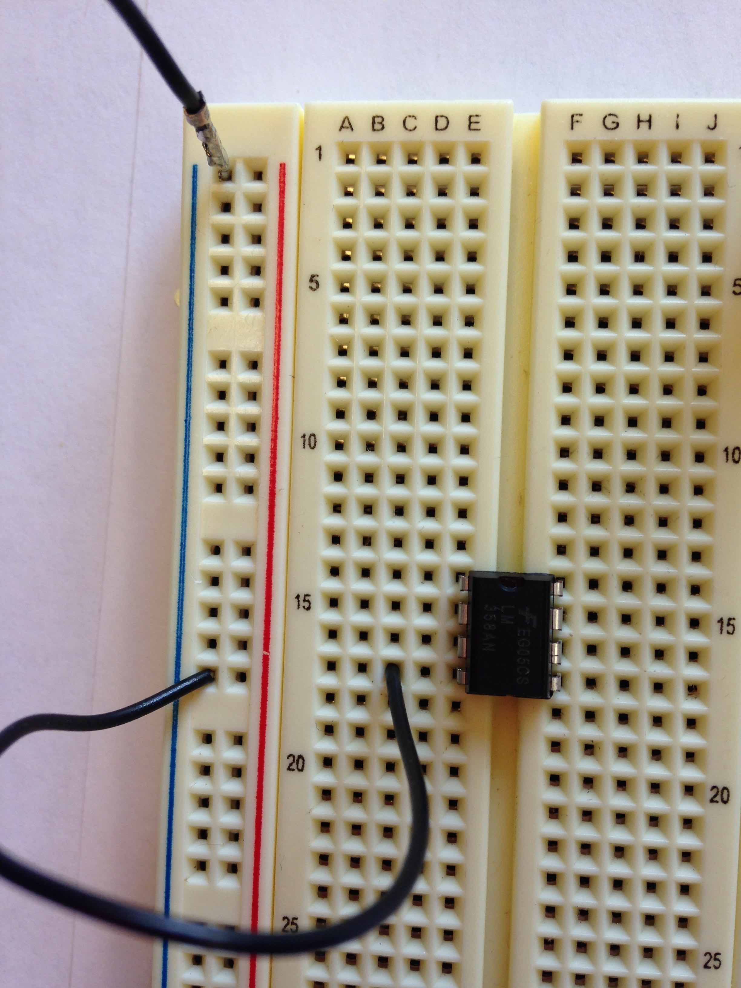
Connect negative supply

Slide 68
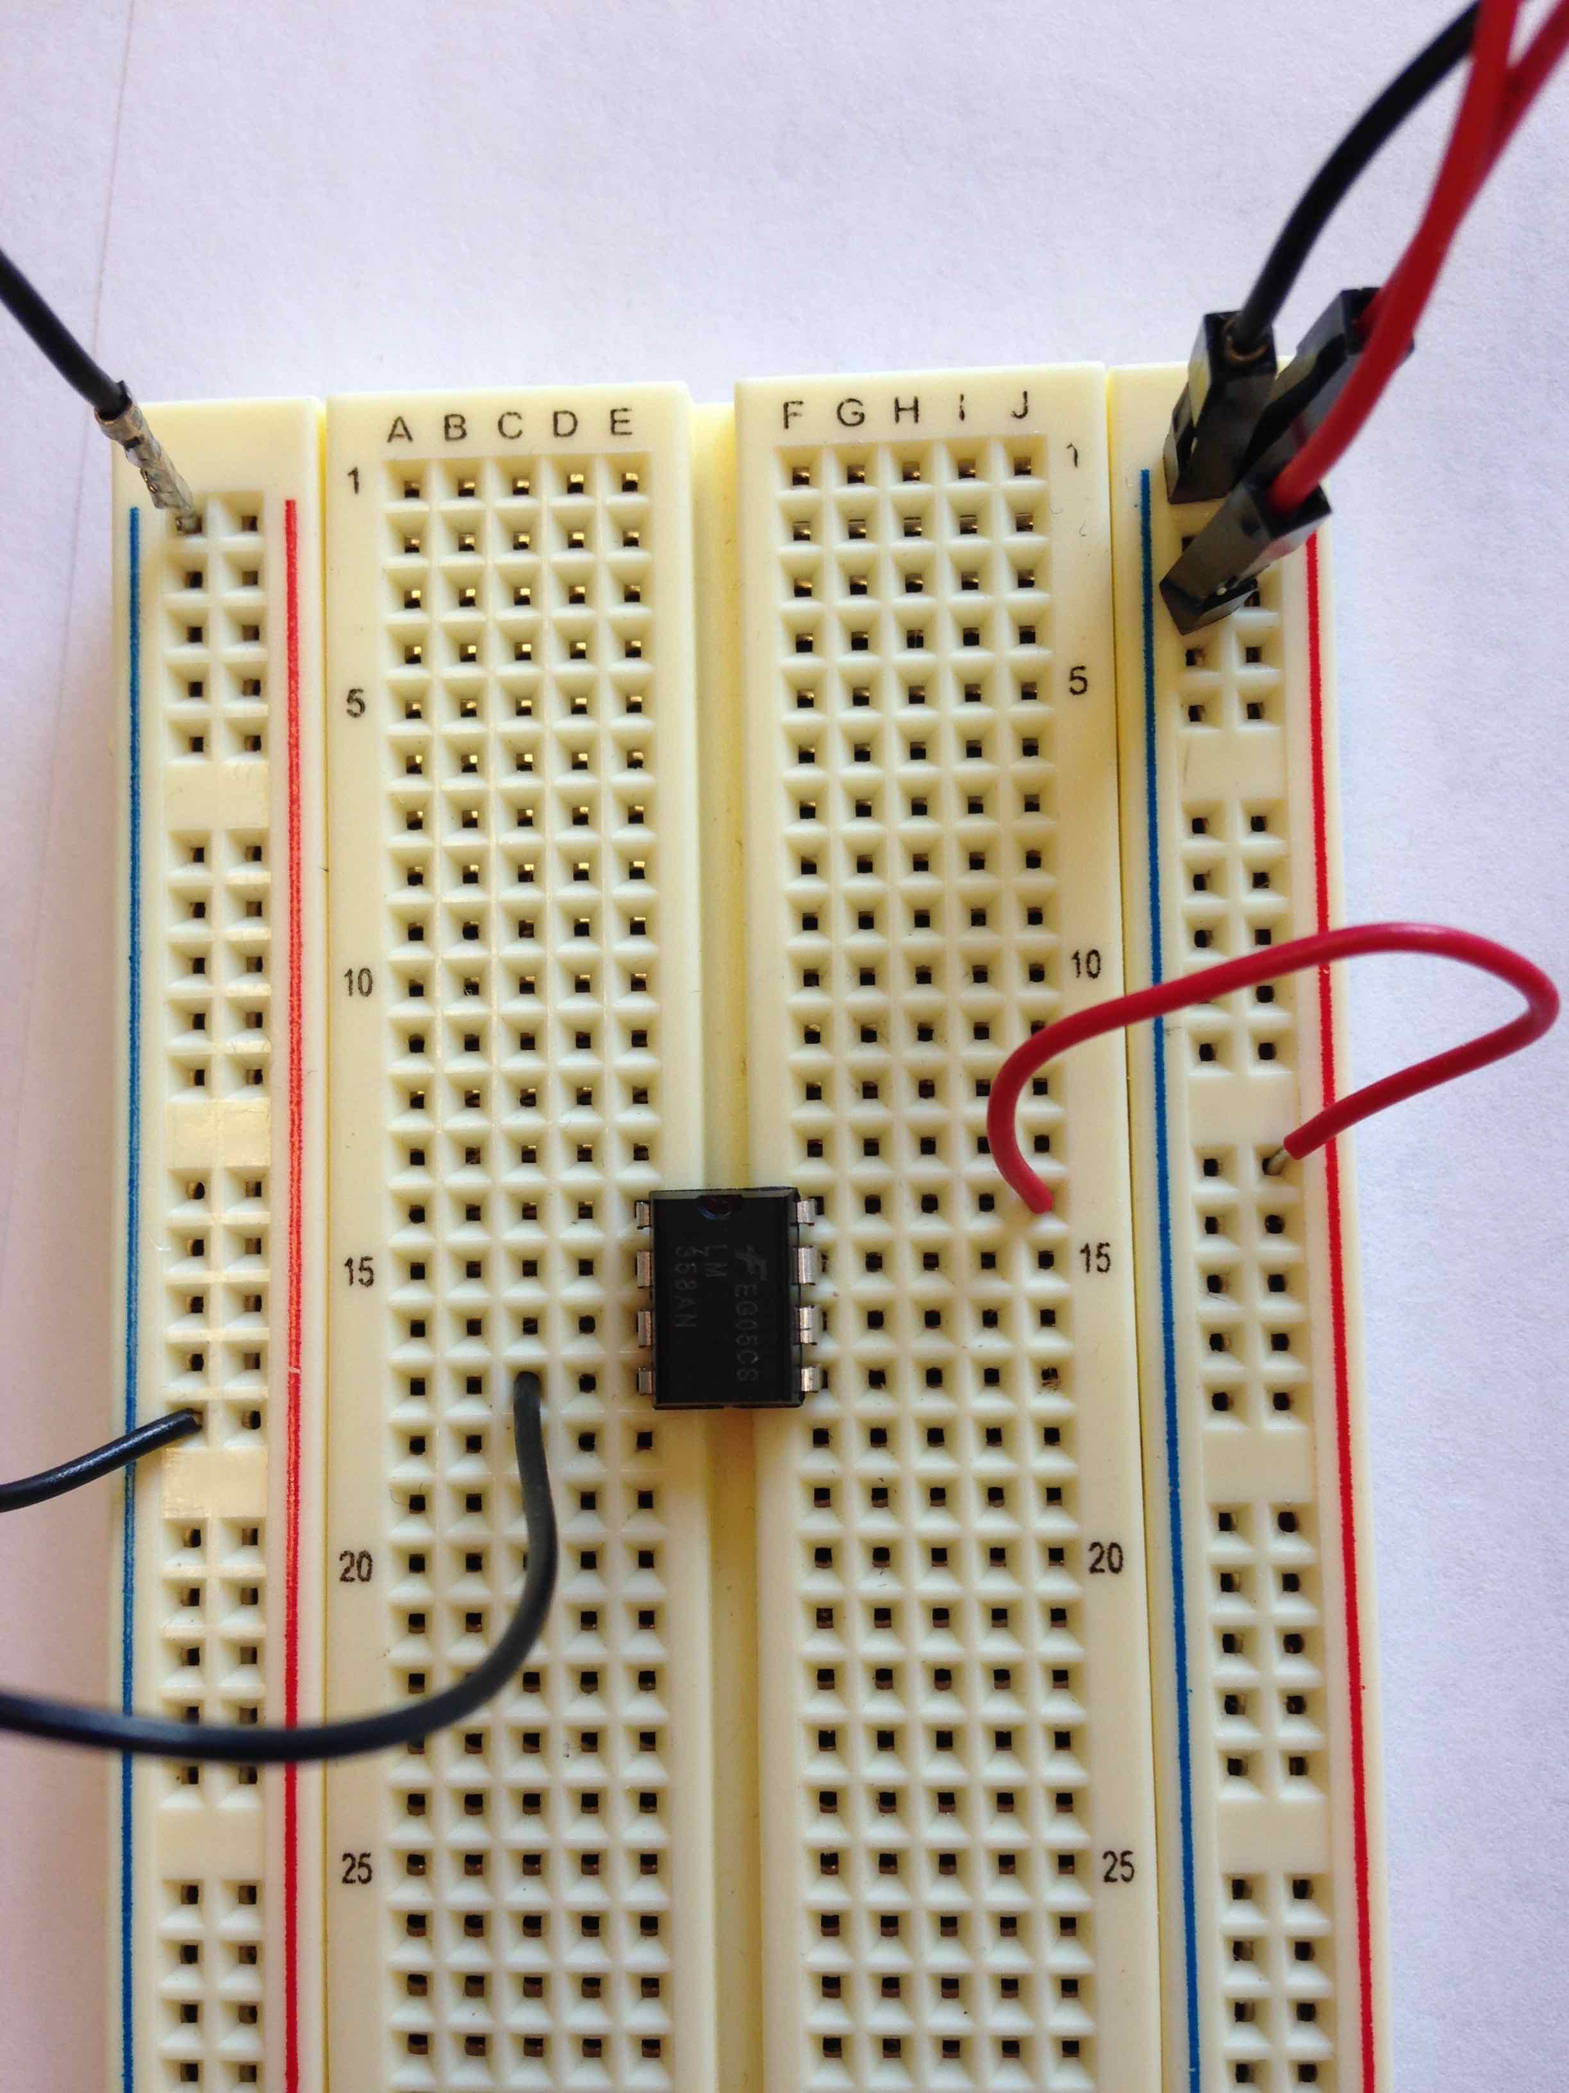
Connect positive supply

Slide 69
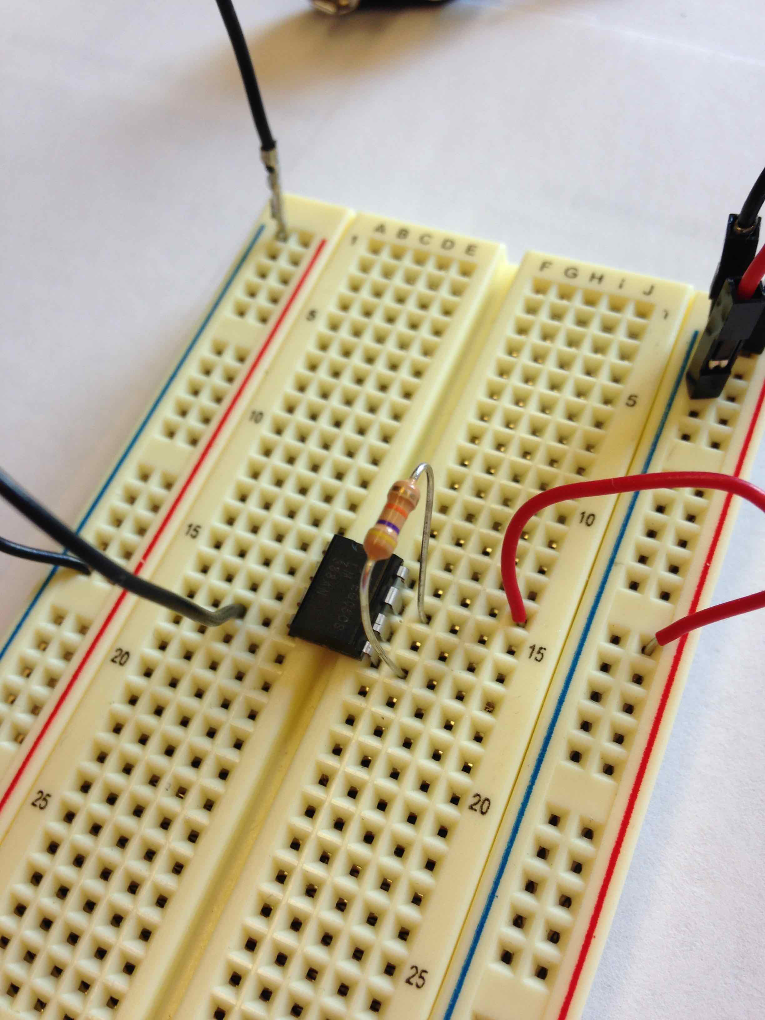
First resistor: 47K= yellow purple orange gold
Goes between pin 5 and 7

Slide 70
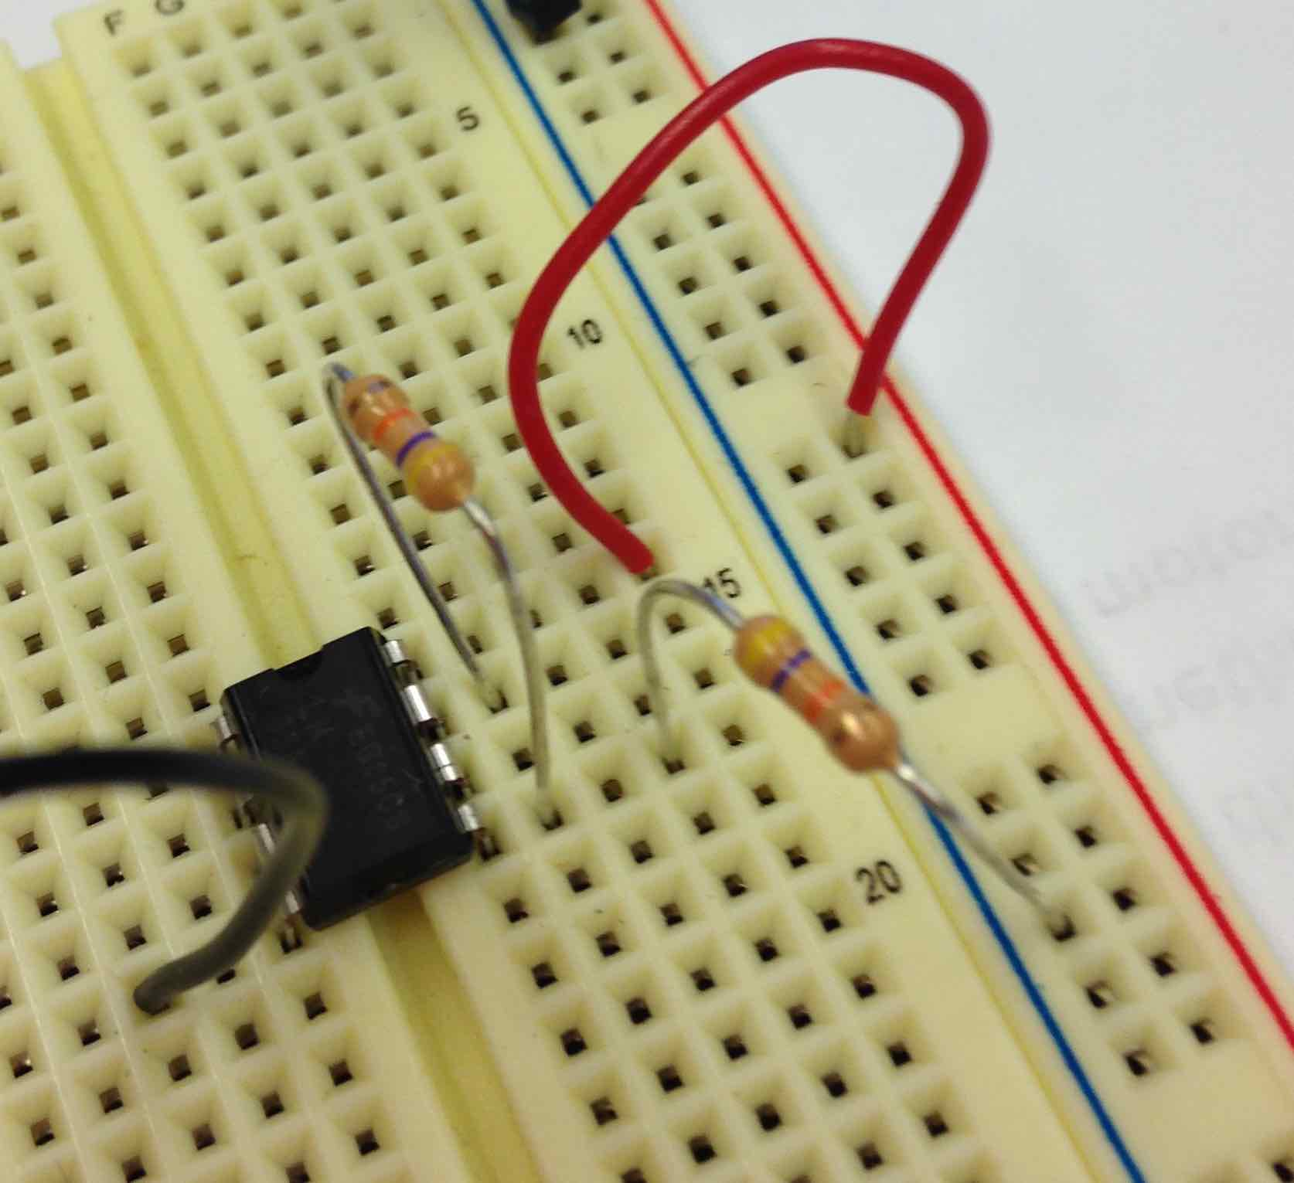
Second resistor: 47K= yellow purple orange gold
Goes between pin 5 and ground

Slide 71
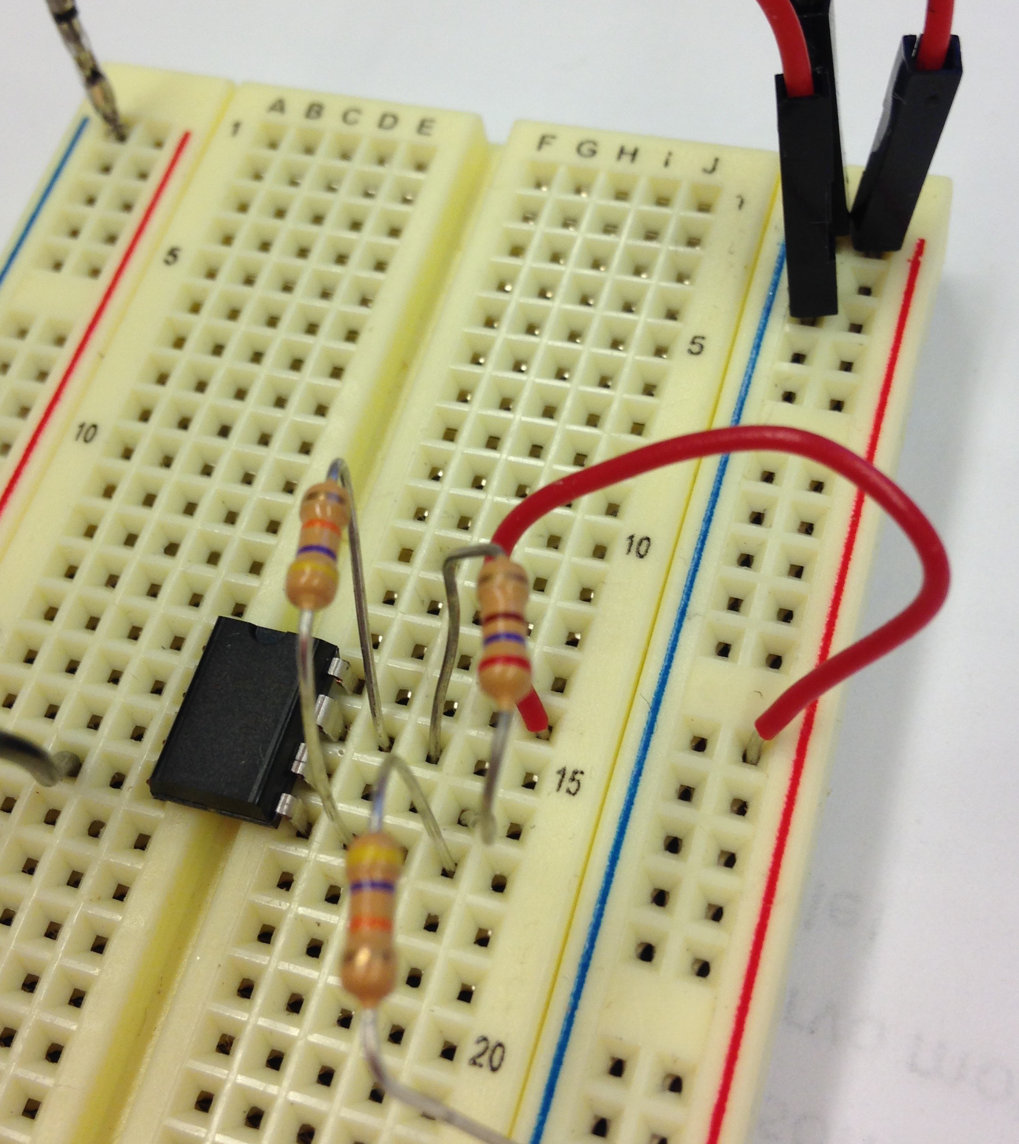
Third resistor: 270= red purple brown gold
Goes between output and inverting input
Pins 6 and 7

Slide 72
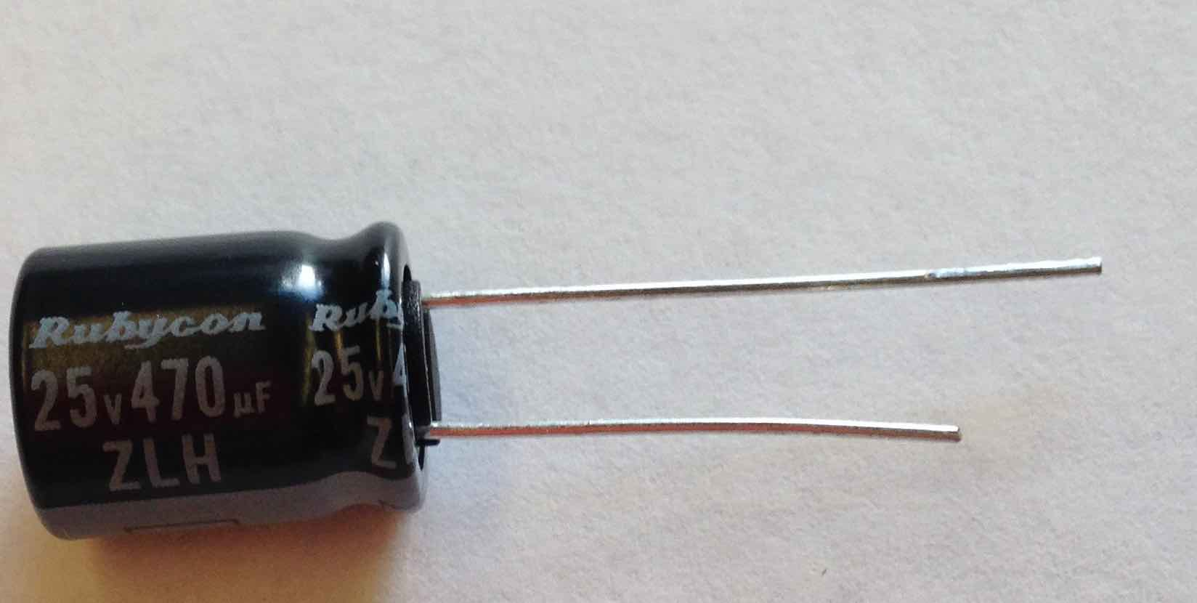
Capacitor
It has a plus and minus side!
One lead is shorter!
Short lead is minus!

Slide 73
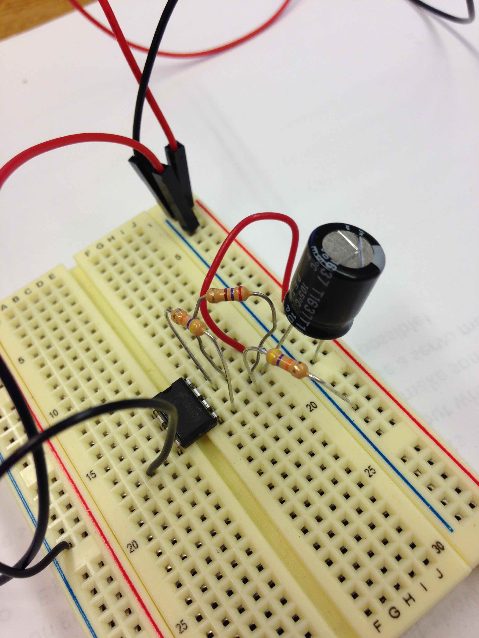
Capacitor
Short lead goes to ground
Long lead goes to inverting input

Slide 74
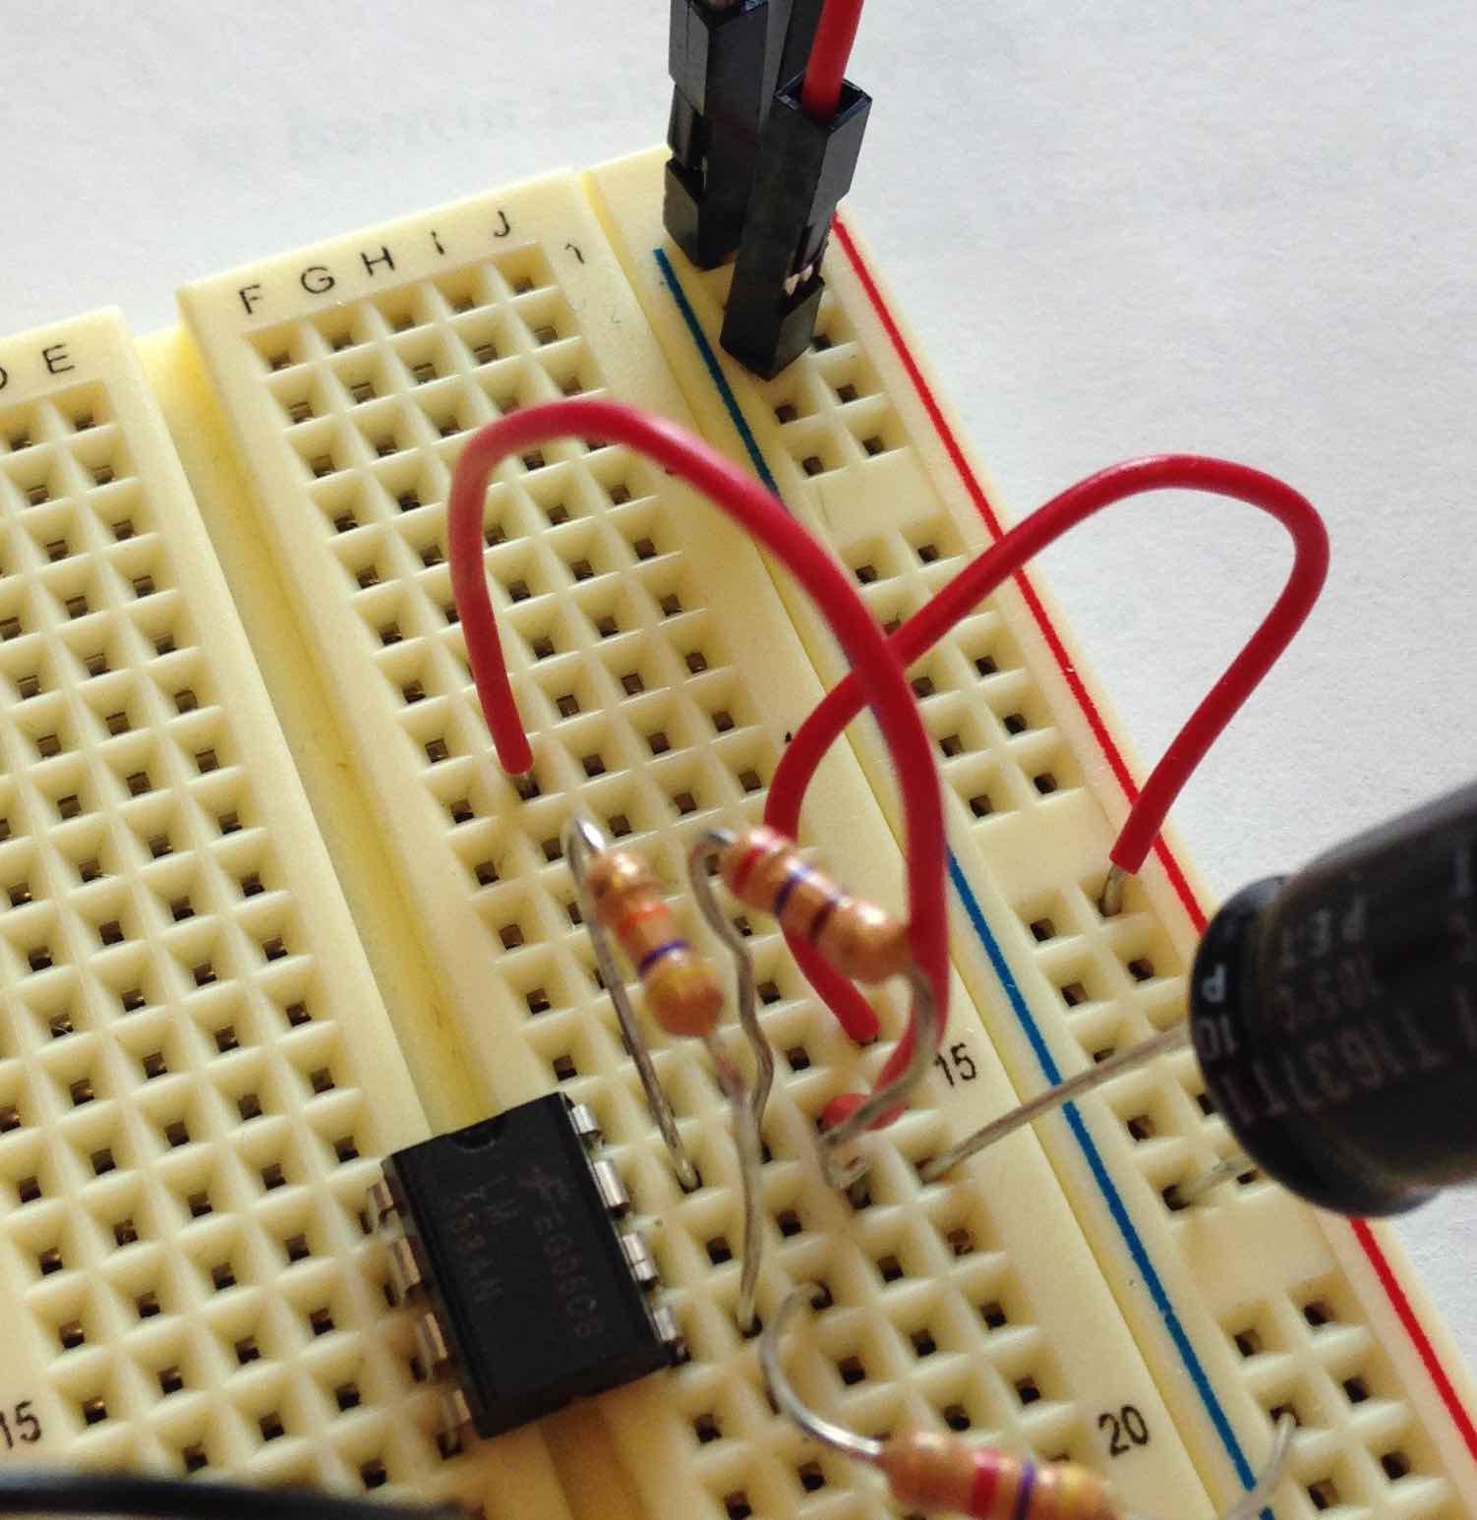
It’s getting crowded
We still need to add this stuff
It also connects to output pin
Use a jumper wire to open up a new space

Slide 75
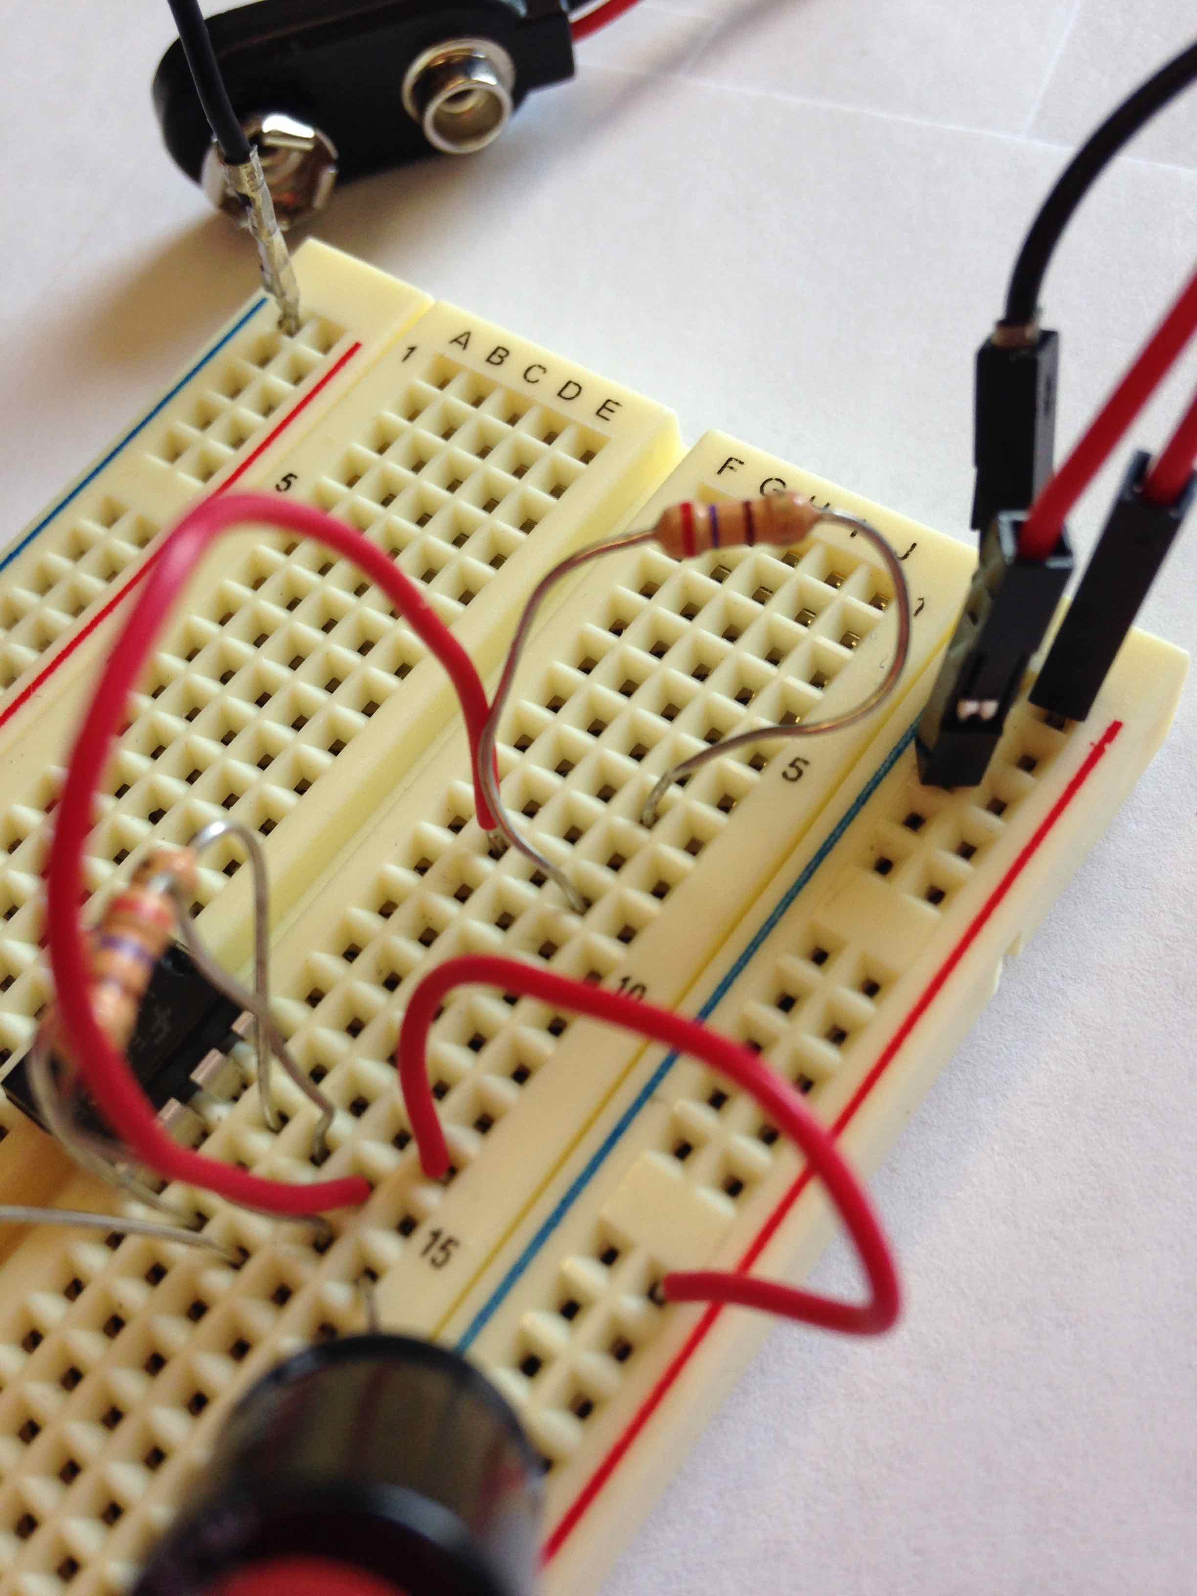
Resistor for LED: 270 (red purple brown gold)
Connects from jumper to another node

Slide 76
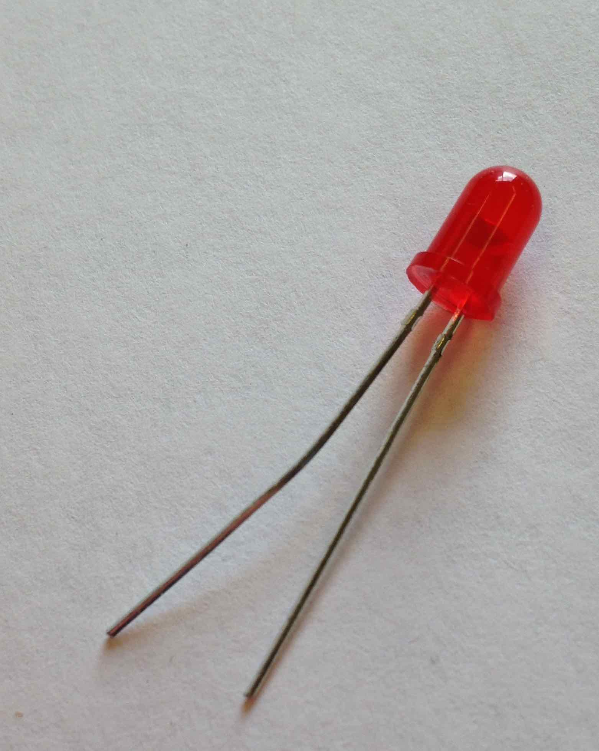
LED
It has a plus and minus side!
One lead is shorter!
Short lead is minus!

Slide 77
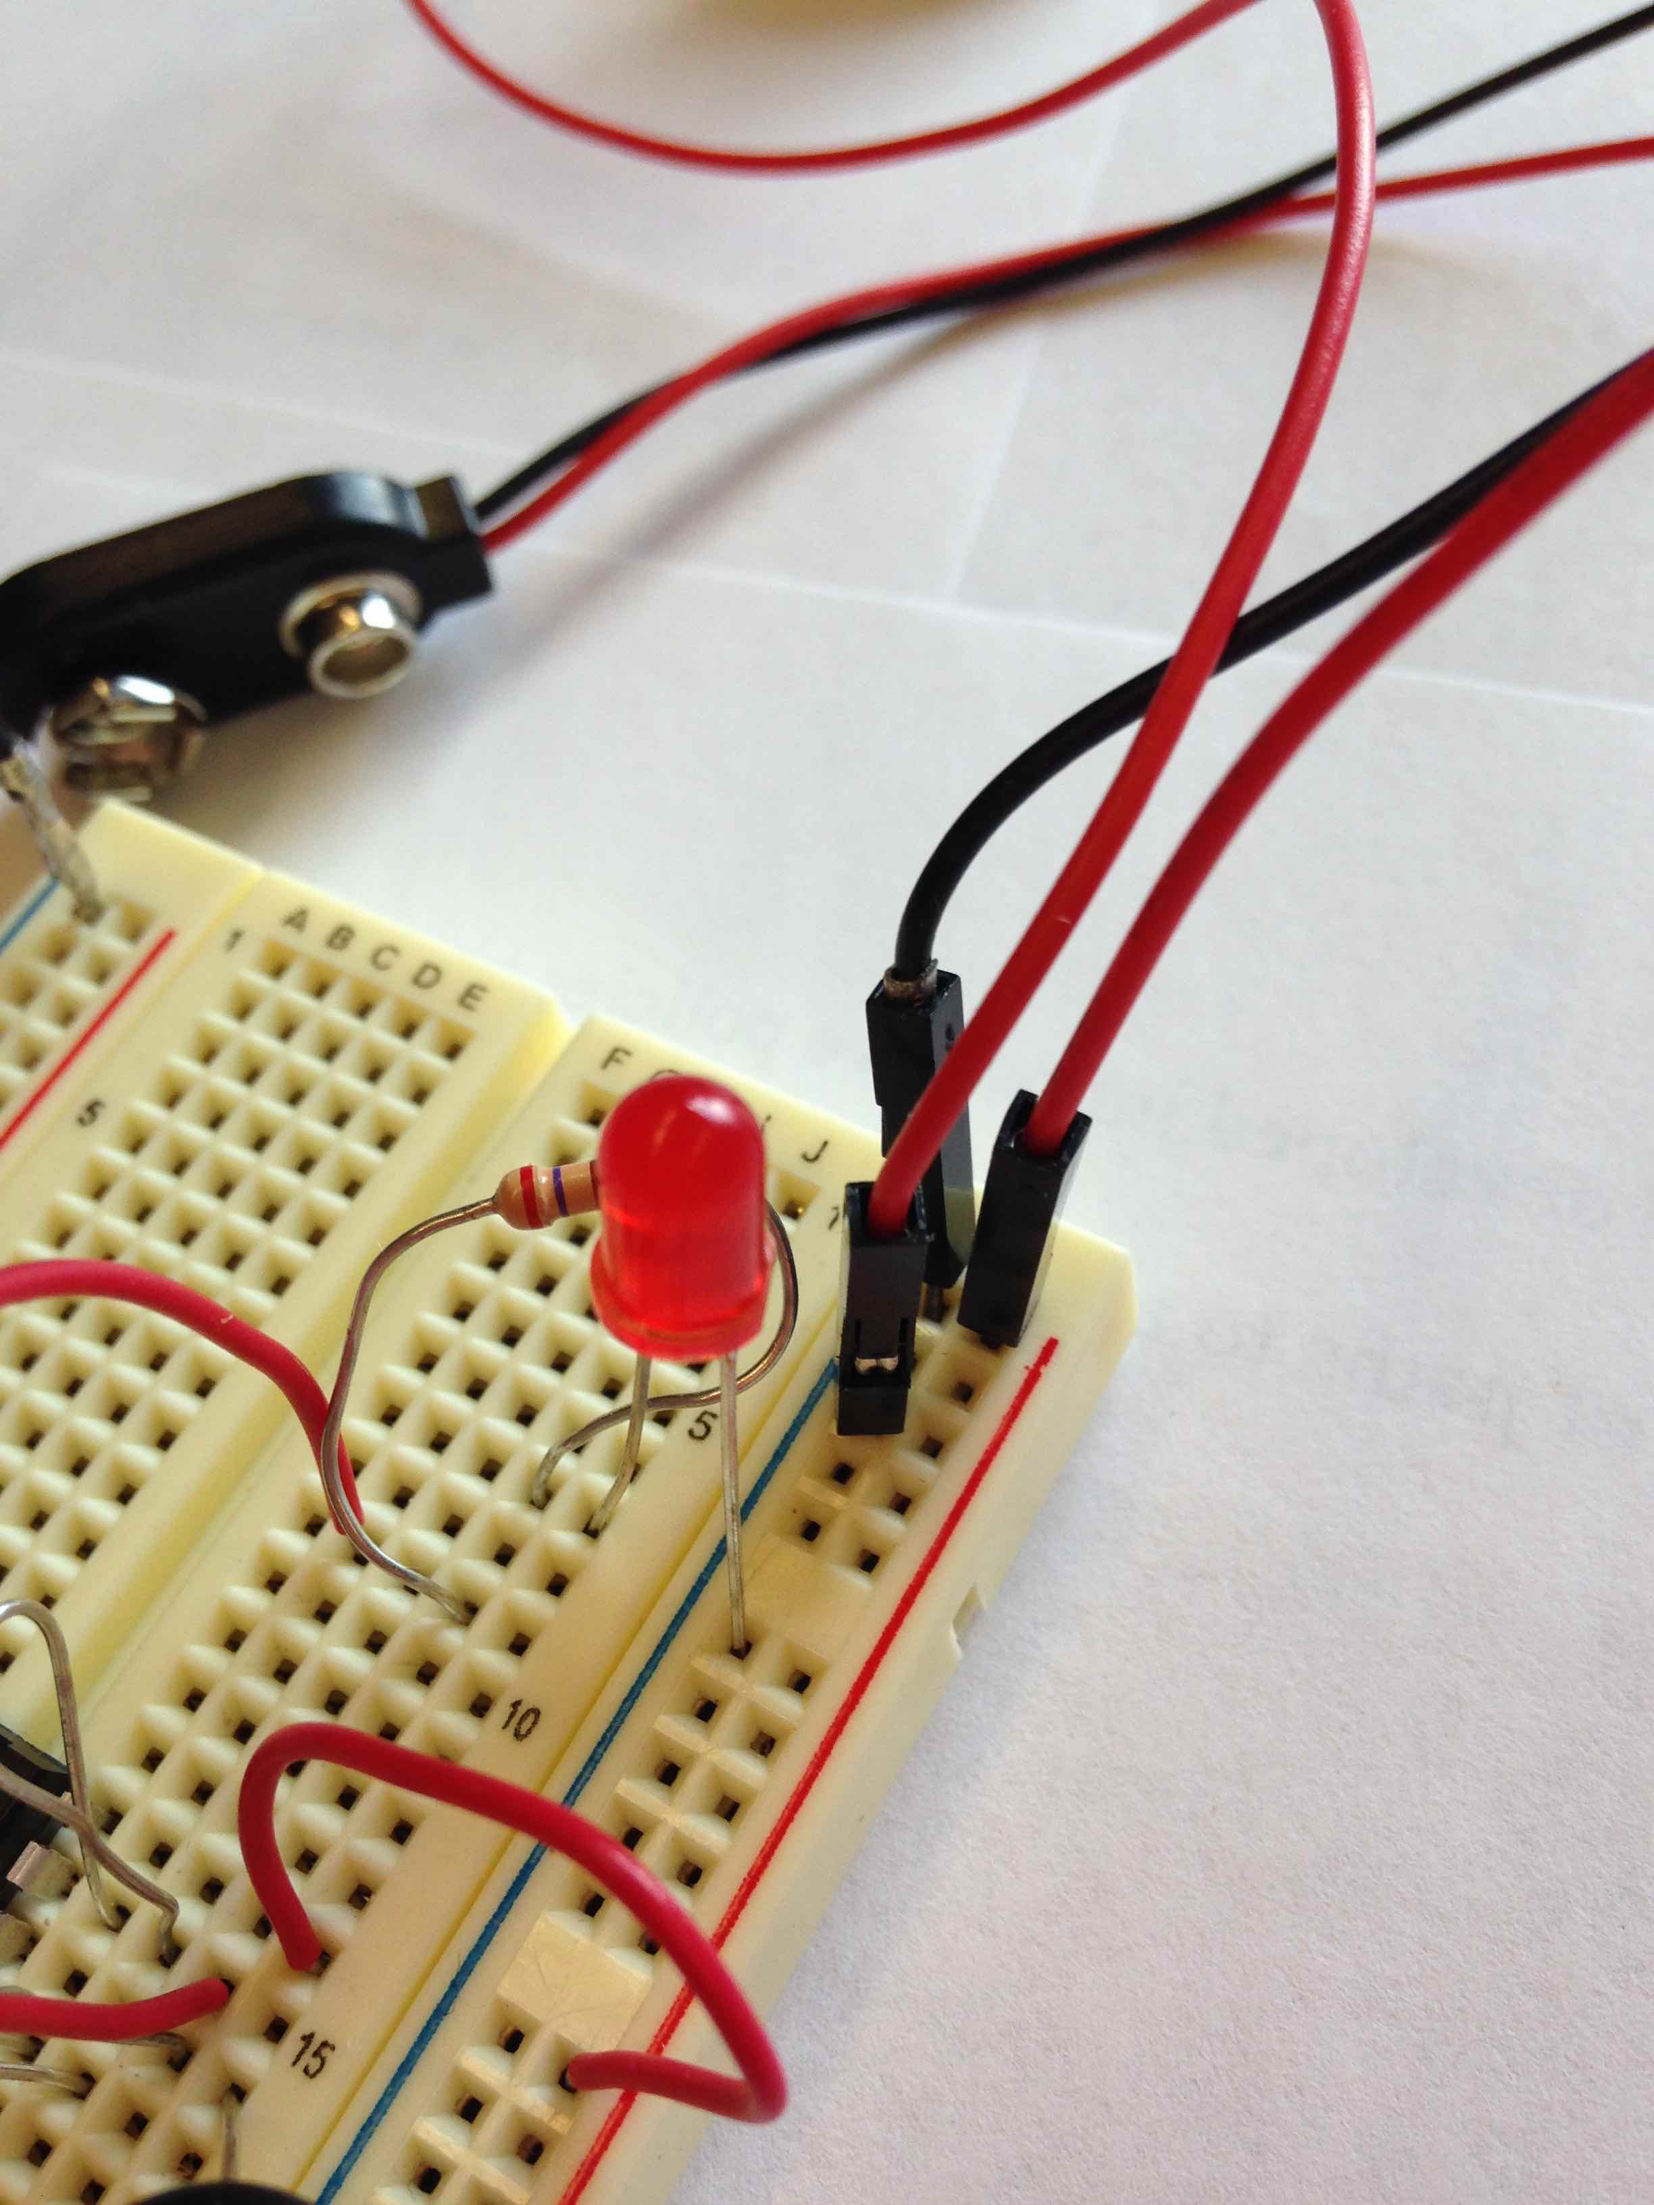
Connect LED
SHORT LEAD GOES TO GROUND

Slide 78
Connect the batteries!
270: red purple brown
47K: yellow purple orange
Capacitor: short lead goes to ground
LED: short lead goes to ground

Slide 79
It should blink the light
Things to try:
  What would happen if you change the value of the feedback resistor R3? Try it.

