Slide 1
Introduction to Circuits: Build an LED Flashlight!
Mark Morscher
Electrical and Computer Engineer
Brought to you by OSU STEM Outreach

Slide 2
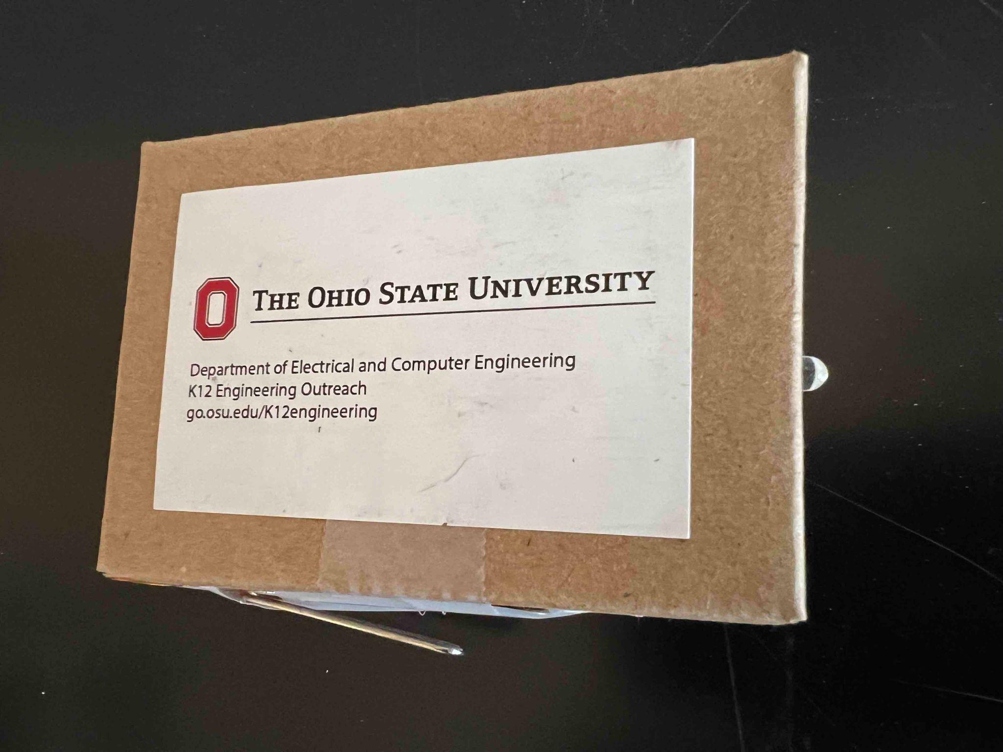
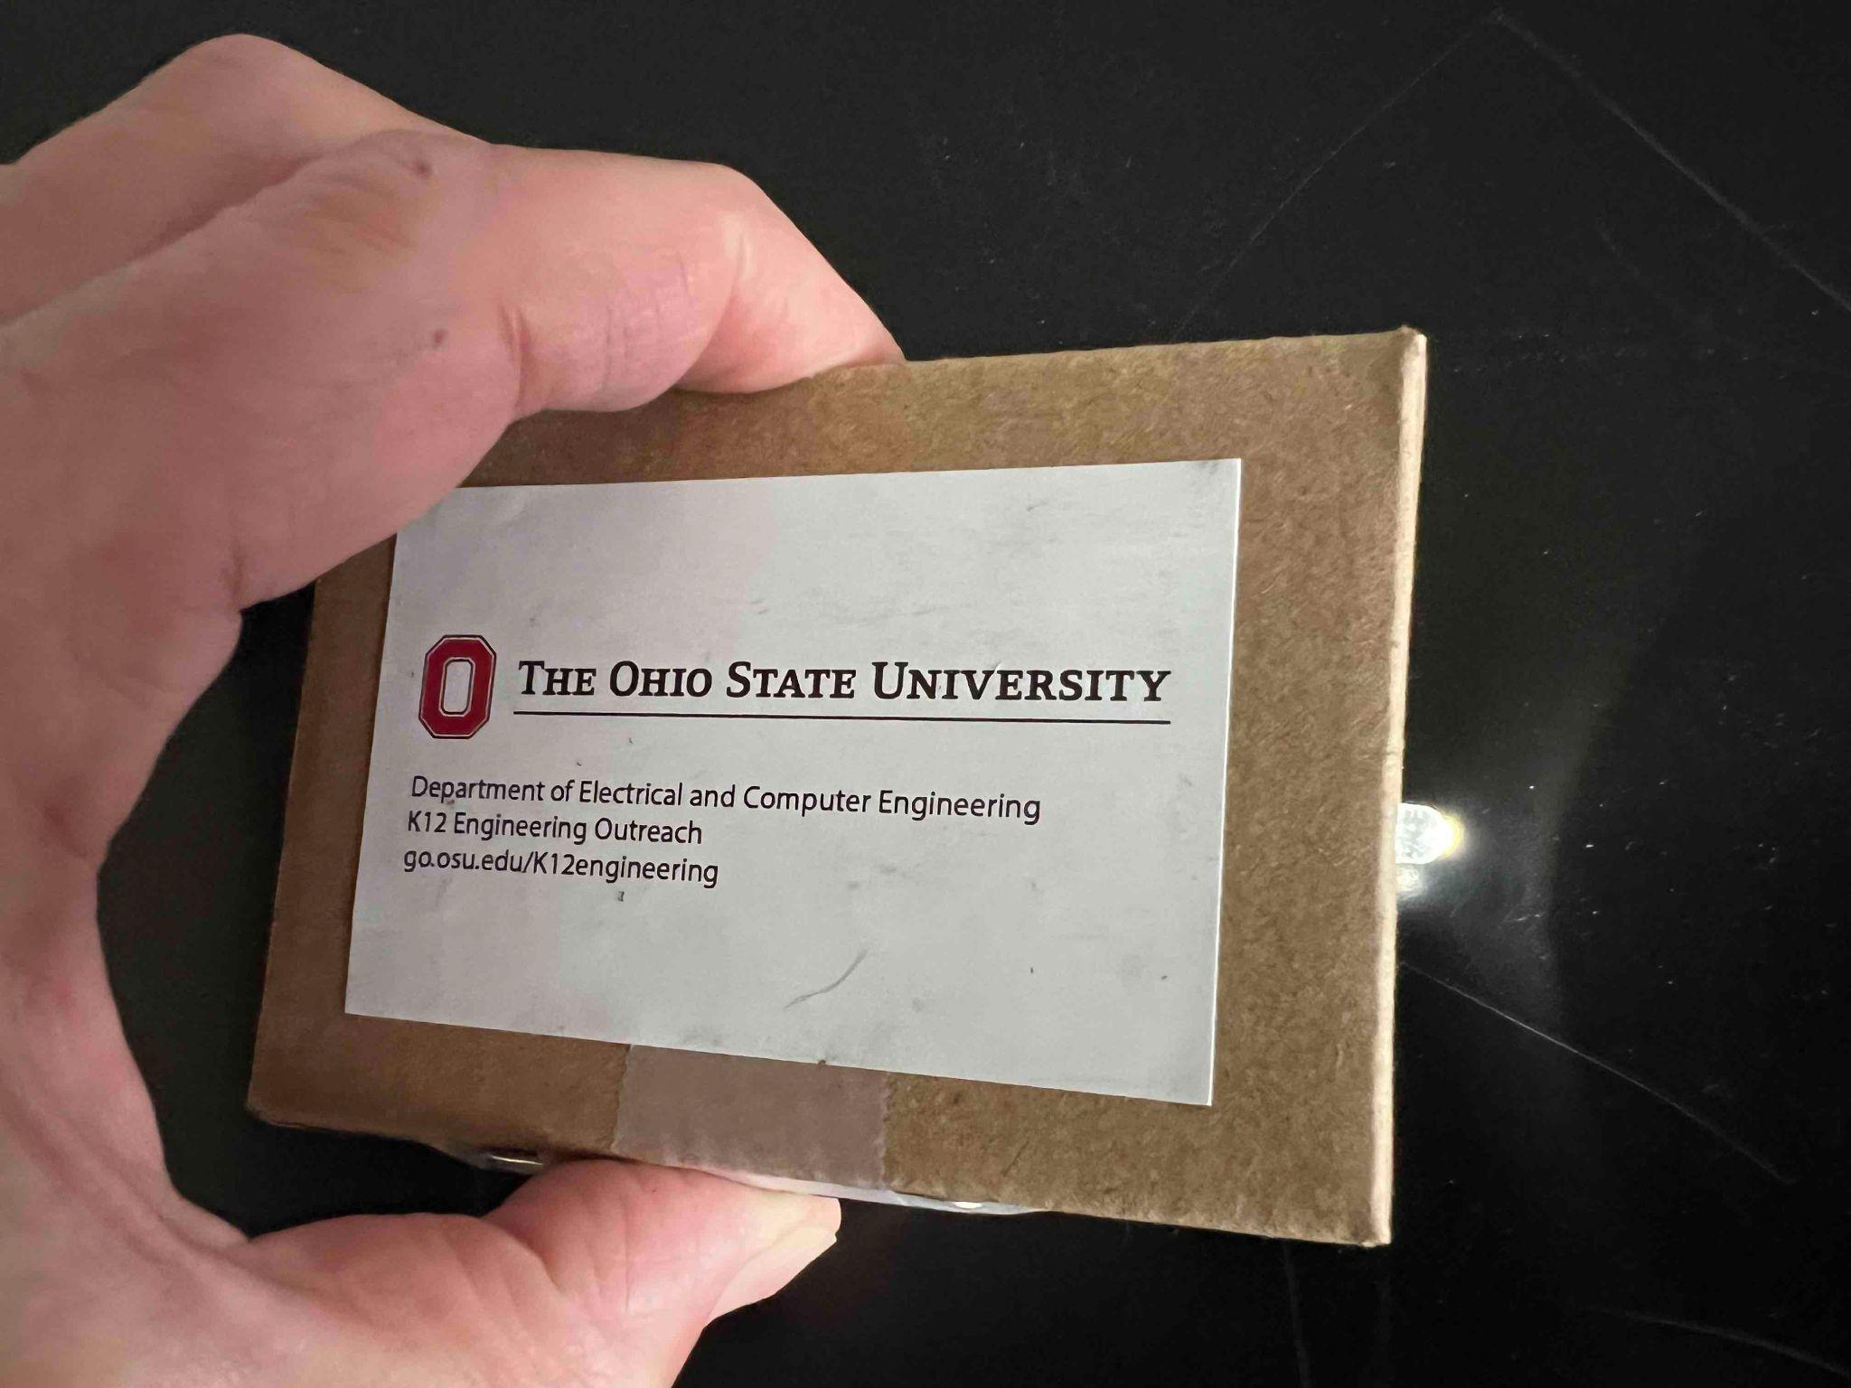
Introduction to Circuits
LED Flashlight

Slide 3
How does it work?
When electricity flows through an LED (light-emitting diode), the LED lights up
We need a battery, an LED, some wire, a switch and some know-how!

Slide 4
Need to learn some things
Electrical components and how to read an electrical schematic
What is a circuit
What parts we’re using
How to build the flashlight

Slide 5
Reading Schematics:
What’s this?
Battery

Slide 6
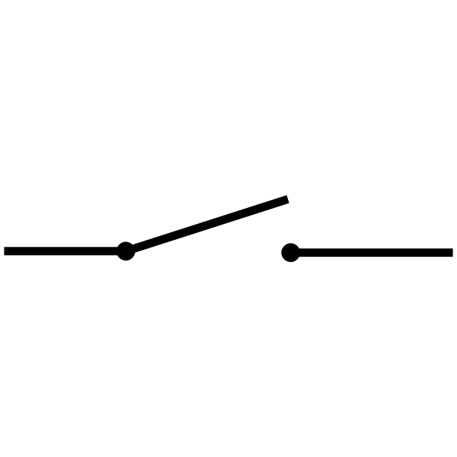
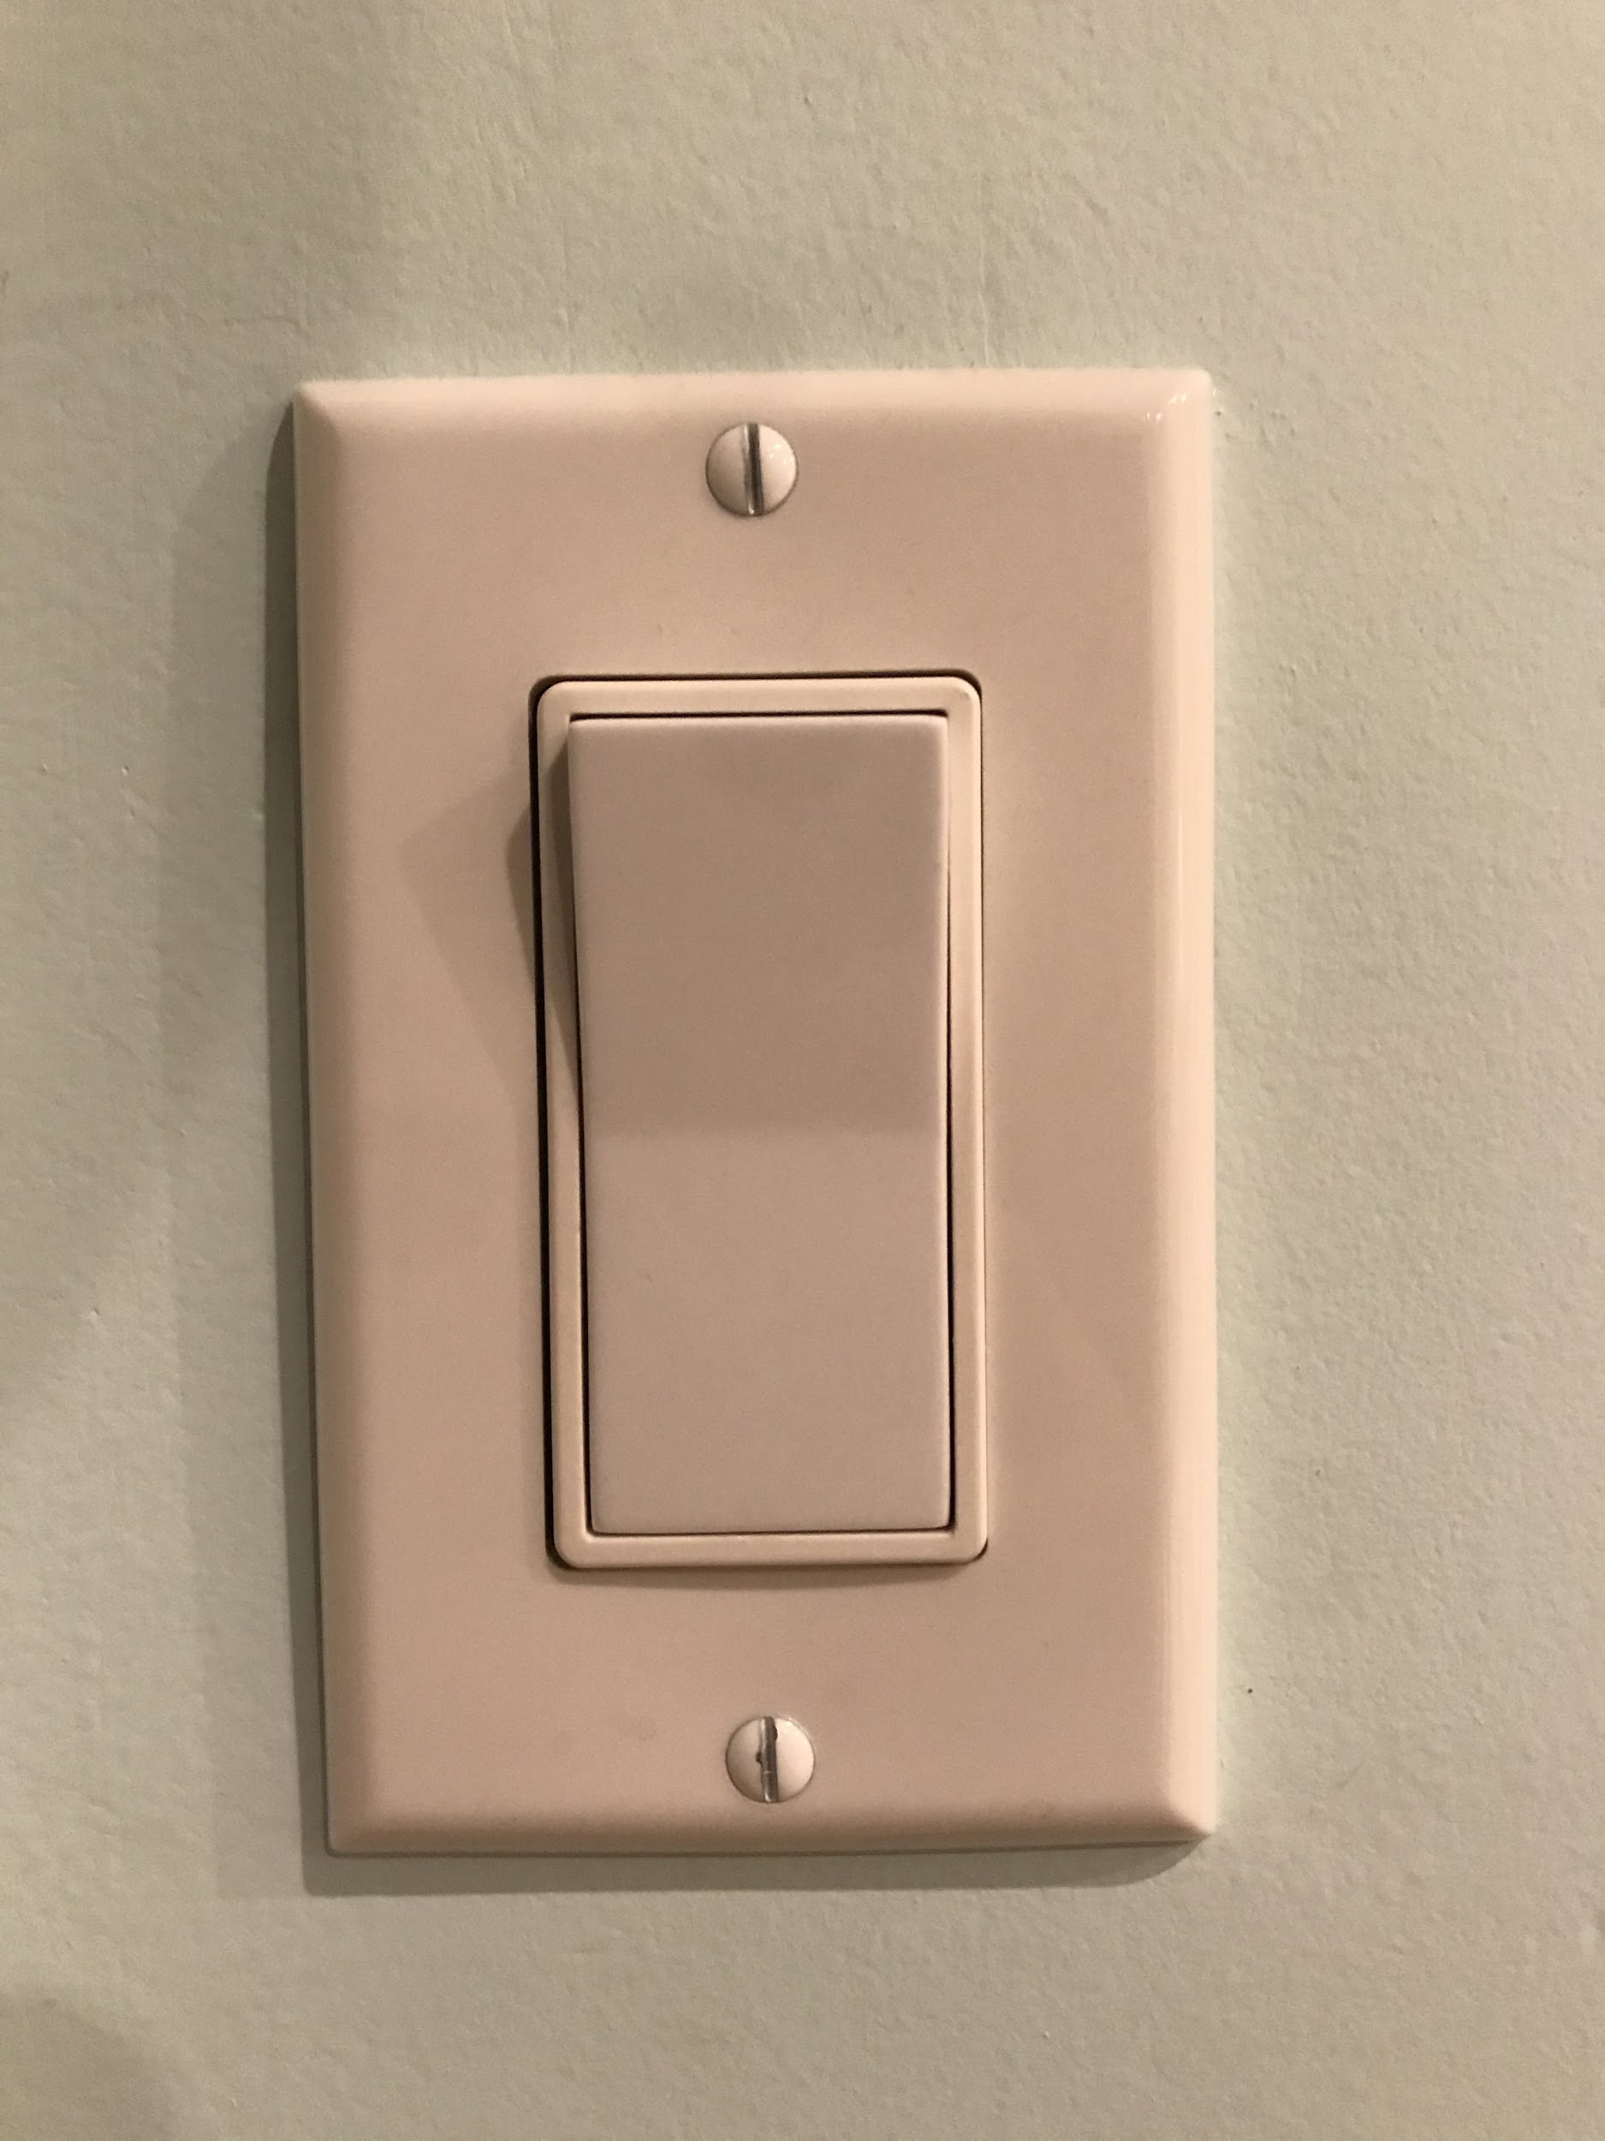
Switch
What does this do?
Schematic symbol
We will be using a paper clip as our switch!

Slide 7
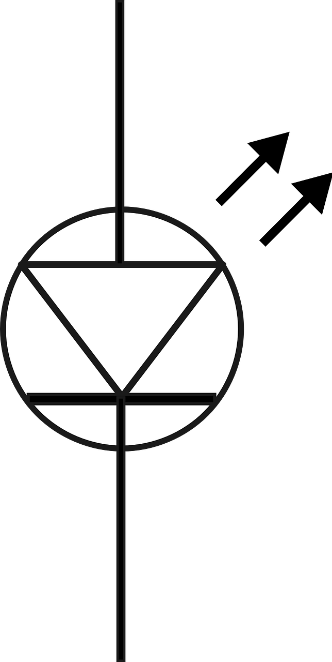
What’s this?
YES
Diode
Lets current flow one direction but not the other
X
NO
We are going to use Light Emitting Diode (LED) as our light bulb

Slide 8
How about this?
Resistor
Schematic symbol
Used to “resist” voltage and reduce current.
We do not need to use one in our circuit.
Why not?

Slide 9
Simple Circuit
+
Current
-
Which direction will current flow?
Current flows from ‘+’ to ‘-’
Remember: Current only flows from anode to cathode on diode

Slide 10
Will current flow?
Current
+
X
Cathode
-
NO!
Will current flow through this circuit?

Slide 11
Will current flow?
+
-
Current
Anode
YES!
Will current flow through this circuit?

Slide 12
Let’s Demonstrate!
+
Current
-
We can demonstrate this with our battery and LED!
Does this make a good flashlight? Why or why not?

Slide 13
Adding a Switch
+
-
What does this do for us?

Slide 14
Are you ready to build?
Box
Coin battery
LED
3 pieces wire
Paper clip
Sandpaper
Sticker
Tape
Marker

Slide 15
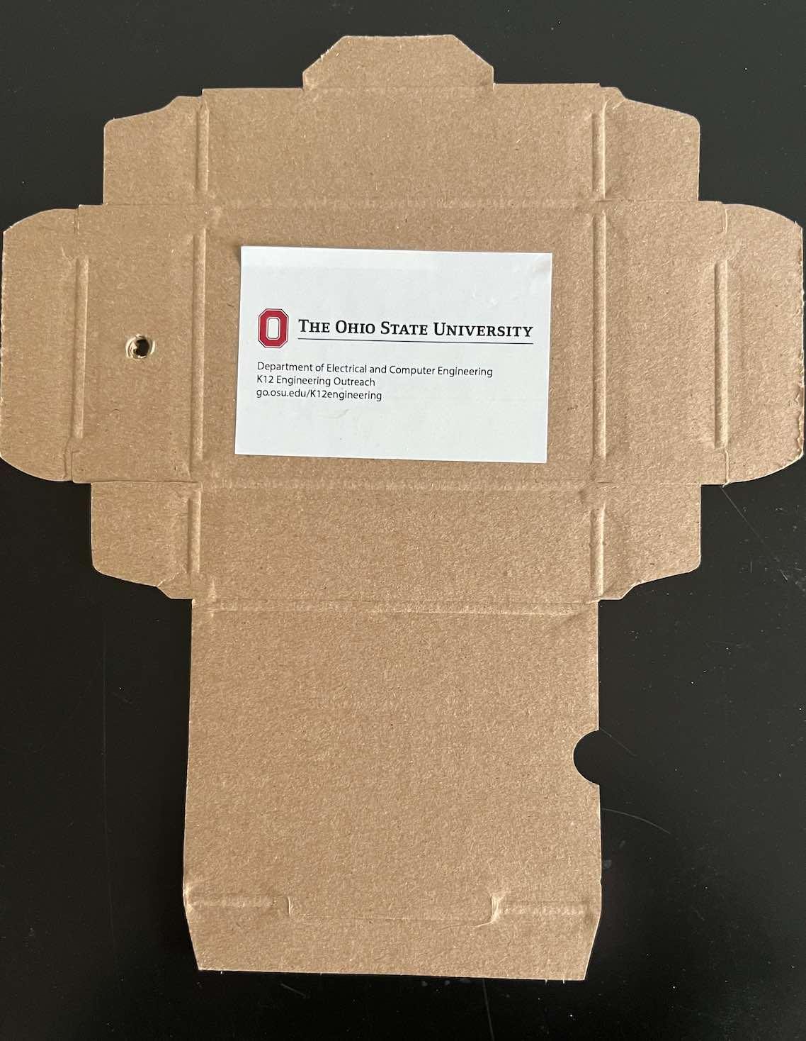
Add the sticker to the box
Use the side with exposed ridges.

Slide 16
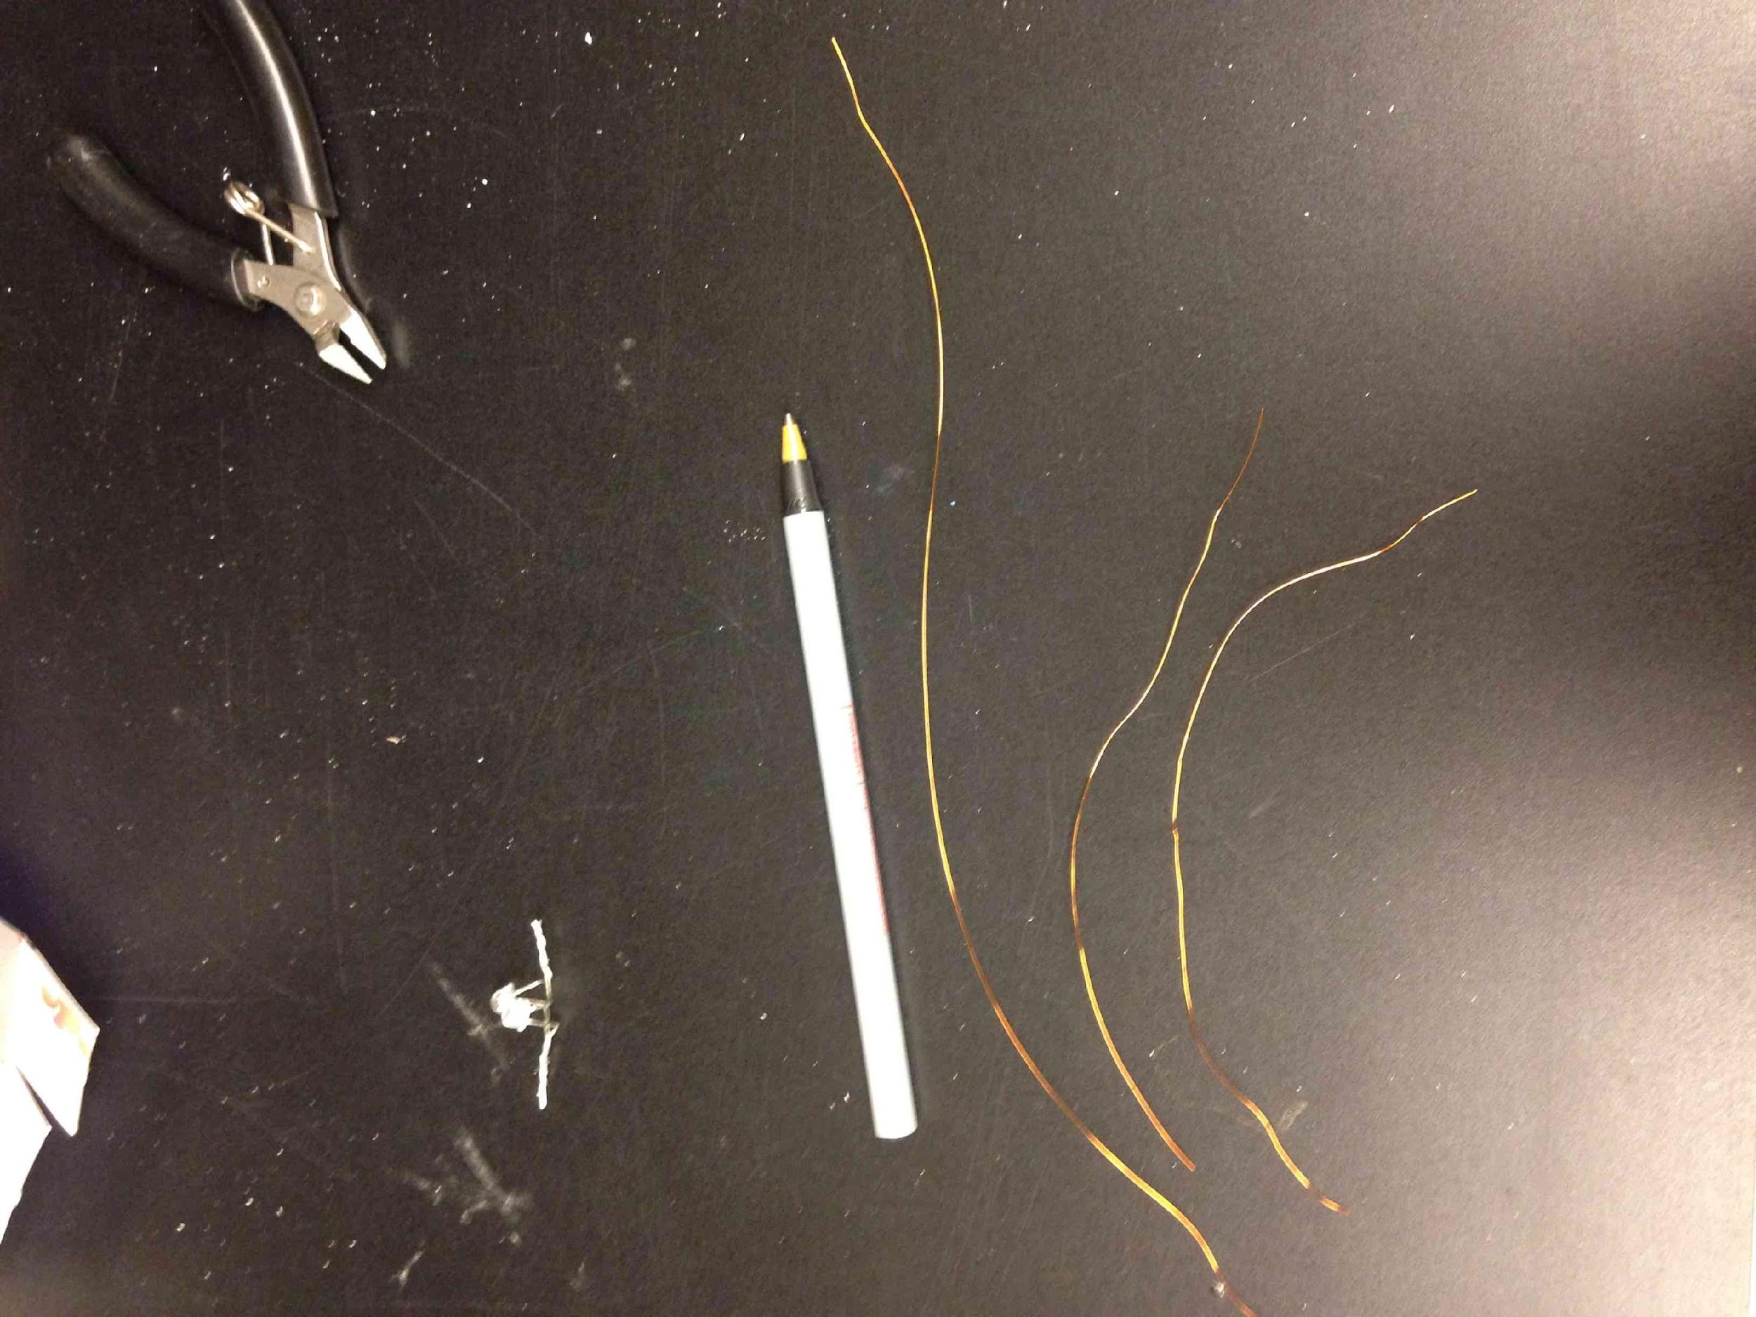
Got three pieces of magnet wire?

Slide 17
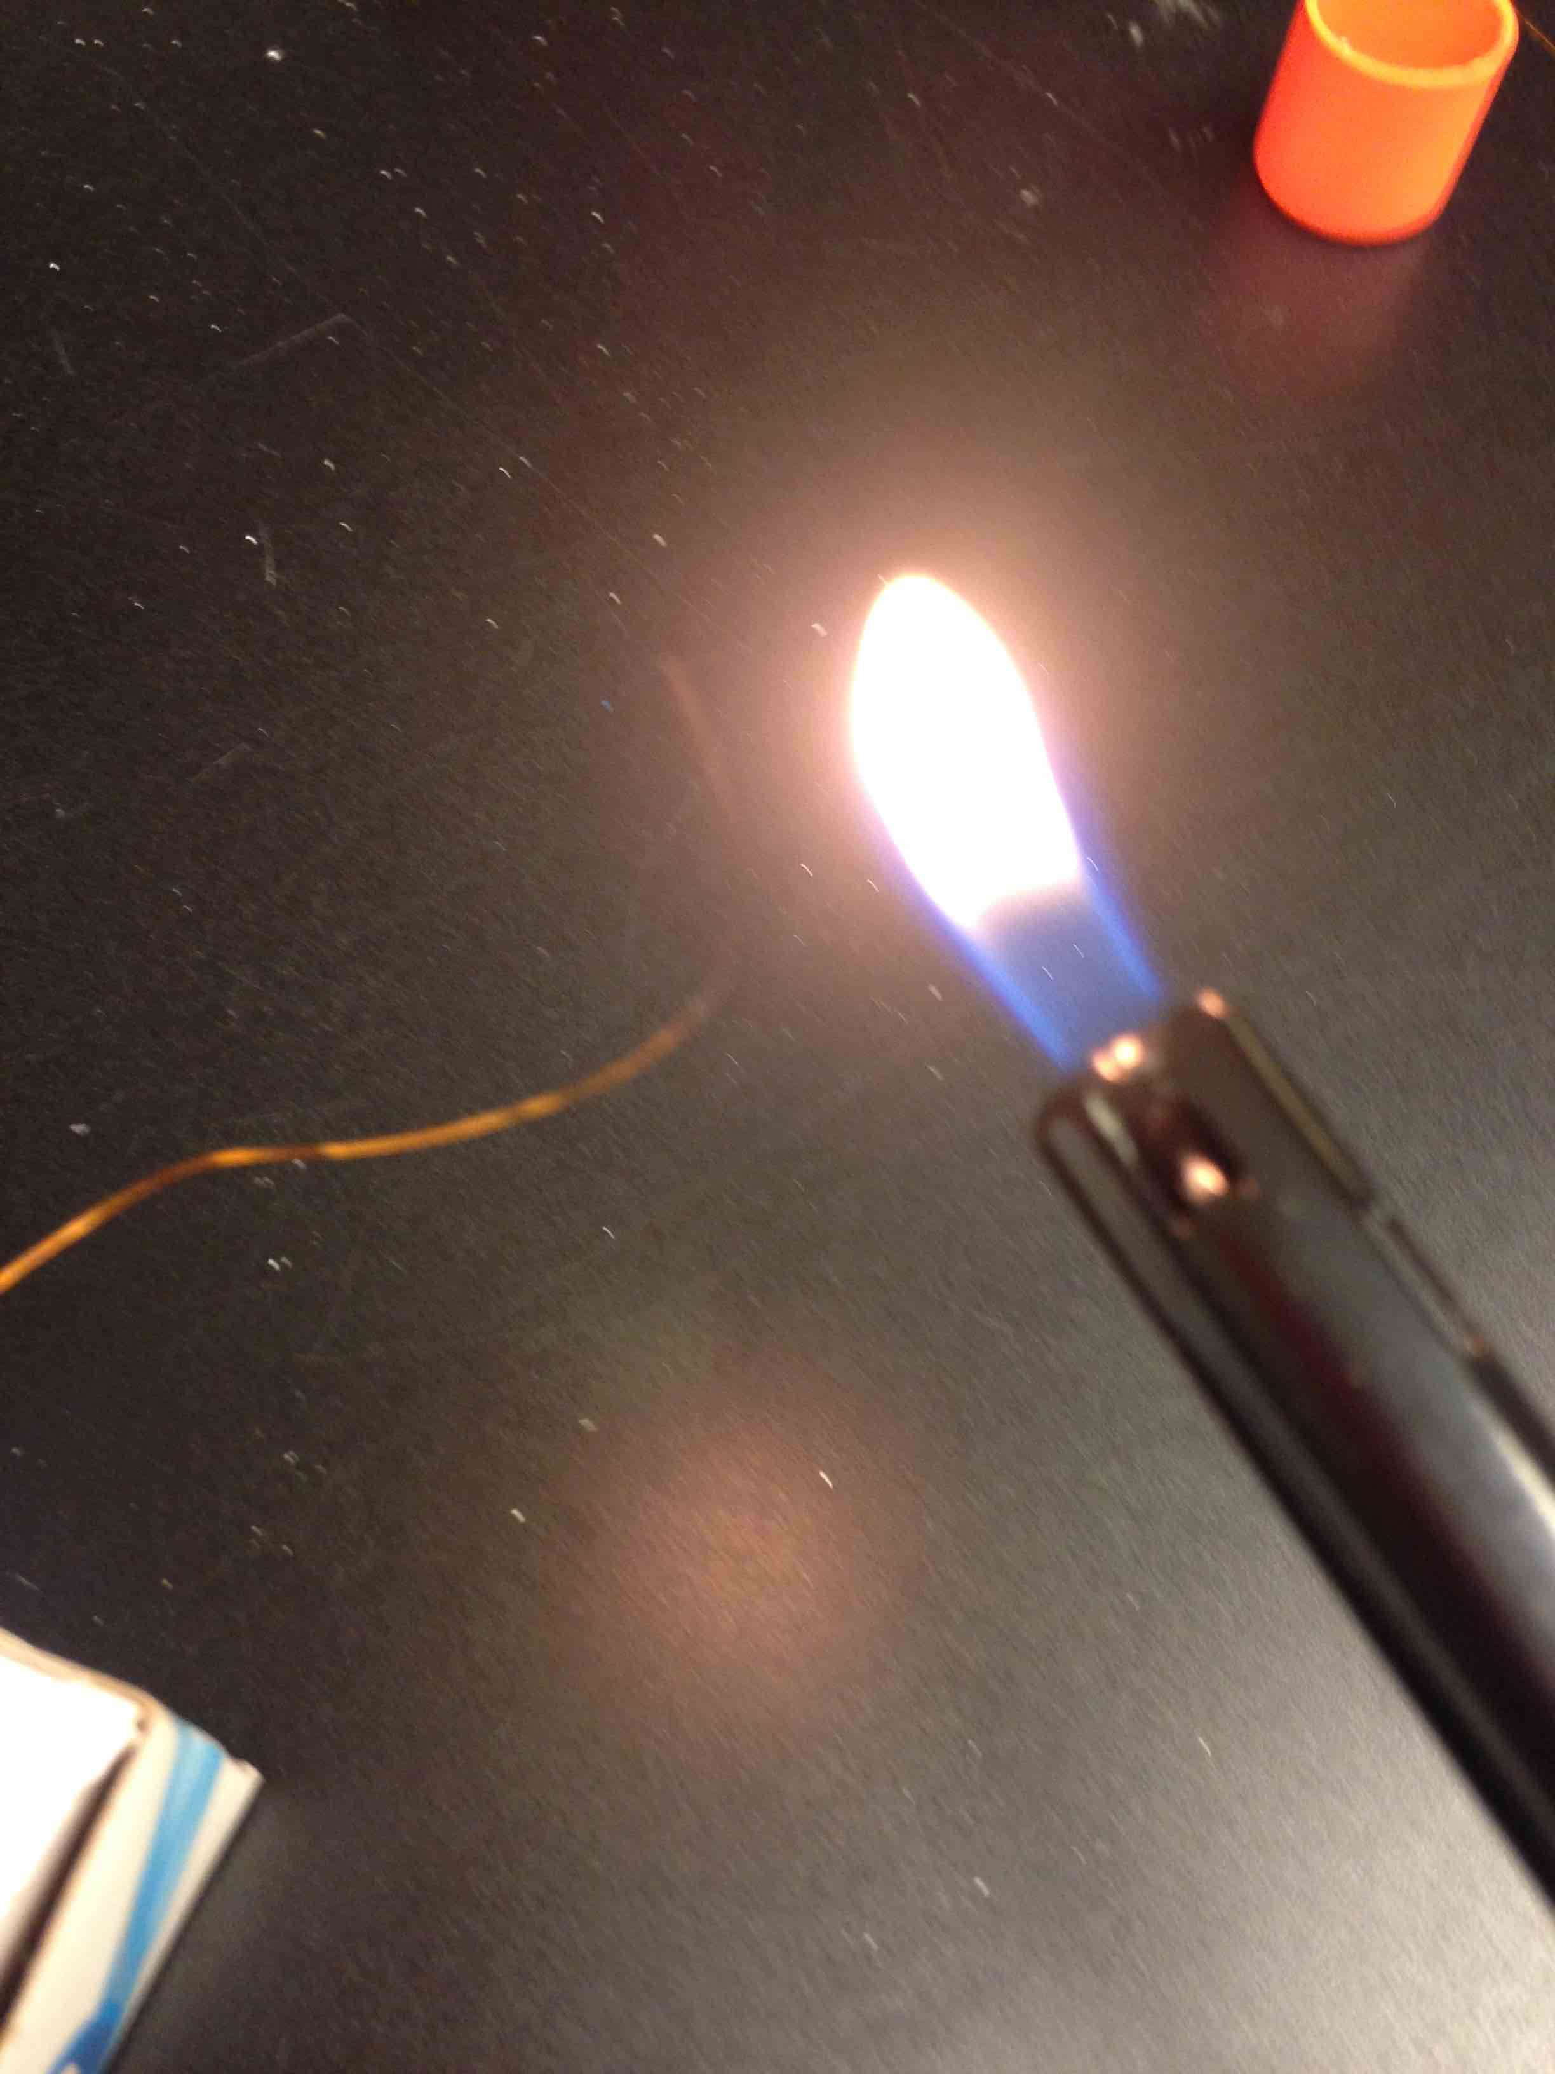
Burn insulation off the ends
Then sand off the black stuff

Slide 18
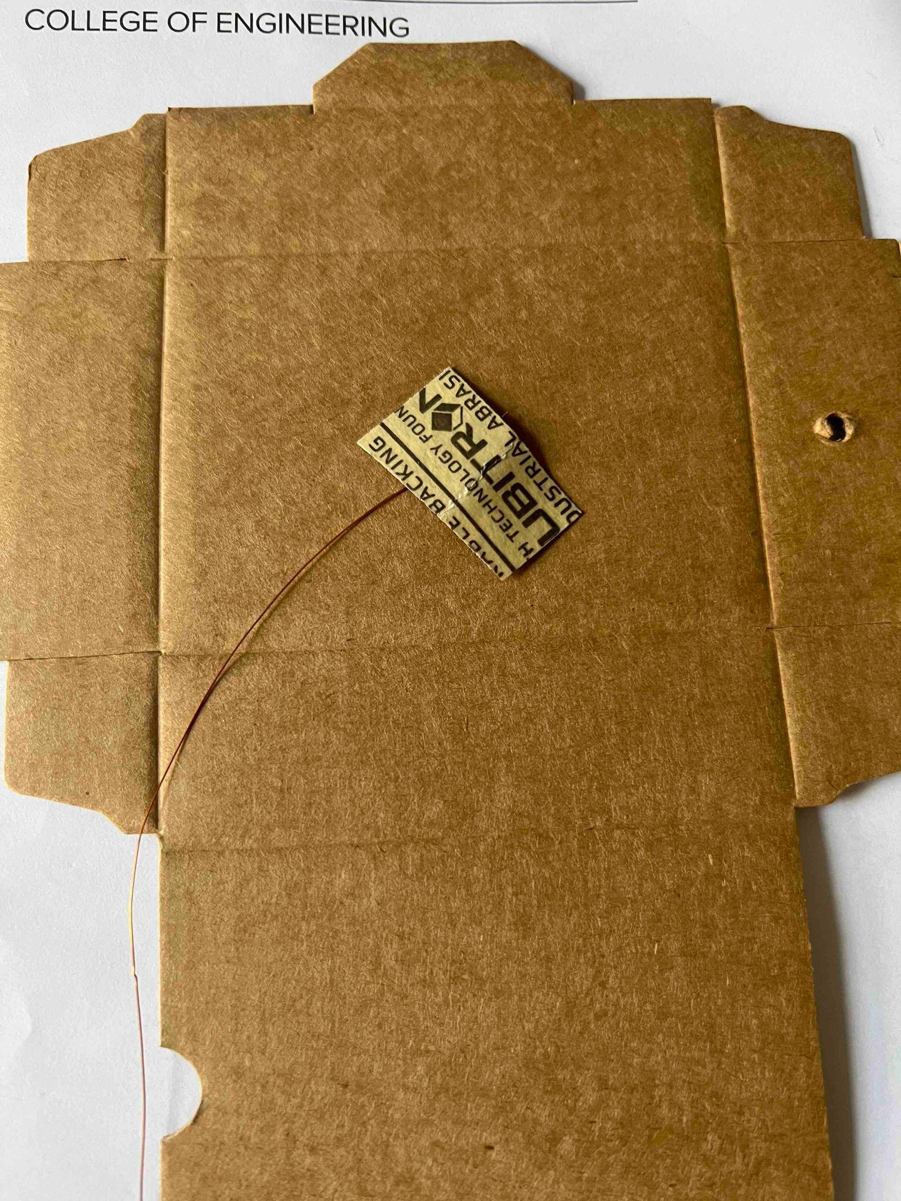
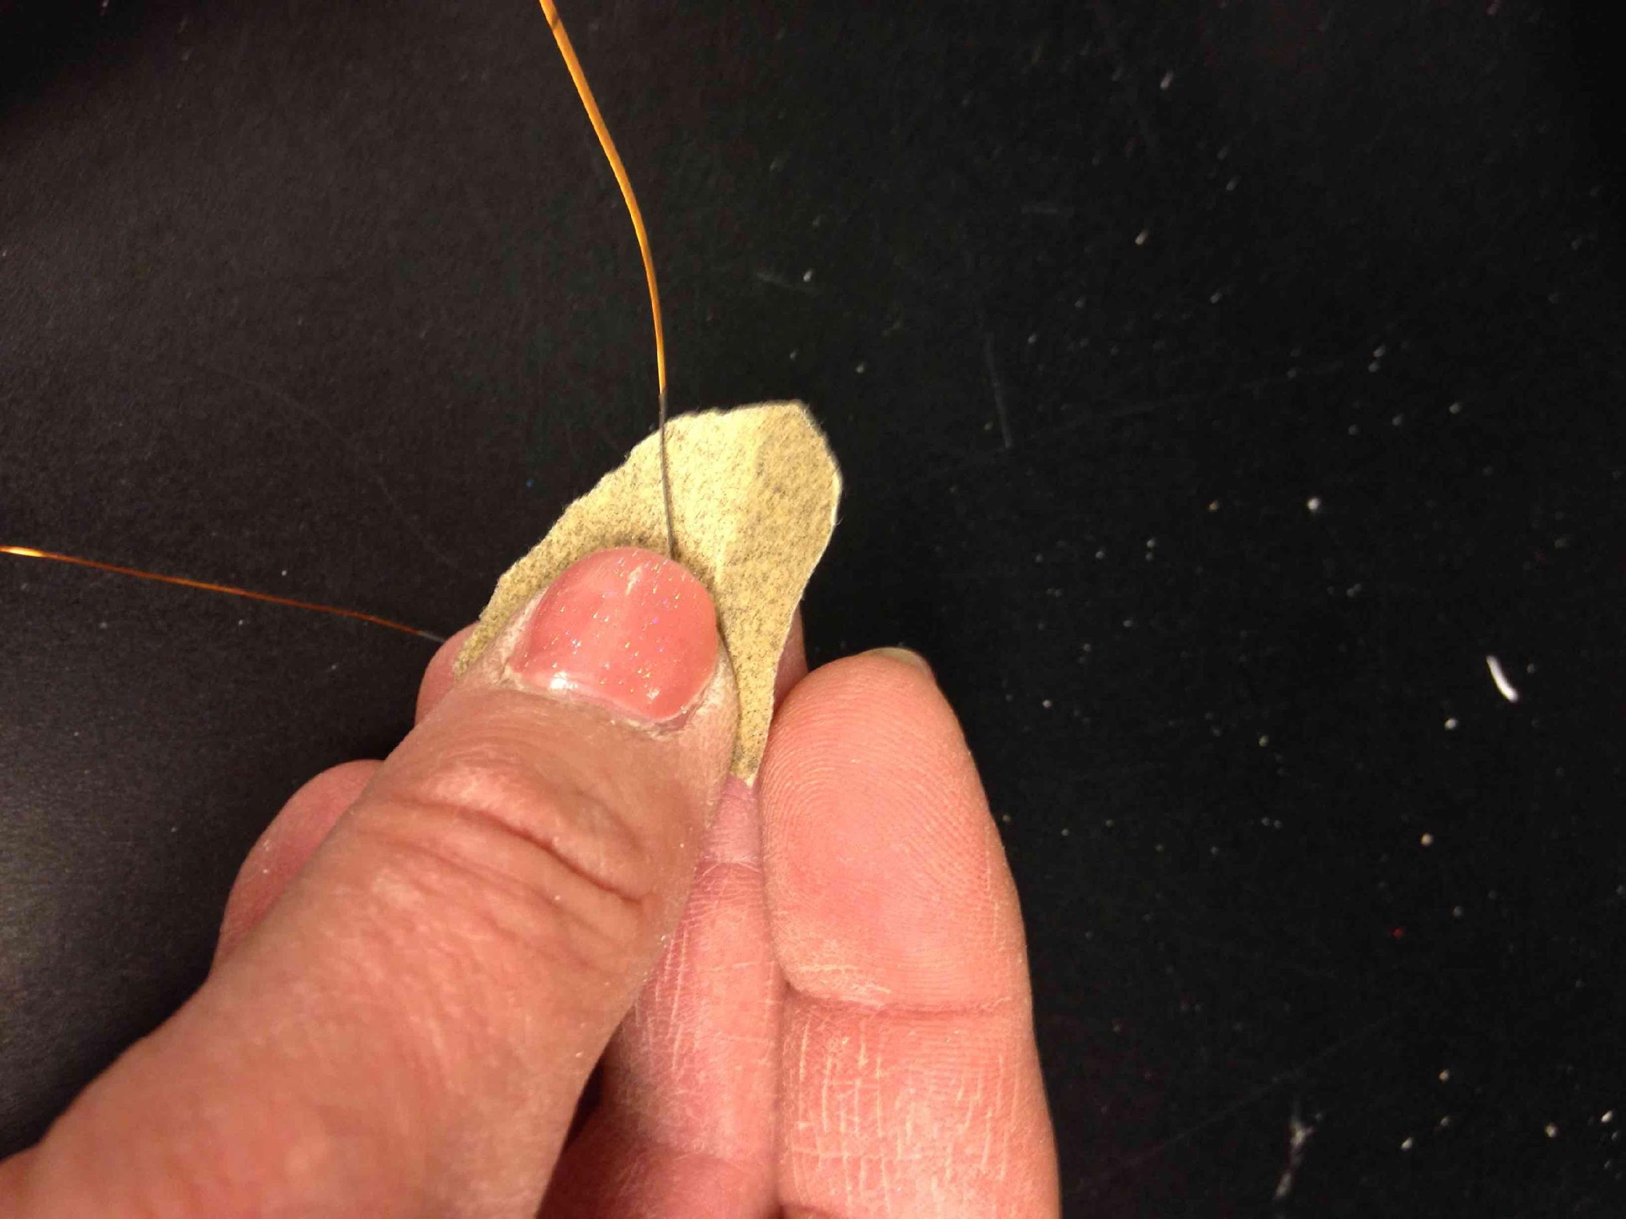
The insulation has been burnt
Sand off the black stuff
…sand on the box
Fold the sandpaper, or...

Slide 19
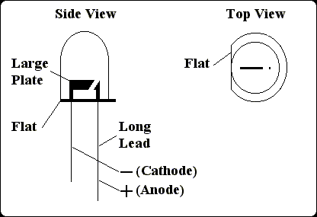
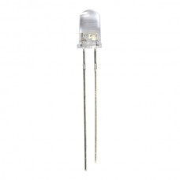
LEDs: one lead is shorter!
Anode
If you forget which is shorter, look for the flat

Slide 20
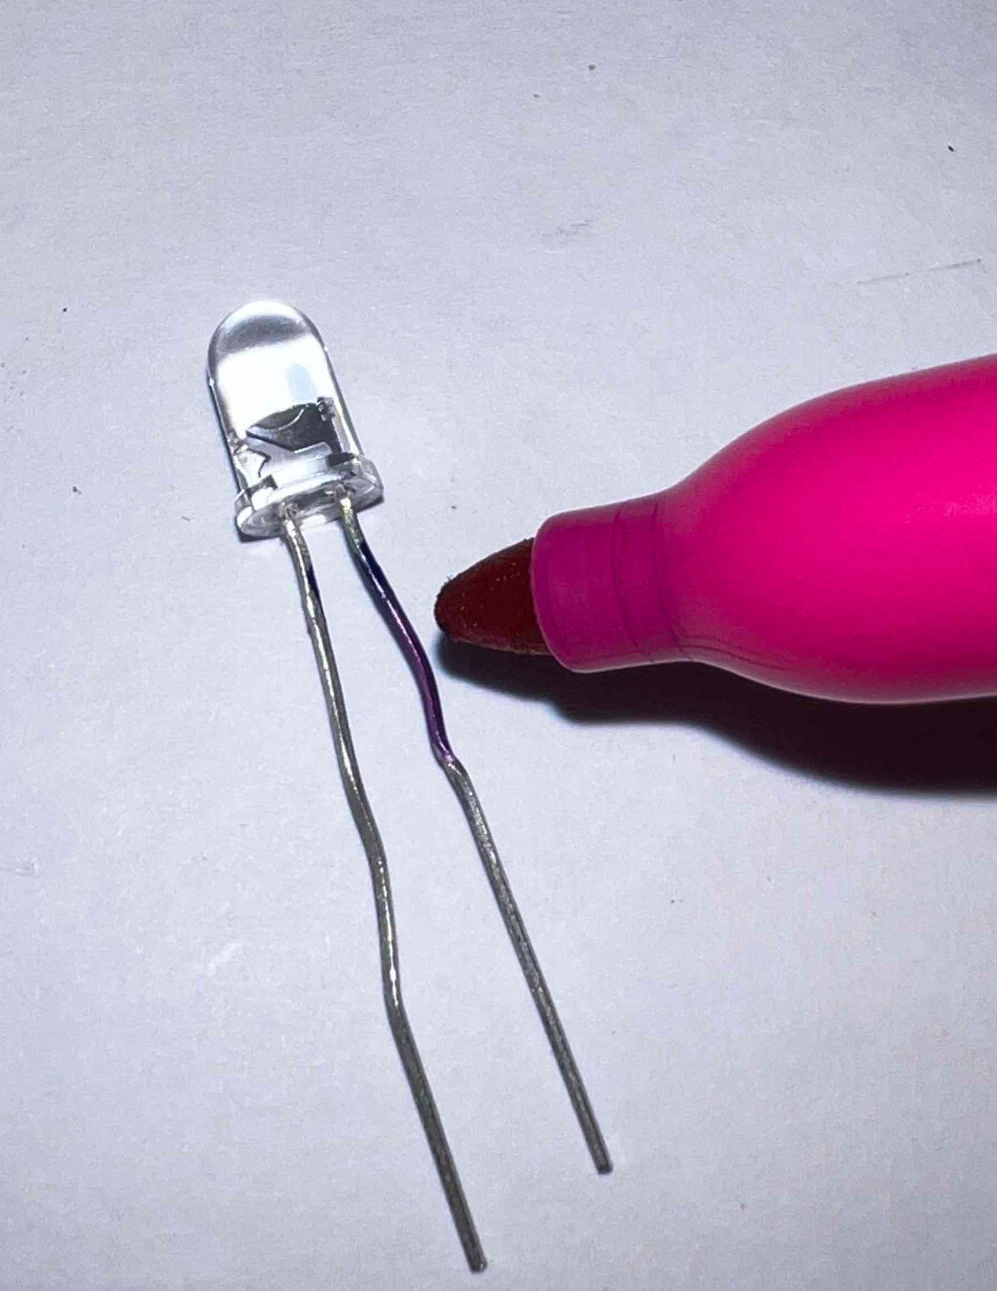
Color the top of the short lead

Slide 21
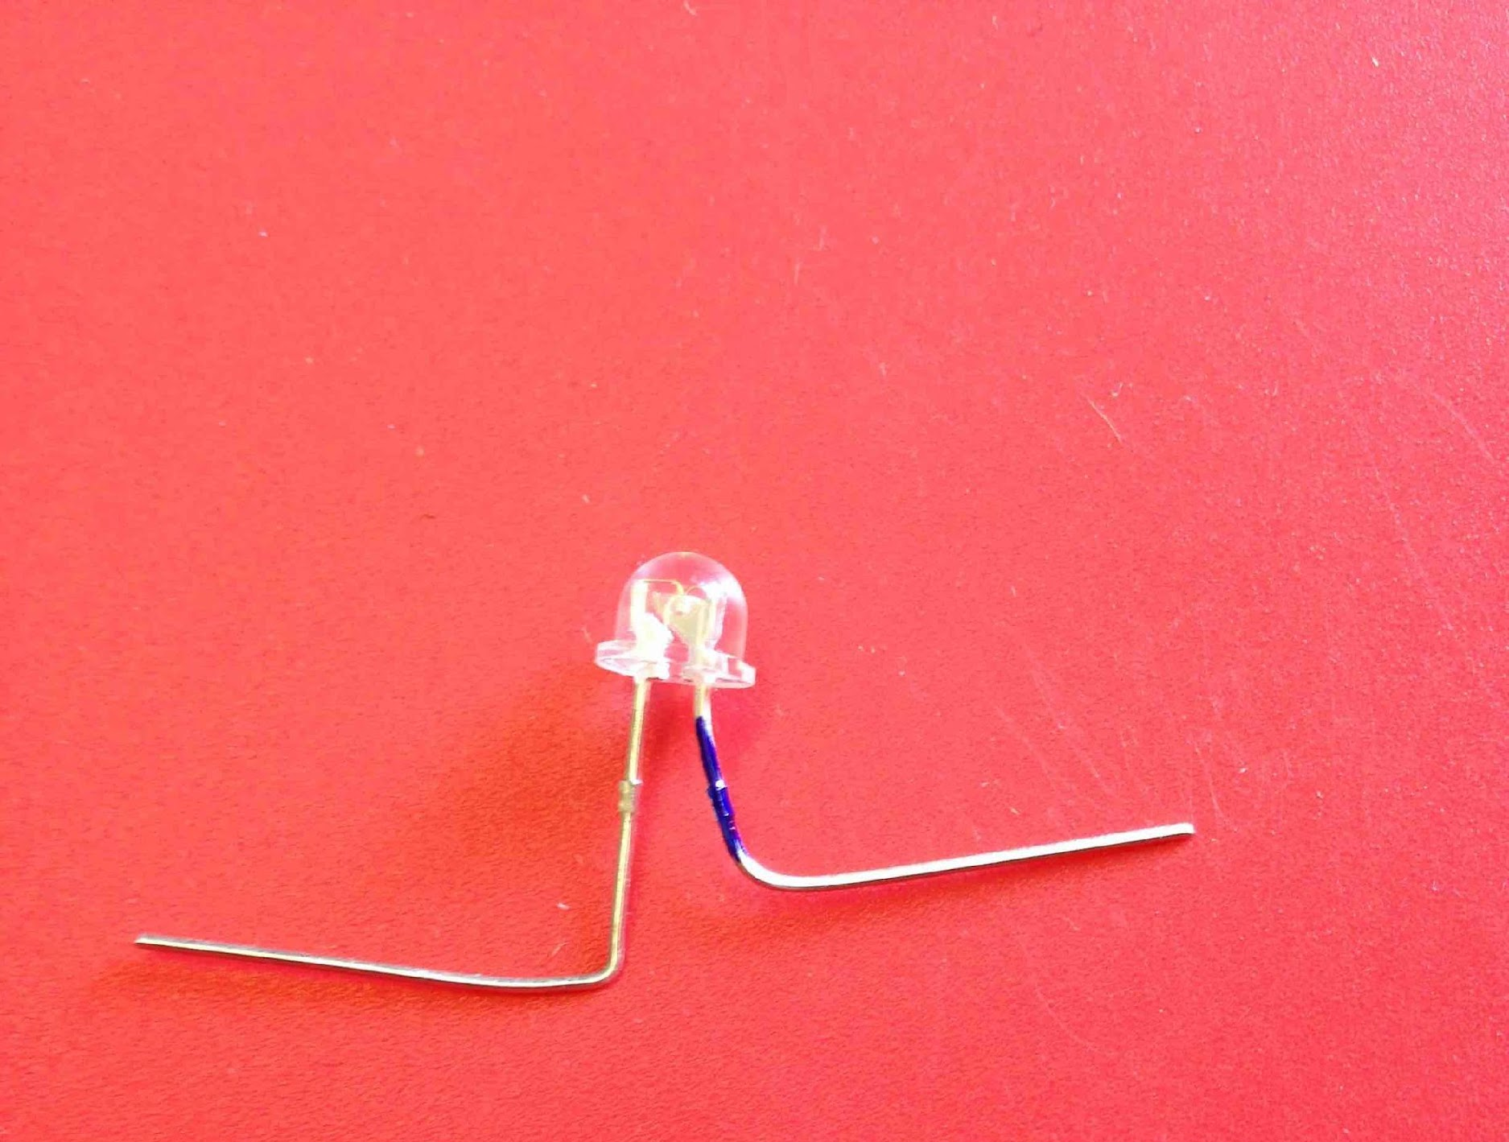
Bend legs at the knees
Short!

Slide 22
Let’s start building this.
+
-
Cathode
We will start by connecting the diode with the battery.

Slide 23
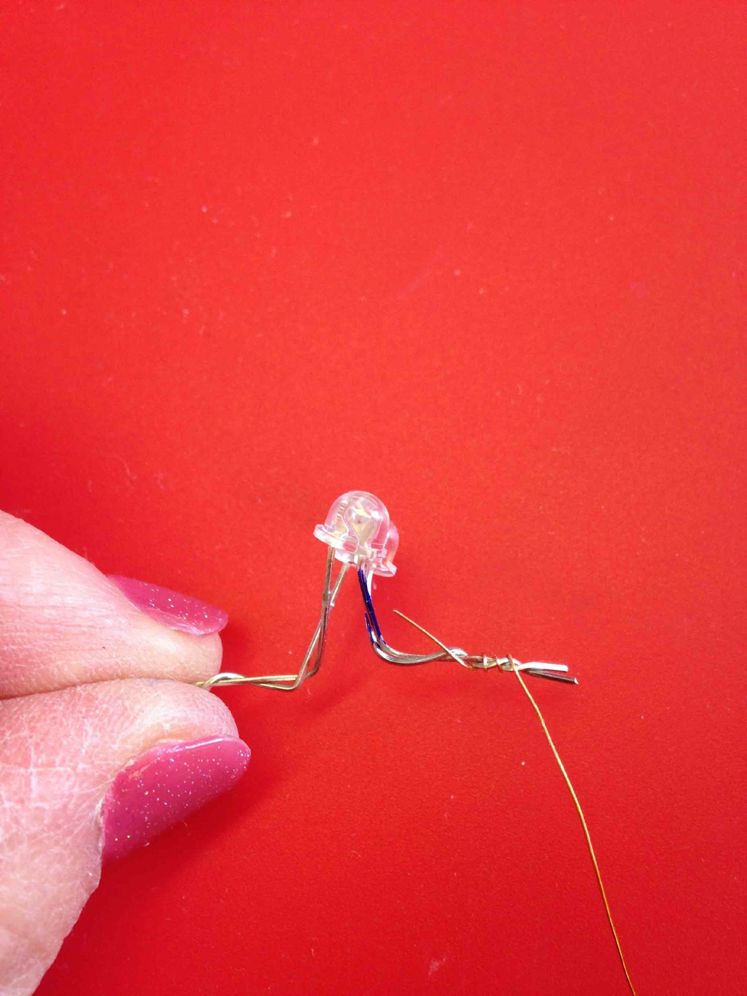
Twist the end of one wire around the SHORT lead

Slide 24
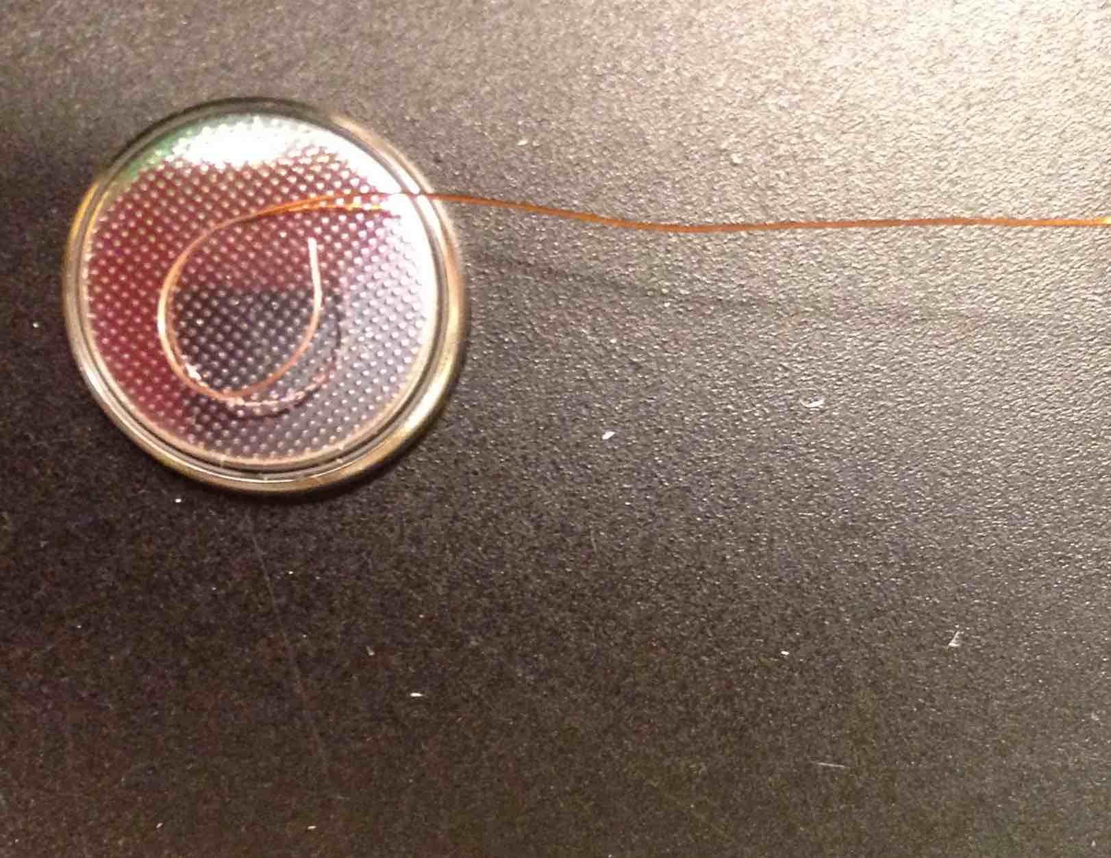
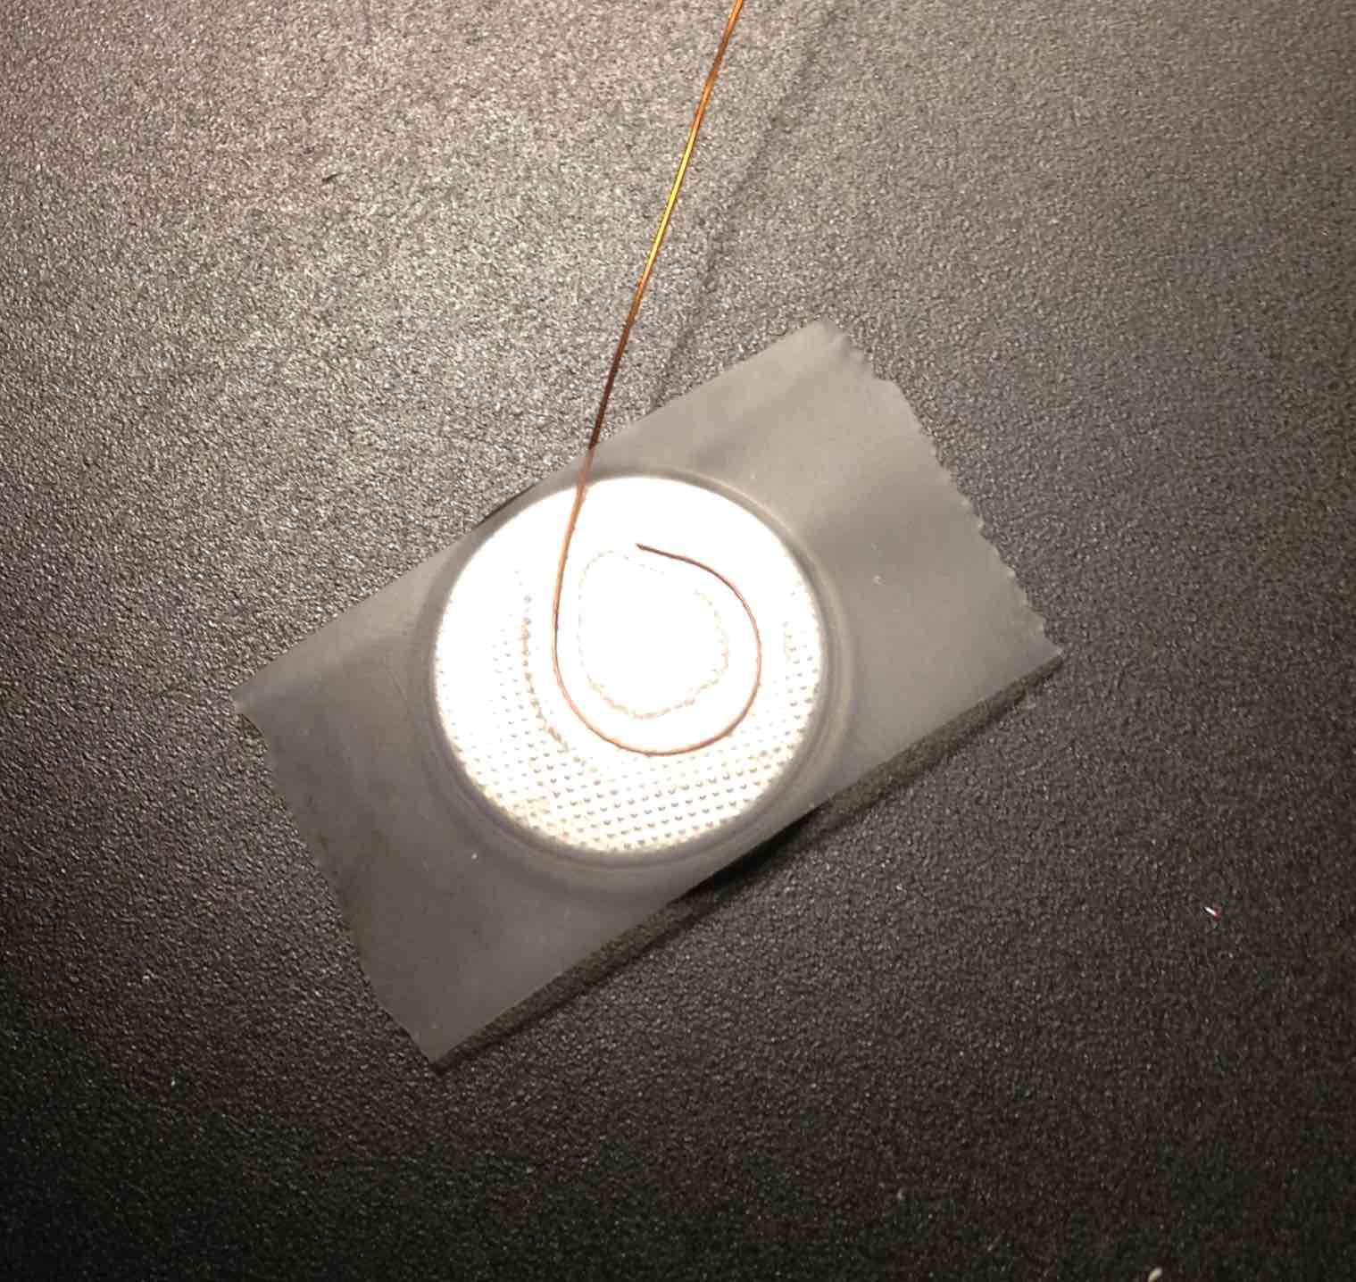
Tape other side of wire to bottom (-) side of battery
Make a small loop in the sanded portion of the wire.
Do not cover the other side of the battery with the tape!

Slide 25
How can we test it at this point?
Need to close the circuit
Touch the bare lead of the LED to the bare side of the battery

Slide 26
We will mark our progress
+
-
Cathode
Engineers test along the way.

Slide 27
Let's do this wire:
+
-
Cathode

Slide 28
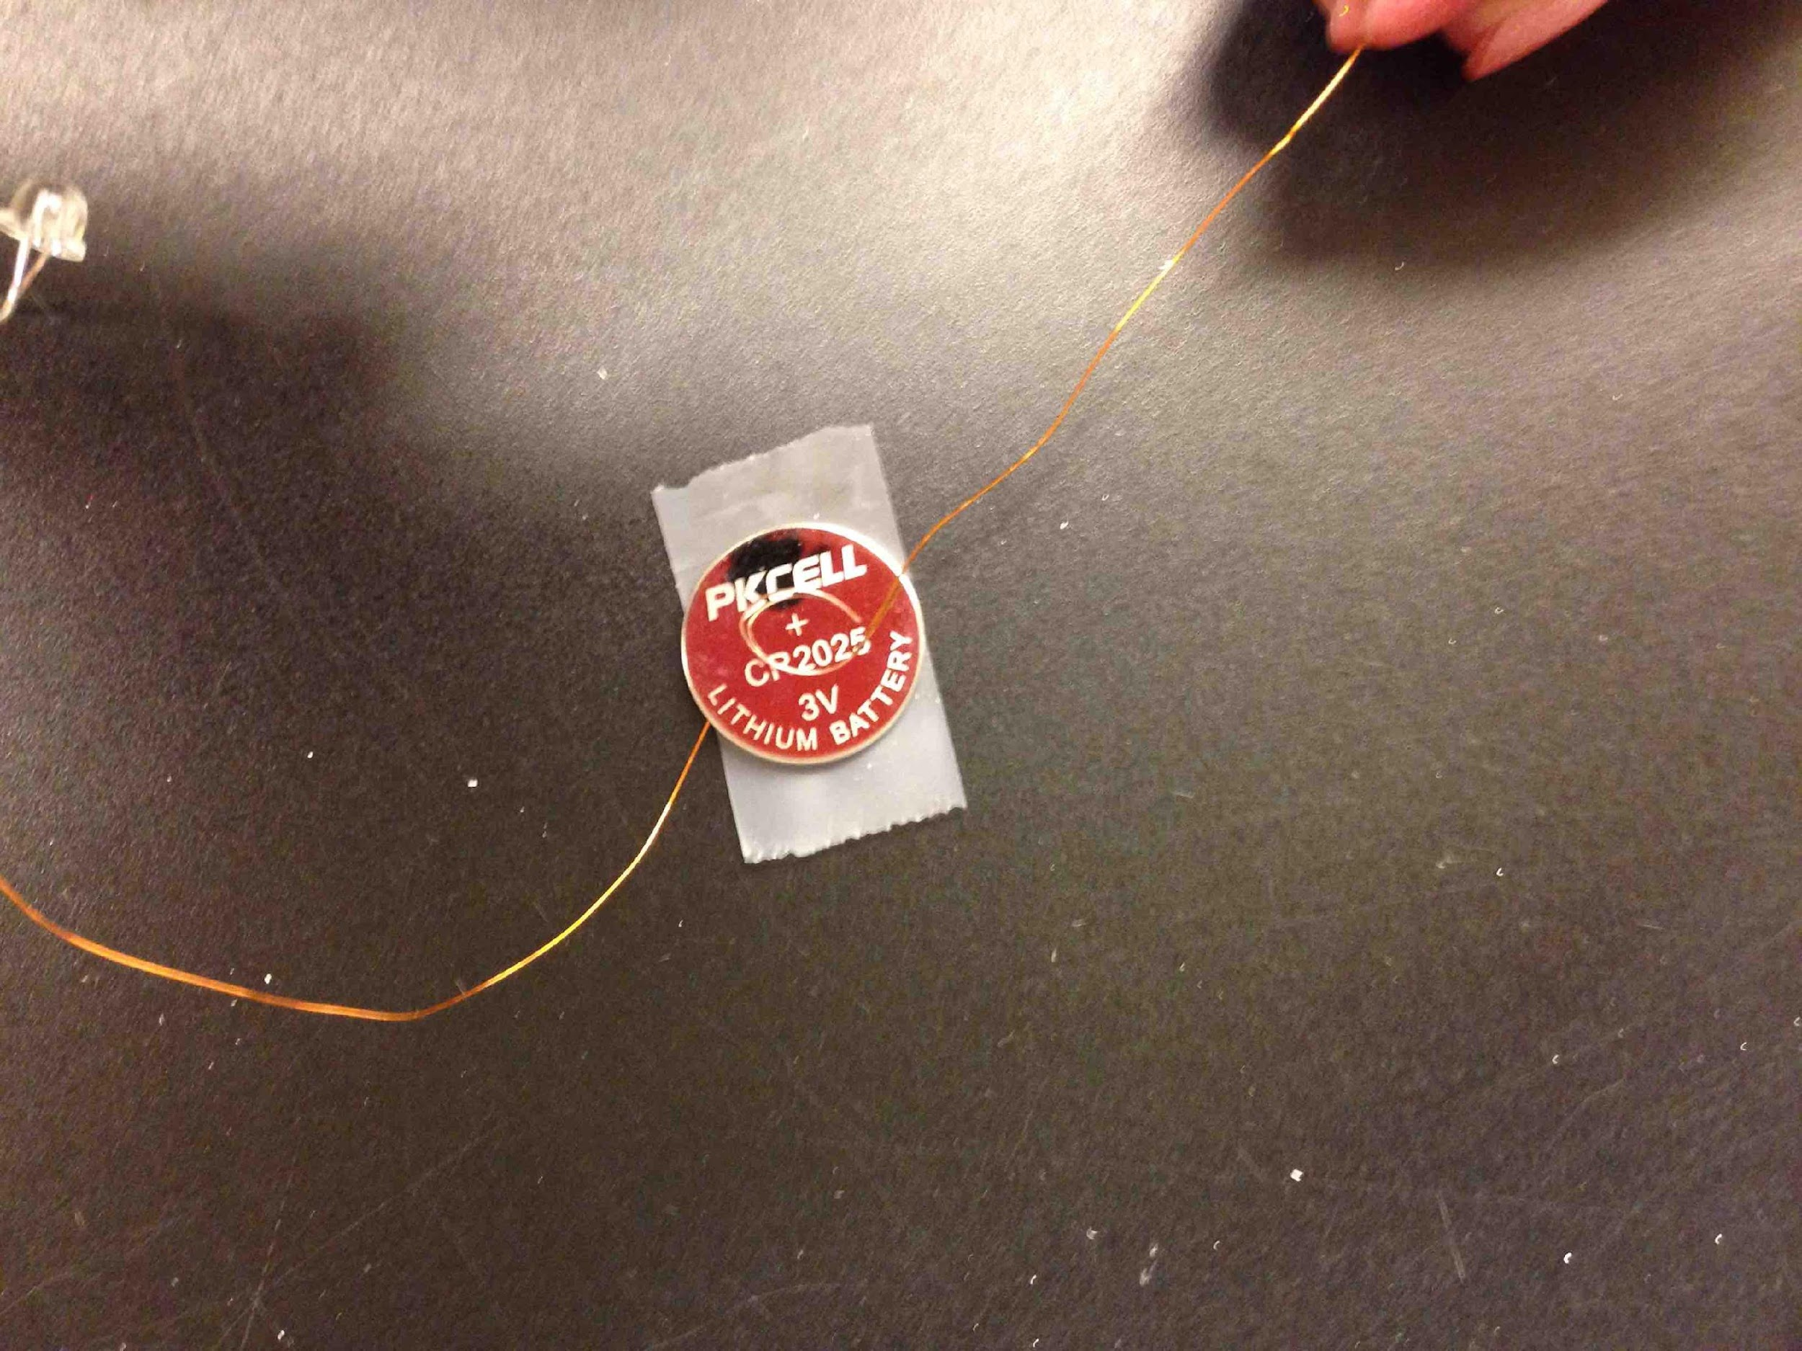
Make a loop in another wire and tape it to the top (+) side of battery
How can we test at this point?

Slide 29
Attach the last wire
+
-
Cathode
Twist the third wire onto the anode, the unused lead of the LED

Slide 30
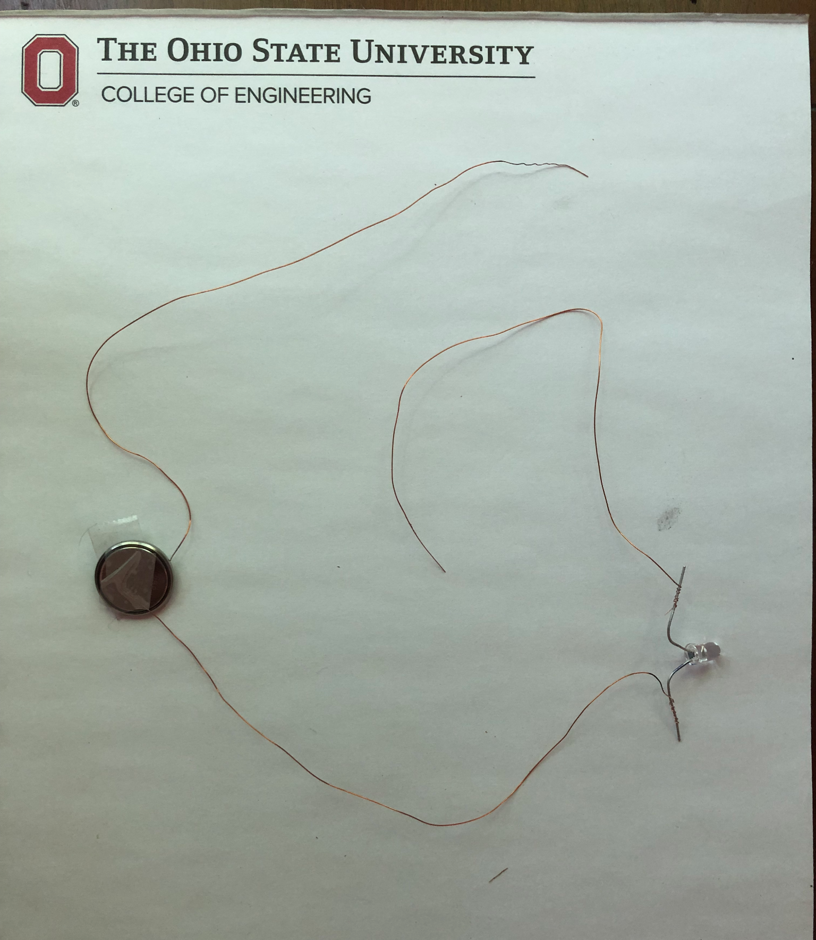
Current state
How can we test this?
What happens if we touch the orange insulation?

Slide 31
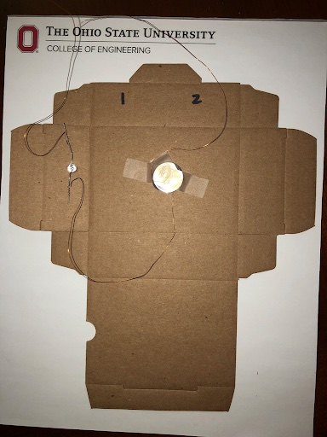
Start building!
Tape battery inside box in the middle of the big section.
Insert the LED into the hole next to the battery
Tape down the LED leads to the box.

Slide 32
Let’s attach the switch
+
-
Cathode

Slide 33
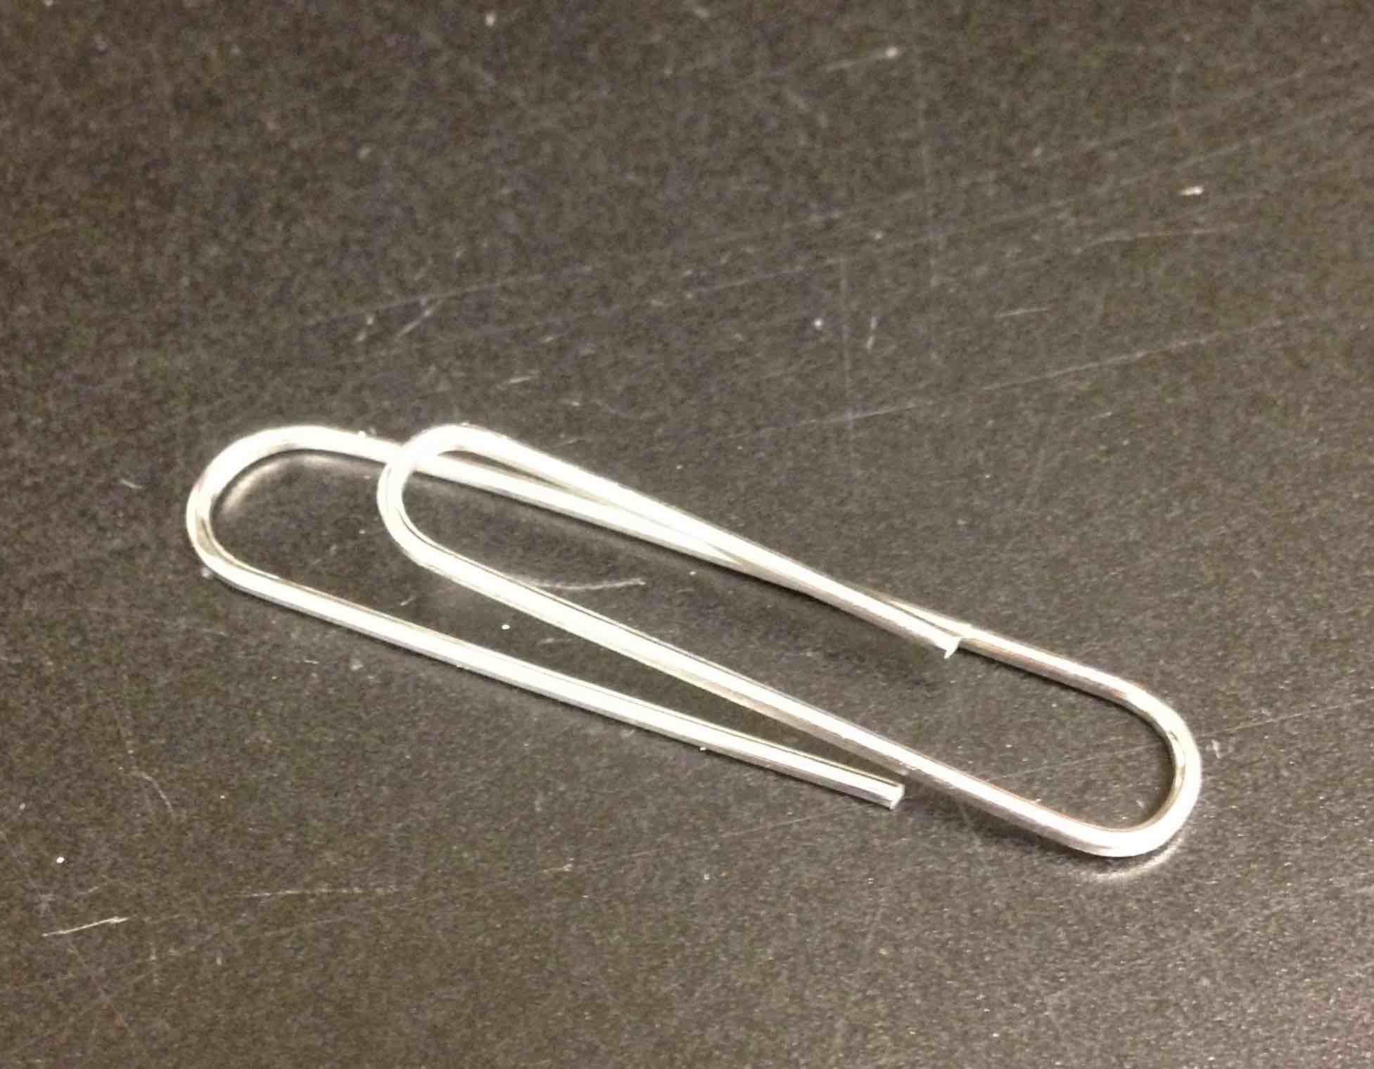
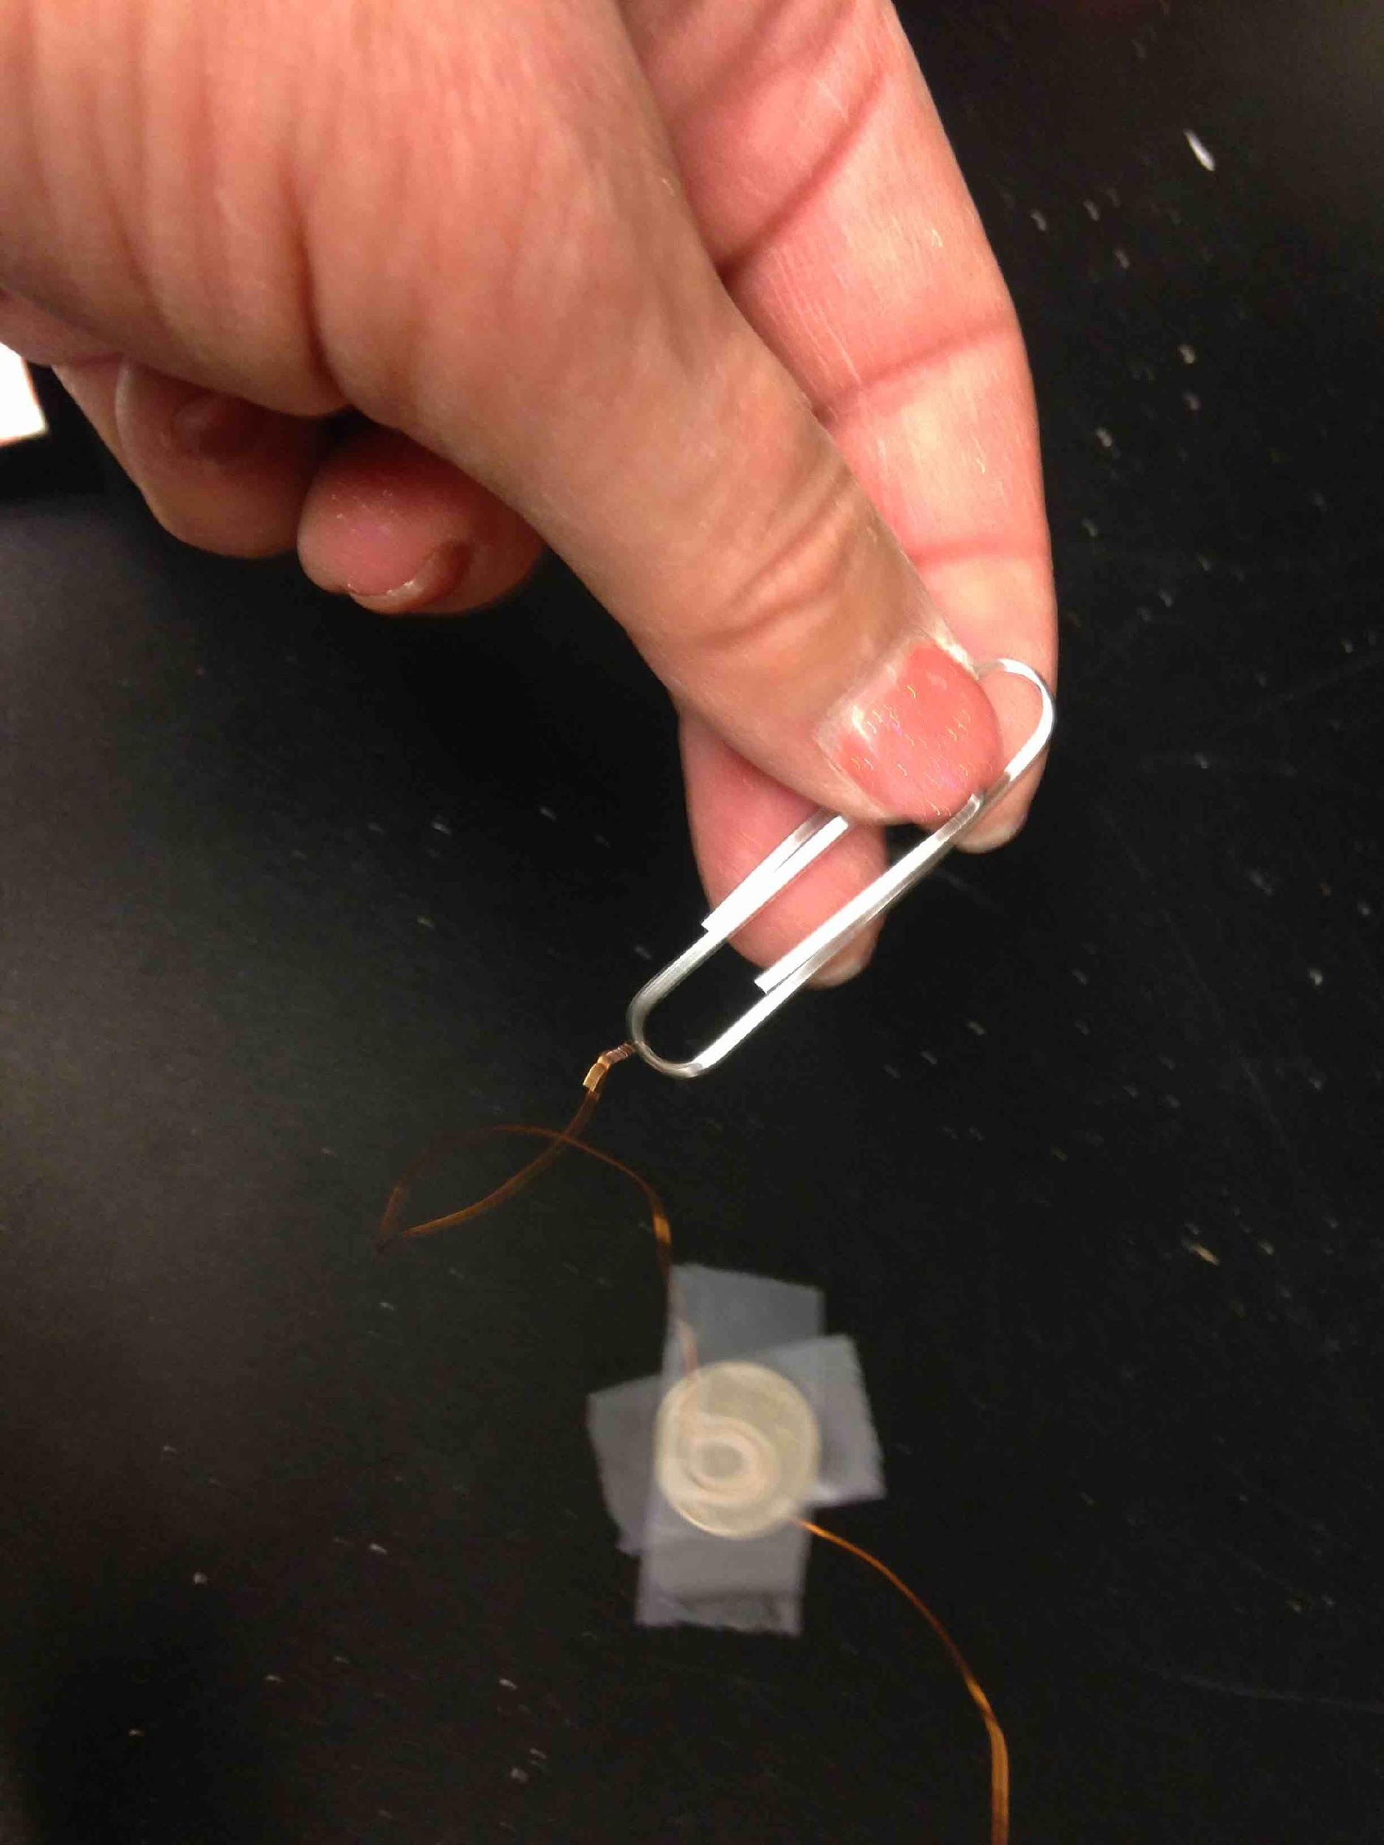
Bend the paper clip a little
Twist the end of the wire from the battery to the paper clip

Slide 34
Technique
1. Loop sanded end of wire over the bottom of paper clip.

Slide 35
Technique
2. Pinch the wire with your fingers of hand not holding paper clip

Slide 36
Technique
3. Twist the paper clip several times to make a good connection

Slide 37
Let’s do the final part of the circuit!
+
-
Cathode

Slide 38
Making the Switch
1. Tape over the bottom of the paper clip between “jaws”

Slide 39
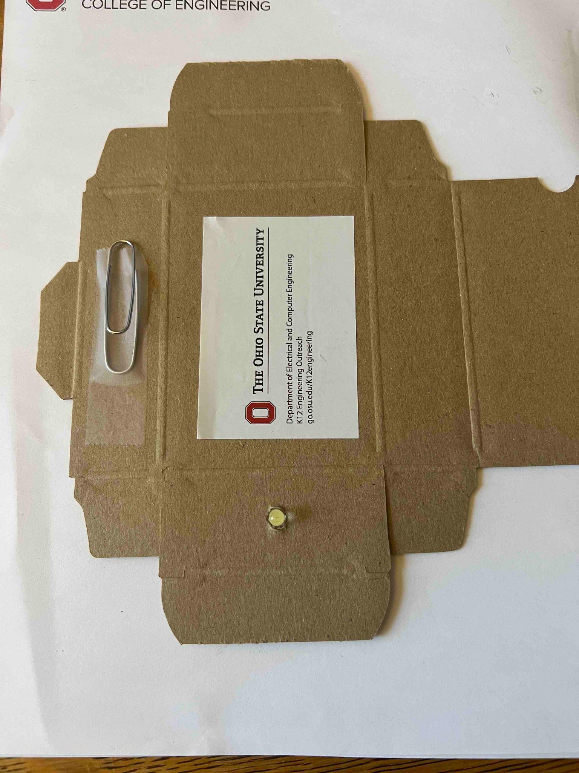
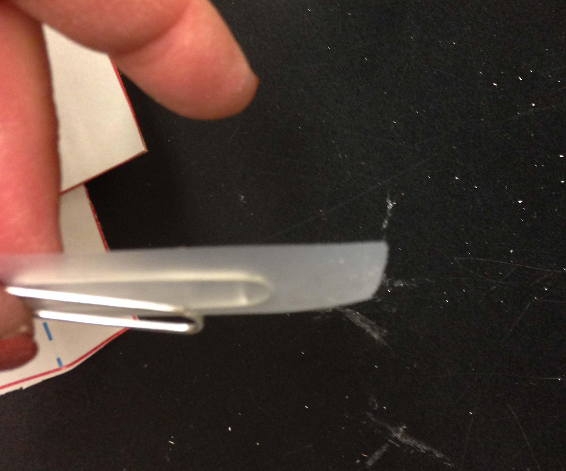
Tape the big loop of the paper clip to the outside of the box
First cover the big loop with tape
Make sure big loop covered with tape

Slide 40
Making the Switch
2. Sanded part of wire placed across bottom of paper clip
Wire
3. Secure wire by taping it down outside of paper clip
Wire

Slide 41
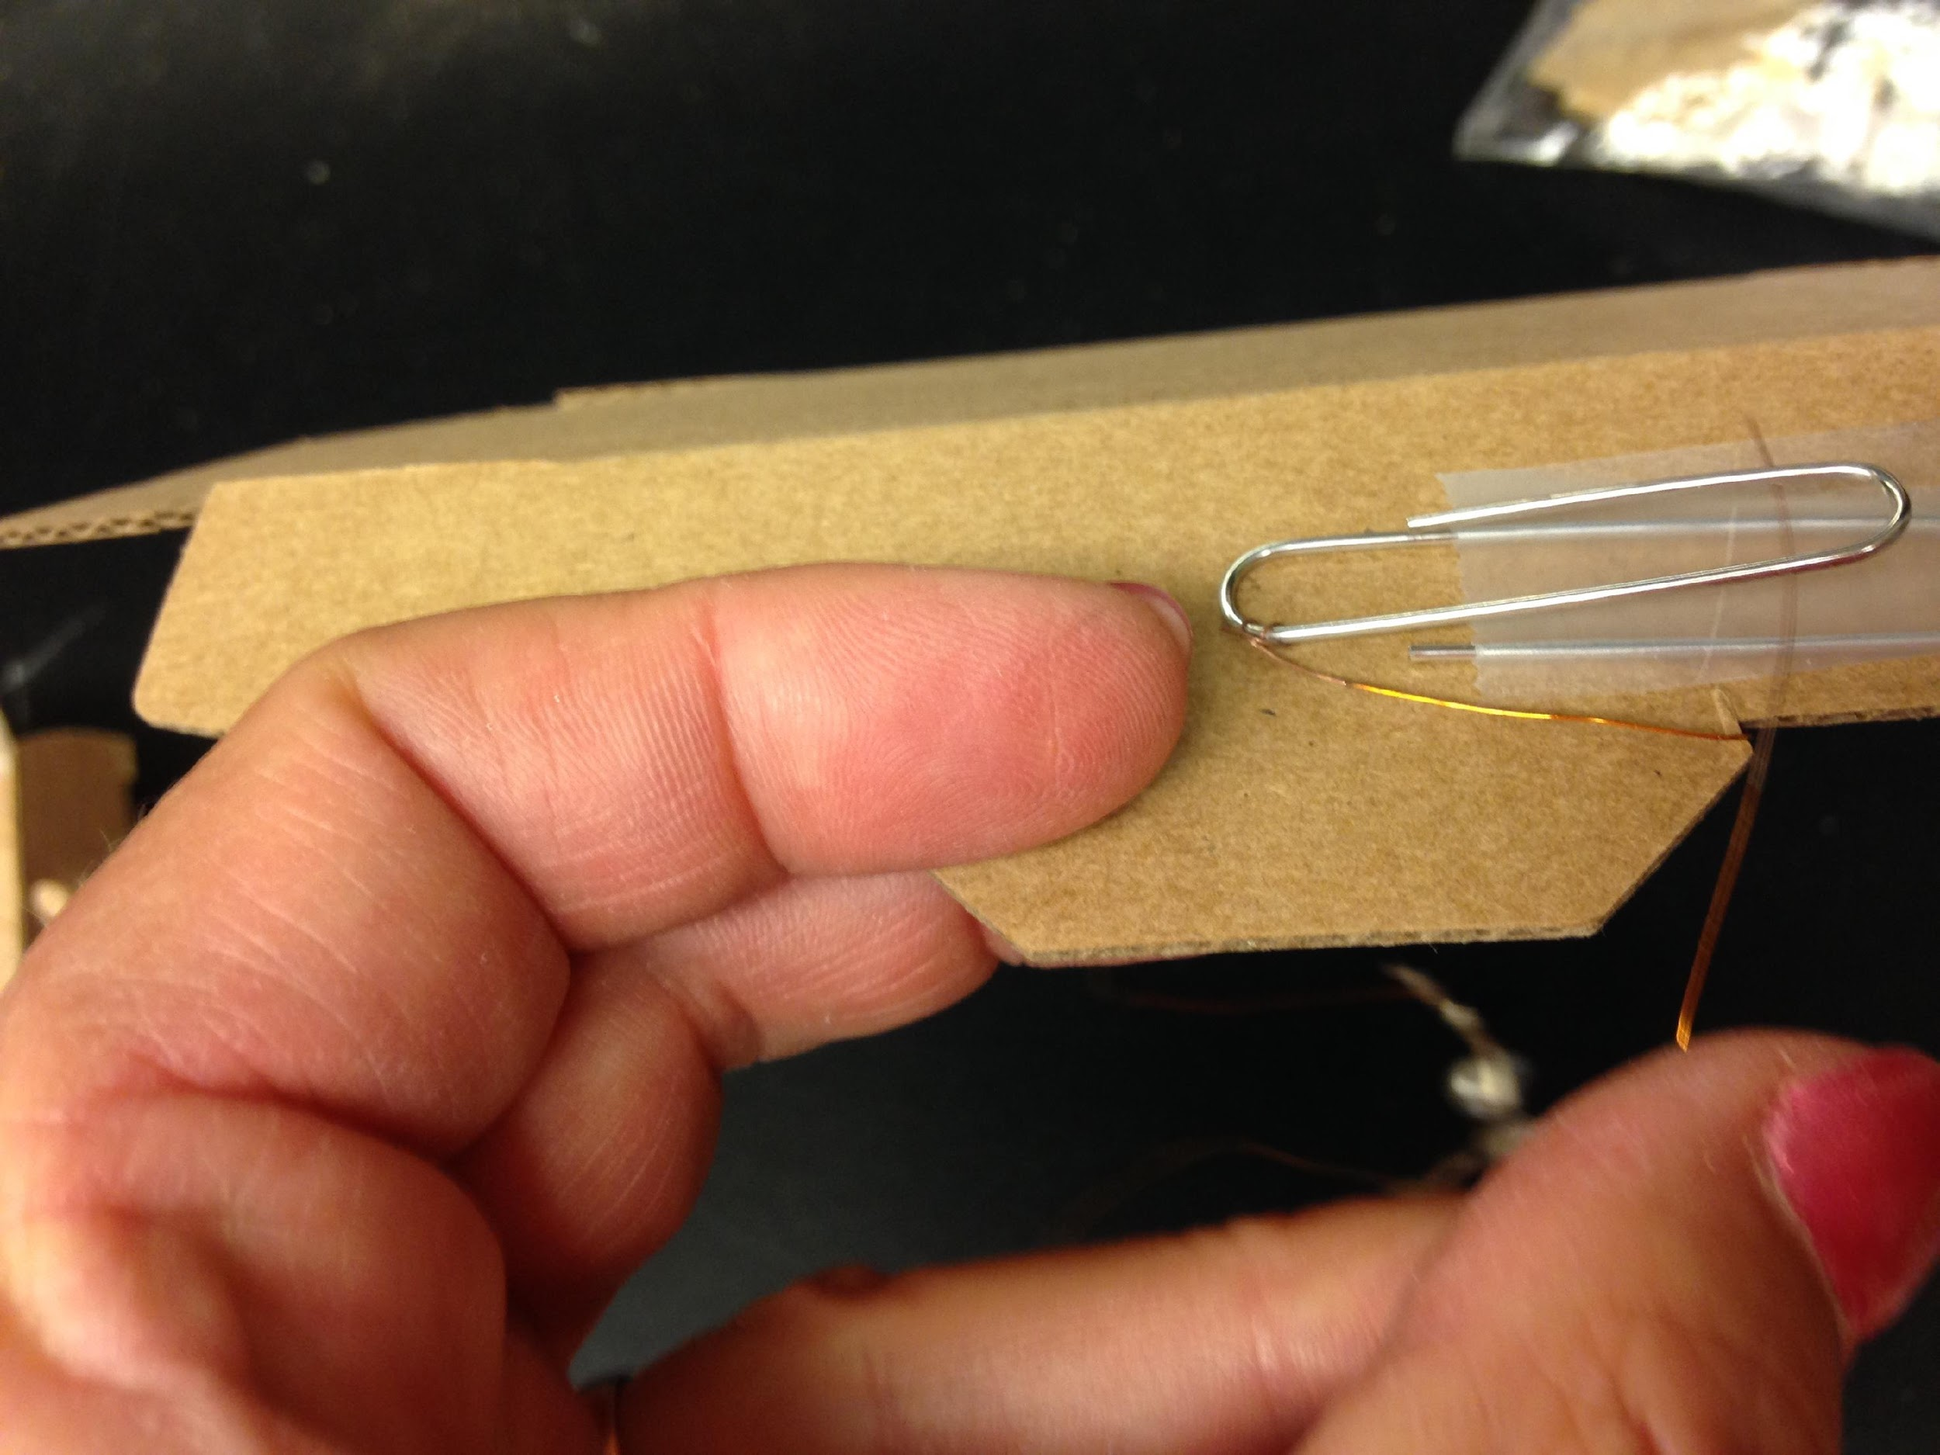
Get the last piece of wire
Slide one sanded end under the top part of the clip
This is going to be your switch!
Must be sanded part!!!

Slide 42
Tape it down ONLY THE END
Tape the other side
Test it!

Slide 43
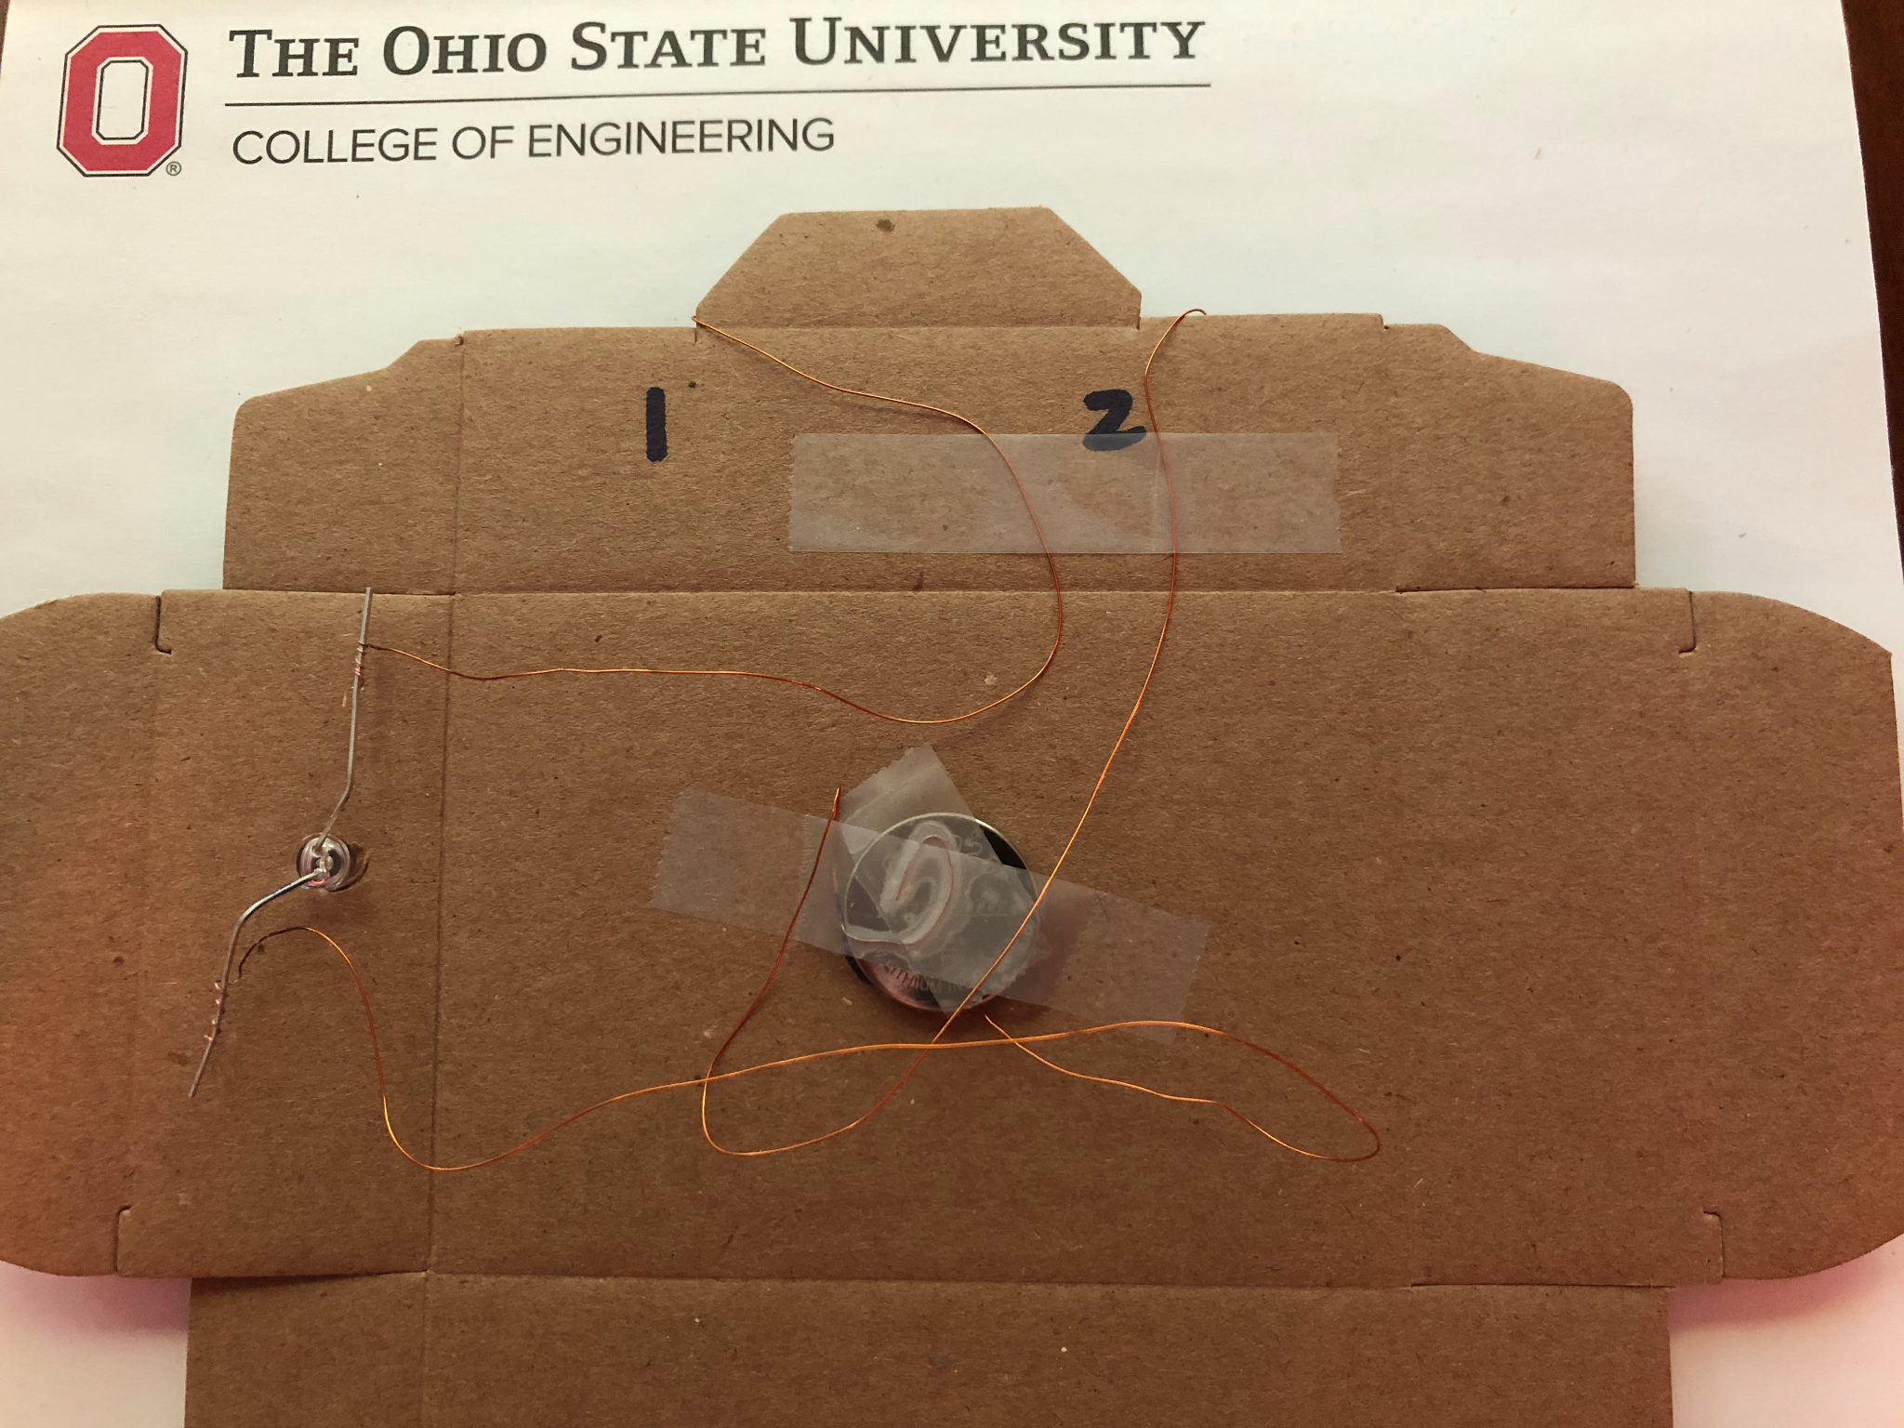
Thread the two wires from the switch to the inside
Route wires by the tab.
Tape them down to secure!

Slide 44
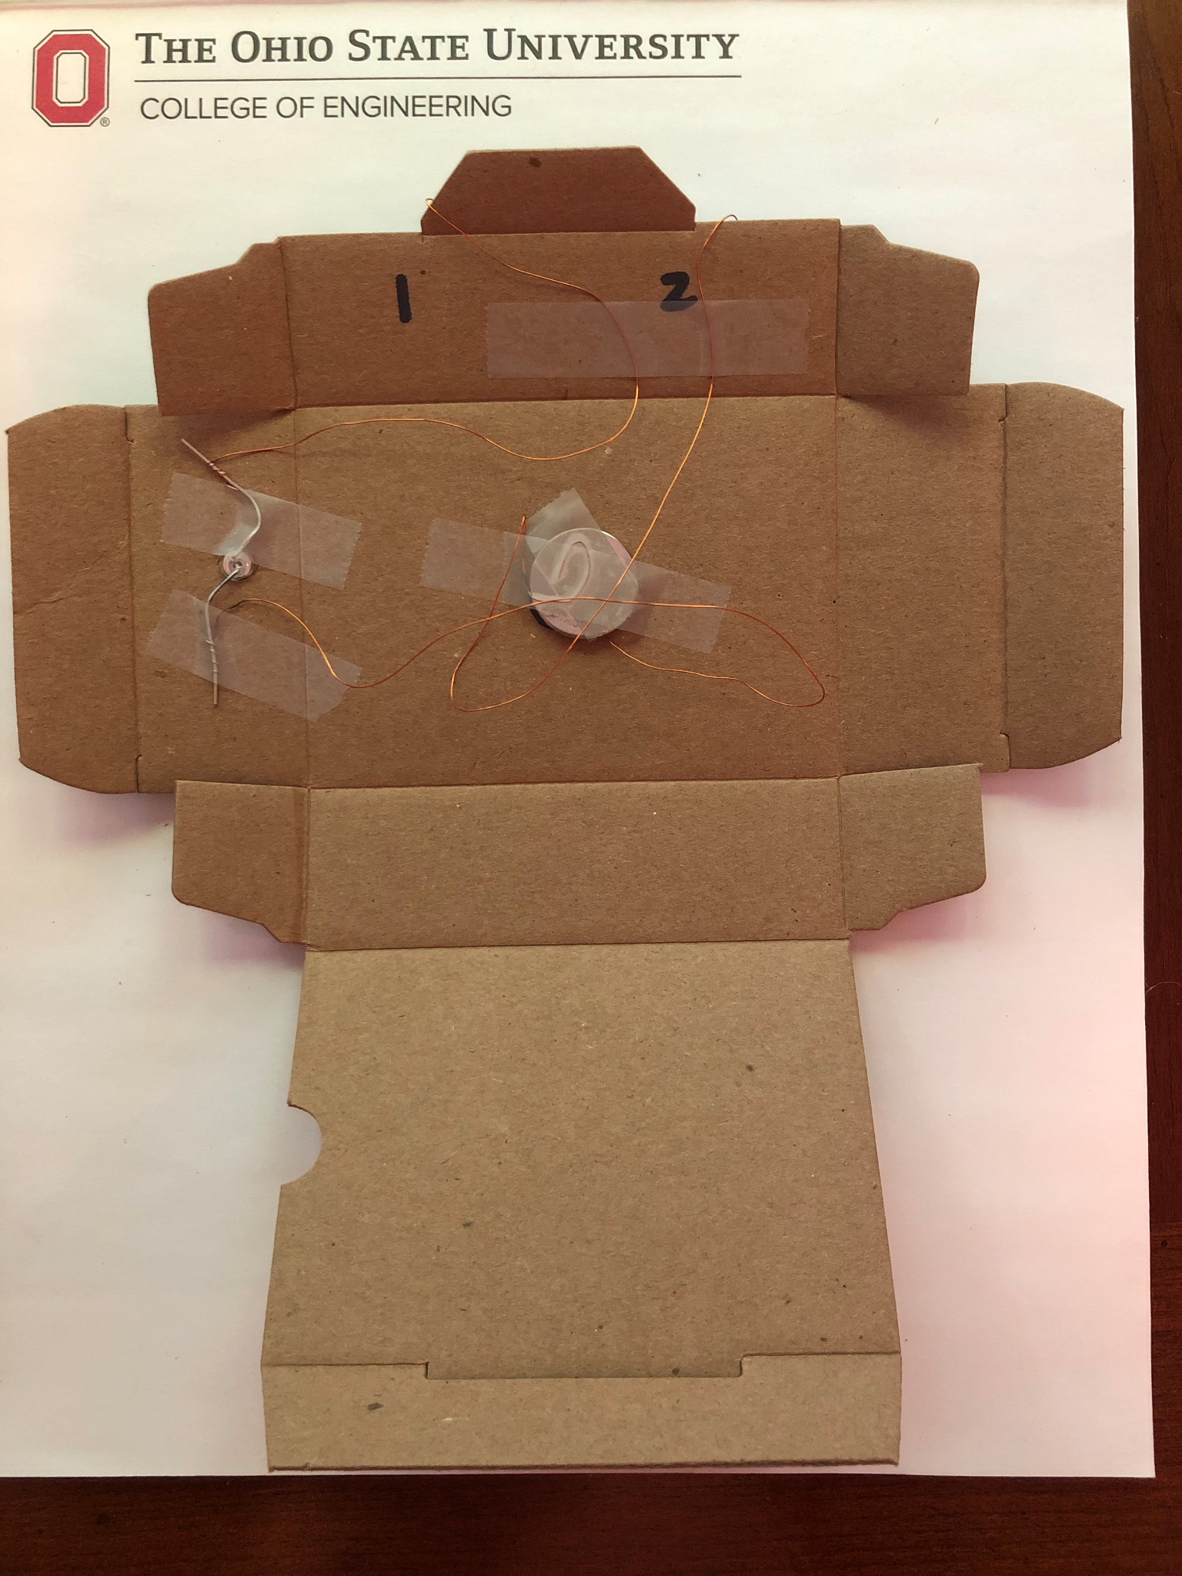
Fold the Box!
Start by slightly folding each crease in.

Slide 45
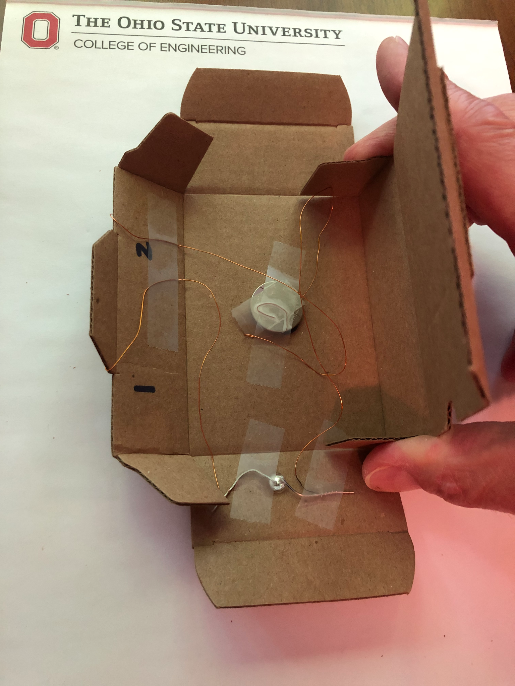
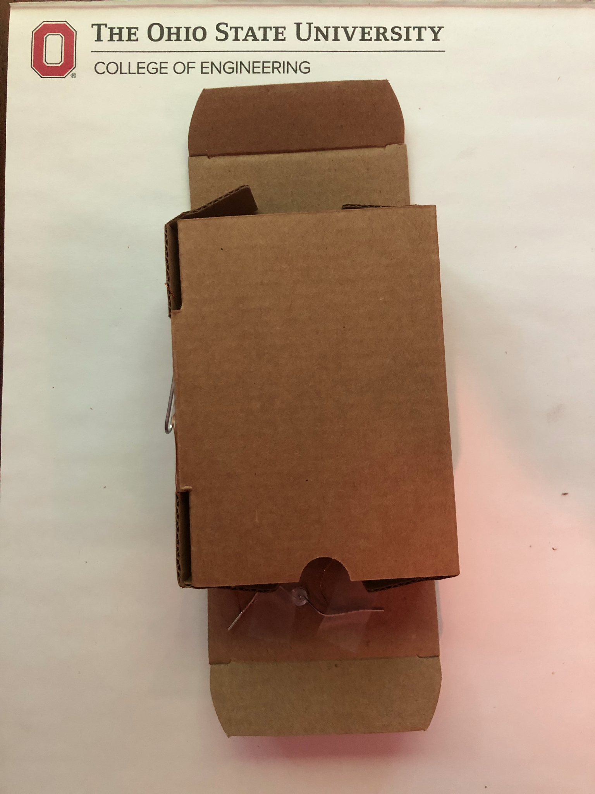
Fold up long sides, connect with flap

Slide 46
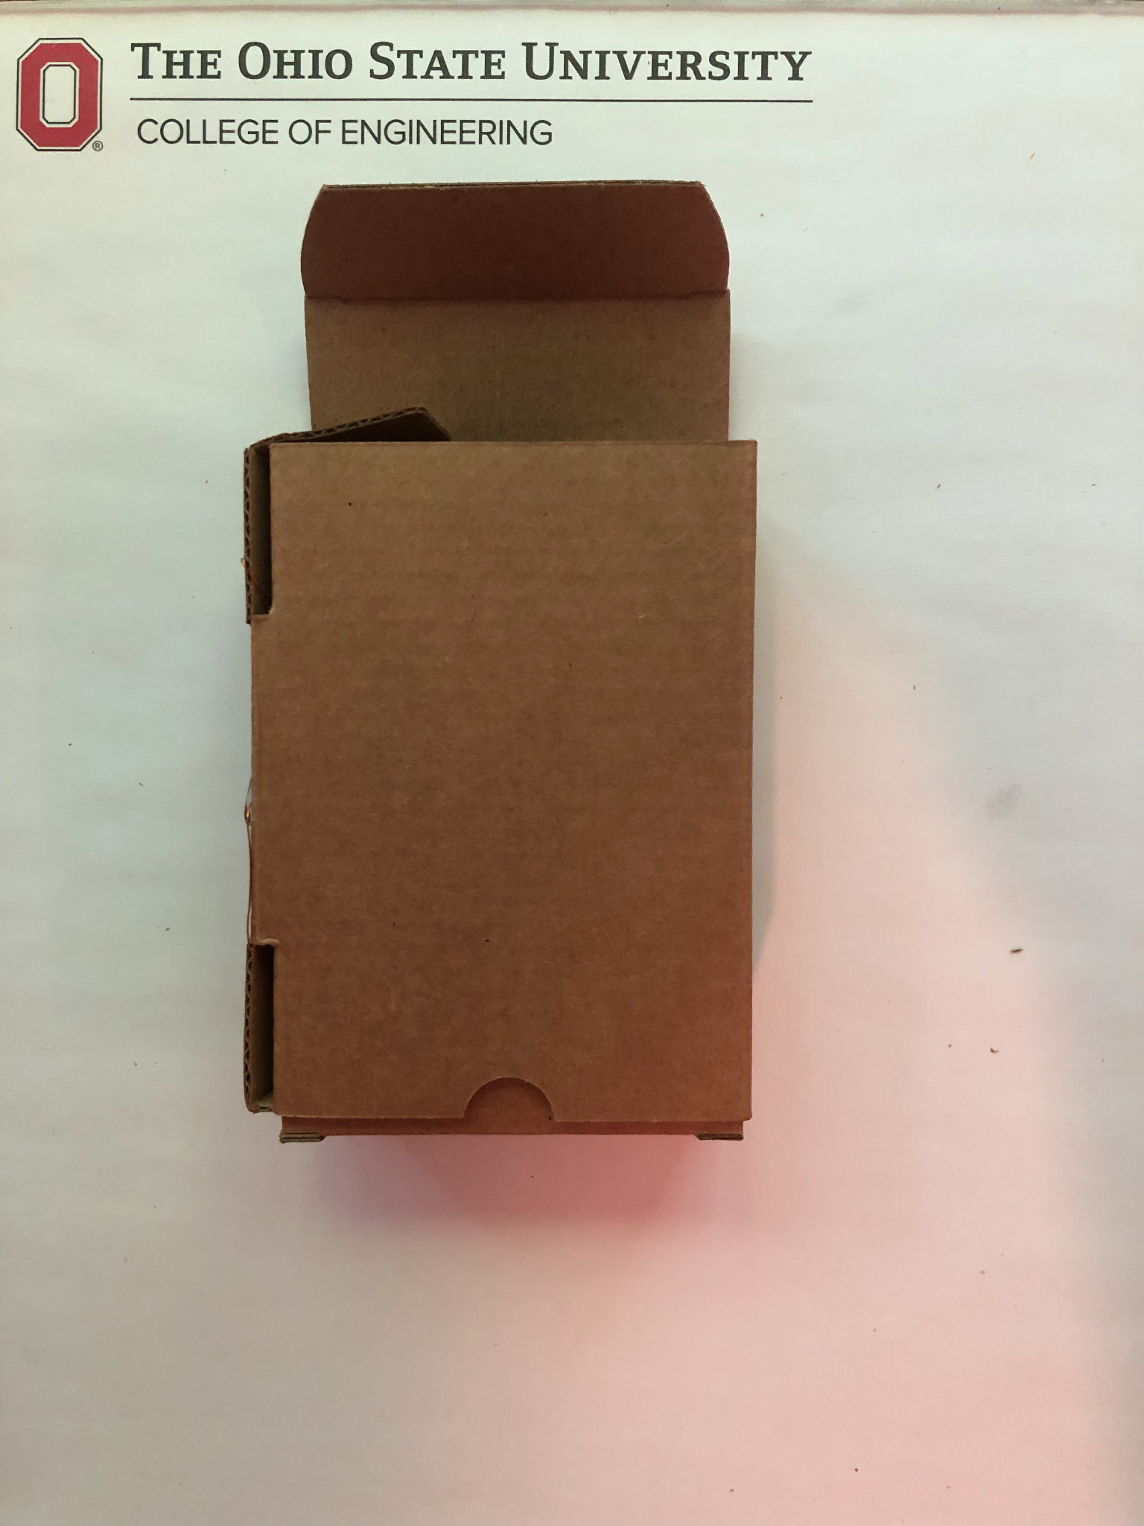
Fold in end flaps

Slide 47
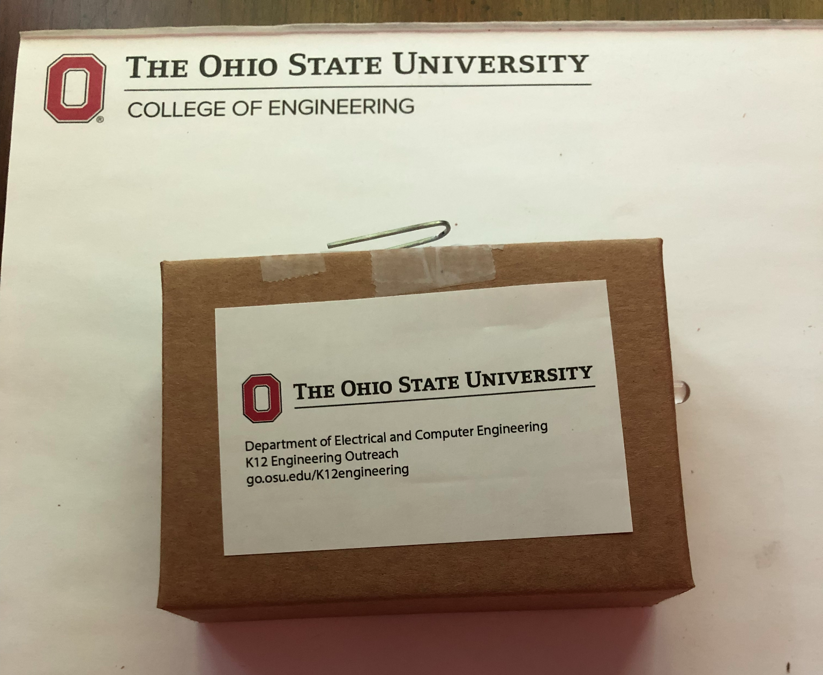
Tape the box.
You are done!

Slide 48
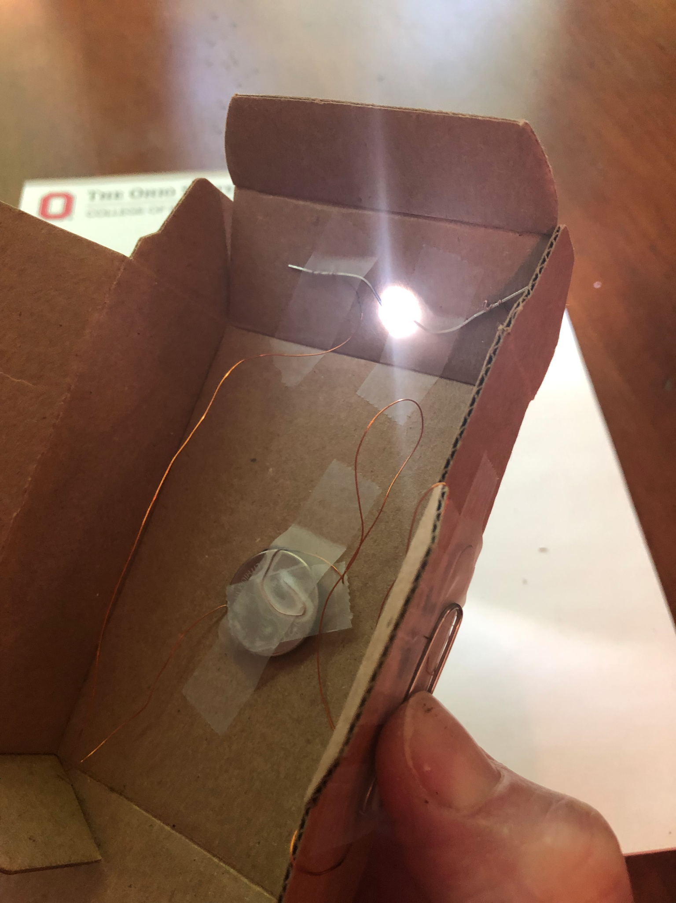
You have built a circuit!
What is this?
+
-
What is this?
What is this?

Slide 49
Questions?

