Slide 1
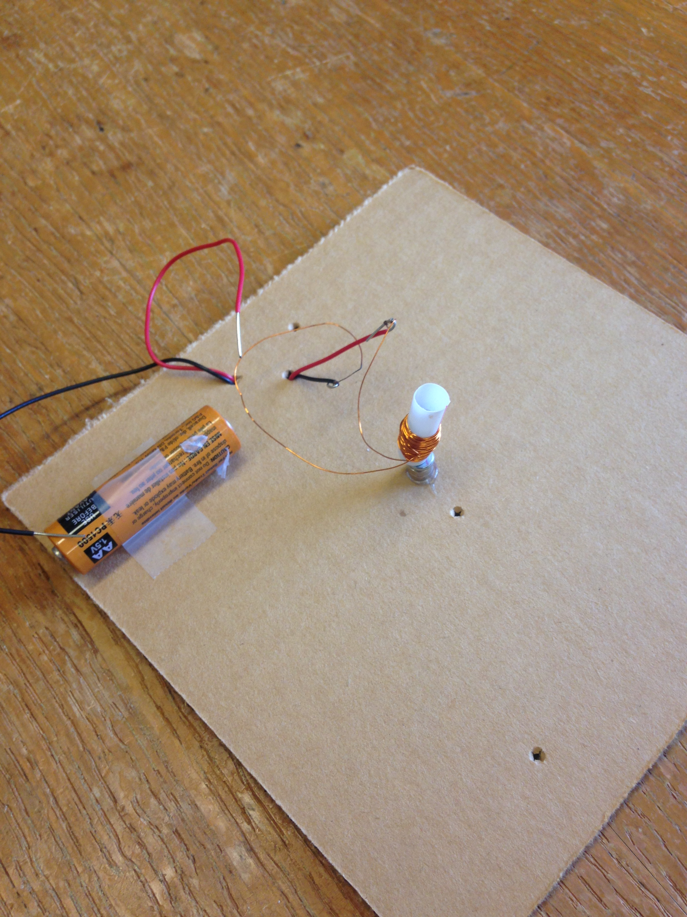
Build a jumping jack

Slide 2
We will use electromagnetism
We will create a force field:
We will make an electric field
That creates a magnetic field
That creates a force
The force will push the jack

Slide 3
First, think about magnets
Like poles repel
South repels south
Opposite poles attract
The magnets produce a force
http://www.swe.org/iac/lp/magnets_03.html

Slide 4
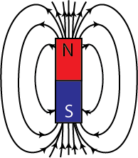
We say the magnet has a field
The field is invisible
But it is real
It can act on objects
Repel or attract them

Slide 5
Example: compass needle
Opposite poles attract
North end of compass needle attracted to south pole of magnet
Why can’t we feel the magnetic field?
We’re not magnetic!
hyperphysics.phy-astr.gsu.edu/.../ elemag.html

Slide 6
Let’s Practice
Which side is the N pole?
Which side is the S pole?
Web.mit.edu/
Physics 8.02
Module Guide 09

Slide 7
Let’s Practice
Solution:
Arrows point out of the North pole and into the south pole.
Web.mit.edu/
Physics 8.02
Module Guide 09

Slide 8
Let’s Practice
Will these magnets attract or repel each other?
Web.mit.edu/
Physics 8.02
Module Guide 09

Slide 9
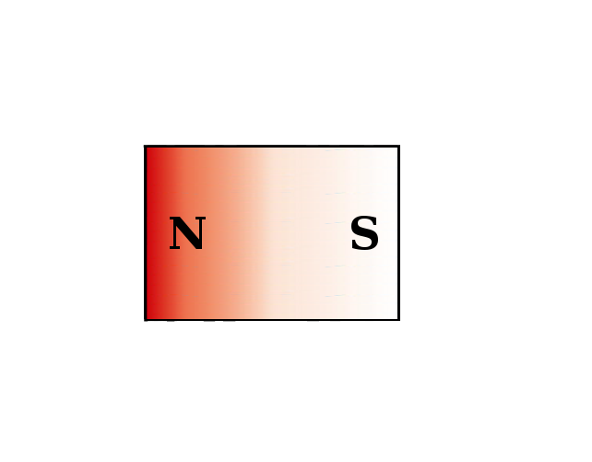
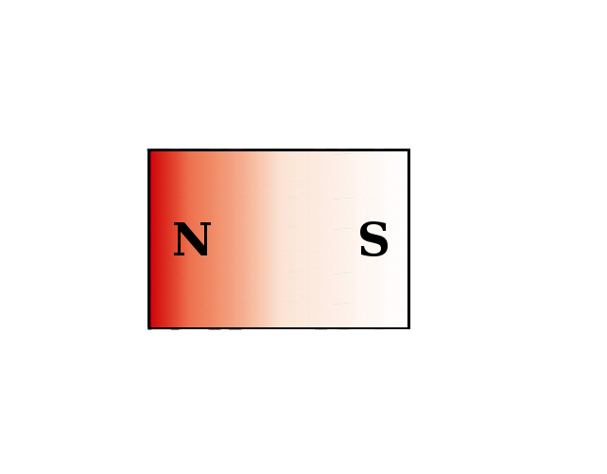
Let’s Practice
Opposite poles attract:
Web.mit.edu/
Physics 8.02
Module Guide 09

Slide 10
Then what?
We want to push the jumping jack, which is made of plastic
Plastic is not magnetic
What should we do?
We will put electromagnetism to work

Slide 11
First piece of information
When current (I) flows though a wire, it creates a magnetic field (B)
Use right hand rule to find direction
http://en.wikipedia.org/wiki/Electromagnet

Slide 12
Is this drawn correctly?
Web.mit.edu/
Physics 8.02
Module Guide 09

Slide 13
If the current changes
Suppose the current reverses direction
What will happen to the field?

Slide 14
If the current changes
Suppose the current reverses direction
What will happen to the field?
It will reverse
Can we use this to push a magnet around?
Yes, but it’s pretty weak

Slide 15
Suppose we make a loop
All the field lines inside the loop go the same direction
Is the figure drawn correctly?
The field gets concentrated
physicsed.buffalostate.edu/.../ rhr/rhr.htm

Slide 16
Remember Two Magnets?
Will these magnets attract or repel each other?
Web.mit.edu/
Physics 8.02
Module Guide 09

Slide 17
Replace one magnet
Web.mit.edu/
Physics 8.02
Module Guide 09

Slide 18
Reverse Current
Web.mit.edu/
Physics 8.02
Module Guide 09

Slide 19
Ok! We can push the magnet!
But the field is still weak.
Need a way to amplify the field.

Slide 20
A bunch of loops=electromagnet
www.utm.edu/~cerkal/ magnetic.htm

Slide 21
OK, we have all the pieces!
Need jumping jack
Need a “voice coil”
About 50 turns should do it
Need a magnet
And a current source

Slide 22
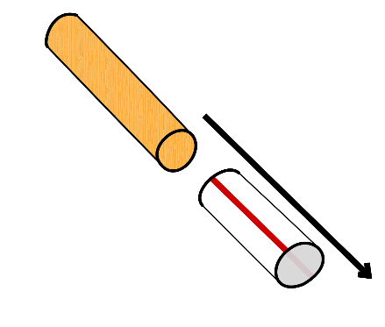
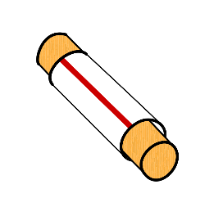
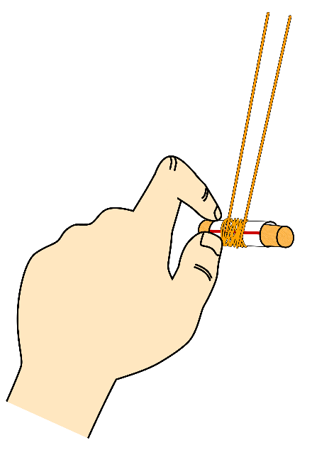
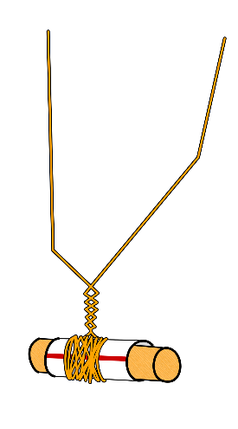
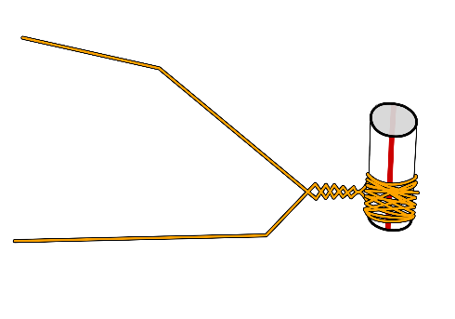
Electromagnet
Slide straw over dowel
Wrap wire around straw
Leave about 6” free before you start winding
Leave 6” at the end
Overlap wire as much as possible
Make sure all wire is on the straw
Twist wire so it doesn’t unwind
When finished, slide coil to one end of straw
Remove dowel

Slide 23
Like this!

Slide 24
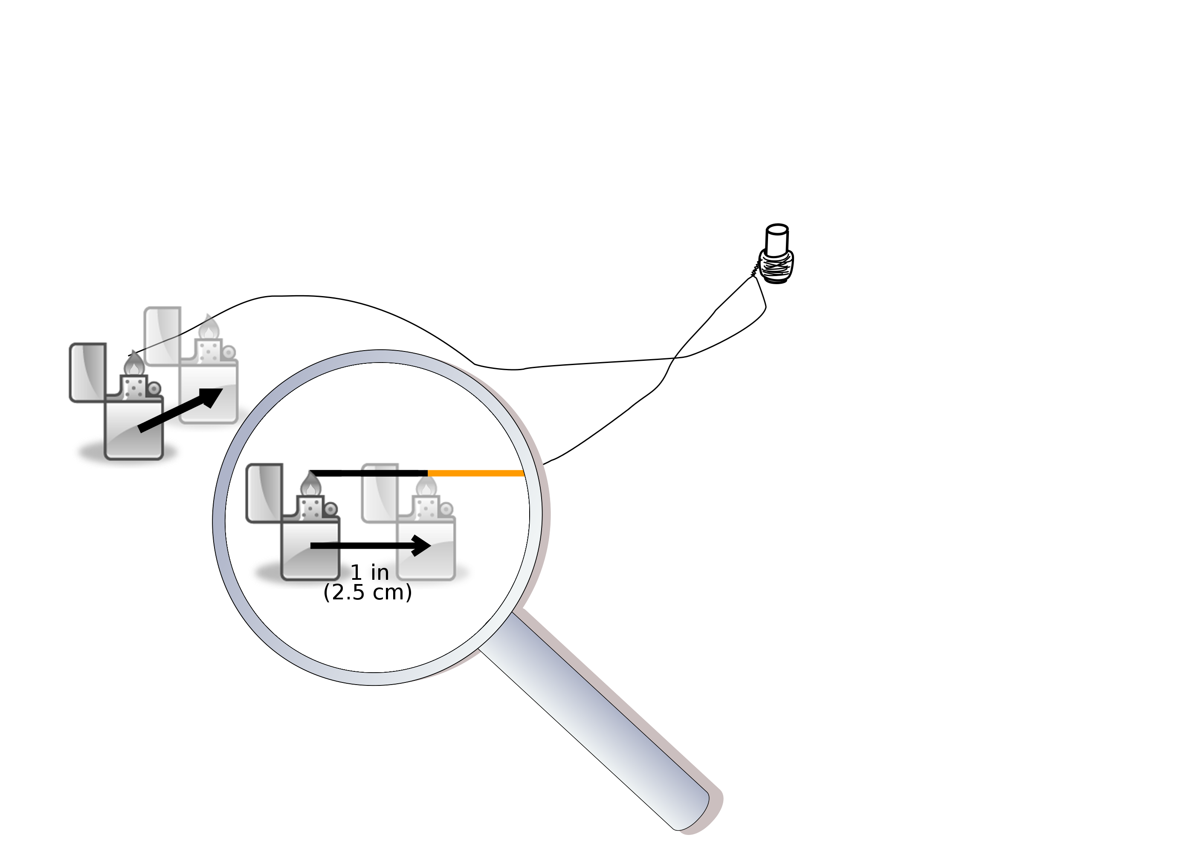
Burn leads
Burn 1 inch of the end of each of the two wires coming off the coil.

Slide 25
Thread black and red wires through the holes
Make one end longer

Slide 26
Thread long end through again
This is called a “strain relief”
Keeps things from pulling on the wires

Slide 27
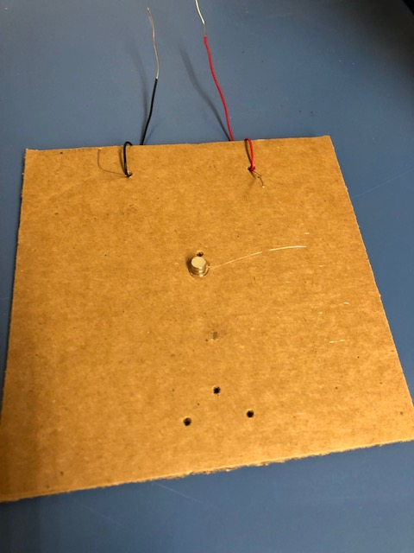
Glue magnets to cardboard
Magnets should be stacked.
Both magnets should be on the same side of the cardboard!

Slide 28
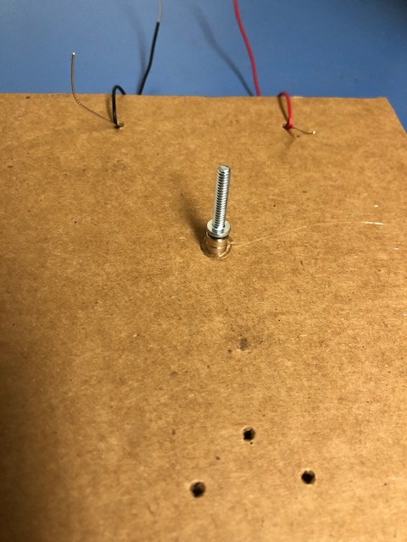
Attach a screw to the magnets
Magnets should be stacked.
Both magnets should be on the same side of the cardboard!
You won’t need glue!

Slide 29
Connect to wires to electromagnet
Twist the red wire with one lead
Be sure to twist with the burned part!

Slide 30
Then connect the black wire
Make sure it’s the burned part!

Slide 31
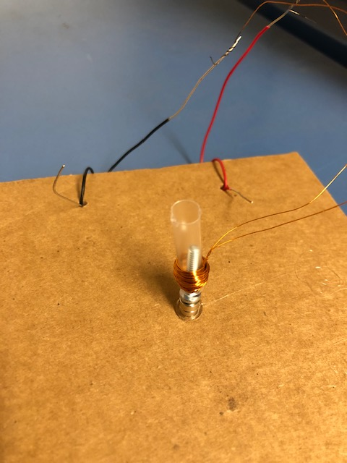
Put the jack on the screw

Slide 32
Then try the battery
If it jumps, tape the battery down!
If it doesn’t jump. Try reversing the battery

Slide 33
Troubleshooting
Did it work?
If it tried to jump down, swap the ends of the battery
If it wiggles or jerks, but doesn’t jump, double check the connections, make sure they’re tight
Make sure the leads aren’t binding the jack

Slide 34
What is the principle of science we used?

