Slide 1
Homopolar Motor

Slide 2
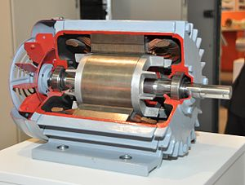
What is a motor?
An electric motor converts electricity into mechanical energy (motion)
All electric motors used electricity and magnetism
We want to create a force that will move something

Slide 3
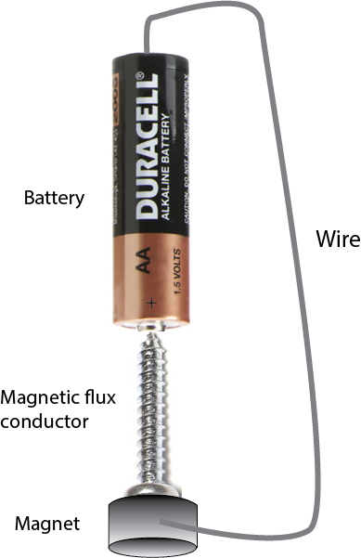
Lorentz Force
When electrical current flows in the presence of a magnetic field, a force is created
Let’s break this down

Slide 4
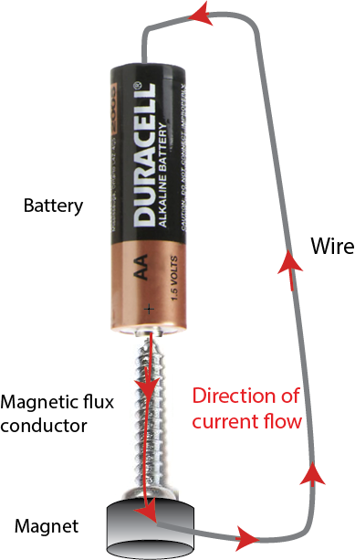
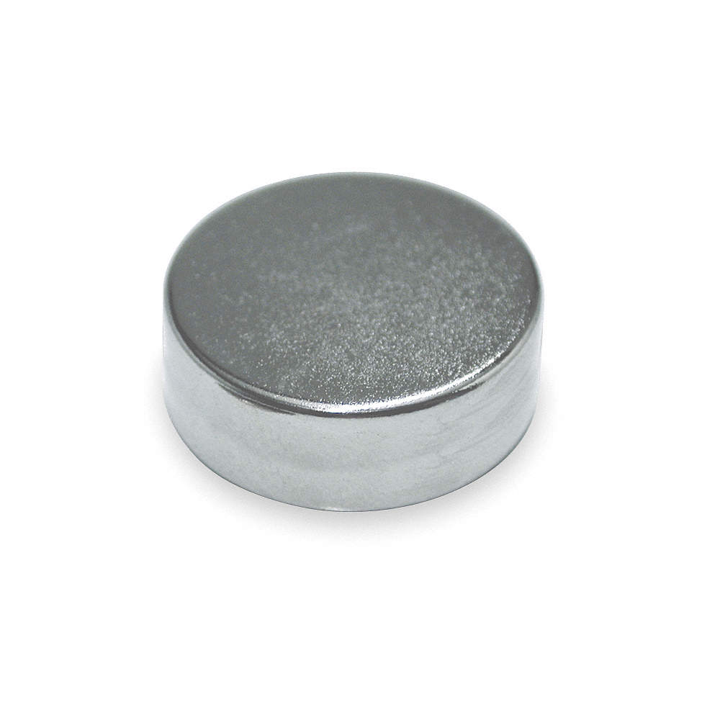
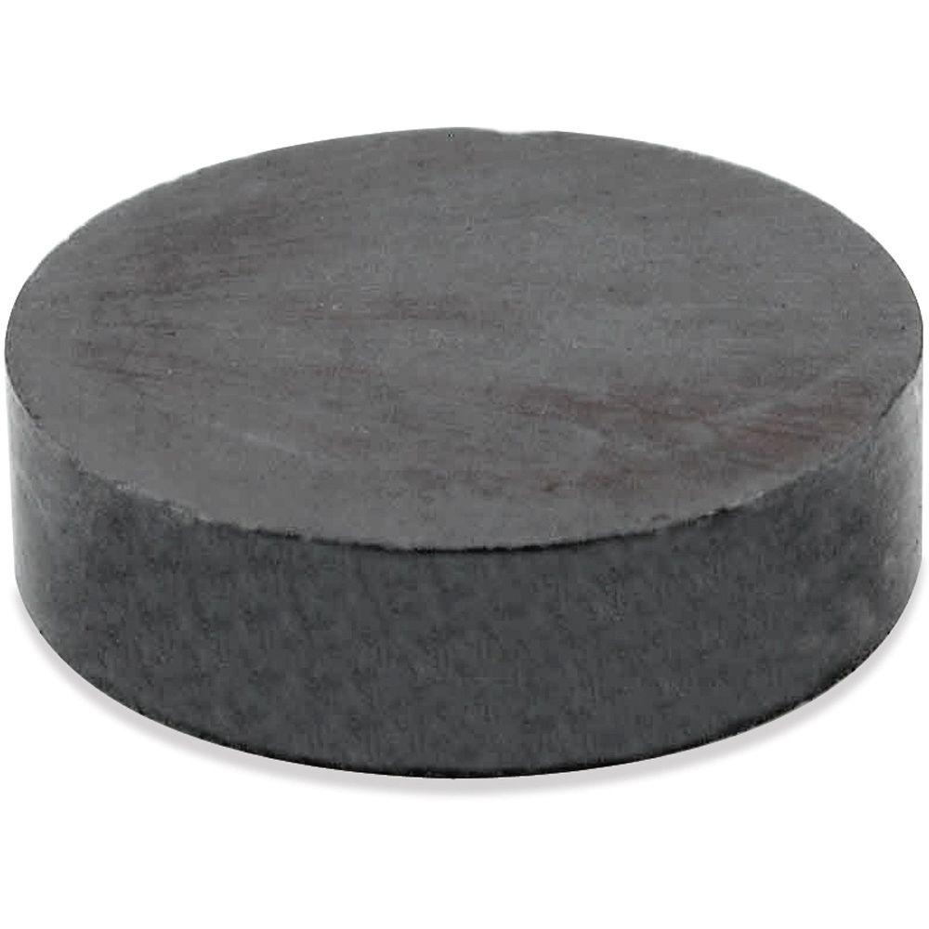
Which way does the current flow?
Current flows from + to –
Better make sure the screw is conducting
Better make sure the magnet is conducting
Has to be a metal-covered neodymium magnet, not a ceramic magnet
P
O

Slide 5
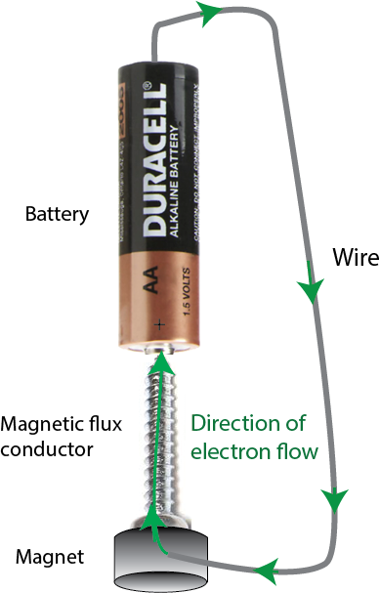
But electrons are charged negatively
Electrical current is carried by electrons moving
Their negative charge means the electrons are moving the opposite direction
Remember this

Slide 6
Magnetic field
Where the lines are close together, field is strong
Where lines are far apart, field is weak
Arrows always come out of the North Pole
Which is the north pole, the red or green side?
https://www.kjmagnetics.com/blog.asp?p=magswitch

Slide 7
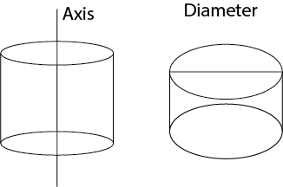
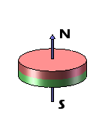
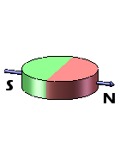
Axis of a cylinder
Which of these is axially magnetized?
For this motor, be sure to use axially magnetized magnets
How could you tell?
https://www.kjmagnetics.com/blog.asp?p=magswitch

Slide 8
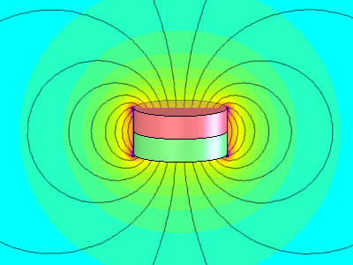
What does the screw do?
It changes the shape of the magnetic field
It conducts the magnetism through the screw
Makes the screw stick to the battery
Make the tip of the screw one pole of the magnet
The point of the screw reduces friction (small area to rub)

Slide 9
Lorentz Force
When current flows in the presence of a magnetic field, there is a force
We have a current
We have a magnetic field
Where is the force?

Slide 10
The right hand rule
“v” is the direction of motion (velocity) of the electrons
“B” is the direction of the magnetic field
They are both “vectors”- they have a strength and a direction
https://cnx.org/contents/bK5Ikv2k@1/Magnetic-Force-and-Right-Hand-Rule

Slide 11
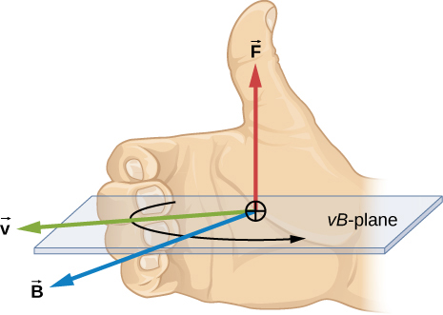
Vector-speak
Force goes in direction of “v cross B”
Point your fingers in the direction of ”v” (velocity of electrons)
Curl them in the direction toward ”B” (the magnetic field)
Your thumb tells you the direction of the force
https://cnx.org/contents/bK5Ikv2k@1/Magnetic-Force-and-Right-Hand-Rule
https://www.pexels.com/photo/person-s-right-hand-1257770/

Slide 12
Let’s try it
Point fingers in direction of v (the velocity of the electrons)
https://www.123rf.com/photo_11079965_right-hand-five-fingers-isolated-with-white-background.html

Slide 13
Curl them in the direction of B
B
v

Slide 14
Your thumb points in the direction of F
F (force)
B
Therefore, the force F is away from you
There is a force pushing on the right side of the magnet, pushing it away from you
v

Slide 15
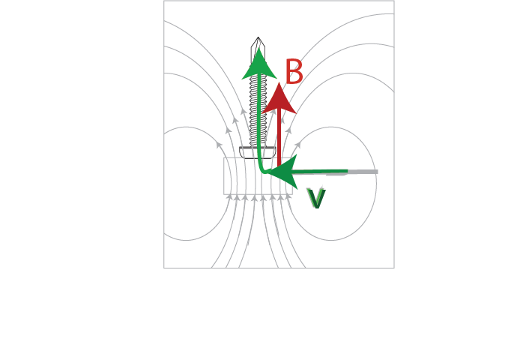
Is there a force on the left side?
No, there is no current there
There is also no force when the magnetic field and the velocity are in the same direction
https://www.123rf.com/photo_11079965_right-hand-five-fingers-isolated-with-white-background.html

Slide 16
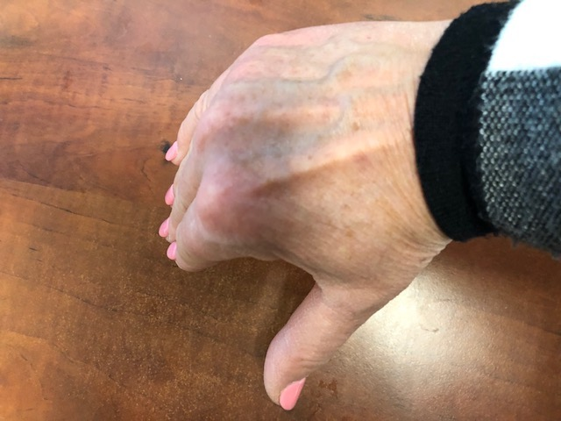
So, the magnet will rotate
B
v
What would happen if the north pole was on the bottom instead of the top?
v
B

Slide 17
That’s the whole thing!
How will you know whether you put your magnetic north side up or south side up?

Slide 18
Did you build the DC motor before?
How is that the same or different?

Slide 19
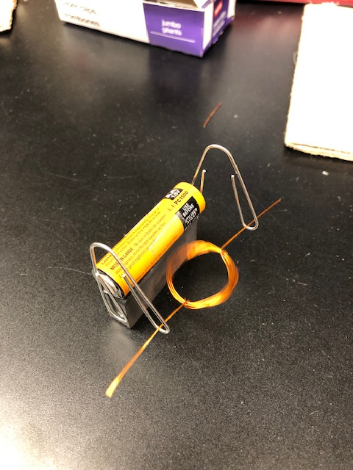
DC motor:
The current flowing through the wire created an electromagnet
That magnet pushed away from the permanent magnet

Slide 20
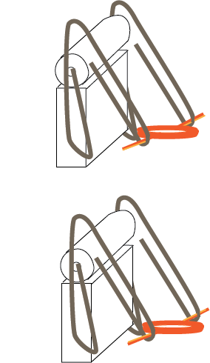
We had to “commutate” the current (turn it off and on at the right times)
We sanded the insulation off one side of the wire
Current can flow!
Bare side of wire is touching paper clips
Insulated side is touching paper clips
Current can’t flow!

Slide 21
Is there a Lorentz force?
There is a current
There is a magnetic field
But, the current flowing in the top of the loop is in the opposite direction from the current in the bottom of the loop

Slide 22
Try v cross B (right-hand rule)
The force is pushing the left side of the ring down
The force is also pushing the right side of the loop up
Lorentz force helps it rotate

Slide 23
Homopolar motor
No commutation!
The current flows in one direction, all the time (that’s why it’s called “homopolar”- homo=same, polar=direction)

Slide 24
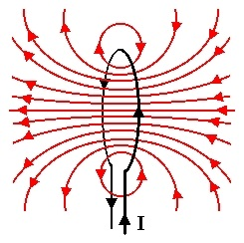
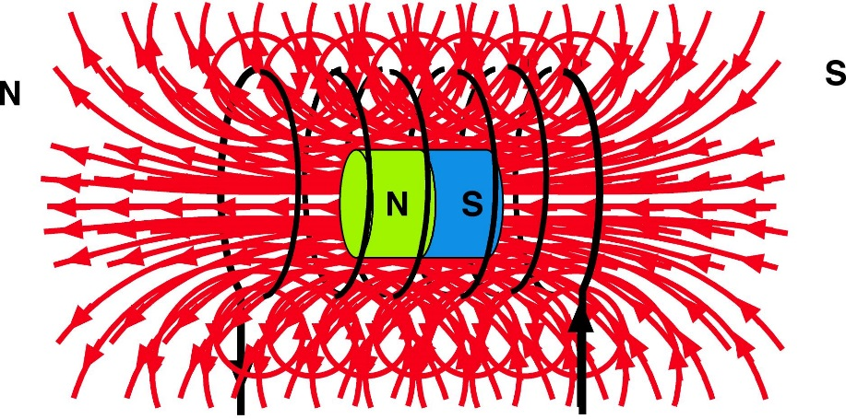
In the DC motor, we made multiple loops
This was to increase the strength of the electromagnetic
More loops = stronger magnet

Slide 25
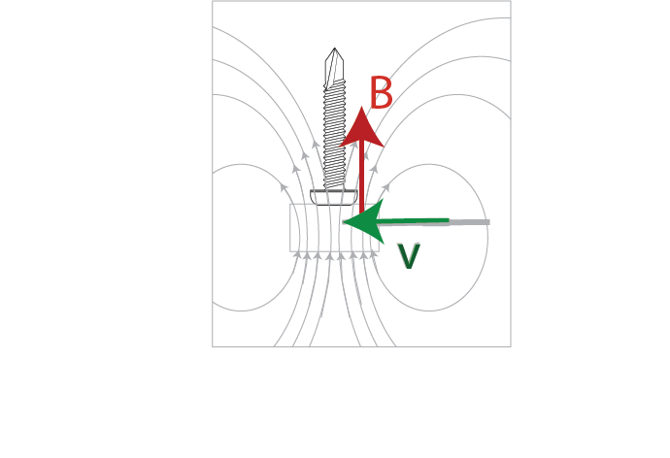
Does not help homopolar motor
All the action is inside the magnet
The loops don’t do anything here

Slide 26
The DC motor is better
If you want to know more, we have classes you can take! And labs!
Homopolar motors have several weaknesses and are not widely used.
But they sure are cool!

